Slide 1
Course: Programming Fundamentals
4.00 Credit Hours, Fall 2018,
Undergraduate Program

Slide 2
Problem Solving and Implementation A programming task can be divided into two phases: 1. Problem solving Define : Clearly describe a problem Design its solution: Produce an ordered sequence of steps that describe solution to the problem; 2. Implementation phase Implement the program in some programming language write code, compile, link, Test and Debug

Slide 3
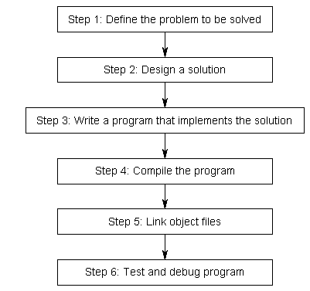
Developing a program
Problem solving
Phase
Implementation phase

Slide 4
Defining a Problem: Break the definition of the problem down into manageable steps. Example; input, Processing; Output
Input ; Read the temperature from keyboard
Processing; Test the Temperature below or above freezing
Output; Display the result on Screen

Slide 5
Design the solution
Algorithm
A sequence of language independent steps which may be followed to solve a problem. An Algorithm can be developed with a:
Pseudo Code
Flowchart

Slide 6
Algorithm
Pseudo code
Pseudo code is a method of designing a program using English like statement to describe the logic and processing flow.
There are no real rules; you can follow your own standards. Conveniently understood and exchanged between IT professionals.

Slide 7
Defining a Problem: Break the definition of the problem down into manageable steps; Input, Processing; Output
Example -1:
Read in the temperature. If the temperature is less than 32 indicate below freezing on the screen. Else if the temperature is above freezing then indicate the same on the monitor screen.
Divide the above problem into manageable parts.
Input ; Read the temperature from keyboard
Processing; Test the Temperature below or above freezing
Output; Display the result on Screen

Slide 8
Algorithm
Pseudo code
Example -1:
Read the Temp
if (Temp < 32) then
Print “BELOW FREEZING”
else
Print “ABOVE FREEZING”
endif

Slide 9
Algorithm
Flowchart
Diagrammatic or Graphical representations of steps for solving the given problem.
Use standard symbols developed by ANSI (American National Standard Institute)

Slide 10
Building Blocks of Flowchart
Start and End Symbols
Connector
Arrows (indicate flow of control)
Processing Steps
Input/Output
Decision

Slide 11
Defining a Problem: Break the definition of the problem down into manageable steps; Input, Processing; Output
Example -1:
Read in the temperature. If the temperature is less than 32 indicate below freezing on the screen. Else if the temperature is above freezing then indicate the same on the monitor screen.
Divide the above problem into manageable parts.
Input ; Read the temperature from keyboard
Processing; Test the Temperature below or above freezing
Output; Display the result on Screen

Slide 12
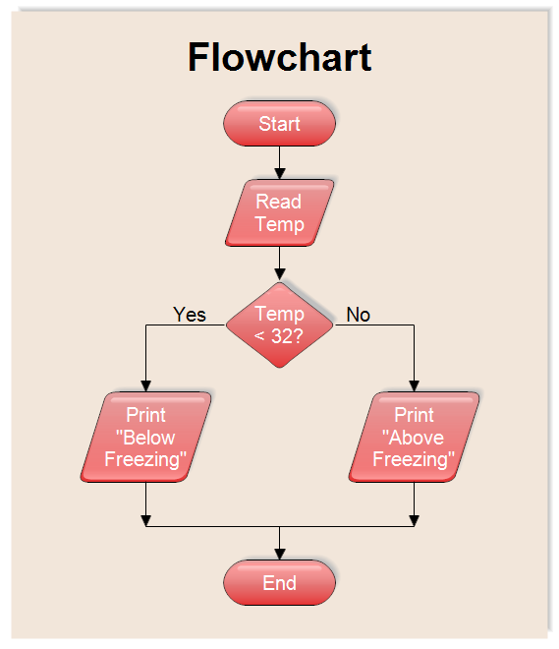

Slide 13
Define The Problem Example-2; Determine the sum of first 5 natural numbers. Break into steps Input – Nil Processing: Sum the numbers from 1 to 5 Output - Sum

Slide 14
Design the Solution Example-2; Determine the sum of first 5 natural numbers. Algorithm; Pseudo Code 1. Set N=1 Set Sum = 0 2. Repeat step 3 & 4 while N <= 5 3. Sum = Sum + N 4. N = N + 1 5. Print Sum 6. end

Slide 15
Design the Solution Example-2; Determine the sum of first 5 natural numbers. Algorithm; Flow Chart
Start
Sum=0
N=1
N≤5
Y
Sum=Sum+N
N=N+1
N
Print Sum
End

Slide 16
Developing a program
Problem solving
Phase
Implementation phase

Slide 17
Implementation Phase
Write a program (source code)
Compile a program (source code to Object code)
Link a Program ( Object code to Executable code)
Test and Debug the Program (rectify the errors in the program)

Slide 18
Write a code
Create a source code we need an editor
Line editor --- line by line editing
Screen editor --- note pad, word pad, customized editor
After writing the code we save the code with file extension
e.g MyProg.cpp

Slide 19
Compile a program
source code to Object code
We need a compiler e.g C++
It converts user readable code to machine readable code
Cannot be executed because different sections are not mapped together, say not linked together

Slide 20
Link a Program
Object code to executable code
first.obj to first.exe
Can be executed because different sections are mapped together.
Execute the code by simply run the exe file

Slide 21
Test and Debug the program
Rectifying logical errors in the code, manually or may Use debugger for the assistance. A debugger may:
Execute the code line by line or block by block or in one go
Examine the contents of variables and registers at each step
Examining the flow of control structure by tracing code step by step.

