Slide 1
Course: Programming Fundamentals
4.00 Credit Hours
Undergraduate Program

Slide 2
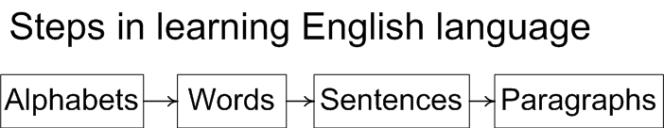
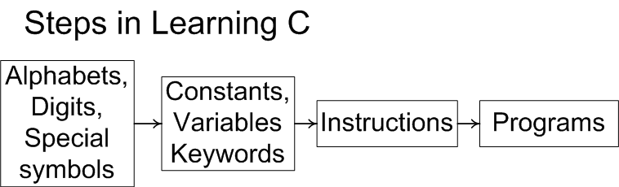
Learning C/C++

Slide 3
Today’s lecture outline
C/C++ character set
Basic constants and variables

Slide 4
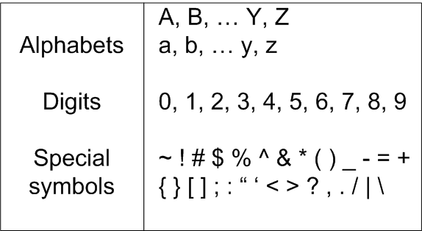
C Character Set

Slide 5
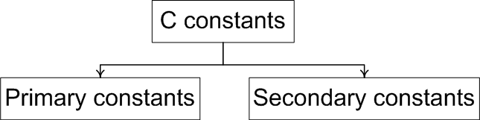
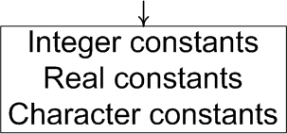
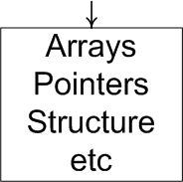
Constants
An entity that doesn’t change

Slide 6
Integer Constants
Must have at least one digit
It must not have a decimal point
It can be either positive or negative
If there is no sign an integer constant is assumed to be positive
No commas or blanks are allowed within an integer constant
Examples: 135, -67, 3401, -5670

Slide 7
Real Constants
Also called Floating Point constants
A real constant must have at least one digit
It must have a decimal point
It could be either positive or negative
Default sign is positive
No commas or blanks are allowed within a real constant
Examples: +325.34, 426.0, -32.76, -48.5792

Slide 8
Character Constants
A character constant is a
single alphabet
a single digit
or a single special symbol
Enclosed within single inverted commas
Both the inverted commas should point to the left
The maximum length can be 1 character
Examples: ’A’, ‘I’, ‘5’, ‘=‘

Slide 9
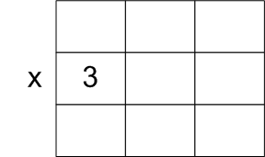
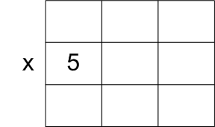
Variables…
An entity that may vary during program execution
Names given to locations in memory

Slide 10
Variables..
No commas or blanks are allowed within a variable name.
No Special symbol are used in name.
Examples: Interger1, Sum, _FirstNum
Invalid variable names
#sum, 12x, first name

Slide 11
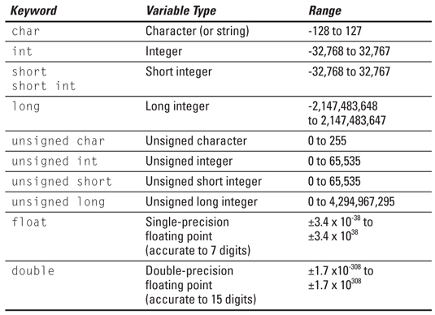
Variable Types

Slide 12
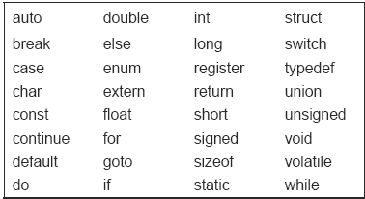
Keywords
Meaning already explained to compiler
Cannot be used as variable name

