Slide 1
Course: Programming Fundamentals
4.00 Credit Hours,
Undergraduate Program

Slide 2
C/C++ Instructions
Type Declaration Instruction
To declare the type of variables used in a C /C++ program.
Arithmetic Instruction
To perform arithmetic operations between constants and variables
Control Instruction
To control the sequence of execution of various statements in a C/C++ program.

Slide 3
Type Declaration Instruction
This instruction is used to declare the type of variables being used in the program.
int hours, payrate, grosspay;
float salary;
char name;

Slide 4
Variations of type declaration instruction
Initializing at declare time
int x =10, y = 20;
float a = 1.25, b = 1.99*2.4+1.5;
Order of variable declaration
int i = 10, j = 25 ;
is same as
int j = 25, i = 10 ;
However,
float a = 1.5, b = a + 3.1 ;
is alright, but
float b = a + 3.1, a = 1.5 ;

Slide 5
Cont.
The following statements would work
int a, b, c, d ;
a = b = c = 10 ;
However, the following statement would not work
int a = b = c = d = 10 ;

Slide 6
Arithmetic Instruction
C/C++ arithmetic instruction consists of
variable name on the left hand side of =
and variable names & constants on the right hand side of =.
The variables and constants appearing on the right hand side of = are connected by arithmetic operators like +, -, *, and /.

Slide 7
Example
int ad ;
float kot, deta, alpha, beta, gamma ;
ad = 3200 ;
kot = 0.0056 ;
deta = 3.2 * 2 / 5 ;
The variables and constants together are called ‘operands’ that are operated upon by the ‘arithmetic operators’

Slide 8
Types of arithmetic statement
Integer mode arithmetic statement
This is an arithmetic statement in which all operands are either integer variables or integer constants.
Example:
int i, king, issac, noteit ;
i = i + 1 ;
king = issac * 234 + noteit - 7689 ;

Slide 9
Cont.
Real mode arithmetic statement
This is an arithmetic statement in which all operands are either real constants or real variables.
Example.
float x, y, si, prin, anoy, roi ;
x = y + 23.123 / 4.5 * 0.3442 ;
si = prin * anoy * roi / 100.0 ;

Slide 10
Cont..
Mixed mode arithmetic statement
This is an arithmetic statement in which some of the operands are integers and some of the operands are real.
Example.
float si, prin, anoy, roi, avg ;
int a, b, c, num ;
si = num * anoy * roi / 100.0 ;
avg = ( a + b + c + num ) / 4 .0;

Slide 11
Arithmetic instructions
C/C++ allows only one variable on left-hand side
Modular operator
This operator returns the remainder on dividing one integer with another
Expression 10 / 2 yields 5 whereas, 10 % 2 yields 0
Expression 10 / 3 yields 3 whereas 10 % 3 yields 1

Slide 12
Cont.
Arithmetic operations can be performed on ints, floats and chars.
char x, y ;
int z ;
x = 'a' ;
y = 'b' ;
z = x + y ;

Slide 13
Cont..
No operator is assumed to be present. It must be written explicitly.
a = c.d.b(xy)
b = c * d * b * ( x * y )

Slide 14
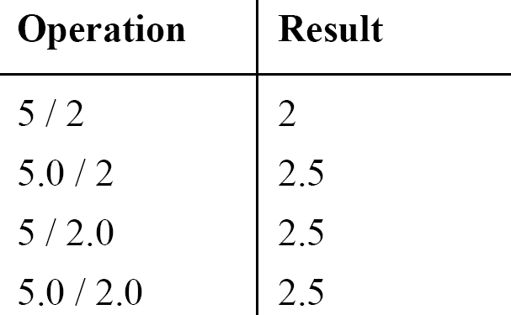
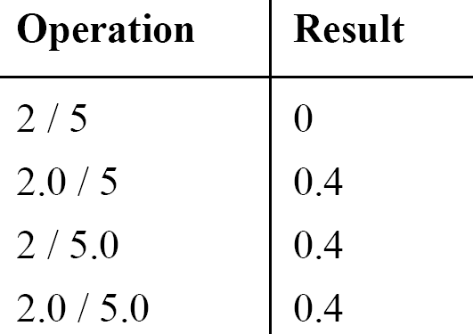
Integer and float conversions
An arithmetic operation between an integer and integer always yields an integer result
An operation between a real and real always yields a real result
An operation between an integer and real always yields a real result

Slide 15
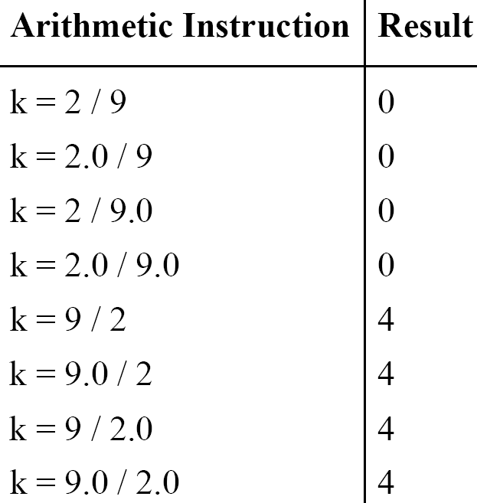
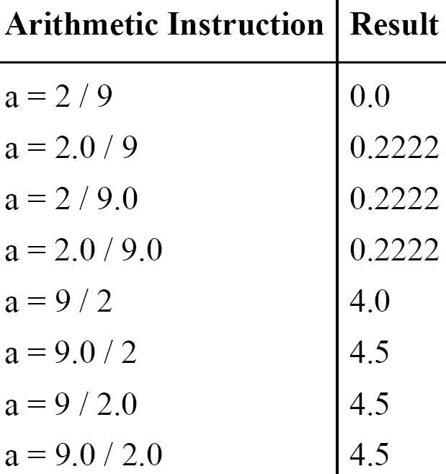
Type Conversion in Assignments
k is int and a is float

Slide 16
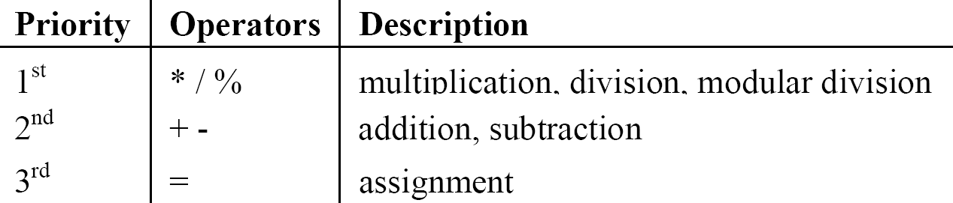
Hierarchy of Operations

Slide 17
Example
i = 2 * 3 / 4 + 4 / 4 + 8 - 2 + 5 / 8
i = 6 / 4 + 4 / 4 + 8 - 2 + 5 / 8 operation: *
i = 1 + 4 / 4 + 8 - 2 + 5 / 8 operation: /
i = 1 + 1+ 8 - 2 + 5 / 8 operation: /
i = 1 + 1 + 8 - 2 + 0 operation: /
i = 2 + 8 - 2 + 0 operation: +
i = 10 - 2 + 0 operation: +
i = 8 + 0 operation : -
i = 8 operation: +

Slide 18
Association of Operators
When an expression contains two operators of equal priority the tie between them is settled using the associativity of the operators
It can be of two types
Left to right
Right to left

Slide 19
Example
Consider the expression
a = 3 / 2 * 5 ;
Left to right:
a = 3 / 2 * 5
a = 1 * 5
a = 5
Right to left :
a = 3 / 2 * 5
a = 3 / 10
a = 0

Slide 20
Control Instructions in C/C++
Enable us to specify the order in which the various instructions in a program are to be executed by the computer.
Sequence Control Instruction
Selection or Decision Control Instruction
Repetition or Loop Control Instruction
Case Control Instruction

Slide 21
Which are invalid variables
BASICSALARY
_basic
basic-hra
#MEAN
group.
422
population in 2006
over time

Slide 22
Summary
The three primary constants and variable types in C are integer, float and character
A variable name can be of maximum 31 characters
Do not use a keyword as a variable name
An expression may contain any sequence of constants, variables and operators
Operators having equal precedence are evaluated using associativity
Input/output in C can be achieved using scanf( ) and printf( ) functions.

