Slide 1
Course: Programming Fundamentals
4.00 Credit Hours,
Undergraduate Program

Slide 2
Today’s Lecture outline
Decision control structure
Relational operator in C/C++
if statement
if-else statement
Nested if else statement
Logical operator in C/C++

Slide 3
Selection/Decision Control
By default execution of a program is sequential
Mostly we want instructions to be executed according to situation.
This issue is dealt in C/C++ programs using decision controls

Slide 4
Selection/Decision Control
The if statement
The if-else statement
Decision depend upon conditions
The conditional operators
Equality
Relational

Slide 5
Relational Operators
C/C++ equality
>
<
>=
<=
==
!=
Standard algebraic
Relational Operator
>
<
≥
≤
Equality operators
=
≠
Example
x > y
x < y
x >= y
x <= y
x == y
x != y
Meaning
x is greater than y
x is less than y
x is greater than or equal to y
x is less than or equal to y
x is equal to y
x is not equal to y

Slide 6
If Statement
if (this condition is true )
execute this statement ;
Single-entry/single-exit
Nonzero is true, zero is false

Slide 7
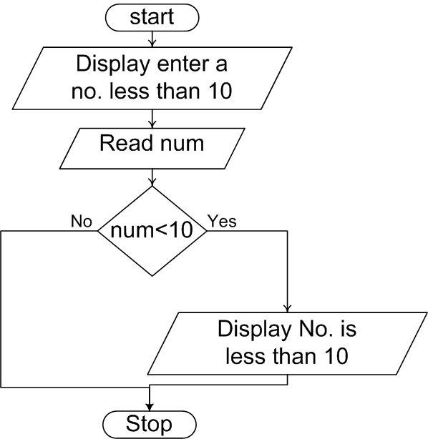
If Statement Flowchart – 1

Slide 8
If Statement Flowchart – 2
While purchasing items, a discount of 10% is offered if the quantity is more than 1000. If the quantity and price per item is input through a keyboard, write a program to calculate and display the total expense
Input : quantity, price
Processing: calculating discount and expense
Out put : display expense

Slide 9
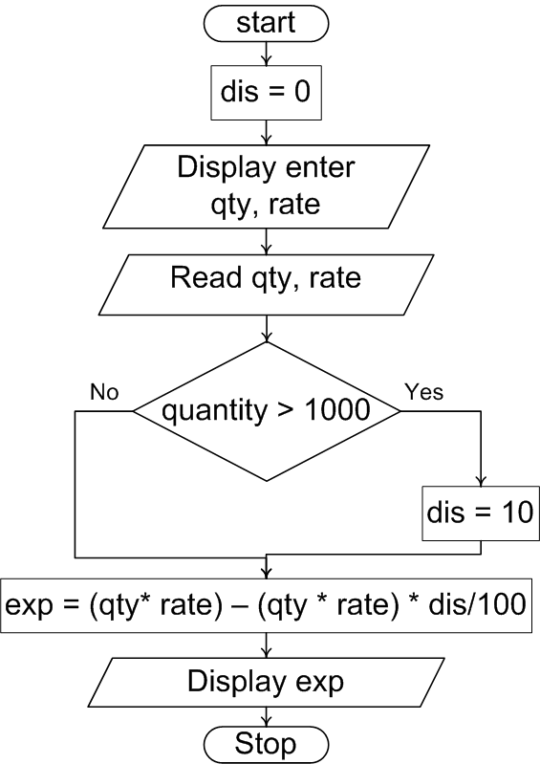
If Statement Flowchart..

Slide 10
Multiple statement within if
More than one statement can be executed if the condition in if statement is true
Example program
Current year and year of joining is input through key board. If the no of year the employed has served the organization is greater then 3 then a Bonus of Rs. 2500/- is given to employ. Otherwise the program should do nothing

Slide 11
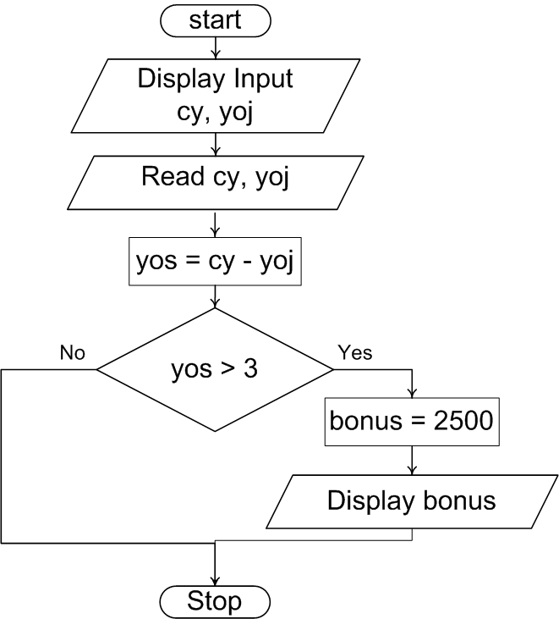
Compound Statements..

Slide 12
The if-else Statement
if-else
Different actions if conditions true or false
Example
if student’s grade is greater than or equal to 60
Display message “Passed”
else
Display message “Failed”
C Code
if ( grade >= 60 )
printf("Passed“);
else printf("Failed“);

Slide 13
Nested if else
It is possible to write an entire if-else with either the if statement block or else statement block

Slide 14
Nested if else flowchart
Start
Enter either 1 or 2
Read x
x == 1
x == 2
Display you entered 1
Display you entered other than 1 or 2
Display you entered 2
End

Slide 15

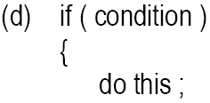
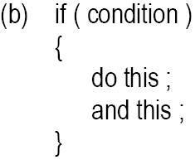
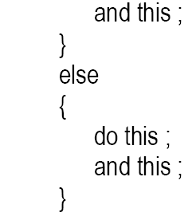
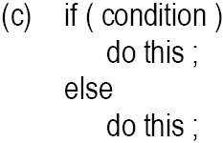
Forms of if statement

Slide 16
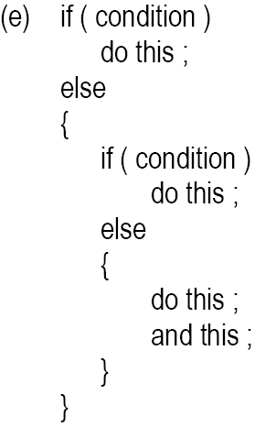
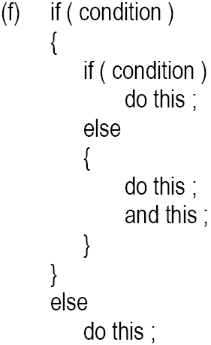
Cont.

Slide 17
Logical Operators
&& (logical AND)
true if both conditions are true
if ( gender == 1 && age >= 65 ) senior++;
|| (logical OR)
true if either of condition is true
if (semesterAvg >= 90 || finalExam >=90 ) printf("Student grade is A“);

Slide 18
Cont.
! (logical NOT, logical negation)
Returns true when its condition is false, & vice versa
if ( !( grade == 20 ) ) printf(“hello world“);
Alternative:
if ( grade != 20 ) printf(“hello world“);

Slide 19
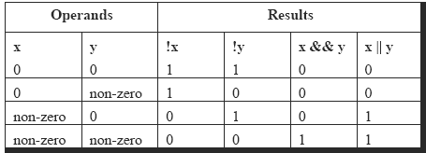
Logical Operators..

Slide 20
Example of Using Logical Operators
A company insures its drivers in the following cases:
If the driver is married
If the driver is unmarried, male & above 30 years of age
If the driver is unmarried, female & above 25 years of age

Slide 21
Using Logical Operators..
if ( ms == 'M' )
printf ( "Driver is insured" ) ;
else
{
if ( sex == 'M' )
{
if ( age > 30 )
printf ( "Driver is insured" ) ;
else
printf ( "Driver is not insured" ) ;
}
else
{
if ( age > 25 )
printf ( "Driver is insured" ) ;
else
printf ( "Driver is not insured" ) ;
}
}
if ( ( ms == 'M') || ( ms == 'U' && sex == 'M' && age > 30 ) ||
( ms == 'U' && sex == 'F' && age > 25 ) )
printf ( "Driver is insured" ) ;
else
printf ( "Driver is not insured" ) ;

Slide 22
Example Program
To calculate the division
Input: marks of 5 different subjects
Rules
Average above or equal to 60 - First division
Average between 50 and 59 - Second division
Average between 40 and 49 - Third division
Average less than 40 – Fail
Solution
Nested if-else
Logical operators

Slide 23
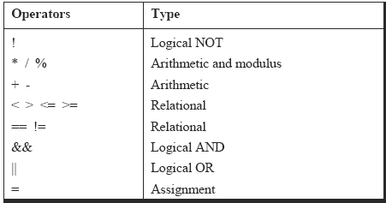
Revised Hierarchy

