Slide 1
Today’s lecture outline
Introduction to Array
Accessing elements of array
A simple array program

Slide 2
Array
It is a group of elements having same data type
Offers a simple way of grouping like variables for easy access
An array is a collective name given to a group of ‘similar quantities’
Arrays in C/C++ share a few common attributes
Variables in an array share the same name
Variables in an array share the same data type
Individual variables in an array are called elements
Elements in an array are accessed with an index number

Slide 3
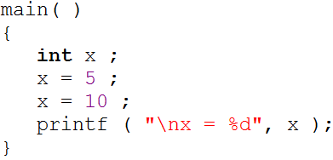
Cont.
Ordinary variables are capable of holding only one value at a time
There are situations in which we would want to store more than one value at a time in a single variable

Slide 4
Cont.
For example, suppose we want to arrange the percentage marks obtained by 100 students in ascending order
In such a case we have two options to store these marks in memory:
Declare 100 variables to store percentage marks obtained by 100 different students, i.e. each variable containing marks of single student
int m1, m2, m3 ……… m100;
Declare one variable (called array or subscripted variable) capable of storing or holding all the hundred values

Slide 5
Array declaration
int marks[10];
type
size
Array name
Like any other variable, arrays occupy memory space
marks [10]
Index of elements in array
0
1
2
3
4
5
6
7
8
9
500
504
508
512
516
520
524
528
532
530
Memory address of array elements

Slide 6
How to access array elements
int x;
int marks[10];
x= 2;
marks[0] = 2;
cin>>x;
marks[1] = 3;
cout<<“x=“<<x;
cin>>marks[2];
cout<< “marks[2]=”marks[2];
x
2
43
Output
x = 43
695
Output
marks [2] = 16
0
1
2
3
4
5
6
7
8
9
2
3
16
500
504
508
512
516
520
524
528
532
530

Slide 7
Points to remember
Array is a collection of elements having same data type
Memory allocate to array elements are continuous
Array size must be mentioned in array declaration ( int marks [10]; )
Array index always starts with 0
In 10 elements array, index of first elements is 0 and index of last element is 9
Array element can be access using array index

Slide 8
A Simple Program Using Array
Write a program that take 10 integer from user and then display sum and Average of those integers
Write a program

Slide 9
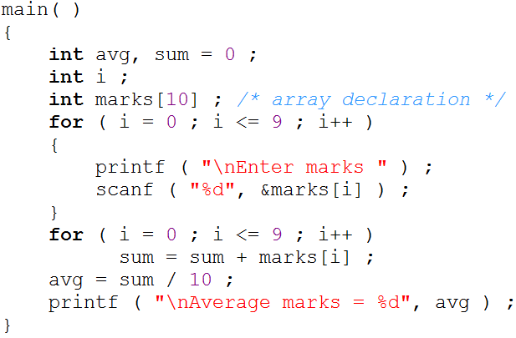
Marks program

