Slide 1
Today’s lecture outline
A program to calculate percentage marks
Array initialization
Bound checking
Passing array element to a function
Pointer arithmetic

Slide 2
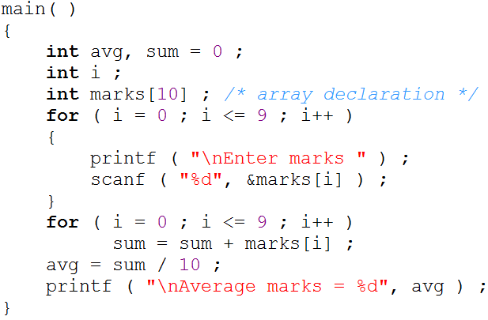
Marks program

Slide 3
Array initialization

Slide 4

Bounds Checking
In C there is no check to see if the subscript used for an array exceeds the size of the array
Data entered with a subscript exceeding the array size will simply be placed in memory outside the array
To see to it that we do not reach beyond the array size is entirely the programmer’s botheration and not the compiler’s
0
1
2
3
4
5
6
7
8
9
500
504
508
512
516
520
524
528
532
530

Slide 5
Passing Array Elements to a Function
Array elements can be passed to a function by calling the function by value, or by address
In the call by value we pass values of array elements to the function
In the call by reference we pass addresses of array elements to the function

Slide 6
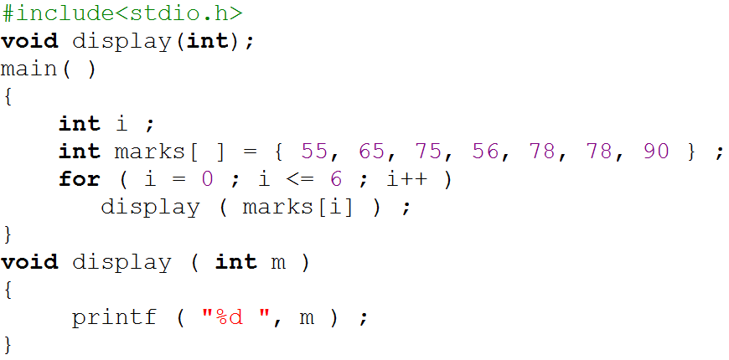
Value of array element pass to a function
0
1
2
3
4
5
6
55
65
75
56
78
78
90
500
504
508
512
516
520
524
i = 0
i = 2
i = 3
i = 1
i =4
i = 5
i = 6
i = 7
display(marks[6])
display(90)
display(marks[2])
display(75)
display(marks[5])
display(78)
display(marks[3])
display(56)
display(marks[4])
display(78)
display(marks[o])
display(55)
display(marks[1])
display(65)
Program output
55
65
75
56
78
78
90

Slide 7
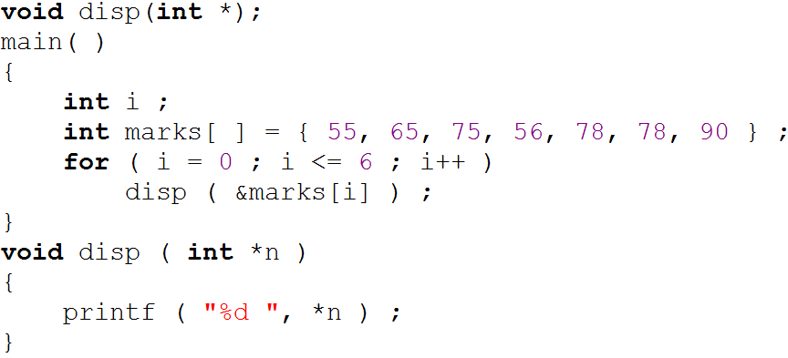
Address of array element pass to a function
0
1
2
3
4
5
6
55
65
75
56
78
78
90
500
504
508
512
516
520
524
i = 0
i = 2
i = 3
i = 1
i =4
i = 5
i = 6
i = 7
display(&marks[4])
display(516)
display(&marks[2])
display(508)
display(&marks[3])
display(512)
display(&marks[1])
display(504)
display(&marks[5])
display(520)
display(&marks[6])
display(524)
display(&marks[o])
display(500)
Program output
55
*n
*n
*n
*n
*n
512
*n
520
*n
524
516
504
508
65
500
75
*(512) = 56
*(520) = 78
*(524) = 90
*(516) = 78
*(504) = 65
*(508) = 75
*(500) = 55
56
78
78
90

Slide 8
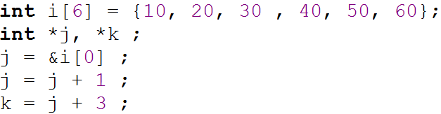
Pointer arithmetic
Addition of a number to a pointer
*j
504
*k
516
500
*j → 10
j → 500
0
1
2
3
4
5
10
20
30
40
50
60
500
504
508
512
516
520

Slide 9
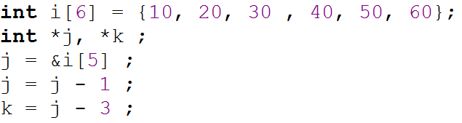
Cont.
Subtraction of a number from a pointer
*j
520
*k
504
516
0
1
2
3
4
5
10
20
30
40
50
60
500
504
508
512
516
520

Slide 10
Points to remember
Array elements are always stored in contiguous memory locations.
A pointer when incremented always points to an immediately next location of its type
A pointer when decremented always points to the immediate previous location of its type
Comparison between pointers can test for either equality or inequality

