Slide 1
Today’s lecture outline
Pointer arithmetic – a program
Sorting techniques – a program
Passing an Entire Array to a Function
2 Dimensional Array

Slide 2
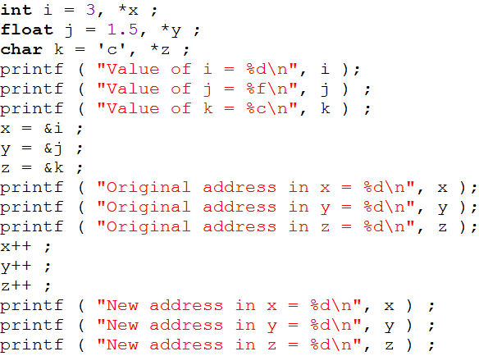
Pointer arithmetic - program
564
*x
560
i
3
560
564
794
*y
790
j
1.5
790
794
*z
321
320
k
c
320
321

Slide 3
Sorting program
Sorting means arranging element of array in ascending or descending order
After arranging array elements in ascending order
After arranging array elements in descending order
0
1
2
3
4
5
24
34
12
44
56
17
500
504
508
512
516
520
0
1
2
3
4
5
12
17
24
34
44
56
500
504
508
512
516
520
0
1
2
3
4
5
56
44
34
24
17
12
500
504
508
512
516
520

Slide 4
Sorting techniques
Selection sort
Bubble sort
Insertion sort

Slide 5
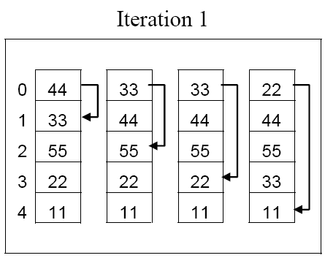
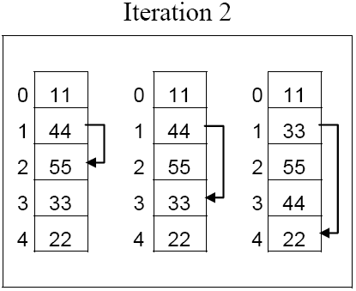
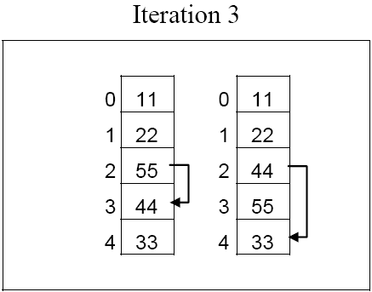
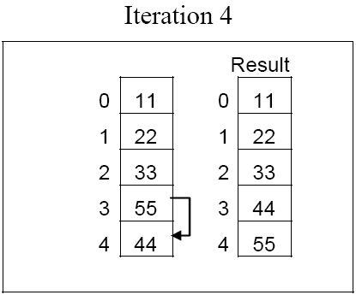
Selection sort

Slide 6
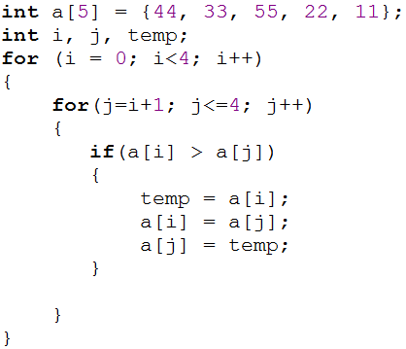
C program – Selection sort
0
1
2
3
4
44
33
55
22
11
i = 0
j = 1
if ( 44 > 33)
true
0
1
2
3
4
33
44
55
22
11
j = 2
if ( 33 > 55)
false
j = 3
if ( 33 > 22)
true
0
1
2
3
4
22
44
55
33
11
j = 4
if ( 22 > 11)
true
0
1
2
3
4
11
44
55
33
22

Slide 7
Cont.
0
1
2
3
4
11
44
55
33
22
i = 1
j = 2
if ( 44 > 55)
false
j = 3
if ( 44 > 33)
true
0
1
2
3
4
11
33
55
44
22
j = 4
if ( 33 > 22)
true
0
1
2
3
4
11
22
55
44
33

Slide 8
Cont..
0
1
2
3
4
11
22
55
44
33
i = 2
j = 3
if ( 55> 44)
true
0
1
2
3
4
11
22
44
55
33
j = 4
if ( 44 > 33)
true
0
1
2
3
4
11
22
33
55
44

Slide 9
Cont…
0
1
2
3
4
11
22
33
55
44
i = 3
j = 4
if ( 55 > 44)
true
0
1
2
3
4
11
22
33
44
55

Slide 10
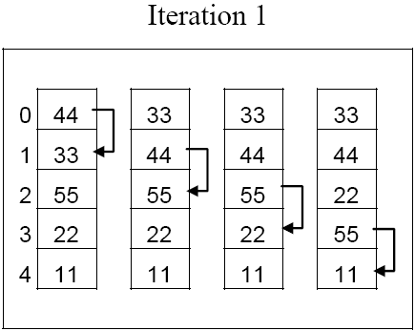
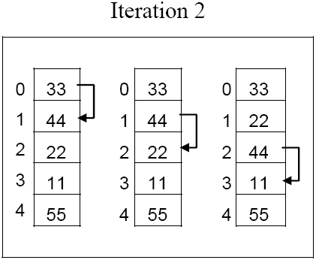
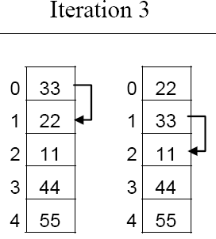
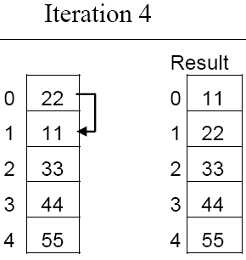
Bubble sort

Slide 11
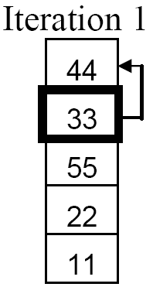
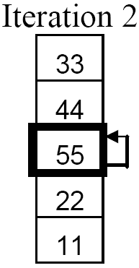
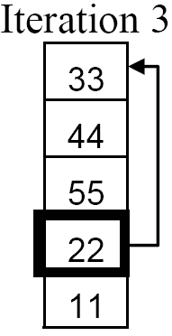
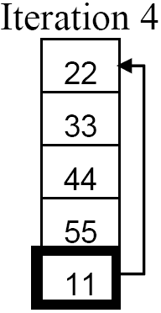
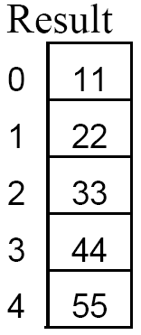
Insertion sort

Slide 12
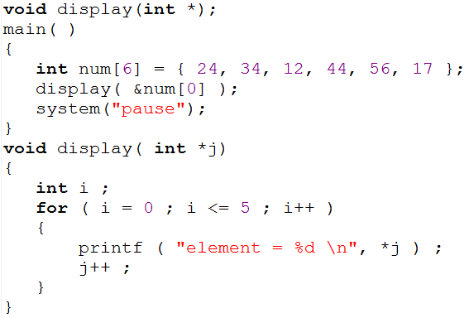
Passing array to a function
0
1
2
3
4
5
24
34
12
44
56
17
500
504
508
512
516
520
*j
504
500
524
512
520
516
508
5
1
6
0
3
i
2
Program output
4
element = 24
element = 34
element = 12
element = 44
element = 56
element = 17

Slide 13
Two Dimensional Arrays
It is also possible for arrays to have two or more dimensions
For example you want to input roll no and mark of 4 students.
Since we know 1D array, so for this problem we can have two 1D array
One for roll number
Second for marks
One 2D array can be used to store these values

Slide 14
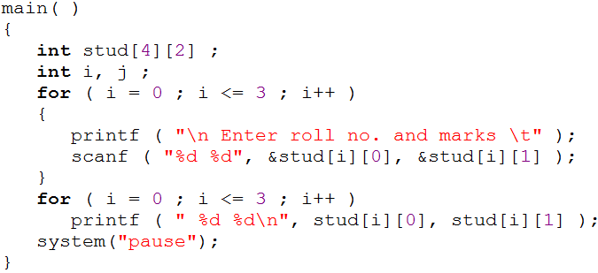
Example program
row
column
0
1
0
10
85
1
12
65
stud[3][1]
stud[2][1]
stud[0][1]
stud[2][0]
stud[1][1]
stud[3][0]
stud[0][0]
stud[1][0]
2
13
89
3
14
92
Roll Number
Marks

Slide 15
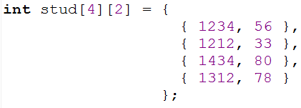
Initializing a 2-Dimensional Array

Slide 16
Example program
Write a program that adds two 4 x 4 matrices.
3 | 5 | 6 | 1
5 | 3 | 2 | 9
1 | 0 | -3 | 4
7 | 2 | 3 | -9
4 | 2 | -7 | 0
5 | 7 | 3 | 1
6 | 3 | -1 | 0
8 | 9 | -2 | 3
7 | 7 | -1 | 1
10 | 10 | 5 | 10
7 | 3 | -4 | 4
15 | 11 | 1 | -6
+
=

