Slide 1
Today’s lecture outline
Loops
while loop

Slide 2
Loops in C/C++
Three major loops structures in C/C++
while loop
for loop
do while

Slide 3
Loop in general
Loop has a termination point → finite loop
Loop execution stops when the loop condition becomes false
Loop has a counter that counts number of iterations of that loop
Loop has a statement or a set of statements that are executed until the loop condition become false

Slide 4


Repetition - Example
Formula 1 car race
There is a path/track
Each car has to complete a certain no of rounds say 10
In each round, when a car cross the finish line
the condition is check whether the car has completed total no of round or not.

Slide 5
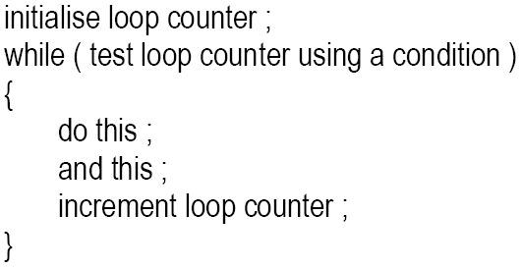
General form while loop

Slide 6
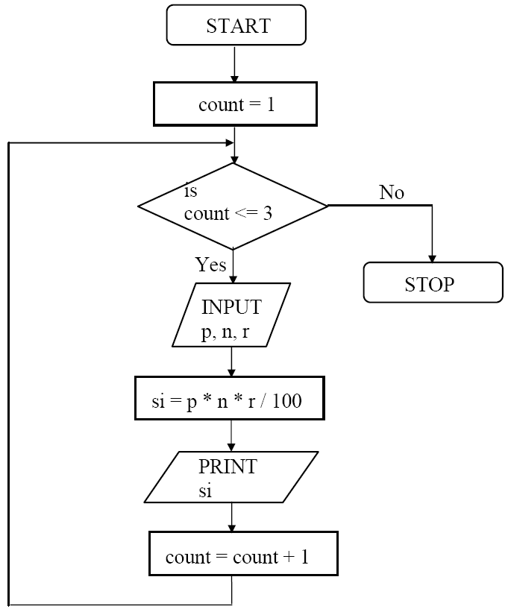
The while loop
Condition
Set of statements
Loop counter

Slide 7
A while loop program
main( )
{
int count = 0;
int total = 0;
while(count < 5)
{
total = total + count;
cout<< “count=“<<count<<“ total=“<<total;
cout<<endl;
count = count +1;
}
}
Memory
2
count
4
0
1
3
5
total
0
0
1
3
6
10
Program Output
count = 0, total = 0
count = 1, total = 1
count = 2, total = 3
count = 3, total = 6
count = 4, total = 10

Slide 8
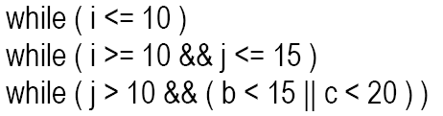
Points to remember
Loop body will keep on executing until the loop condition become false
When loop condition become false, the first statement after the while block will be executed
Condition can be a single or compound

Slide 9


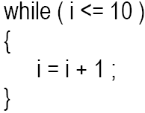
Cont.
Statement within loop body can be single line or block of statement.
In case of single line parentheses are optional
In case of block, parentheses are must

Slide 10
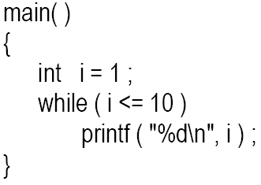
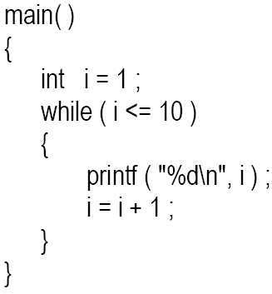
Cont..
A loop can be infinite loop

Slide 11
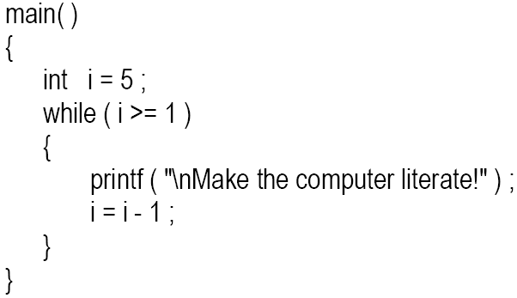
Cont.
Loop counter can be decremented

Slide 12
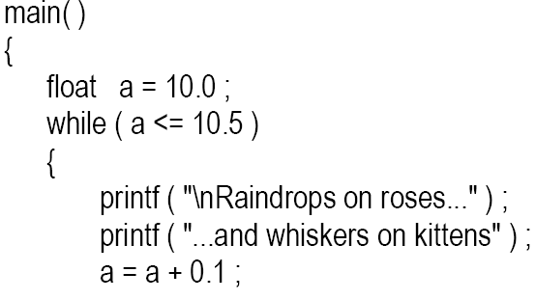

Cont.
It is not necessary that a loop counter must only be int. it can be float or char

Slide 13
Pre and post increment operator
Pre increment/ decrement
++x; is same as x = x + 1;
or – –x is same as x = x – 1;
Post increment/ decrement
x++; is same as x = x + 1;
or x-- is same as x = x – 1;

Slide 14
Difference between pre and post operators
x = 1;
y = x ++;
cout<<x<<y;
y = x;
x = x + 1;
output
x = 2, y = 1
x = 1;
y = ++ x;
cout<<x<<y;
x = x + 1;
y = x;
output
x = 2, y = 2

Slide 15
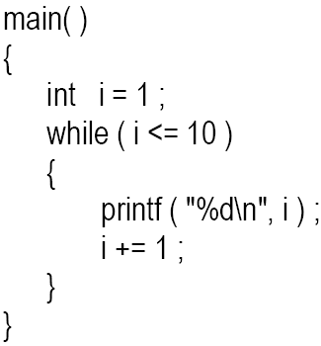
Other operator
i = i + 1;
+= is a compound assignment operator
j = j + 10 can also be written as j += 10
Other compound assignment operators are -=, *=, / =, %=.

Slide 16
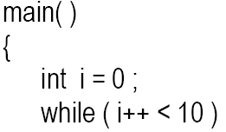

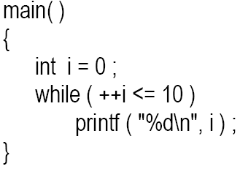
Example program
First comparison i < 10 is performed then value of i is incremented
First the value of i is incremented then comparison i < 10 is performed

