Slide 1
IEEE-STYLE RESEARCH PRESENTATION
Communication Under Delayed Liveness
Testing Dropout Rescue in Cooperative MARL
What we study
Not “does communication help?” — instead, a targeted system failure: ambiguous teammate liveness under heartbeat delay and silent dropout.
Headline target
A dropout-rescue interaction — comm benefit under delay-dropout minus comm benefit under delay-only — not a single-cell lift.
Sam Chen
CS 2860 · Cooperative MARL Research Project
April 2026
1 / 13

Slide 2
MOTIVATION
Distributed-systems liveness, in cooperative MARL teams
Missing heartbeats are ambiguous: slow vs dead.
Team must choose: reallocate, wait, or keep coordinating — and mistakes are costly.
RWARE = sparse reward, local observation; we layer realistic failure dynamics on top.
Alive but delayed
Heartbeats lag by D steps. Observations look stale; the teammate is still working.
1
2
Ambiguity window
Dropout occurs, but in-flight heartbeats keep arriving. Receiver can mistake dead for delayed.
3
True dropout
Heartbeats stop. Teammate has stopped contributing for the rest of the episode.
Speaker note: We frame communication as a robustness tool for failure-aware coordination, not a generic coordination boost.
Communication Under Delayed Liveness | Cooperative MARL · RWARE
2 / 13

Slide 3
EXPERIMENTAL CONTRACT
What we changed (mechanism) — what we held constant (fairness)
Mechanism knobs (what we vary)
Held constant (fairness)
Regime: delay-only vs delay-dropout (one teammate disappears mid-episode).
Heartbeat delay D ∈ {0, 2, 5, 30} steps.
Dropout window: steps 200–350 of the episode.
Method: hb-only (heartbeat features) vs hb+comm (RIAL-style learned discrete messages).
Diagnostic ceilings: oracle / death-token, oracle high-level (HRL).
Same shaping (pickup_bonus = 0.5) and step penalty across cells.
Same training budget (updates, rollout, eval schedule).
Production eval: eval_every=25, eval_episodes=30.
Pooled seeds across two labs (SAM + PK), n = 6 per cell.
Critic / actor information split: critic sees alive flags, actor does not.
Speaker note: The actor/critic info split is what makes the problem non-trivial: the receiver must infer liveness from observation, not read it.
Communication Under Delayed Liveness | Cooperative MARL · RWARE
3 / 13

Slide 4
METRIC
We measure the interaction effect, not a one-off gain
Interaction (the headline target)
Method × Regime → unshaped eval return
Δ = (comm benefit | dropout) − (comm benefit | delay-only)
delay-only
delay-dropout
hb-only
A
C
Tests whether comm helps specifically when dropout creates real ambiguity.
Subtracts away the generic “comm helps coordination” effect.
Stable across reasonable changes in shaping and eval budget.
hb+comm
B
D
comm benefit | dropout = D − C
comm benefit | delay-only = B − A
interaction Δ = (D − C) − (B − A)
Speaker note: The interaction asks whether messages help more when dropout is real — exactly the falsifiable form of our hypothesis.
Communication Under Delayed Liveness | Cooperative MARL · RWARE
4 / 13

Slide 5
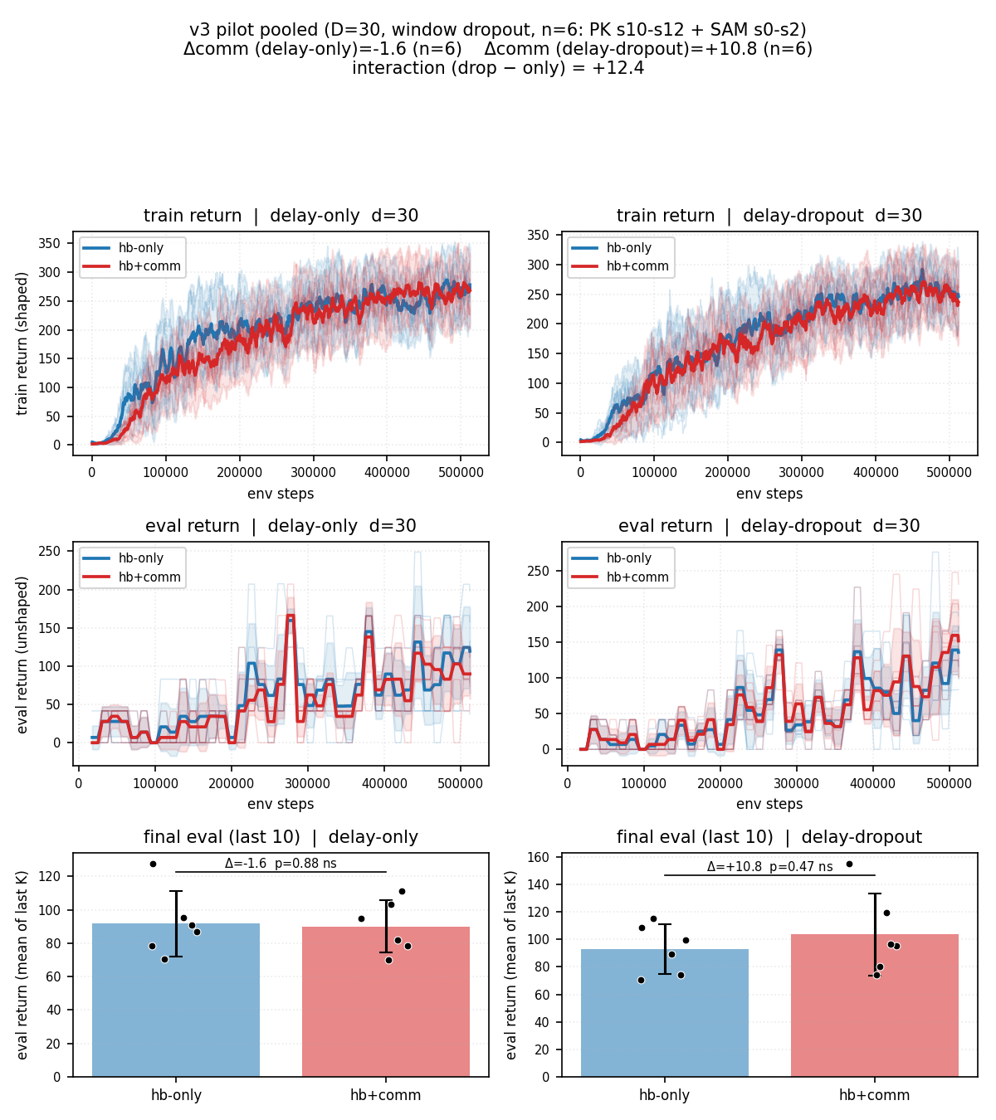
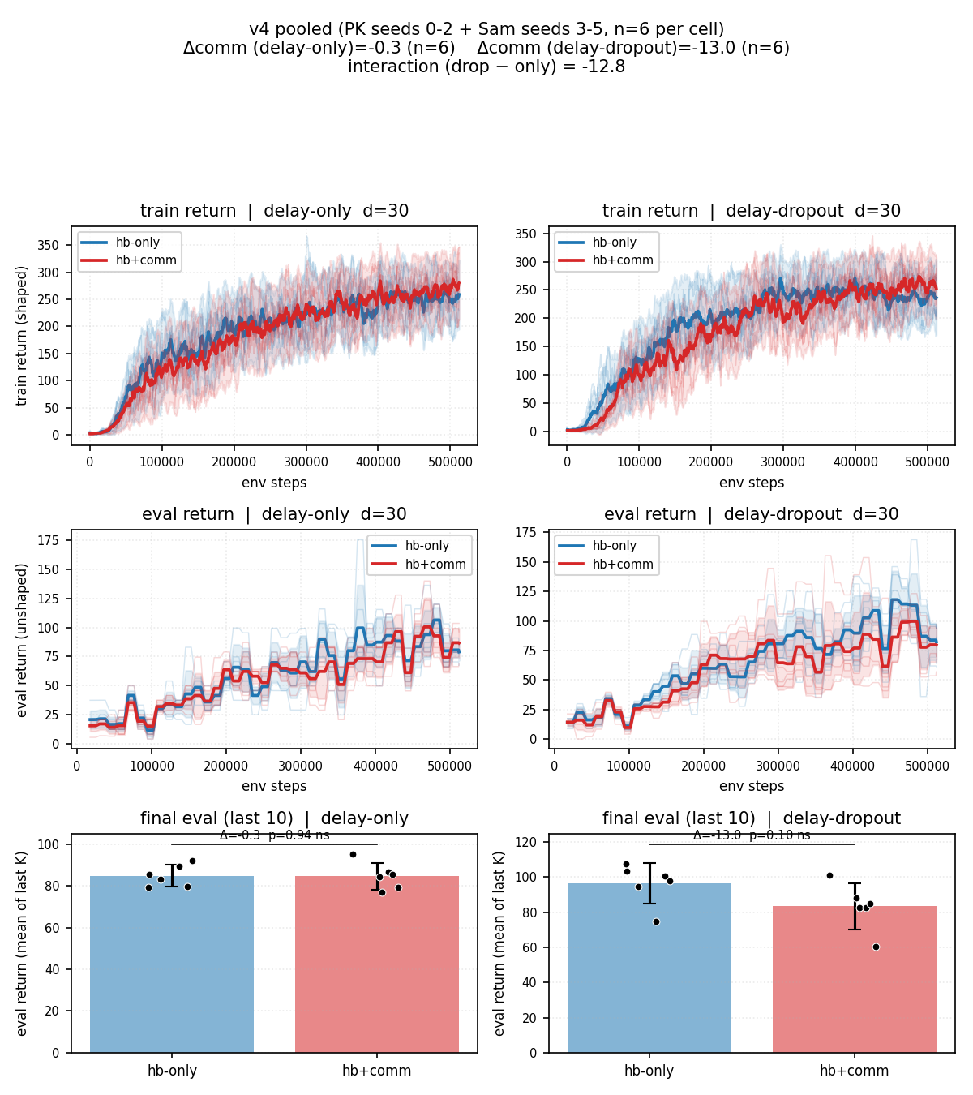
PROCESS
How the story matured as the evaluation got stronger
PHASE 1
PHASE 2
PHASE 3
Cheap eval, tiny maps
Production eval + pooling
Cleaner map + diagnostics
3 episodes / checkpoint; coarse reward grid; pilots can look “positive” by chance.
30 episodes / checkpoint, n = 6 across labs; eval SEM drops 2–7×; interaction weakens.
Stop arguing seeds, start arguing mechanisms: headroom, grounding, oracle ceilings.
Phase 1 — pilot v3 dashboard (n = 6, eval = 3 ep/ckpt)
Used only to demonstrate that cheap eval was misleading.
Phase 2 — pilot v4 pooled (n = 6, production eval)
Shaped train vs. unshaped eval split — the first major correction.
Speaker note: We are not cherry-picking — we are stress-testing the same hypothesis under stronger evaluation.
Communication Under Delayed Liveness | Cooperative MARL · RWARE
5 / 13

Slide 6
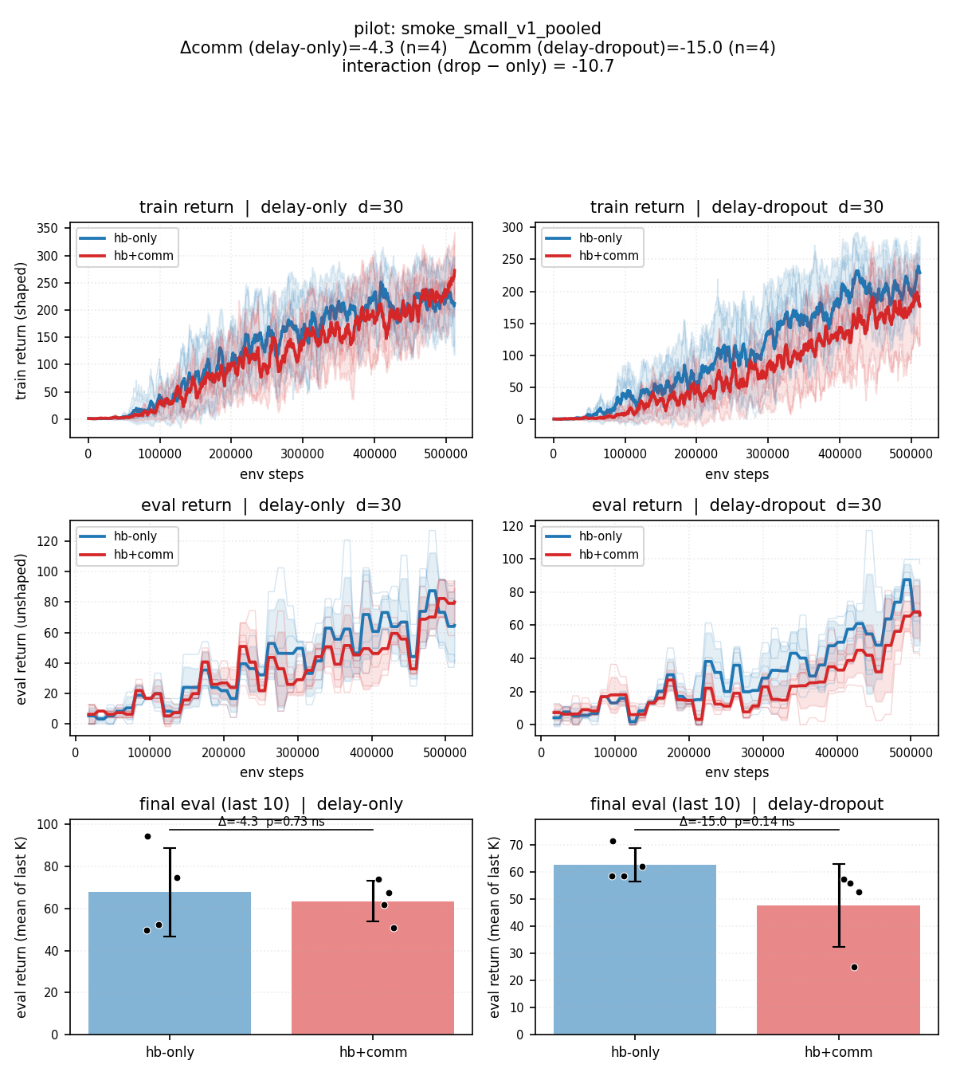
MAIN RESULT
Pooled main results: learned comm does not show dropout-specific rescue
What the pooled eval shows
Comm benefit under dropout is not consistently positive in unshaped eval.
Per-seed signs disagree — high variance, not an underpowered positive.
Train return improves with comm (shaping artifact) but eval does not.
Interaction estimates (Δ on unshaped eval)
−12.8
−10.7
exp_pilot_v4_pooled
smoke_small_v1_pooled
n = 6, tiny-4ag-v2, unshaped eval (last 10).
small-4ag-v2 smoke; same direction, larger map.
Figure 1 — pooled smoke, rware-small-4ag-v2.
Speaker note: The hoped-for positive interaction is not what we observe — and the failure is consistent across map sizes.
Communication Under Delayed Liveness | Cooperative MARL · RWARE
6 / 13

Slide 7
CONFOUND
Why dropout can look “helpful” on tiny maps
Crowding inverts the dropout sign
Removing one of four agents on a 7×7 grid reduces collision pressure on survivors.
Eval throughput can rise even though the team is objectively weaker.
Train curves disagree: dropout reduces shaped-train return ≈ 29% (hb-only).
Same artifact survives noise reduction; it is real, not a measurement error.
Field warning. This is a benchmarking lesson, not a model limitation. Headroom checks must precede comm claims.
Figure 2 — tiny-4ag-v2 v3 pilot dashboard.
Speaker note: On crowded maps, dropout can fake performance gains; we explicitly control for this with bigger maps and 2-agent diagnostics.
Communication Under Delayed Liveness | Cooperative MARL · RWARE
7 / 13

Slide 8
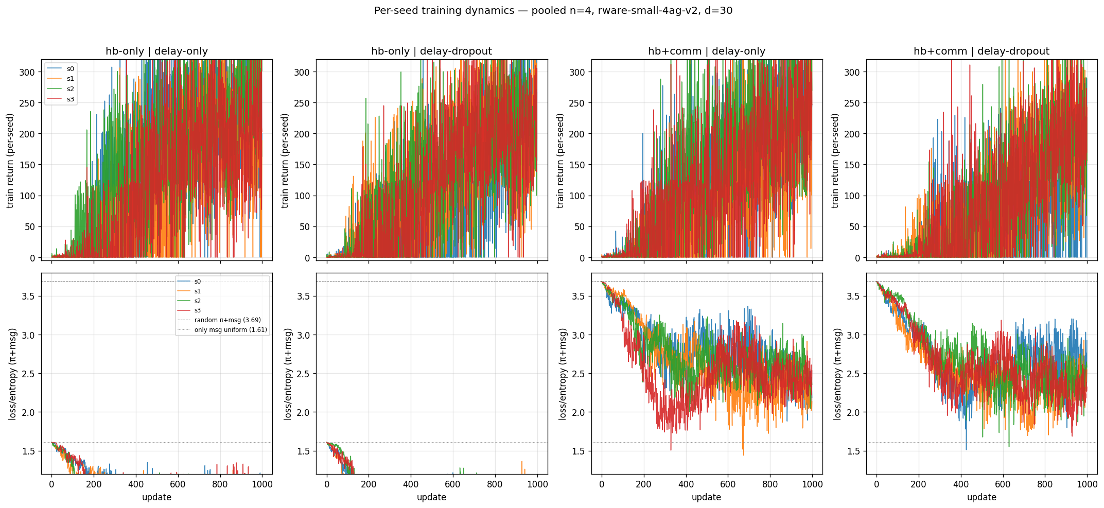
MECHANISM I
Why messages do not help — they often stay near-random (weak grounding)
Observation
hb+comm message-entropy ratio stays close to a uniform-token baseline.
No stable codebook emerges; tokens remain near-random across seeds.
Interpretation
High entropy is a proxy for “not using the channel.”
Effectively a hb-only baseline plus extra optimization noise.
Figure 3 — per-seed dynamics. Top row: shaped-train return; bottom row: estimated message entropy.
Why this matters. Message entropy is not a vibe metric — it is a behavioural proxy for whether the policy actually relies on its own messages. Treat it as a first-order grounding diagnostic.
Communication Under Delayed Liveness | Cooperative MARL · RWARE
8 / 13

Slide 9
MECHANISM II
If messages are explicit, the channel can carry useful signal
Derived contrasts
Oracle − learned comm: +2.55
Oracle − heartbeat-only: −1.75
What this separates
Information CAN flow through this channel.
The learned recipe does NOT produce usable symbols.
Control / execution remains the dominant bottleneck.
Source: matrix_results/diagnostics_v1_sam/summary.json (n = 4 seeds).
Speaker note: Oracle is a diagnostic ceiling, not a deployable method — its purpose is to separate channel capacity from learning failure.
Communication Under Delayed Liveness | Cooperative MARL · RWARE
9 / 13

Slide 10
MECHANISM III
Comm does not just add bits — it changes the optimization landscape
↑
≈ 2×
↓
Coefficient of variation
Collapse-like episodes
Convergence reliability
hb+comm runs show wider seed-to-seed train spread than hb-only.
More frequent low-return windows mid-training in hb+comm seeds.
Joint actor + message gradient interferes with action-only optimization.
Implication
The failure is not only “missing information.” The joint policy is harder to train when the actor must simultaneously learn to send and receive. Even where the channel could in principle help, the learner may not arrive there reliably under PPO + RIAL-style discrete messages.
Communication Under Delayed Liveness | Cooperative MARL · RWARE
10 / 13

Slide 11
HRL DIAGNOSTIC
Is the failure HRL? Partially — but high-level is not the only bottleneck
Interpretation
Oracle high-level helps slightly (+0.05 to +0.12 vs. base HRL).
Absolute returns remain near zero in all three configurations.
High-level abstraction is not the only issue — the low-level executor cannot reliably deliver shelves.
Pre-empts “the project would work if you used HRL” — partial but not sufficient.
Source: matrix_results/diagnostics_v1_sam (n = 4 seeds).
Speaker note: HRL keeps the same low-level executor; the bar chart isolates whether high-level choice or low-level skill is the bottleneck.
Communication Under Delayed Liveness | Cooperative MARL · RWARE
11 / 13

Slide 12
CONTRIBUTIONS
What we add beyond a single negative result
INFRASTRUCTURE
PROTOCOL
MECHANISTIC
Tooling and pipelines
Evaluation discipline
Negative-result decomposition
Matrix runner with regime × delay × method × seed sweeps.
Cross-lab pooling with strict config-equality checks.
Production-eval mode (eval_every=25, eval_episodes=30) and pooled dashboards.
Headroom check before measuring comm.
Interaction effect (Δ) as the headline target, not single-cell lifts.
Crowding / map-density confound checks to avoid “dropout looks easier” artifacts.
Ungrounded discrete messages as a first-class failure mode (entropy diagnostic).
Oracle / death-token isolates channel capacity from learning failure.
Optimization-side evidence: comm changes training dynamics, not just bits.
Speaker note: The contribution is a benchmark + protocol + mechanistic decomposition, even when the headline hypothesis fails.
Communication Under Delayed Liveness | Cooperative MARL · RWARE
12 / 13

Slide 13
CONCLUSION
Conclusion and the next disambiguation experiment
Conclusion. Learned discrete communication, as trained here, is not a reliable dropout-rescue tool. The signature points to grounding and training dynamics, with environment headroom and control limits as modulators.
Future work — 2×2 of unanswered questions (rows: ↑ headroom · columns: grounding →)
References (IEEE-style, cited)
Ungrounded × Low headroom
Ungrounded × High headroom
[1] J. N. Foerster et al., “Learning to communicate with deep multi-agent reinforcement learning,” NeurIPS, 2016.
[2] C. Yu et al., “The surprising effectiveness of PPO in cooperative multi-agent games (MAPPO),” NeurIPS, 2022.
[3] F. Christianos, L. Schäfer and S. V. Albrecht, “Robotic Warehouse (RWARE),” GitHub, 2020.
[4] E. Jang, S. Gu and B. Poole, “Categorical reparameterization with Gumbel-Softmax,” ICLR, 2017.
[5] L. Lamport, “Time, clocks, and the ordering of events in a distributed system,” Commun. ACM, 1978.
this project (RWARE 4-agent)
easier benchmarks; sanity check
Grounded × Low headroom
Grounded × High headroom
DIAL / Gumbel-Softmax on RWARE
next study (deliberate target)
Communication Under Delayed Liveness | Cooperative MARL · RWARE
13 / 13

