Slide 1
Eiffel for .NET Binding
for Db4o
Ruihua Jin
db4o User Conference
March 12, 2008

Slide 2
What is Eiffel?
  Pure object-oriented
  Design By Contract
  Single and multiple inheritance
  Constrained and unconstrained genericity
  Agents

Slide 3
A Sample Eiffel Class
class
PARALLELOGRAM
create
make
feature
make(h1: REAL; h2: REAL)
require
h1_positive: h1 > 0
h2_positive: h2 > 0
do
height1 := h1
height2 := h2
end
creation procedure

Slide 4
scale (f: REAL)
require
f_positive: f > 0
do
height1 := height1 * f
height2 := height2 * f
ensure
h1_scaled: height1 = old height1 * f
h2_scaled: height2 = old height2 * f
end
height1: REAL
height2: REAL
precondition
postconditions
attributes

Slide 5
class invariants
invariant
h1_positive: height1 > 0
h2_positive: height2 > 0
end -- class PARALLELOGRAM

Slide 6
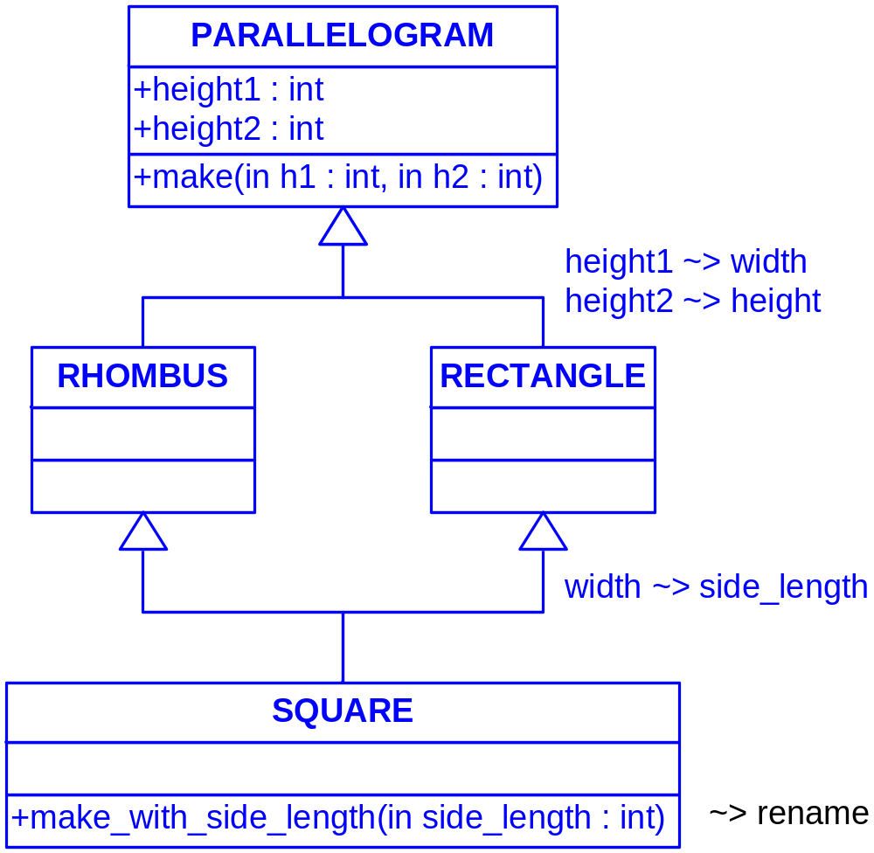
From Eiffel Types ...

Slide 7
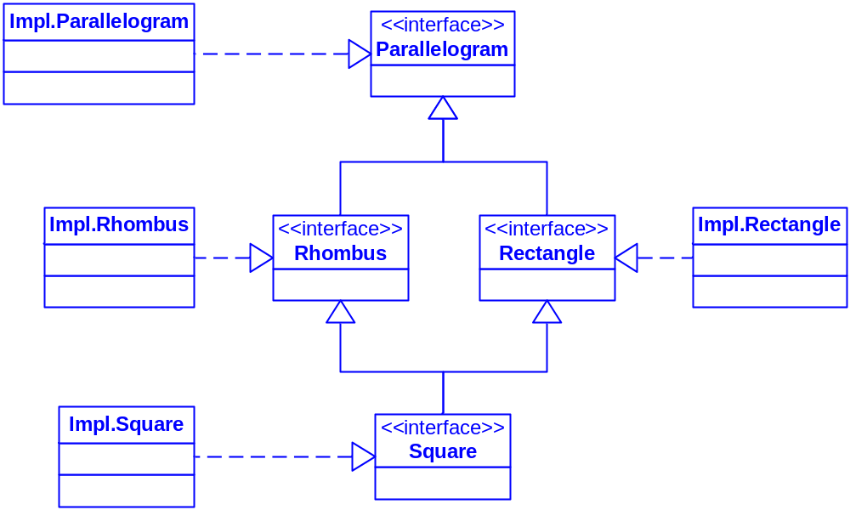
... to .NET Types

Slide 8
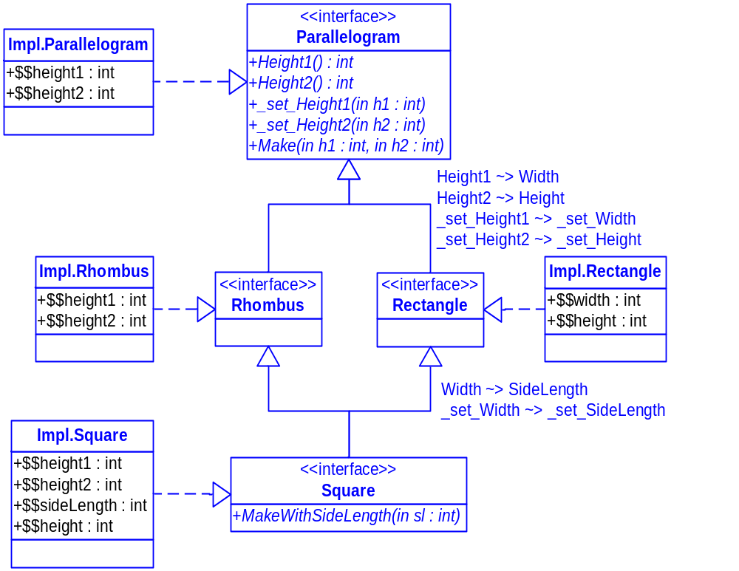

Slide 9
Querying for Eiffel Objects
  Query-By-Example
  SODA Query API
  Native Queries

Slide 10
Query-By-Example
Limitations
  cannot perform advanced query expressions using AND, OR, NOT, etc.
  cannot constrain on values like 0, "", or nulls
  need to be able to create objects without initialized fields
  need a constructor to create objects without initialized fields
Additional limitations in Eiffel for .NET
  only returns direct instances of the template type
  works correctly only if the template class does not have any subclasses

Slide 11
SODA Query API
Issues initially found in Eiffel for .NET
  .NET field names are different to their original Eiffel attribute names
side_length => $$sideLength
  Feature renaming in descendant classes
  query.constrain({PARALLELOGRAM})
hc := query.descend(“$$height1”).constrain(10)
  only returns Impl.Parallelogram objects
  Hint: Always use interfaces as query extents!

Slide 12
Providing a solution for SODA
Wrapper class QUERY for IQUERY
  given an Eiffel attribute name, the wrapper passes its corresponding .NET field name to
object_container.query.descend
Wrapper class CONSTRAINT for ICONSTRAINT
  OR-joins all related constraints for renamed fields
query.constrain({PARALLELOGRAM})
hc := query.descend(“$$height1”).constrain(10)
wc := query.descend(“$$width”).constrain(10)
sc := query.descend(“$$sideLength”).constrain(10)
c := hc.or_(wc).or_(sc)

Slide 13
Native Queries
class
RECTANGLE_PREDICATE
inherit
PREDICATE
feature
match(r: RECTANGLE): BOOLEAN is
do
Result := r.width > 10
end
end

Slide 14
Introducing Eiffel Agents
Encapsulate routines
  Agents with closed target
agent c.my_function(?, a, b)
    a and b: closed arguments set at the time of the agent’s definition
    ?: open argument set at the time of any call to the agent
  Agents with open target
agent {C}.my_function(?, a, b)
    {C}: class to which my_function belongs

Slide 15
Native Queries with Agents
EIFFEL_PREDICATE
  inherits from PREDICATE
  to be initialized with an agent
  return value of match = value of agent
NQ using agent with open target
agent {RECTANGLE}.diagonal_greater_than(10)
NQ using agent with closed target
agent my_query.diagonal_greater_than(?, 10)

Slide 16
Performance of Native Queries
In Eiffel for .NET
  cannot be optimized to be run against field indexes
match(candidate: SOME_TYPE): BOOLEAN
  NQ with agents run slower than PREDICATE queries by a factor of 1-4, depending on the number of candidate objects

Slide 17
Genericity
From Eiffel generic types to .NET types
class
GLIST[G]
feature
item: G
end
class GlistReference
{
object item;
}

Slide 18
Querying for Generic Objects
The described mapping raises some issues
  GLIST[STRING] would conform to GLIST[RECTANGLE]
Solution: helper class GENERICITY_HELPER
  conformance test of candidate objects in match
  filtering out non-conforming objects in query result

Slide 19
TypeHandler for Eiffel Strings
A type handler is necessary to enable db4 sorting objects by Eiffel string fields in SODA queries
query.descend(“str_fld”).order_ascending
still working on it...
Nice-to-have: comparison constraints in SODA Queries
query.descend("str_fld").constrain(“a").greater

Slide 20
Drawing conclusions
Eiffel for .Net is compatible with C# with respect to storing and retrieving objects, except for genericity
Querying for Eiffel Objects
  Query-By-Example: possible, some additional restrictions
  SODA Query API: efficient, avoid too many field renamings
  Native Queries: ok if database not too big; cannot be optimized, using agents there is a performance penalty

Slide 21
Project Homepage
http://defcon.origo.ethz.ch/
or
http://developer.db4o.com/ProjectSpaces/view.aspx//Defcon

Slide 22
Thank you!
Questions?

Slide 23
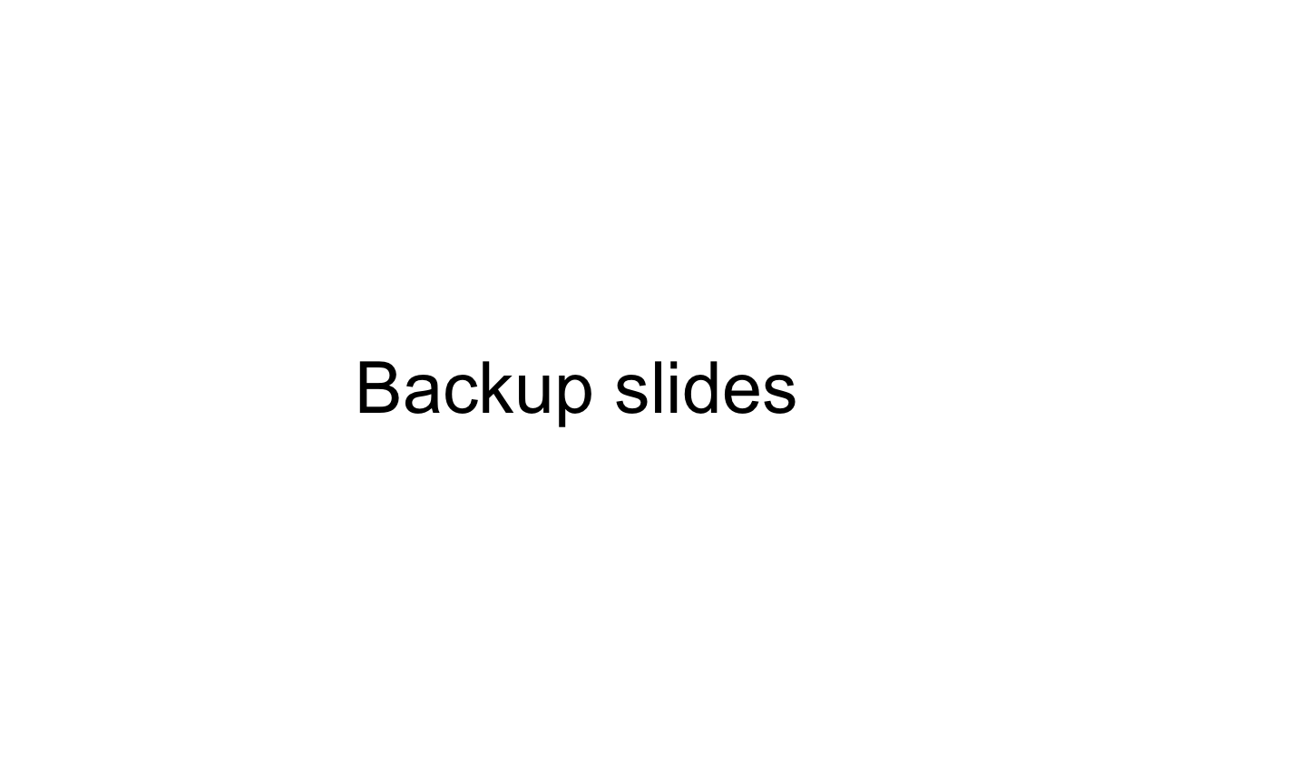

Slide 24
Persistence of C Structs
  Eiffel wrapper class for C struct
  persist Eiffel wrapper class

