Slide 1
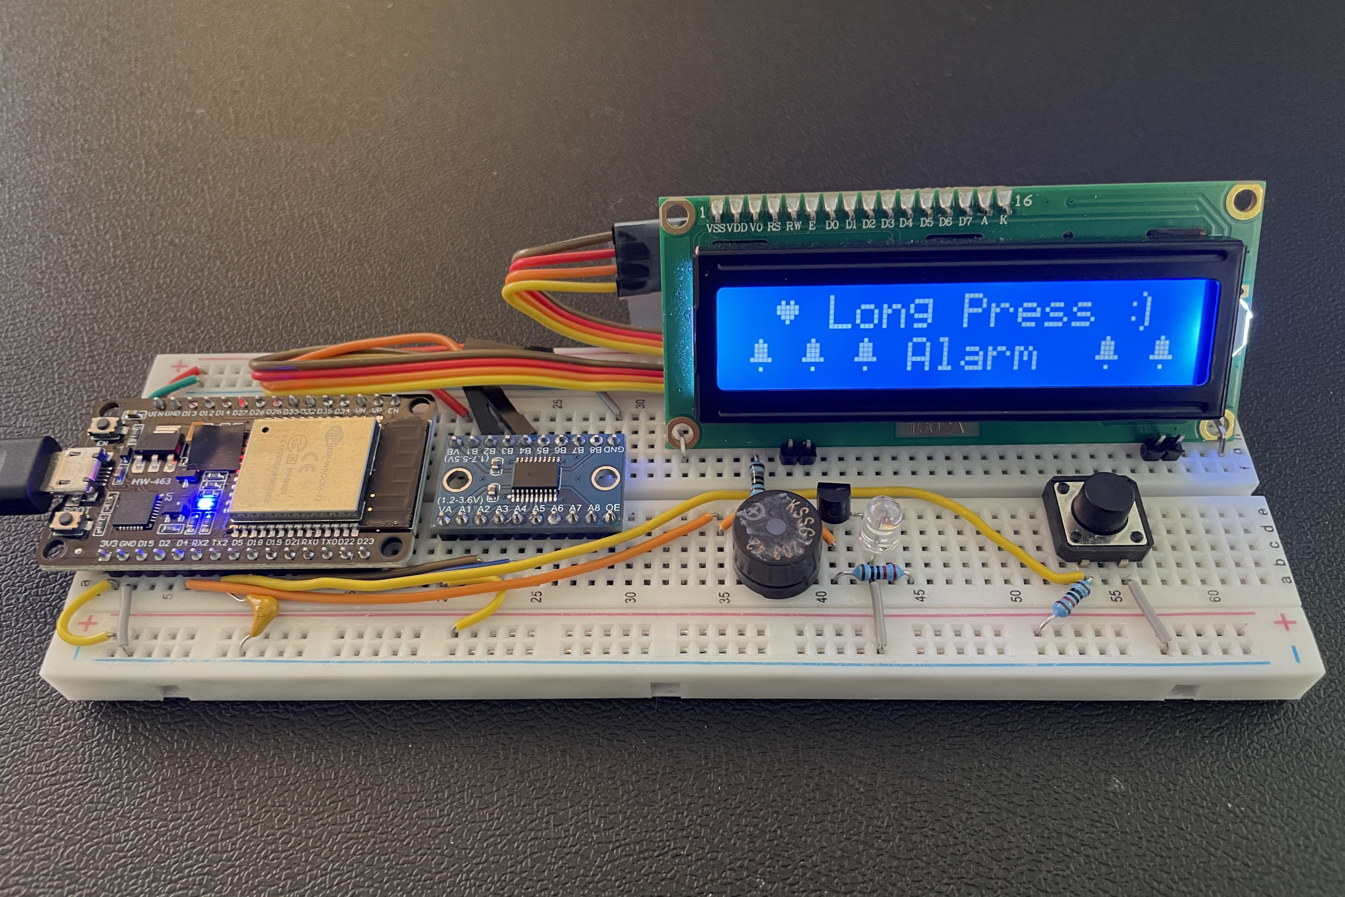
Long Press Alarm – No more Snooze!
LCD 1602
Level Shifter 5V-3.3V
5V
GND
SDA
SCL
ESP32
3.3V
10K
Push Button Read
Push Button
5V
1nF
GND
Alarm
LED
330R
10R
Buzzer
2N7000 MOSFET
Video: https://youtu.be/btpxy9vB6y4
Github: https://github.com/pk17r/LongPressAlarm

