Slide 1
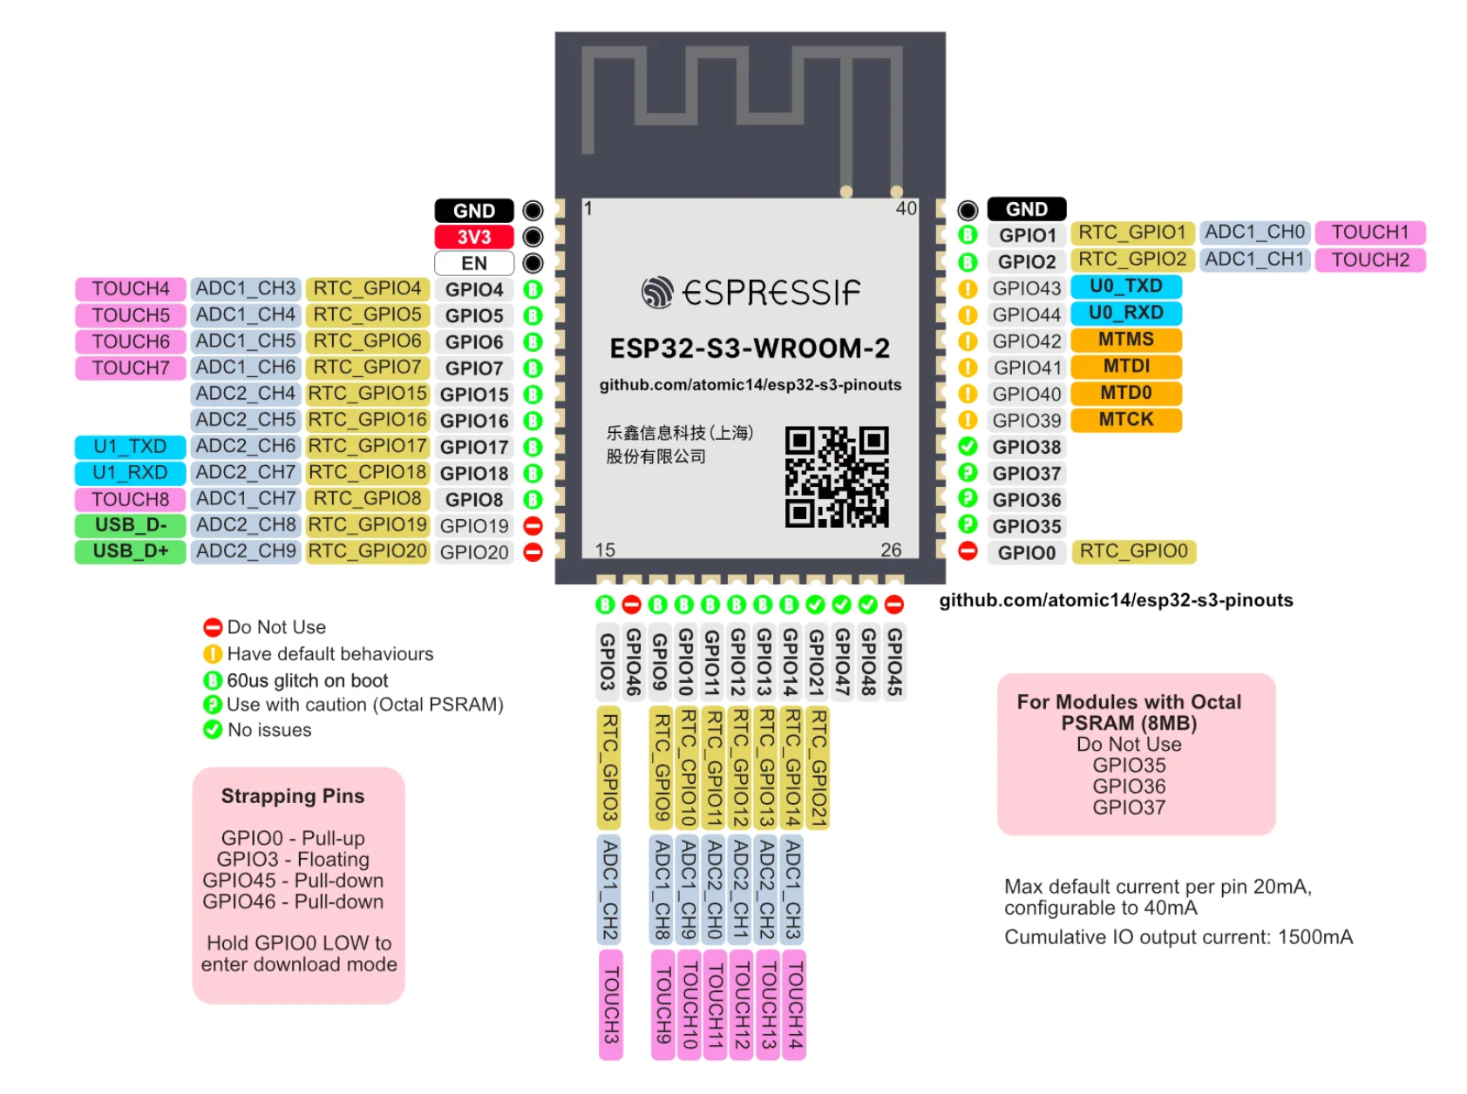
BTN
INC-BTN
PHOTORESISTOR
IO5-DEC-TOUCH
IO6-INC-TOUCH
IO7
WS2812
BUZZER-SIG
TS-CS
SQW
I2C-SDA
IO19-D-
IO20-D+
TX
RX
DEC-BTN
LED-SIG
IO40
WIFI-LED
IO38
----------
----------
----------
BOOT
----------
TS-IRQ
BL
DC
RES
MISO
SCK
MOSI
CS-DISPLAY
I2C-SCL
----------
----------

