Slide 1
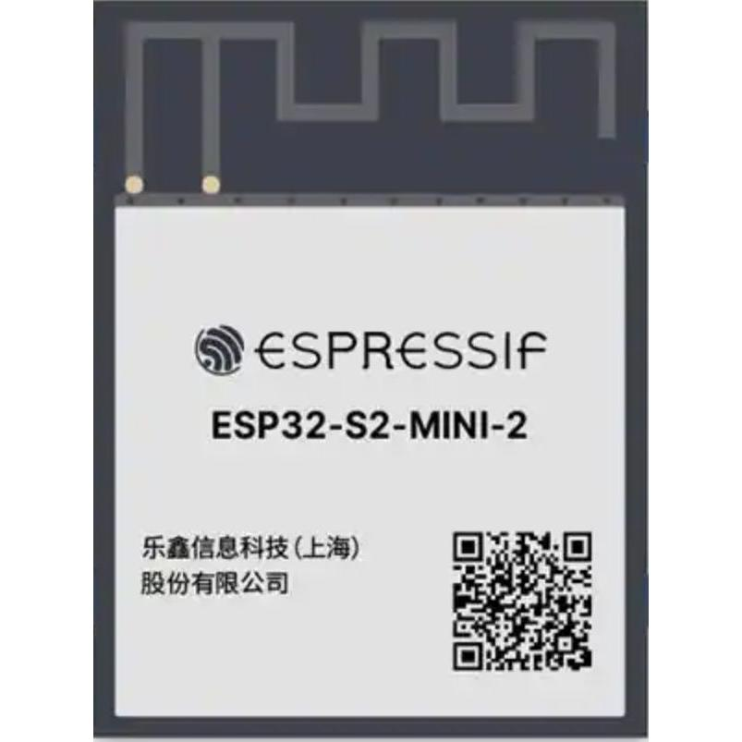
GND
GND
GND
ENABLE
GND
-
GPI046
INPUT ONLY
3V3
GND
RTC_GPIO0
GPIO0
-
-
GND
TOUCH1
ADC1_CH0
RTC_GPIO1
GPIO1
GPIO45
U0_RXD
TOUCH2
ADC1_CH1
RTC_GPIO2
GPIO2
!
GPIO44
U0_TXD
TOUCH3
ADC1_CH2
RTC_GPIO3
GPIO3
!
GPIO43
MTMS
TOUCH4
ADC1_CH3
RTC_GPIO4
GPIO4
!
GPIO42
TOUCH5
ADC1_CH4
RTC_GPIO5
GPIO5
!
GPIO41
MTDI
TOUCH6
ADC1_CH5
RTC_GPIO6
GPIO6
!
GPIO40
MTDO
TOUCH7
ADC1_CH6
RTC_GPIO7
GPIO7
!
GPIO39
MTCK
TOUCH8
ADC1_CH7
RTC_GPIO8
GPIO8
GPIO38
TOUCH9
ADC1_CH8
RTC_GPIO9
GPIO9
GPIO37
FSPI_MISO
TOUCH10
ADC1_CH9
RTC_GPIO10
GPIO10
GPIO36
FSPI_CLK
GPIO11
GPIO11
GPIO11
TOUCH11
GPIO35
FSPI_MOSI
TOUCH11
ADC2_CH0
ADC2_CH0
RTC_GPIO11
RTC_GPIO11
B
B
GND
-
-
-
GND
Do Not Use
Have default behavior
Okay to use
-
GPIO12
GPIO13
GPIO14
GPIO15
GPIO16
GPIO17
GPIO18
GPIO20
GPIO21
GPIO26
NC
GPIO33
GPIO34
!
GPIO19
GND
- ADC1 is unaffected with active WiFi while ADC2 gets affected
- FSPI default pins have higher 80MHz SPI frequency
- GPIO19/20 are USB D+/D-
- GPIO43/44 are UART Tx/Rx
- GPIO26 is unavailable on modules with PSRAM
- GPIO46 is input only
RTC_GPIO13
RTC_GPIO12
RTC_GPIO14
RTC_GPIO15
RTC_GPIO16
RTC_GPIO17
RTC_GPIO18
RTC_GPIO19
RTC_GPIO20
RTC_GPIO21
FSPI_CS
Strapping Pins
GPIO0 – Pull-Up
GPIO45 – Pull-Down
GPIO46 – Pull-Down
Hold GPIO0 LOW to enter Download Mode
UNAVAILABLE ON PSRAM MODULE
ADC2_CH2
ADC2_CH1
ADC2_CH3
ADC2_CH4
ADC2_CH5
ADC2_CH6
ADC2_CH7
ADC2_CH8
ADC2_CH9
USB_D-
DAC_1
USB_D+
TOUCH13
DAC_2
TOUCH12
TOUCH14
XTAL_32K_P
XTAL_32K_N
U1_TXD
U1_RXD

