Slide 1

Predictive Analytics for Enhancing Machine Maintenance Optimization
Team Paramount
- Penchala Akshay Kumar Kandagaddala
- Shashank Rao Gujja
- Venkata Satya Naveen Nagulapalli
- Sudheshna Mullaguru
- Yogesh Savirigana
- Vijaya Lakshmi Kalpana Potti

Slide 2
Have performed the initial data preprocessing, checked for the data inconsistency and performed the required sampling and done the feature engineering in converting the features to the consistent format
Implemented the Random Forest classifier algorithm, proceeded to evaluate the model's performance, and subsequently computed the confusion matrix to assess its predictive capabilities.
I have engaged in the process of Data Exploration utilizing Pyspark SQL, wherein I have authored SQL queries to extract and analyze data.
executed the implementation of the Linear Support Vector Classification (SVC) Model,, and meticulously calculated the confusion matrix, thereby obtaining valuable insights into its classification performance.
Effectively implemented the Decision Tree classifier algorithm, meticulously evaluated the model's performance, and, subsequently, interpreted the final outcomes derived from all the employed models.
Implemented the Logistic Regression algorithm, evaluated the model's performance, and meticulously computed the confusion matrix.

Slide 3

PROBLEM STATEMENT:
Our primary aim is to establish a predictive maintenance system that can precisely forecast the potential failure or uninterrupted operation of a specific machine.
This predictive capability plays a pivotal role in upholding the reliability and optimal performance of the industrial machinery
This model also addresses the critical concern of minimizing costly downtime in industrial operations.

Slide 4

WHY IS IT WORTH SOLVING?
Unplanned downtime significantly impacts industrial operations:
It leads to substantial losses in terms of lost production, resulting in missed deadlines and decreased revenue.
Maintenance costs skyrocket as urgent repairs and replacements become the norm, straining our budget.
The overall reliability of our industrial machinery is compromised, eroding our reputation and customer trust.
In the fiercely competitive industrial landscape, such downtime can be the difference between success and stagnation.
This challenge underscores the urgency of finding a robust and effective solution.

Slide 5

HOW DATA ANALYSIS/MODELING HELPS TO TACKLE THIS ISSUE?
Proactively identifying potentially problematic machines to enhance reliability and revenue, two crucial factors highly valued in the industry.
Additionally, this proactive approach aids in refining issues within the supply chain.
Organizations can develop strategic plans for equipment upgrades, replacements, or technological advancements based on the historical performance data.

Slide 6
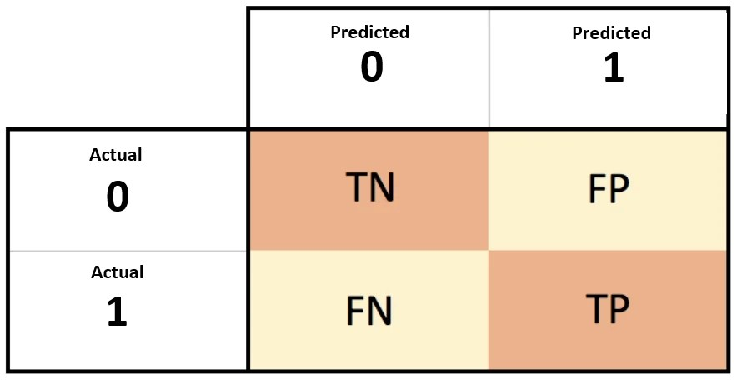
Discuss how you will evaluate the solution you've come up
False Positive: Misidentifying a machine failure when none is imminent, potentially leading to unnecessary maintenance interventions and increased operational costs.
False Negative: Failing to predict an actual machine failure, risking unplanned downtime, decreased productivity, and financial losses.
Evaluation metric – Recall.

Slide 7

Dataset Description:
We have taken the data from the UCI Machine Learning Repository website and the dataset is licensed under a Creative Commons Attribution 4.0 International (CC BY 4.0) license. The dataset comprises 10,000 data points, each represented as a row with 14 features stored in columns
Feature Descriptions
UID (Unique Identifier): Ranges from 1 to 10,000.
Product ID: L (Low), M (Medium), and H (High) quality variants.
Air Temperature [K]: Random walk process, normalized, σ = 2 K.
Process Temperature [K]: Random walk process, normalized, added to air temperature + 10 K.
Rotational Speed [rpm]: Calculated from power, with noise.
Torque [Nm]: Normally distributed, σ = 10 Nm, no negatives.
Tool Wear [min]: Duration varies by product quality: H (5 min), M (3 min), L (2 min).
Machine Failure Label: Binary, indicating machine failure.
The machine failure modes include tool wear failure, heat dissipation failure, power failure, overstrain failure, and random failures, each occurring for specific reasons as described.

Slide 8
Data Model
Start
Importing the data
Data Pre-processing
Data exploration with PySpark SQL
Feature Engineering
Classification for predicting maintenance
Machine Learning models
Logistic Regression
Decision trees
Linear SVC Model
Random Forest
Model Evaluation
Model Evaluation
Model Evaluation
Model Evaluation
Interpreting the best model

Slide 9
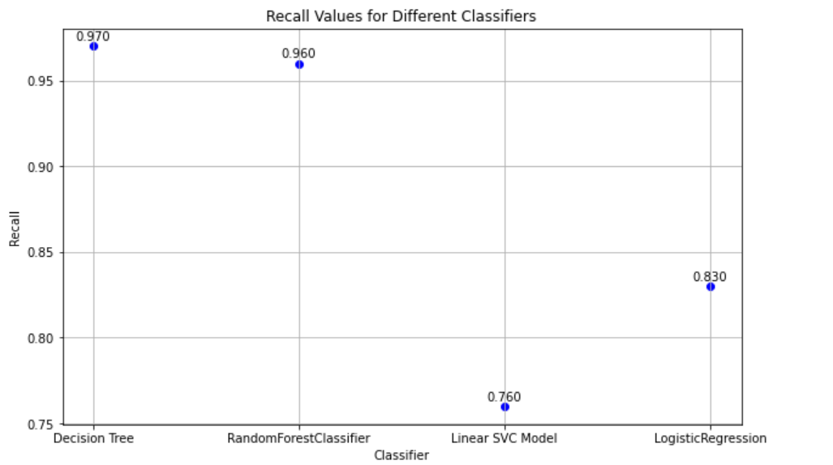
Results
Decision Tree – 97%
Random Forest – 96%
Linear SVC – 76%
Logistic Regression – 83%

Slide 10
Challenges Faced
Overcoming a challenging calculation error in Logistic regression, which initially posed a significant hurdle, but we identified and rectified it.
Dealing with file transfer issues caused by unstable virtual machines presented a notable challenge.
Establishing the Java environment proved to be a task in itself, requiring careful setup and configuration.

Slide 11

Conclusion
Model's Achievements:
Our predictive maintenance model has made significant strides in enhancing operational efficiency and reliability.
Impact on Downtime:
By accurately forecasting machine failures, the model has significantly reduced costly unplanned downtime.
Best Model
Decision Tree: Recall Score - 97%

