Slide 1
ENGI 301 6 Finger Augmentation with Variable Grip Through Usage of Potentiometer
9/25/22
Paul Kim

Slide 2
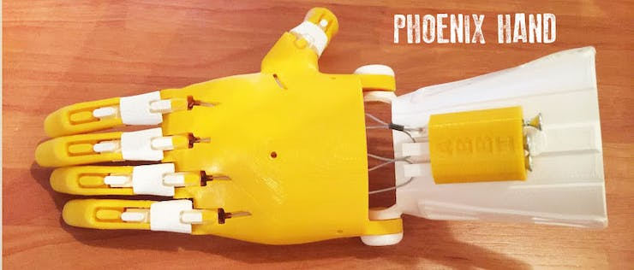
Background Information
What is being proposed?
https://www.hackster.io/amalmathewtech/3d-printed-prosthetic-hand-with-capacitive-touch-sensing-6b0ebe
Background: 3D Printed Prosthetic Hand with Capacitive Touch Sensing Project has been made to “grip” items for the actuation of fingers but:
made use of 2 capacitive sensors for external control
single motor for an entire hand
Arduino Setup
Improvement
Adjust the setup to develop a new usage of 6th finger augmentation
Modify hand design to incorporate sensor if needed
Allow for adjustable grip to allow for better griping controls by using a potentiometer
Can be modified to use capacitive/resistive sensors
Add in a hex display to show “Grip-level”
Add in lights to show on/off state

Slide 3
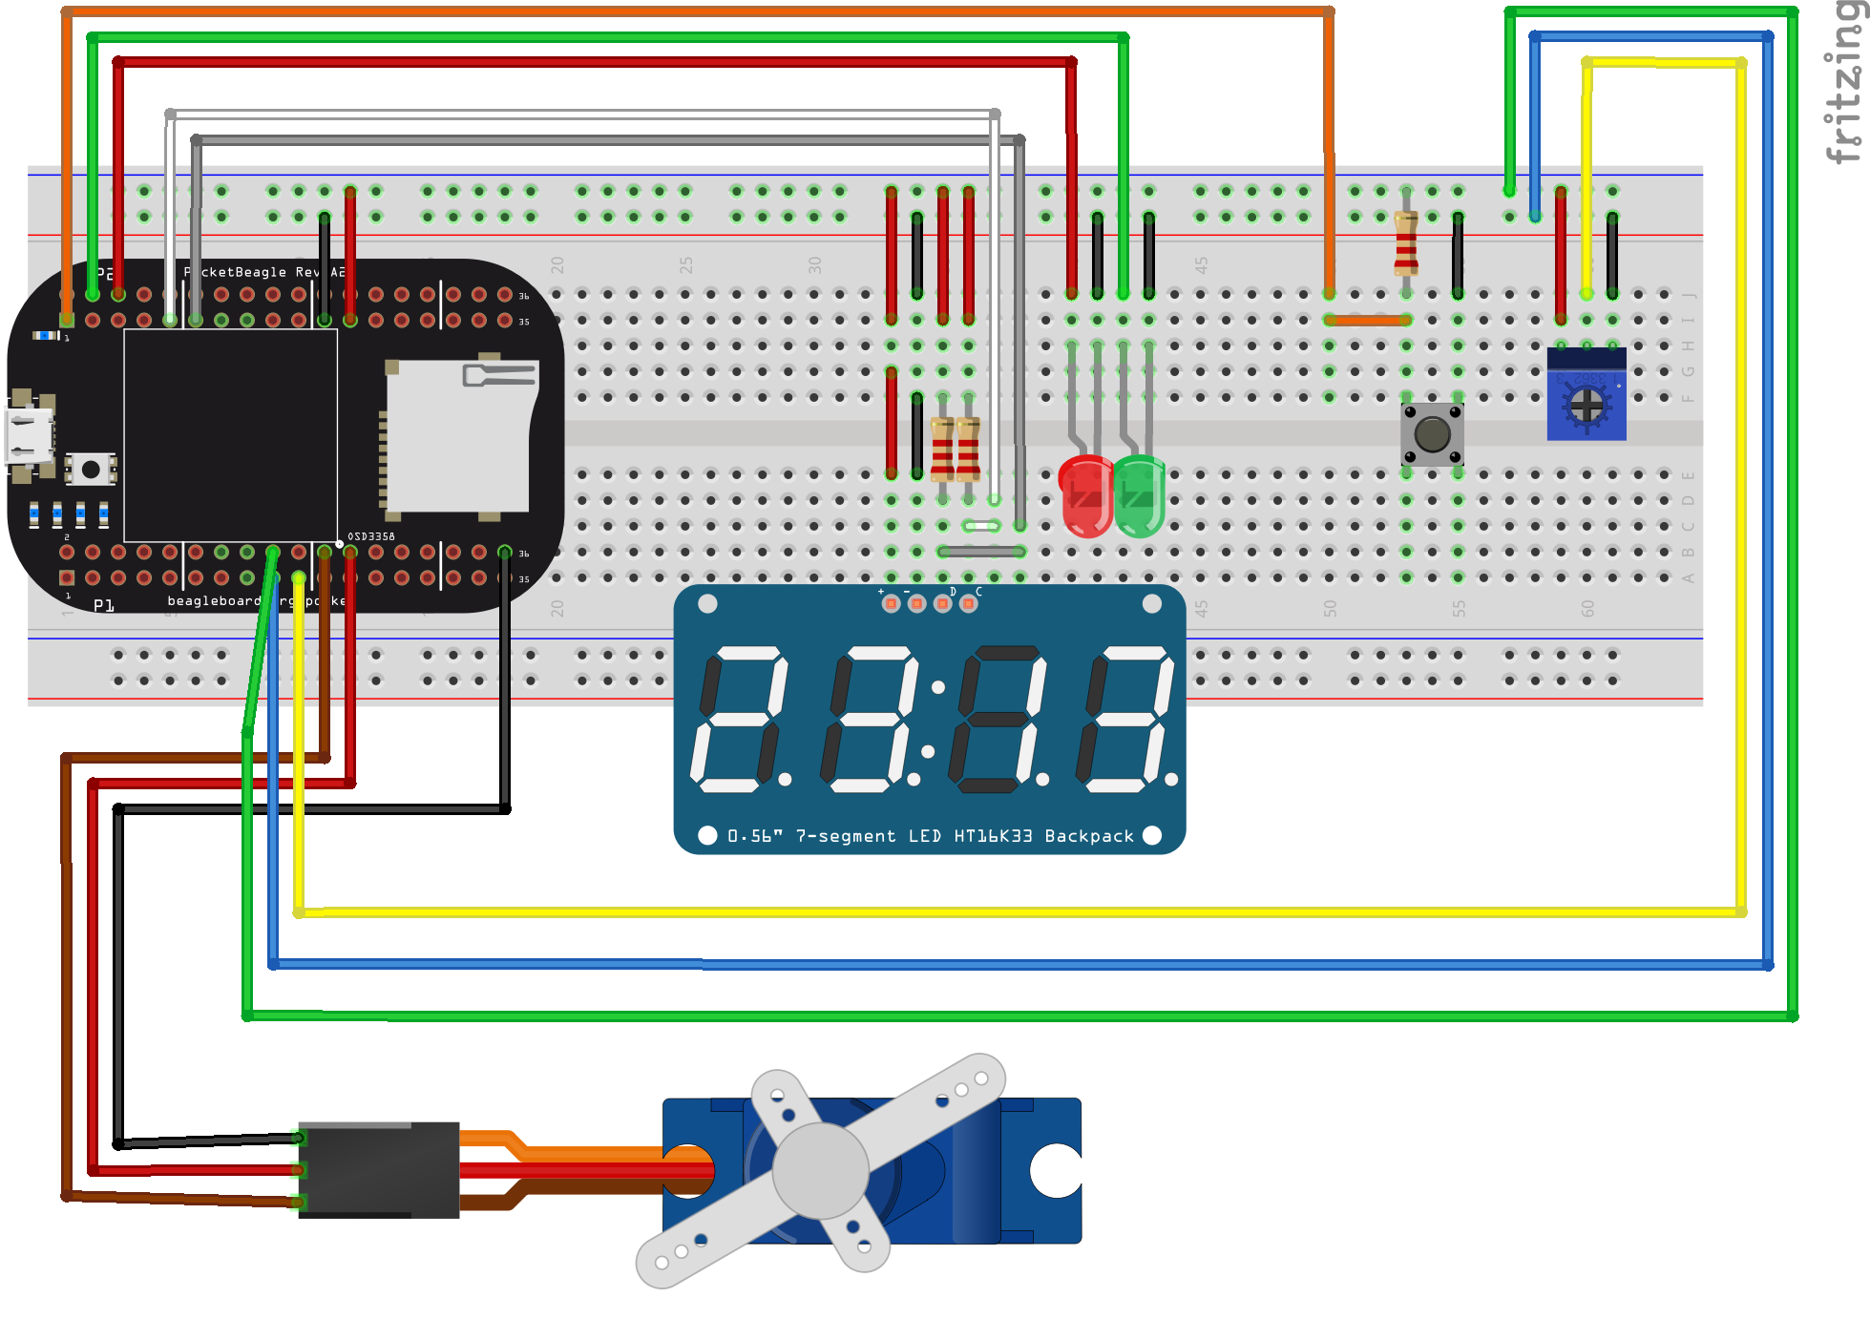
System Block Diagram

Slide 4
System Block Diagram
3.3V
PocketBeagle
3.3V
3.3V
PC Host
1k
USB
1k
Hex Display
μUSB
I2_C1_SPI
(P2_9)
SPI
SCL
VCC
I2_C1_SDA
(P2_11)
SDA
SDA
5 V (P1_24)
GND
Servo
3.3V
VCC
Signal
PWM0_A
(P1_36)
1k
GND
GPIO
(P2_2)
GND (P1_22)
1.8V (P1_18)
Potentiometer
AIN
(P1_19)
GPIO
(P2_4)
GPIO
(P2_6)
AGND (P1_17)

Slide 5
Power Block Diagram
3.3V
Peak Power Dissipation :100 mW
Peak Current :100mA
PocketBeagle
3.3V
3.3V
PC Host
1k
USB
1k
Hex Display
μUSB
I2_C1_SPI
(P2_9)
SPI
SCL
VCC
I2_C1_SDA
(P2_11)
SDA
SDA
GND
Operational Voltage: (4.8~6 V)
Peak Power Dissipation : 550 mW
Peak Current :20 mA
5 V (P1_24)
Servo
VCC
Signal
Peak Power Dissipation :75 mW
Peak Current :20 mA
PWM0_A
(P1_36)
GPIO
(P2_4)
GND
GPIO
(P2_6)
GND (P1_22)

Slide 6
Components / Budget
Component | Need to Buy | Cost
All components present in OEDK/Box Provided
Check following for build instruction and all present components. https://www.hackster.io/pkim7035/6-finger-augmentation-with-beaglebone-d0ea5d
Need all components to be purchased by instructor listed; additional components may be purchased by student

