Slide 1
ENGI 301-Project 2 6 Finger Augmentation
Paul Kim
Project 2
Due 12/13/2022 @ 11:59pm

Slide 2
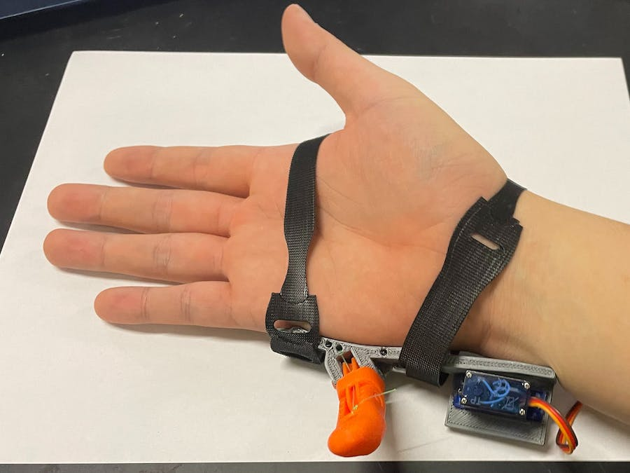
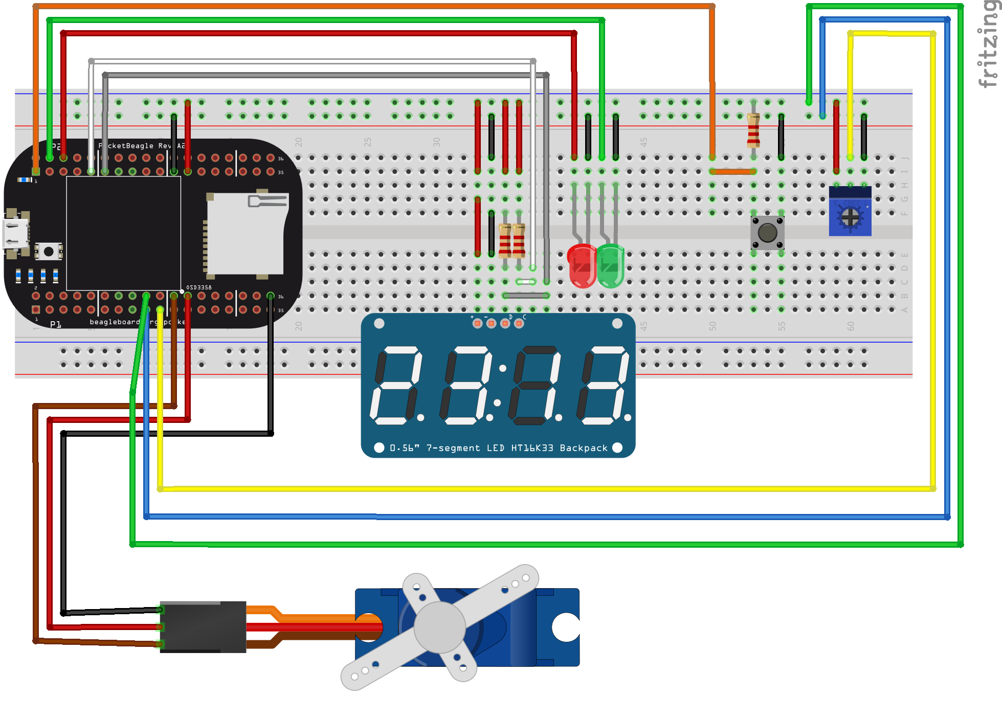
Background Information
6 Finger Augmentation
Hardware:
Hex Display
One Potentiometers
One Button (Turn off button)
Two LEDs (Red, Green)

Slide 3
System Block Diagram – 6 Finger Augmentation
3.3V
PocketBeagle
3.3V
3.3V
PC Host
1k
USB
1k
Hex Display
μUSB
I2_C1_SPI
(P2_9)
SPI
SCL
VCC
I2_C1_SDA
(P2_11)
SDA
SDA
5 V (P1_24)
GND
Servo
3.3V
VCC
Signal
PWM0_A
(P1_36)
1k
GND
GPIO
(P2_2)
GND (P1_22)
1.8V (P1_18)
Potentiometer
AIN
(P1_19)
GPIO
(P2_4)
GPIO
(P2_6)
AGND (P1_17)

Slide 4
Mechanical Drawing of 6 Finger Augmentation PCB
3”
.35”
0.1”
2”
0.1”
.25”
Pocket Beagle
Hex Display
0.1”
0.35”
GLED
GLED
0.3”
Servo
0.3”
1.0”
.5”
R
R
0.63”
0.1”
μUSB
1.4”
RLED
RLED
0.05”
0.1”
0.4”
2”
2.2”
0.5”
Pot
0.5”
0.4”
Button
0.3”
R
0.1”
0.06”
0.5”
1.5”
FRONT
Resister
BACK

