Slide 1
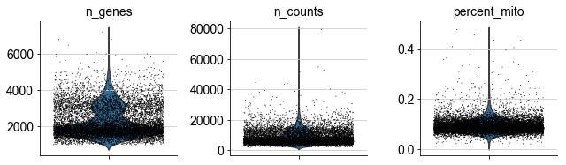
VlnPlot analysis using Scanpy

Slide 2
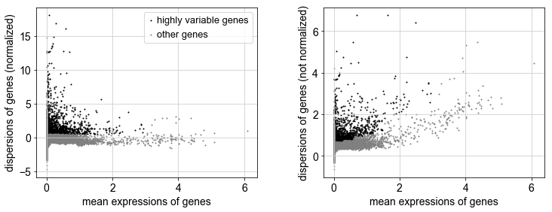
VariableFeaturePlot analysis using Scanpy

Slide 3
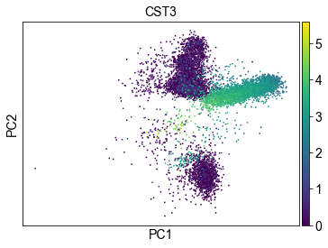
PCA Plot

Slide 4
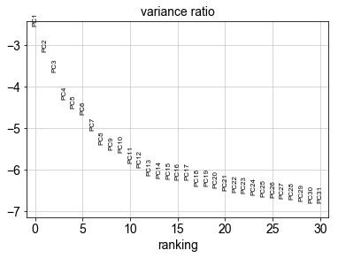
ElbowPlot analysis of PCs using Scanpy

Slide 5
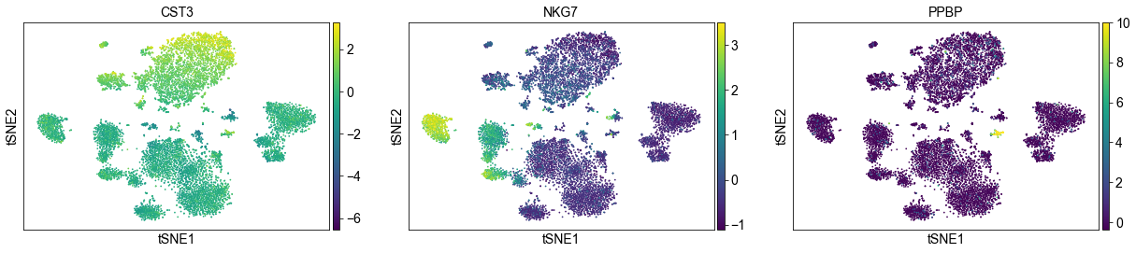
Visualization of gene expression in the t-SNE plot

Slide 6
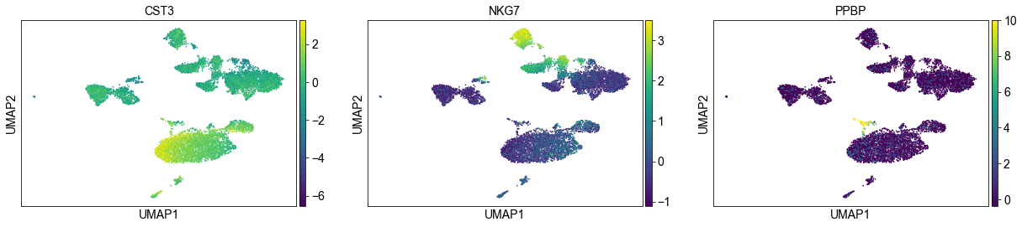
Visualization of gene expression in the UMAP plot

