Slide 1

Estimation of a Nonparametric Information Divergence Measure
Prad Kadambi
Advisor: Dr. Visar Berisha
April 7th 2016
School of Electrical, Computer and Energy Engineering

Slide 2
Outline
Motivation
Information divergence measures have many applications
Previous work has assumed knowledge of probability
Current research focuses on nonparametric estimation
Slow convergence
Methods
Power law model for convergence
Results
- Find asymptotic divergence estimates, and verify power law
Conclusion

Slide 3
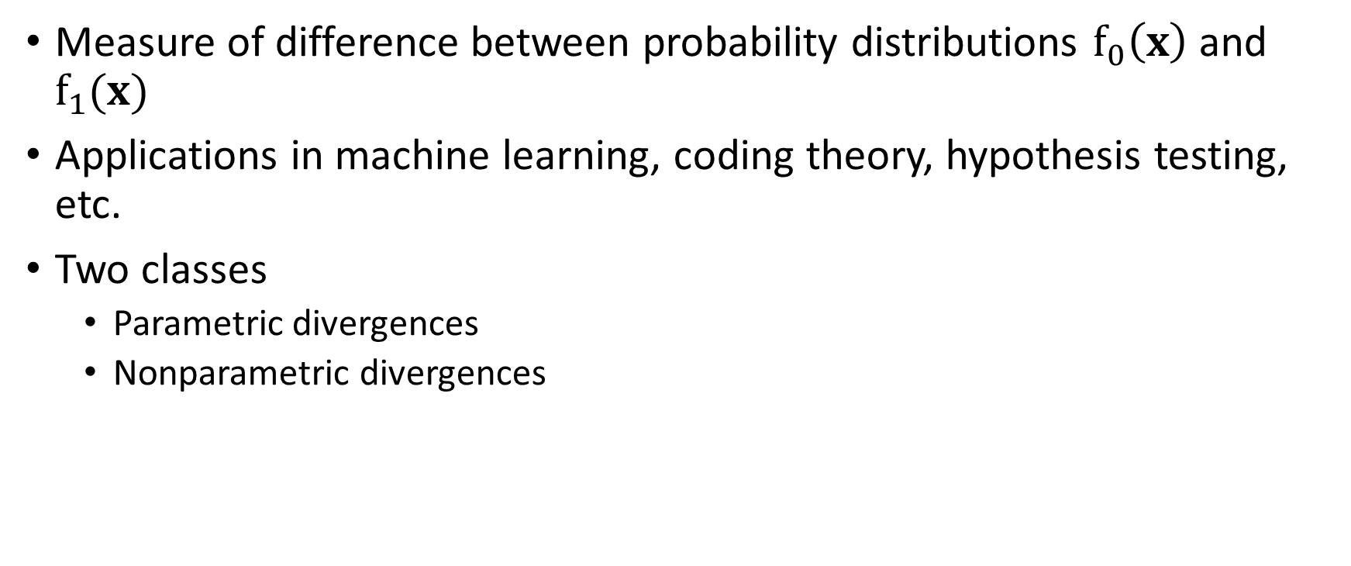
Information Divergence Measures
Measure of difference between probability distributions $f_{0}\left(x\right)$ and $f_{1}(x)$
Applications in machine learning, coding theory, hypothesis testing, etc.
Two classes
Parametric divergences
Nonparametric divergences

Slide 4
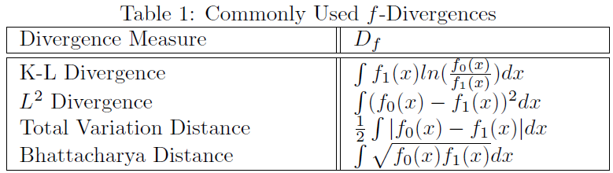
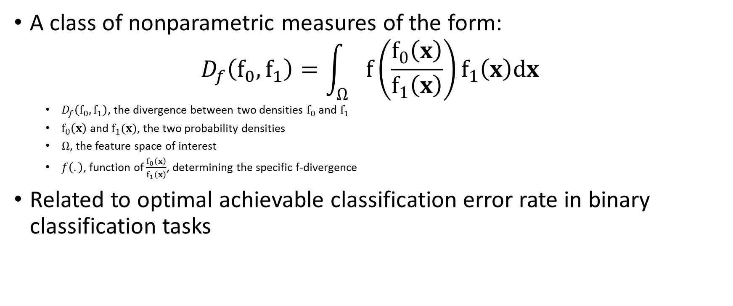
f-divergences
A class of nonparametric measures of the form:
$$D_{f}\left(f_{0},f_{1}\right)=\int_{Ω}{f\left(\frac{f_{0}\left(x\right)}{f_{1}\left(x\right)}\right)}f_{1}\left(x\right)dx$$
$D_{f}\left(f_{0},f_{1}\right)$, the divergence between two densities $f_{0}$ and $f_{1}$
$f_{0}\left(x\right)$ and $f_{1}(x)$, the two probability densities
$Ω$, the feature space of interest
$f\left(.\right)$, function of $\frac{f_{0}\left(x\right)}{f_{1}\left(x\right)}$, determining the specific f-divergence
Related to optimal achievable classification error rate in binary classification tasks

Slide 5
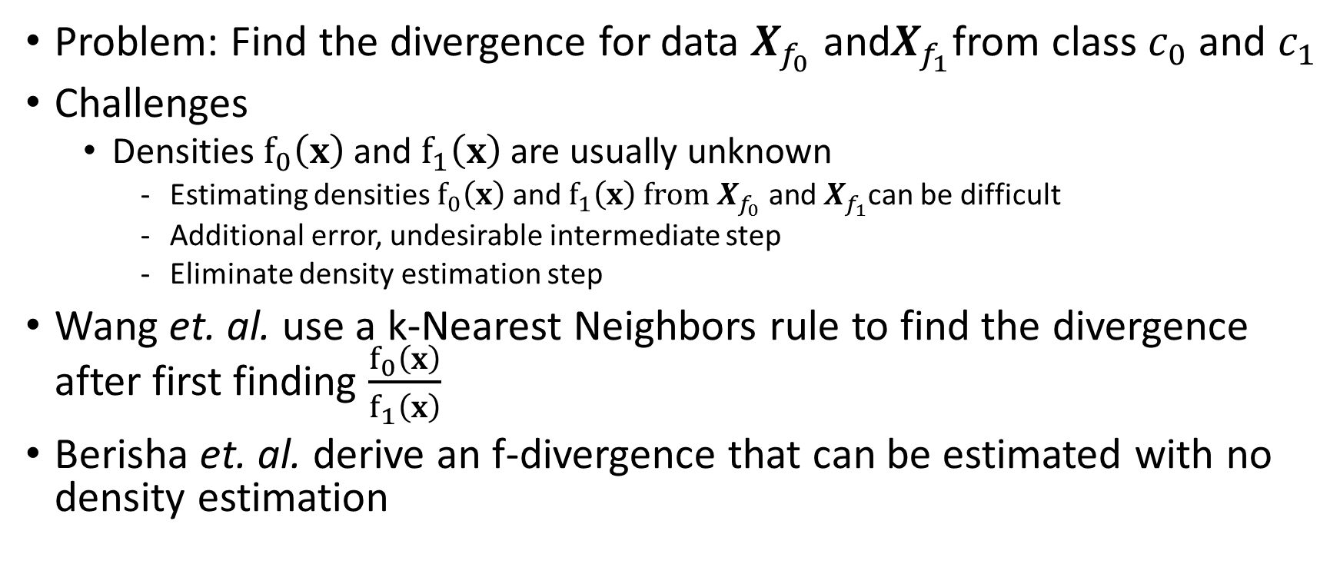
Estimation of f-divergences
Problem: Find the divergence for data $X_{f_{0}}$ and$X_{f_{1}}$from class $c_{0}$ and $c_{1}$
Challenges
Densities $f_{0}\left(x\right)$ and $f_{1}\left(x\right)$ are usually unknown
Estimating densities $f_{0}\left(x\right)$ and $f_{1}\left(x\right)$ $from X_{f_{0}} \text{and}{ X}_{f_{1}}$can be difficult
Additional error, undesirable intermediate step
Eliminate density estimation step
Wang et. al. use a k-Nearest Neighbors rule to find the divergence after first finding $\frac{f_{0}\left(x\right)}{f_{1}\left(x\right)}$
Berisha et. al. derive an f-divergence that can be estimated with no density estimation

Slide 6
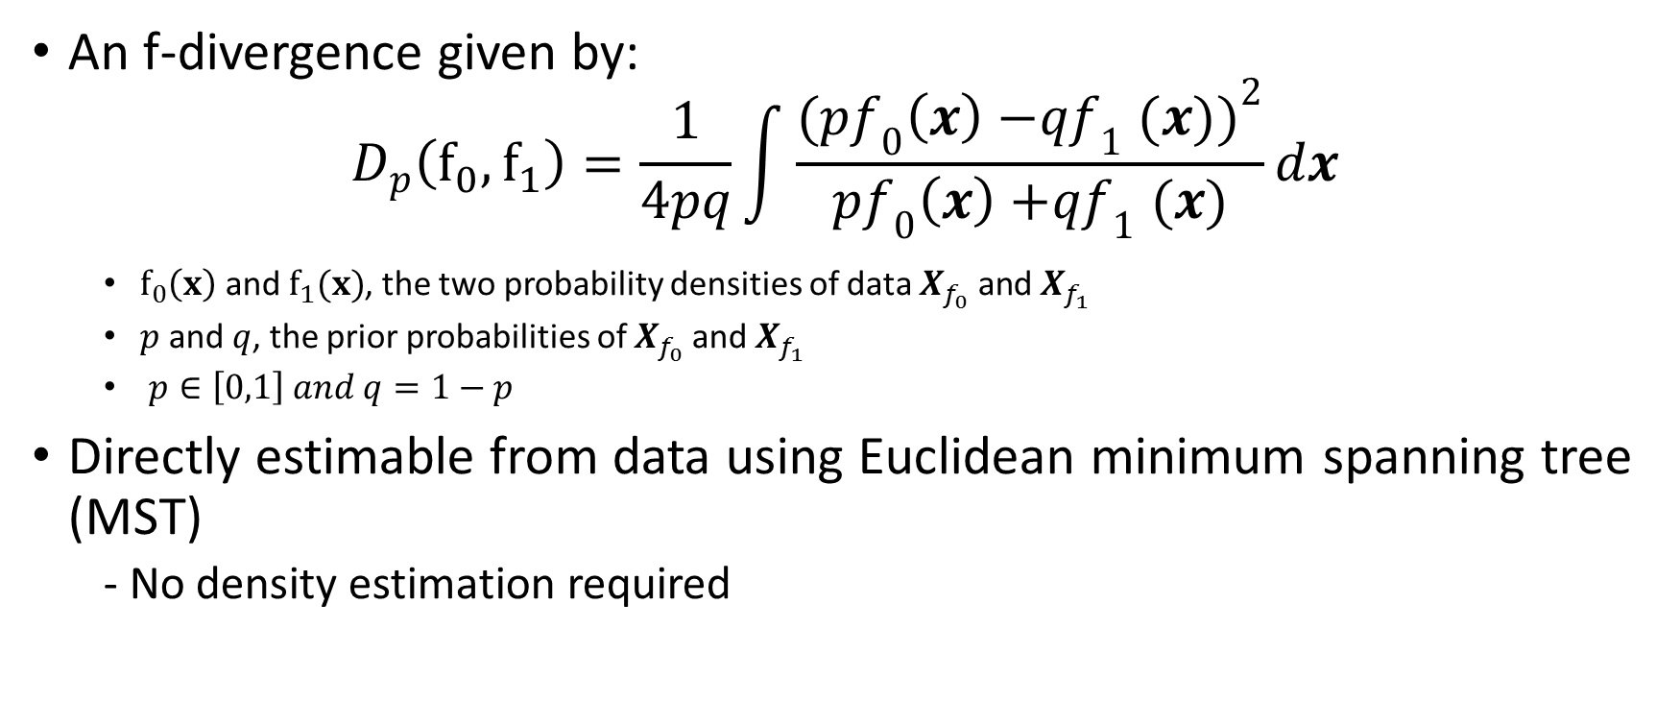

The $D_{p}$ Divergence
An f-divergence given by:
$$D_{p}\left(f_{0},f_{1}\right)=\frac{1}{4pq}\int{\frac{{(pf_{0}\left(x\right){−qf}_{1}(x))}^{2}}{pf_{0}\left(x\right){+qf}_{1}(x)}}dx$$
$f_{0}\left(x\right)$ and $f_{1}(x)$, the two probability densities of data $X_{f_{0}} \text{and}{ X}_{f_{1}}$
$p$ and $q$, the prior probabilities of $X_{f_{0}} \text{and}{ X}_{f_{1}}$
$p∈\left[0,1\right] and q=1−p$
Directly estimable from data using Euclidean minimum spanning tree (MST)
- No density estimation required

Slide 7

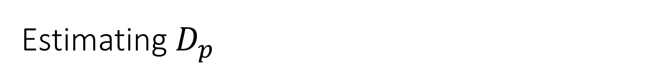
Estimating $D_{p}$
The estimator for $D_{p}$is:
$1−2\frac{𝒞\left(X_{f_{0}},{ X}_{f_{1}}\right)}{N_{f_{0}}+N_{f_{1}}}$ ⟶ $D_{p}$ as $N_{f_{0}}\text{⟶}$∞ and $N_{f_{0}}\text{⟶}$∞

Slide 8
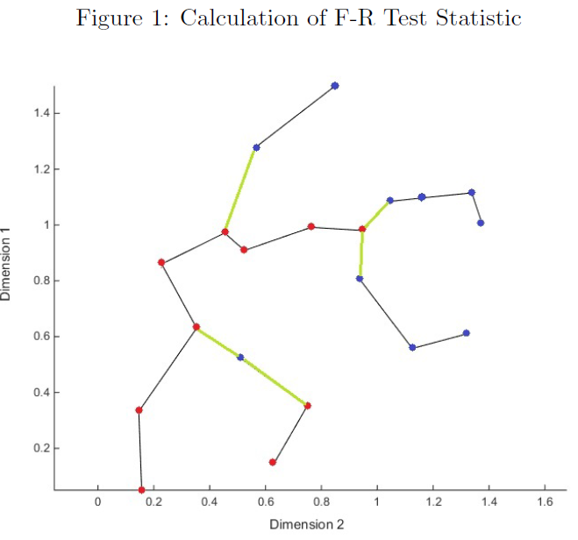




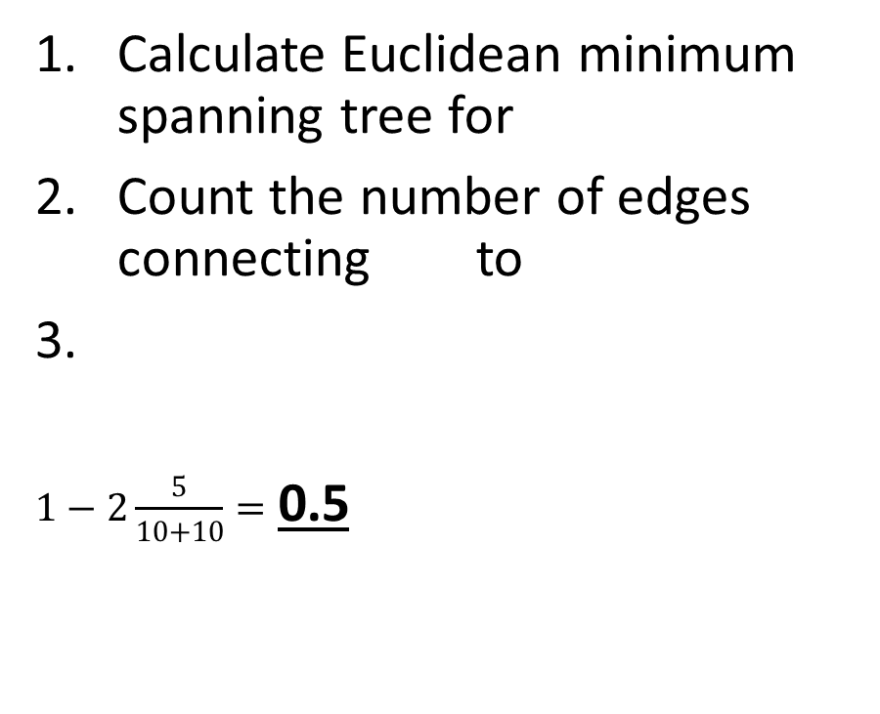
F-R Test Statistic
Calculate Euclidean minimum spanning tree for
Count the number of edges connecting to
$1−2\frac{5}{10+10}=$ 0.5

Slide 9
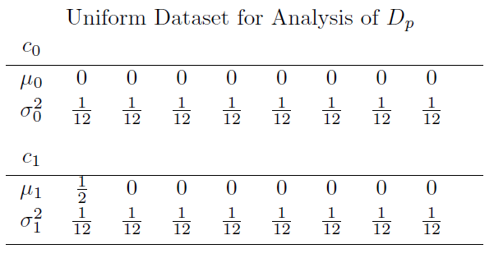
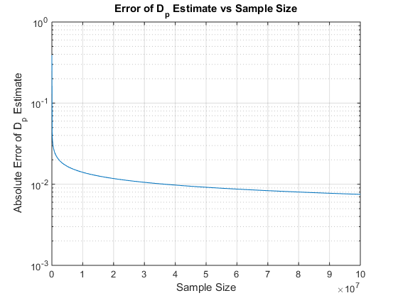
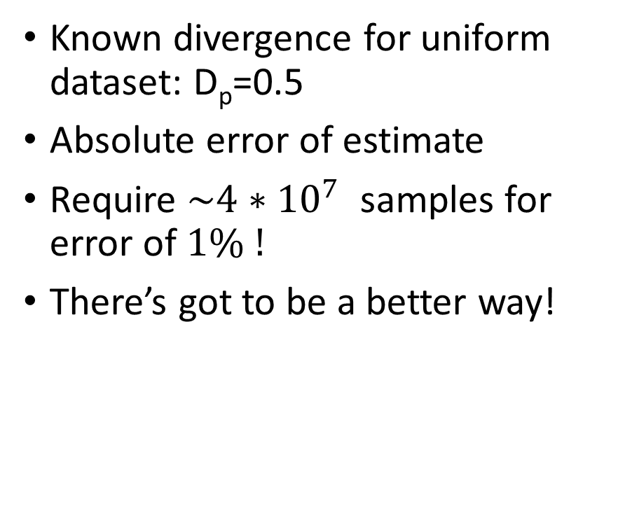
Convergence Rate
Known divergence for uniform dataset: D_{p}=0.5
Absolute error of estimate
Require $\sim 4∗{10}^{7}$ samples for error of $1\% !$
There’s got to be a better way!

Slide 10
Bayes Error Rate

Slide 11
Power Law Formulation
Hawes et. al.

