Slide 1
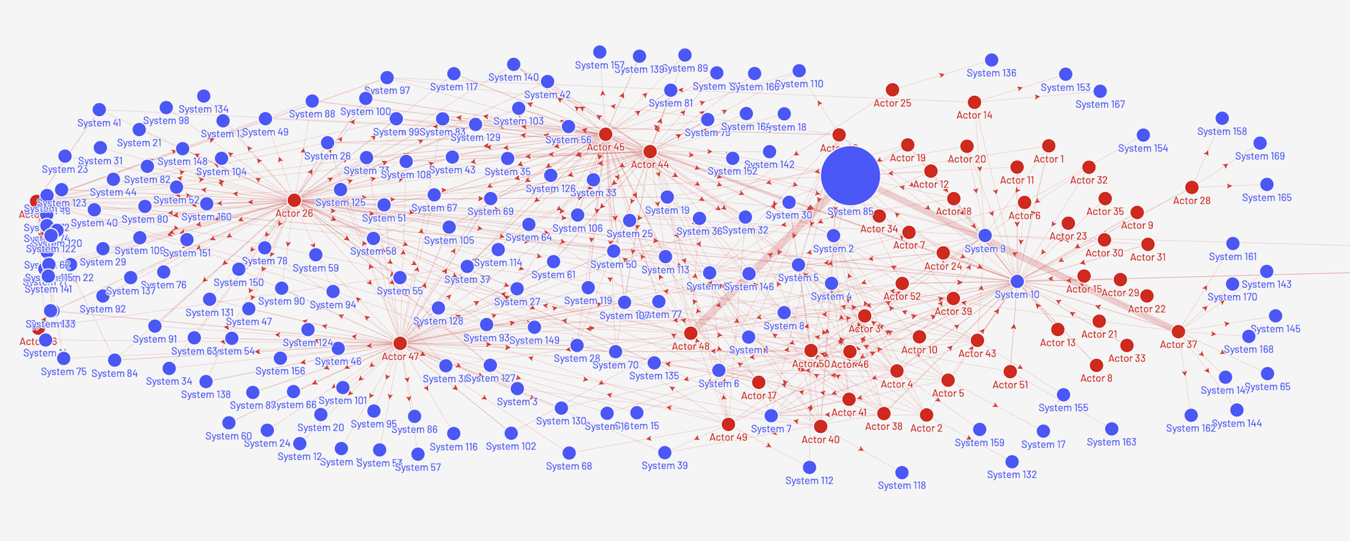
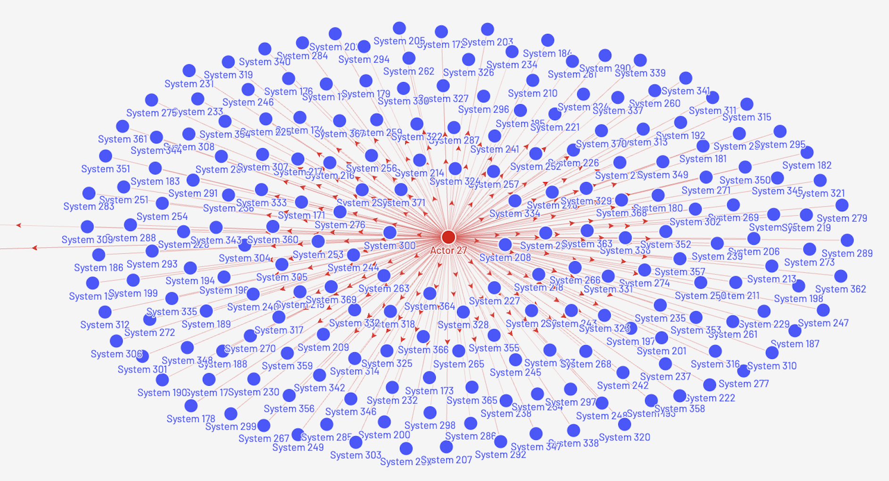
● 52 external IP addresses attempting unauthorized access to ● 371 SLAC nodes

