Slide 1

Supermarket Sales Trend Analysis
BDM Capstone Project
IIT Madras, BS degree
-Pratyush Kala
23f1002374

Slide 2
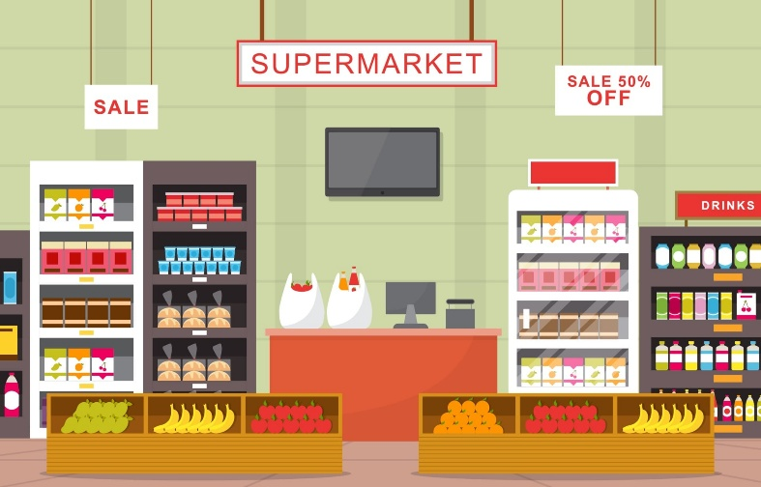

Business Overview
The dataset I used for this project is from Kaggle.com by the author Aung Pyae.
The organization that I am analyzing for this project is a supermarket chain based in Myanmar. The supermarket operates across three branches located in different cities (Yangon, Naypyitaw, Mandalay). We will be analyzing sales data of these branches from January to March 2019

Slide 3





Data Cleaning & Preparation
Preprocessing Steps:
Handled inconsistent date formats (using python)
Derived new columns like Month-Year (using python)
Removed Duplicates and validated data integrity
Tools Used: Excel, Python, VSCode, Google Colab
Methods Applied:
- Pareto Analysis for top products/customers
- Customer Feedback Evaluation
- Time Series Trend Analysis
- Demand Forecasting (ARIMA, SARIMA)

Slide 4
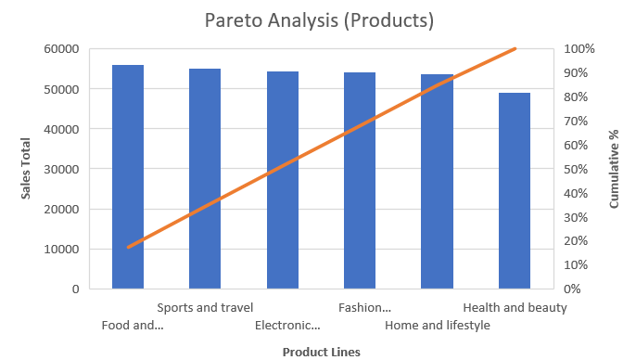
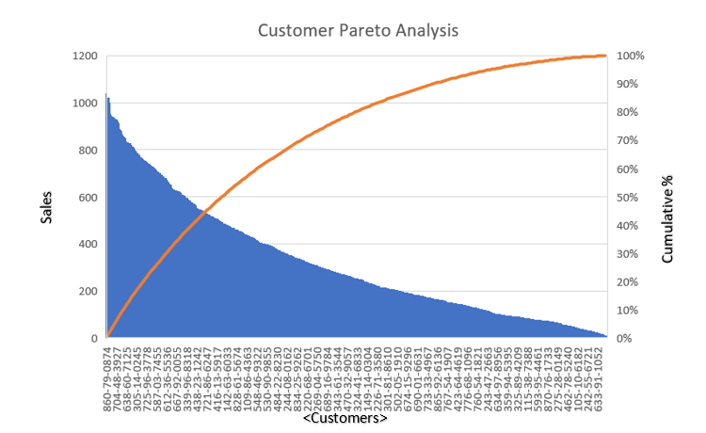
Pareto Analysis
The 80/20 principle of the Pareto analysis did not hold true in this analysis. This means the revenue is spread pretty evenly between different customers and products.
Neither a small percentage of products nor of customers was responsible for the majority of purchases/revenue.
Interpretation: Revenue are spread evenly among the 6 different product lines. It’s also fairly evenly distributed among customers.

Slide 5
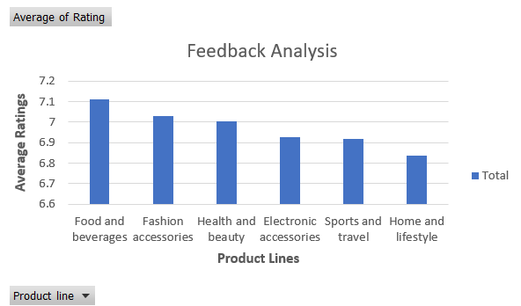
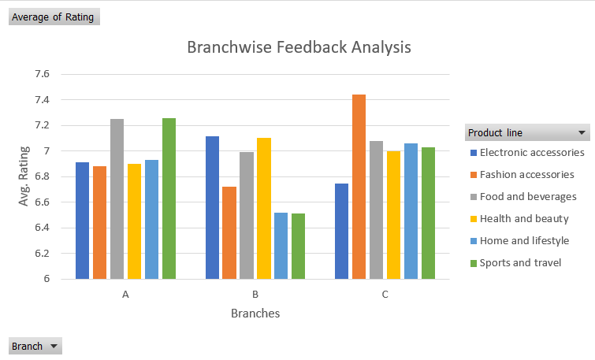
Feedback Analysis
The feedback analysis was done using a rating given by the customers on a scale of 1 to 10 and they were compared in consideration to the product line of the customer’s purchase
Interpretations:
The Home & lifestyle products need some improvement
The Food & Beverages products need attention as the lead products (better inventory management and stock) as they have the most positive reviews
Branch B has the harshest reviews so its services need to be reassessed.

Slide 6
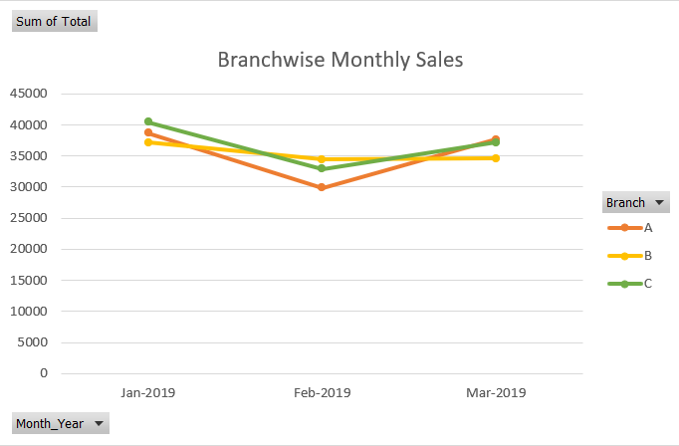
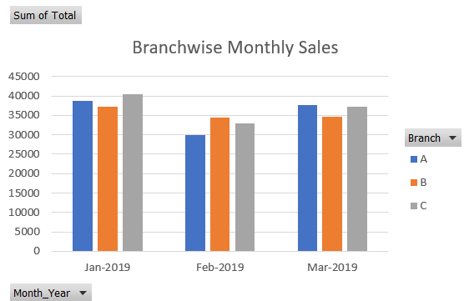
Monthly Sales Trend Analysis
Interpretations:
Sales peaked in January indicating a possibility of post-holiday increase in demand.
Sales saw a dip in February indicating seasonal drop followed by a recovery in March.
All three branches are contributing similarly to overall revenue, but Branch C consistently recorded the highest monthly sales.

Slide 7
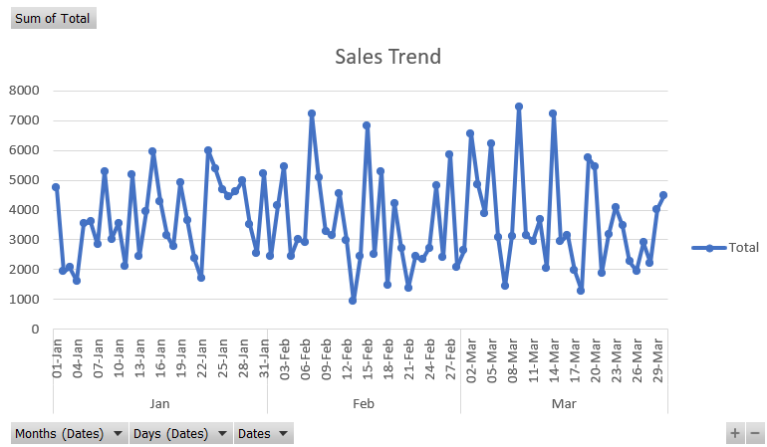
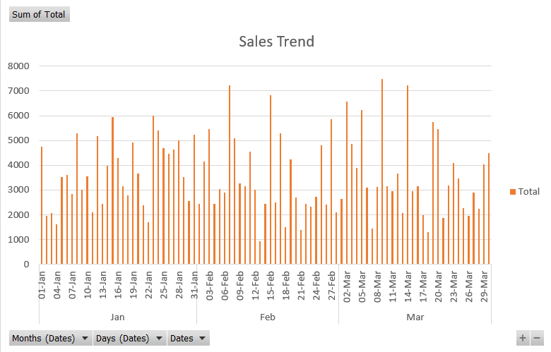
Daily Sales Trend Analysis
Interpretations:
Sales peaked mid-month for all the 3 months which suggests that people demand and purchase supplies during the 2nd and 3rd weeks of the month.
Supply of goods and inventory management should be planned keeping this in mind.

Slide 8
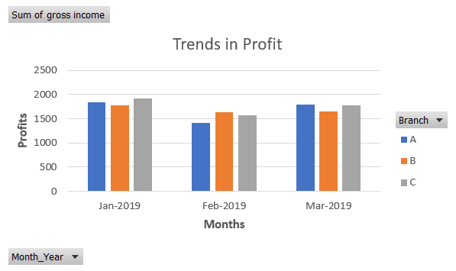
Trends in Profit
Interpretations:
Profit trends mirror sales trends, implying that costs (e.g., inventory, staffing) are well-managed relative to revenue, but further cost optimization and profit maximization should be explored
Supply of goods and inventory management should be planned keeping this in mind.

Slide 9
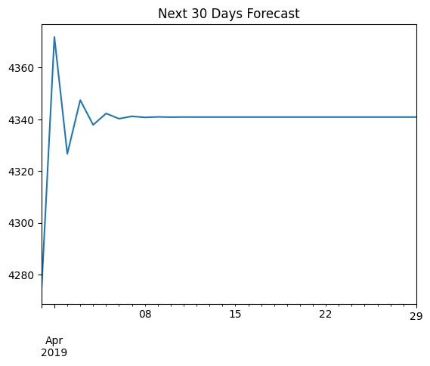
ARIMA forecasting
Interpretations:
The first few days show noticeable fluctuations in forecasted sales.
From around April 8 onward, the forecast flattens out, indicating the model expects sales to remain steady; indicating the model did not detect strong seasonal or upward/downward trends beyond the short term

Slide 10
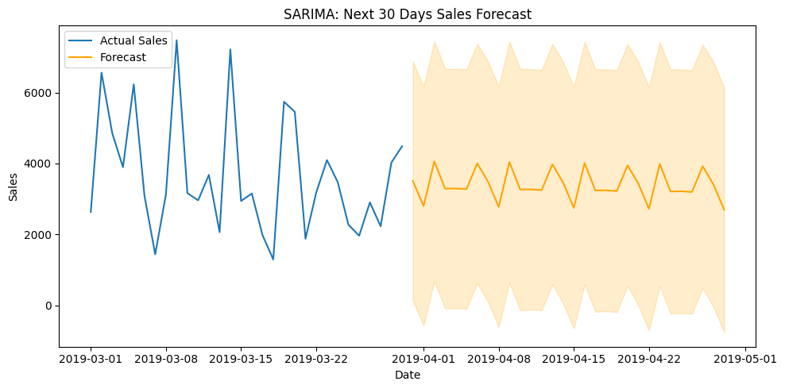
SARIMA forecasting
Interpretations:
Displays a repeating weekly wave-like pattern, suggesting the model learned the weekly seasonality from March; The line is smoother than actual sales, as SARIMA focuses on underlying patterns and ignores random noise.
Shaded Region (confidence interval) is wide suggesting uncertainty, possibly due to volatility in the training data.

Slide 11


Strategic Summary Recommendations
1. Balanced Revenue Distribution
Maintain consistent quality & stock across all categories
Avoid relying on select products/customers
Use purchase history for personalized promotions
2. Feedback-Driven Improvement
Improve Home & Lifestyle (layout, product variety, staff training)
Apply Food & Beverages strategies across departments
Use feedback to refine product mix and customer experience
3. Demand Forecasting
Align inventory & staffing with monthly/daily sales trends
Focus marketing around mid-month peaks
Adopt flexible staffing based on forecasted demand
4. Enhanced Data Collection
Upgrade POS & launch loyalty programs
Store long-term sales/customer data
Promote digital receipts for deeper insights
5. Profit Margin Optimization
Review pricing & supplier contracts
Introduce high-margin/private-label products
Use margin data to guide product placement & offers

Slide 12


