Slide 1

Machine Learning

Slide 2
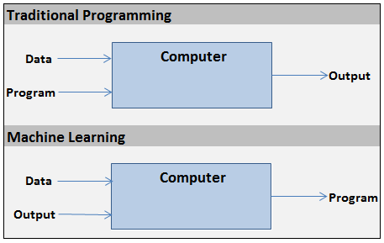
What is it?
Type of analytics where models make/tune themselves.
Really fast math.

Slide 3
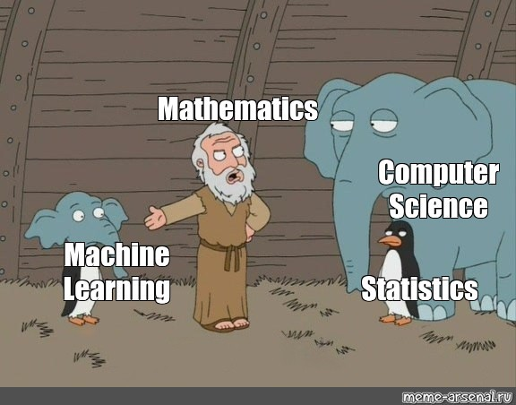
What is it?
Union of Math and Computer Science
Adjusting parameters until they output acceptable values

Slide 4
ML Applications
Image recognition
Time series
Speech recognition
Siri
Natural language processing
If Harry Potter was written by an ai:
https://towardsdatascience.com/if-harry-potter-was-written-by-an-ai-8a86049e8a06

Slide 5
Types of ML
Supervised
Regressions
Neural Networks
Random Forest / Decision Trees
Support Vector Machines
Unsupervised
Clustering (KMeans, KNearestNeighbors)
Reinforcement Learning
Genetic Programming / Evolutionary Algorithms
QLearning
Expert Systems
Tax systems (TurboTax, etc)
Hard coded, rule based, systems designed by field experts

Slide 6
Types of ML At PT
InvestmentGradeGMMCallable Horizon Pricing API
Regression
MDS ShapeManager Template Identification process
Expert System
CusipAssetTypeClassifier
RandomForest, SVM, NaiveBias, KNN
CIA Strategic Portfolio Spreadsheet
Expert System/Reinforcement Learning System

Slide 7
ML Project Roadmap
Problem Definition
Data Collection
Feature Engineering
Model Implementation
Model Training
Model Evaluation
Model Saving

Slide 8
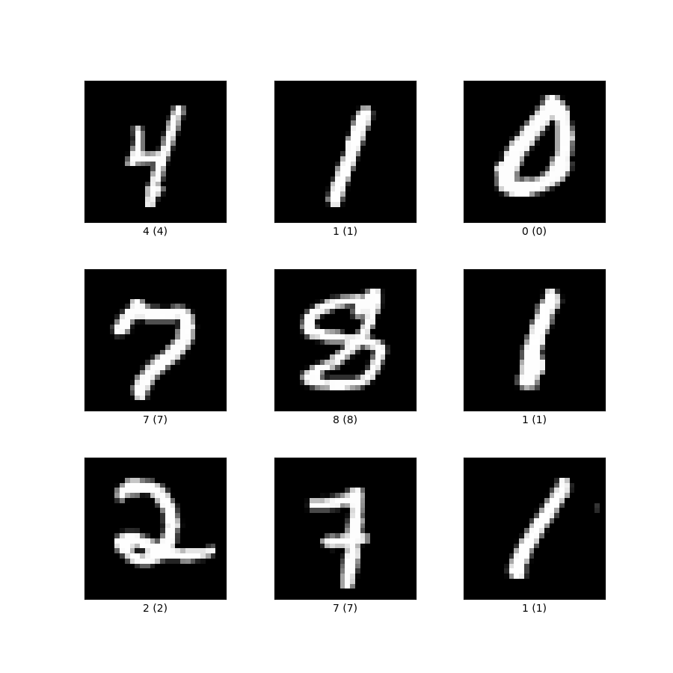
ML Project Roadmap
Boston Housing Regression
MNist Handwritten Image Classification
Given surrounding community housing attributes, I want to predict the price of a house in $1000s.
Given an image of a hand-written digit 0-9 with pixel values from 0-255, I want to determine the number drawn in the image.
Problem Definition
Data Collection
Feature Engineering
Model Implementation
Model Training
Model Evaluation
Model Saving
Attributes like:
Crime per capita
# of rooms in home
Distance to employment
Distance to highway
Pupil-teacher ratio
Etc.
https://www.cs.toronto.edu/~delve/data/boston/bostonDetail.html
https://www.kaggle.com/oddrationale/mnist-in-csv

Slide 9
ML Project Roadmap
Best practice is generally considered to have a tightly integrated ETL process, so data collection stays consistent. This also helps minimize issues like server failure, training halts, model fails to learn, etc.
How am I going to get this data?
API
Database
WWS
What format does it come in?
CSV
JSON
Bitmap
Stream
How will live (real world) data come in for prediction?
REST API call
Scheduler
Is the ETL process for training the same as live data?
Best practices suggests it should be
Problem Definition
Data Collection
Feature Engineering
Model Implementation
Model Training
Model Evaluation
Model Saving

Slide 10
ML Project Roadmap
Transform data so the model can interpret it and can more effectively learn.
Scale data
Normalization, Standardization
Split data into two sets, one for training, one for testing. Common to split into a training set with 75% of the original data and the remaining 25% for testing.
Split data
Kernel Trick
Add dimensionality to dataset.
Problem Definition
Data Collection
Feature Engineering
Model Implementation
Model Training
Model Evaluation
Model Saving
Layer Rows
Add the next row to the current row.
Pad Image
Add zeros surrounding an image
Reshape row
float[] -> float[,] or float[] -> float[,,]
Shuffle
Shuffle the rows of the dataset randomly
Batch
Group rows by n number to train in groups
Bag of Words
Transform text to numbers
Almost every project will involve scaling/splitting the data, this is considered best practice. The rest are not as common, but used and good to know.

Slide 11
ML Project Roadmap
What kind of ML model best fits my problem and data?
Regression
Neural Network
SupportVectorMachine
Random Forest
Kmeans Cluster
KNearestNeighbor Cluster
NaiveBias
PCA
ADAGradBoost
List goes on and on…
Pick hyper parameters for model.
Most models will have a whole host of hyperparameters
How much time do I have?
Some models (Deep Neural Networks) can take days to train.
Problem Definition
Data Collection
Feature Engineering
Model Implementation
Model Training
Model Evaluation
Model Saving
Just because a certain model is popular does NOT mean it is the best for your use case.

Slide 12

ML Project Roadmap
Training Loop
Inputs
Targets
Feed one row at a time through the model
Once every row a been fed through, the training loop has completed one `Epoch`
0, 0
0
1, 1
0
1, 0
1
0, 1
1
Problem Definition
Data Collection
Feature Engineering
Model Implementation
Model Training
Model Evaluation
Model Saving
Give one row to the model/parameters to get an output
Calculate output error
Input
Output
0, 0
0.7
Error
Target
Output
Error
-0.7
0
0.7
-0.7
User error to update parameters

Slide 13
ML Project Roadmap
Using testing data from the split in step #3.
Our model will need to be able to predict values based on real world data (unseen data).
How does it do on unseen data we have?
Problem Definition
Data Collection
Feature Engineering
Model Implementation
Model Training
Model Evaluation
Model Saving
Input
Output
0.7
Does my trained model produce acceptable results on testing data?
Yes
No
Move to final step #7
Move back to step #3

Slide 14
ML Project Roadmap
Where am I going to save a model?
Most of the time its hard to translate a model’s parameters to a relational database
NoSQL
JSON file
If I transformed the data (step #3), how can I ensure the live data will match the format of training data?
Store feature engineering parameters somehow
Problem Definition
Data Collection
Feature Engineering
Model Implementation
Model Training
Model Evaluation
Model Saving

Slide 15
Examples
Example code can be found: https://github.com/pkalivas/Demo.ML

