Slide 1

CITI BIKE DATA
Prediction of Bike Usage in New York City
By
Priyanka Ganeshan Kalmane

Slide 2
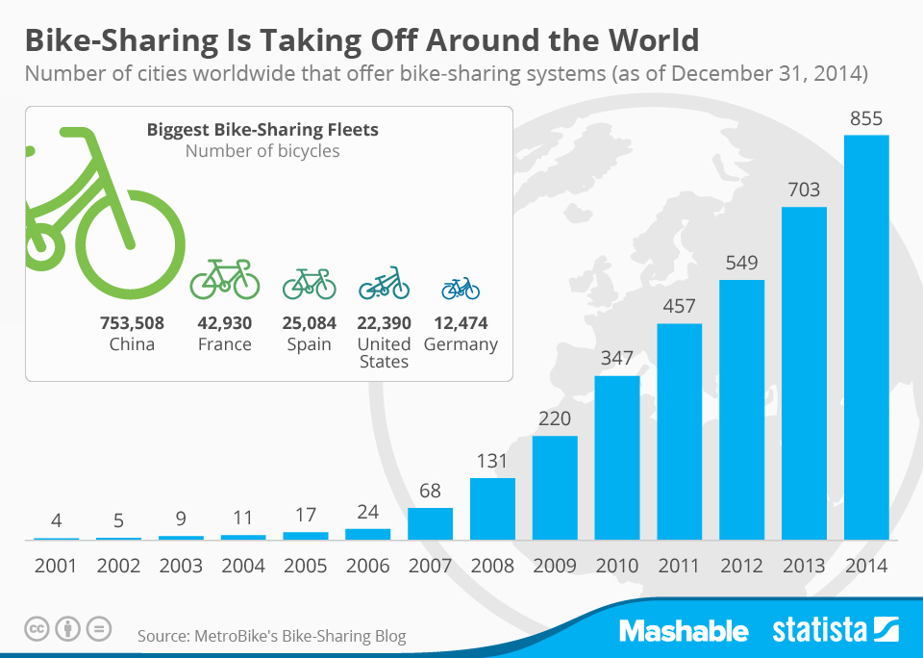
PROBLEM STATEMENT
Pick a bicycle at any self-serve bike-station and return the bike at any bike station located within system’s service area.
Studies about practical use of the systems.
Improving location-allocation of stations.
Impact of expansion of bicycle-sharing system on its usage.
Focus on expansion of system for original users’ ability to reach new areas and attracting new users to bike sharing systems.
Goal : “Predicting the bike usage demand.”

Slide 3
DATA SOURCE AND DESCRIPTION
https://www.citibikenyc.com/system-data
The data includes: Trip Duration (seconds) ;Start Time and Date; Stop Time and Date; Start Station Name; End Station Name; Station ID; Station Lat/Long; Bike ID; User Type (Customer = 24-hour pass or 7-day pass user; Subscriber = Annual Member); Gender (Zero=unknown; 1=male; 2=female); Year of Birth
Comprises data for the year 2016 – Zip file with 12 different CSV files for each month
Total number of observations : 13845655

Slide 4
DATA TRANSFORMATION
Quarterly Analysis
Feature creation – Rush hour demand
Processing of raw data to get number of trips:
Start station level
Rush start hour
Outlier removal : Age, Unknown gender
Calculating distance from coordinate data
Including climate data (Temperature)
Speed calculation

Slide 5
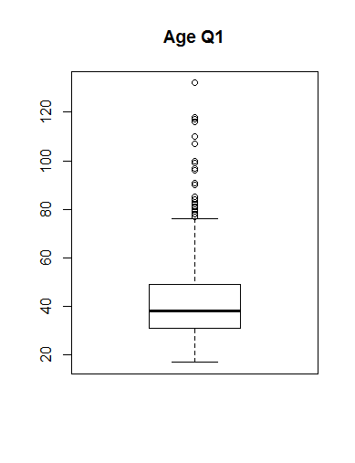
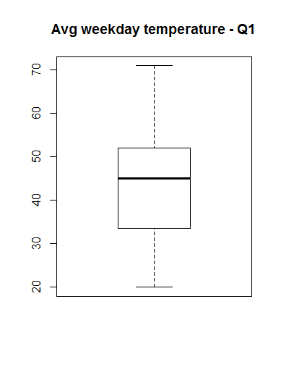
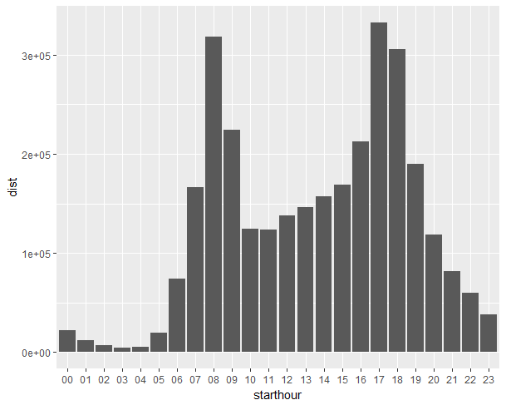
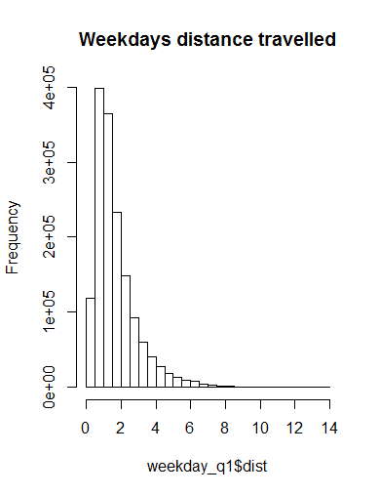
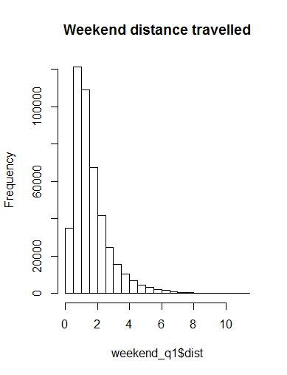
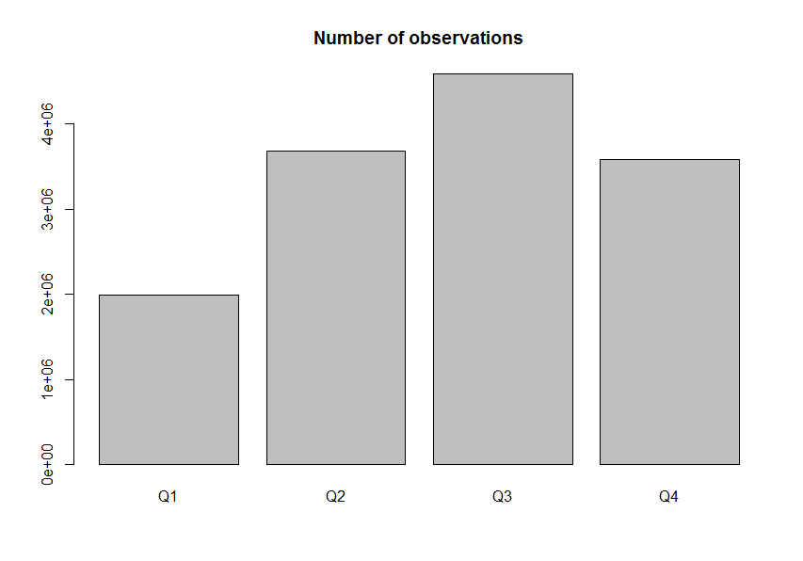
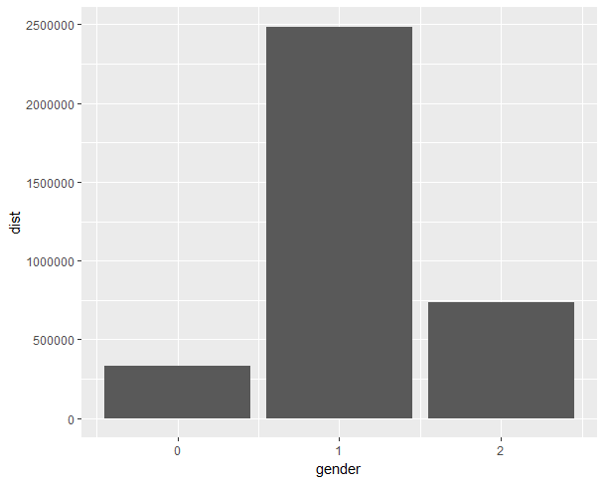
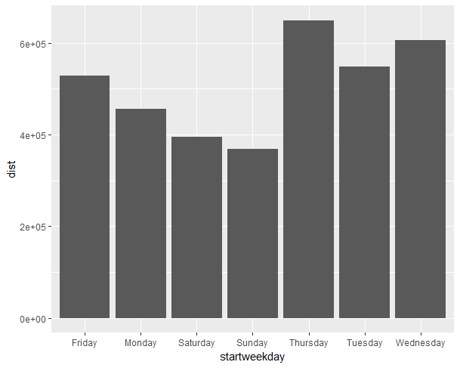
EXPLORATORY DATA ANALYSIS

Slide 6
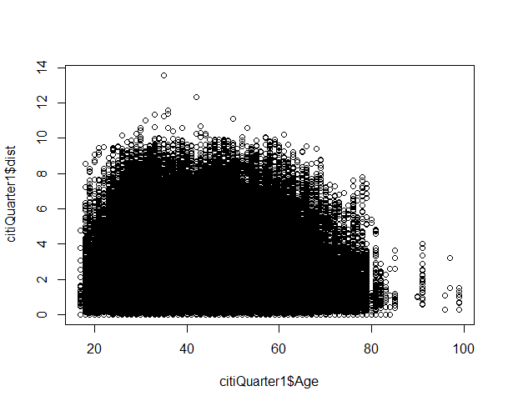
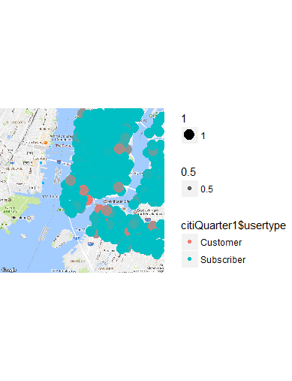
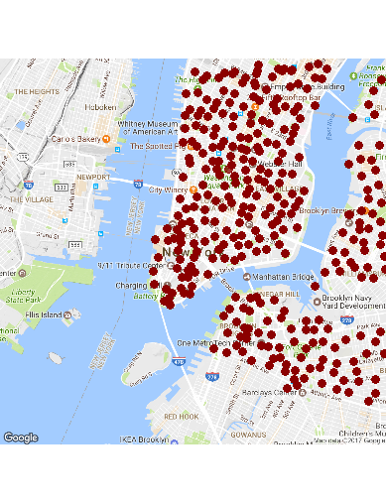
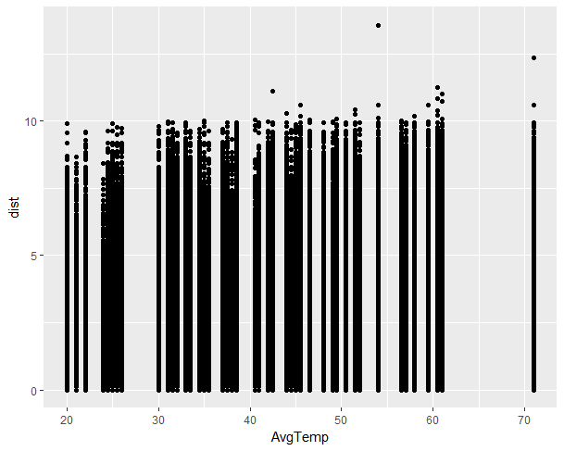
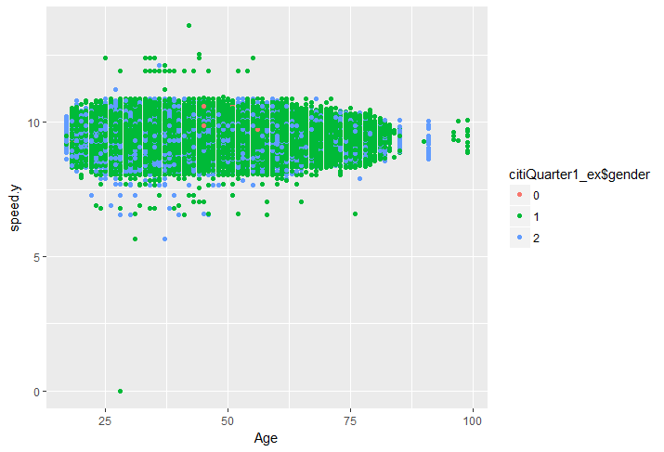
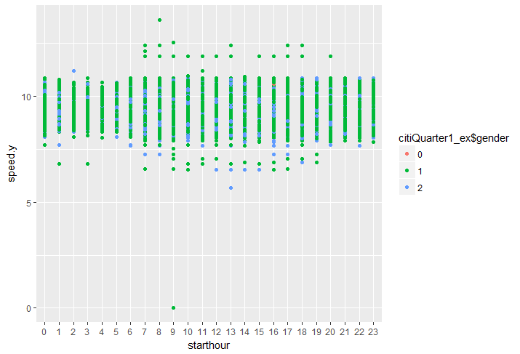
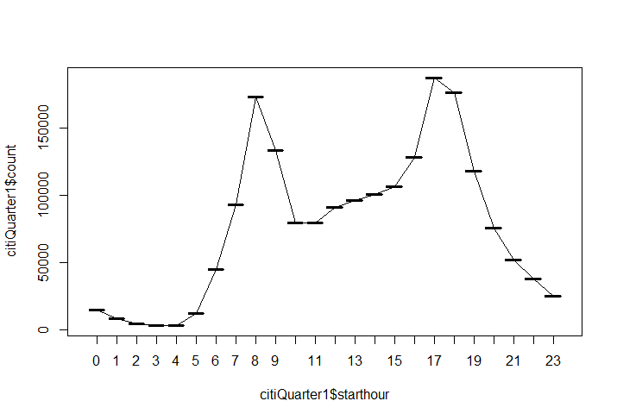
EXPLORATORY DATA ANALYSIS (2)

Slide 7
Modeling technique 1
Hypothesis: “Stations have an impact on bike usage demand”
Multivariate regression
Analysis at station level
Dependent variable : Raw data processed to obtain the number of trips between start station – end station pair
Independent variables: Trip duration, age, gender, Max temperature, Min temperature, start hour, week, month
R-squared value : 0.165 P-value< 2.2*10⁻⁶
“Extremely low R-squared value and P-value. Hypothesis accepted.
Change in modeling technique required”

Slide 8
Modeling technique 2
Hypothesis: “Start hour has an impact on bike usage demand”
Linear regression with interaction & step wise regression
Analysis at Rush hour level
Dependent variable : Raw data processed to obtain the number of trips in a start hour-day pair.
PCR carried out to check for dimensionality reduction.
R-squared: 0.775 P-value< 2.2*10⁻⁶
Cross validation technique
“Hypothesis accepted. PCR shows no considerable reduction in dimensionality – 22 components found”

Slide 9
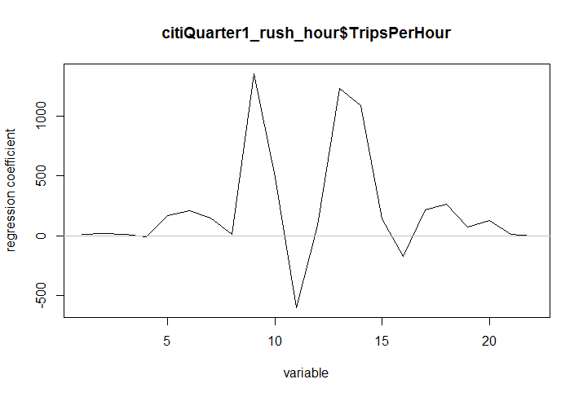
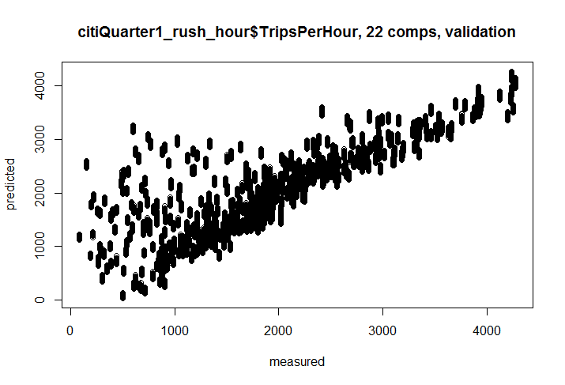
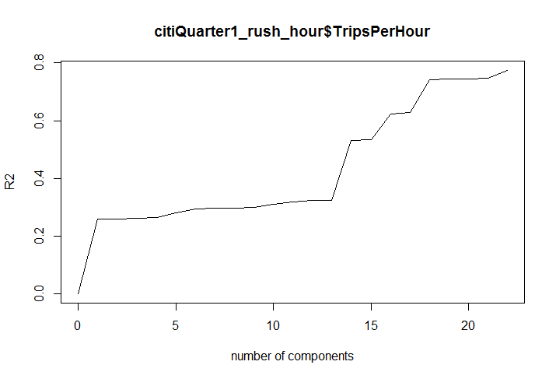
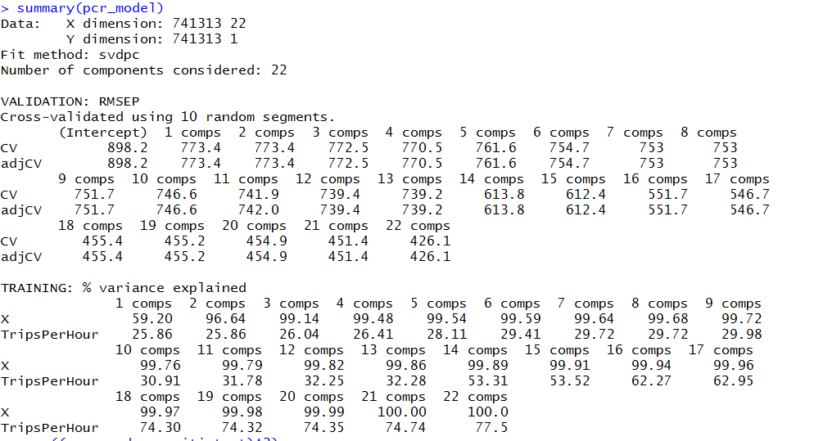
Results

Slide 10
Future goals
Analysis at Climate level
Consider wet days & dry days
Analysis at neighborhood level
Trips between Manhattan to Brooklyn and vice versa
Munge taxi usage data to increase number of data points for analysis
Analysis of summer season – usage is maximum

Slide 11
Conclusion
Goodness of fit – good. Possibility of multicollinearity.
Prediction of bike usage demand during rush hour.
Efficient allocation of resources.
Resulting in maximizing number of bike trips.

Slide 12
THANK YOU! Questions?

