Slide 1

How can our company find the best employee?

Slide 2

Agenda
About Us
Part1: Predictability
Problem Understanding
Solution Approach
Results
Part2: Classification
Problem Understanding
Baseline Analysis
Solution Approach
Results
Key Takeaways

Slide 3

ABOUT US
DANIEL WATSON
ANURAG KAUSHIK
SUJAY NAGVEKAR
JARROD KOSTICK
PRIYANKA KALMANE

Slide 4
Predictability
1

Slide 5
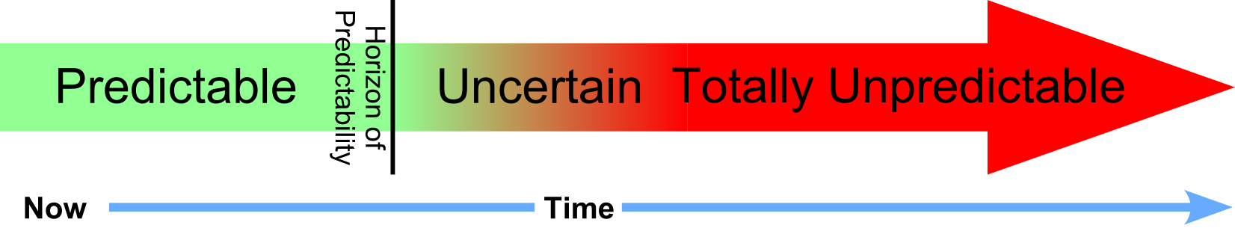
1st Problem Statement
“Is Outmatch improving predictability through their manual weighting approach or are they hurting themselves”

Slide 6
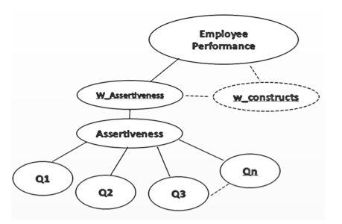
Context of the Problem
Incumbent employee survey data is collected
Question responses are pulled together in raw score for individual personality constructs
Each construct is analyzed through simple mean comparison, correlation, and regression
These results are then used to create a weighted score for each construct to be used in final analysis

Slide 7
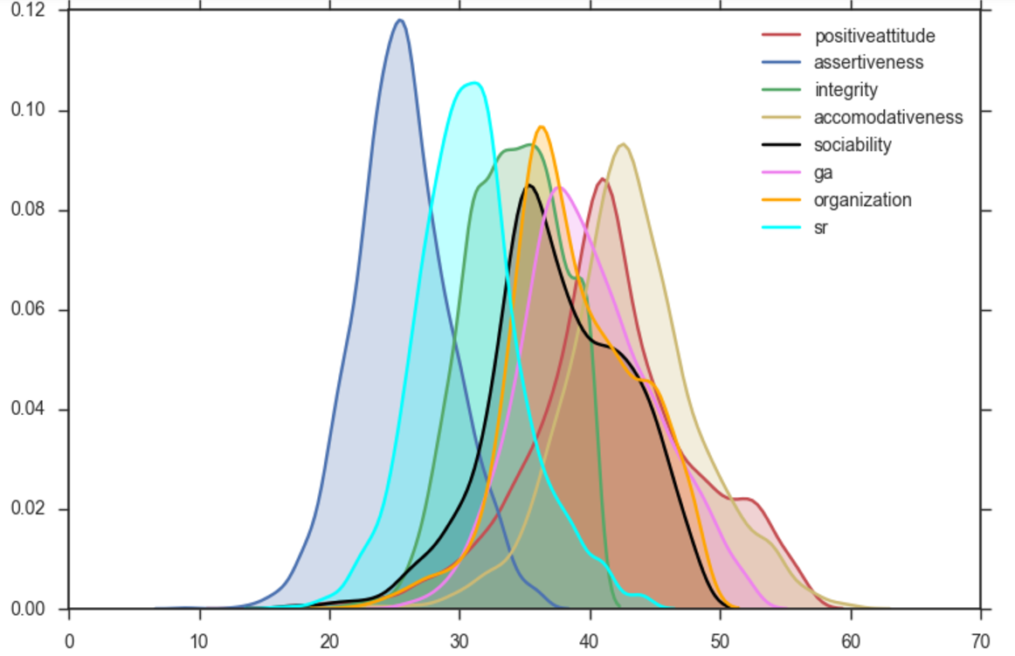
The Independent Variables
Positive Attitude
Assertiveness
Integrity
Accomodativeness
Sociability
Work Intensity
Organization
Work Ethic

Slide 8
Our Modeling Approach
GOAL:
Test to see if we lose predictive power using weighted data over raw data over individual attribute data
Step 1
Identify highly predictive personality traits through regression
Step 2
Collect attribute, raw, and weighted data for each personality trait
Step 3
Select a variety of different modeling techniques IE: regression vs classification and divide data set in 80% test, 20% train
Step 4
Run model 3 times for each data point IE:
Assert Attr vs Z-Overall
Assert Raw vs Z-Overall
Assert Wt vs Z-Overall
Step 5
Repeat Step 4 for each modeling technique across each predictive personality trait
Step 6
Collect and analyze results via classification accuracy

Slide 9
Key Predictive Traits
Models Used
Accommodation
Work Intensity
Organization
01
Linear
02
Random Forest
03
Rpart
04
Smote KKNN

Slide 10
Classification Accuracy
Step 1
Divide the Z-Overall Rating into Top 20, Middle 60 and Bottom 20 Quantiles
Bottom 20%
Middle 60%
Top 20%
Step 2
Recode the 3 classes into 1,2 and 3 respectively
Step 3
Utilize confusion matrices to calculate accuracies based on correct versus incorrect predictions
Notes:
Briefly mention this concept early to describe accuracy results, then mention how the process will be described later

Slide 11
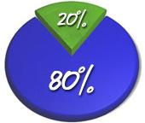
Top 20%
We chose to analyze our results on classifying the best employees as these are the most desirable group to an organization

Slide 12
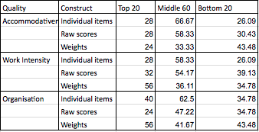
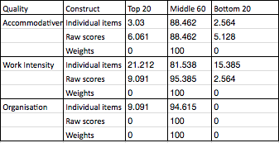
Accuracy Results
LINEAR MODEL
RANDOM FOREST
Notes:
Added charts with an animation so we can see both the numerical and the graphical results

Slide 13
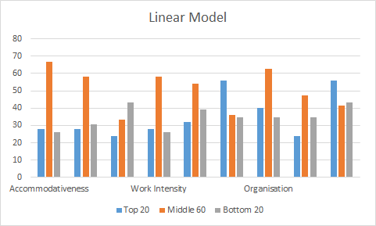
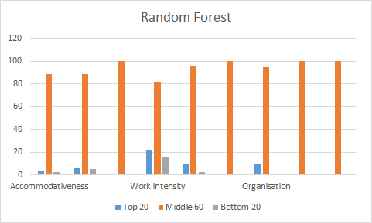
Accuracy Results
LINEAR MODEL
RANDOM FOREST
Items Raw Weights
Items Raw Weights
Items Raw Weights
Items Raw Weights
Items Raw Weights
Items Raw Weights
Weights raw item
Weights raw item
Weights raw item
Weights raw item
Weights raw item
Items Raw Weights
Weights raw item
Weights raw item
Notes:
Added charts with an animation so we can see both the numerical and the graphical results

Slide 14
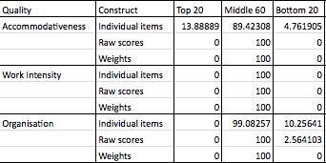
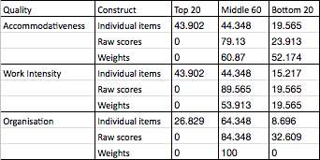
Accuracy Results
RPART
SMOTE KKNN
Notes:
Added charts with an animation so we can see both the numerical and the graphical results

Slide 15
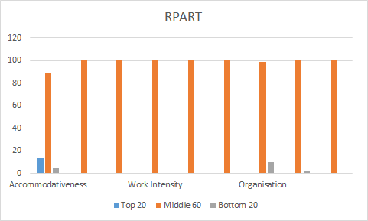
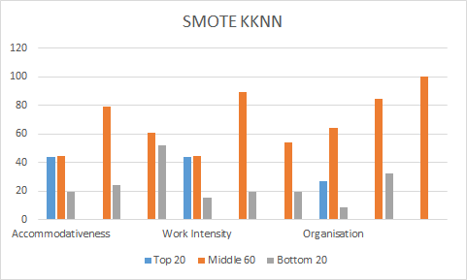
Accuracy Results
RPART
SMOTE KKNN
Items Raw Weights
Items Raw Weights
Items Raw Weights
Items Raw Weights
Items Raw Weights
Items Raw Weights
Notes:
Added charts with an animation so we can see both the numerical and the graphical results

Slide 16
Key Insights
Individual items perform better than the Weighted approach on most models

Slide 17
Employee Classification
2

Slide 18
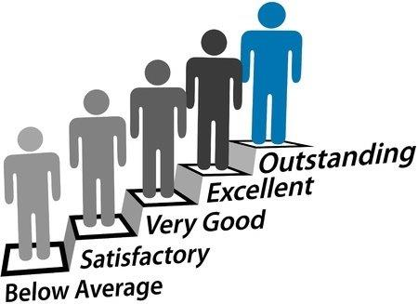
2nd Problem Statement
Can we use modern machine learning techniques and models to better classify potential employees as good, average, or bad

Slide 19

Context of the Problem
All the employees are given a supervisor rating
These ratings are normalised called “Z-Overall rating” ranges between -2.6 to 3.1
Employees will be classified based on the Z-Overall rating

Slide 20
Outmatch Approach
GOAL:
Use Outmatch’s prediction approach to operate as a Baseline Model to judge our models against
Step 1
Run linear regression on weighted values versus Z-overall
Step 2
Analyze beta coefficients produced by regression results
Step 3
Sum beta coefficients, ignoring negative coefficients
Step 4
Divide beta coefficient for each construct by their sum to create a new construct weight
Step 5
Use the new coefficient weights to multiply our previous weighted values to predict Overall Fit
Step 6
Reclassify overall fit into three classes to calculate accuracy

Slide 21
Outmatch Baseline Accuracy
Bottom 20%
Middle 60%
Top 20%
36.75%
58.19%
31.97%

Slide 22
Our Approach
GOAL:
Classify employees into Top 20, Middle 60 and Bottom 20 using classification machine learning techniques
Step 1
Divide the Z-Overall Rating into Top 20, Middle 60 and Bottom 20 Quantiles
Step 2
Recode the 3 classes into 1,2 and 3 respectively
Step 3
Use Raw scores as independent variables and Z-Overall as dependent variables and divide data set in 80% test, 20% train
Step 4
Run classification algorithms such as SMOTE KKNN, SMOTE SVM etc
Step 5
Repeat Step 3 and Step 4 using Weighted scores as independent variables and Z-Overall as Dependent variable
Step 6
Collect and analyze results via classification accuracy

Slide 23
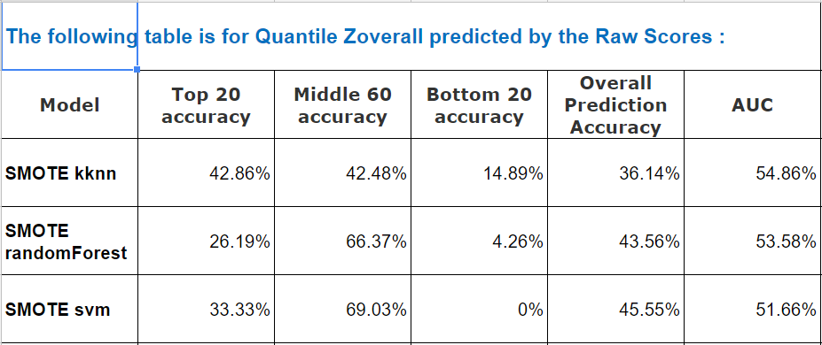
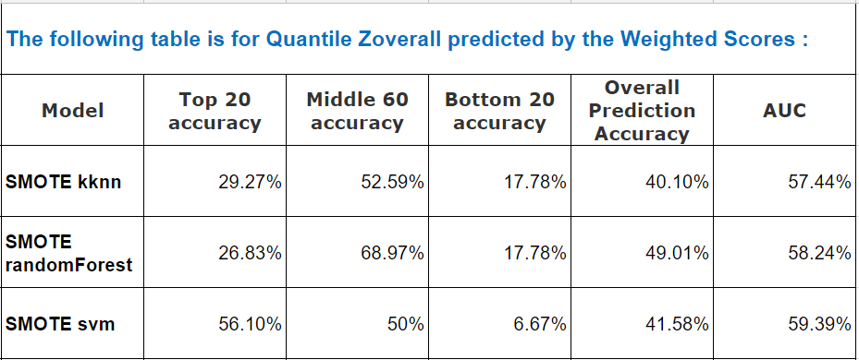
Classification Results
SMOTE KKNN is the most successful at predicting the top 20% for Raw sores
SMOTE svm is the most successful at predicting top 20% for weighted scores
Notes:
Added charts with an animation so we can see both the numerical and the graphical results

Slide 24
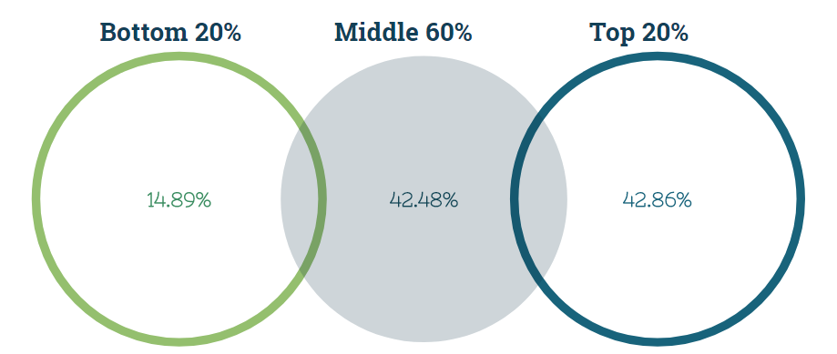
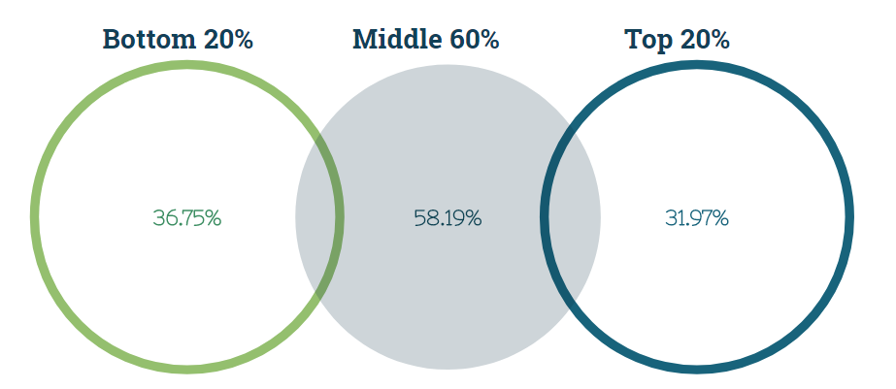
Final Comparison Results
Best Model: Smote KKNN
Outmatch Baseline
Versus
Notes:
Added charts with an animation so we can see both the numerical and the graphical results

Slide 25
Key Takeaways
Found models to improve on Top 20% accuracy
SMOTE KKNN performs best for Raw Scores
Validated the accuracy of the current model
Notes:
Added charts with an animation so we can see both the numerical and the graphical results

Slide 26

Any Questions?

