Slide 1
Applications Presentation
Public Sector Attachment

Slide 2

Content
Objective
Ministry ICT Structure
Projects in the Ministries
Skills acquired in the Public Sector
Supervisors and Mentors
Challenges/Observations
Recommendations
Appendix
1
2
3
4
5
6
7
8

Slide 3
Objective
To be a world renowned institution with state of the act technology to enhance 95% uptime of both internal and external systems on a day to day basis.
To have the best technical response team to resolve complains within a 2-8 hour window if escalated, and to give 100% technical support to the commission on guidelines in improvement of ICT systems and the infrastructure based on international trends and best practices.
Reduction of knowledge gaps by Improving information and communication systems

Slide 4
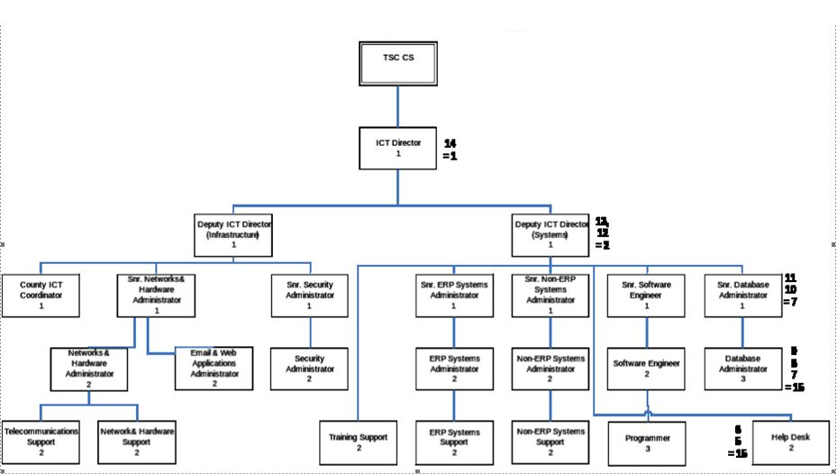
Ministry ICT Structure
TEACHERS SERVICE COMMISSION ICT ORGANISATIONAL STRUCTURE

Slide 5
Projects in the Ministries
Project Name | Ministry Involved
HRMIS(Human Resource Management Information System) | Teachers Service Commission
Mayan EDMS(Electronic Document Management System) | Teachers Service Commission
Payroll System | Teachers Service Commission

Slide 6
Skills acquired in the Public Sector
Technical skills | Organization Skills | Trainings attended
ERP Administration | Time management | HRMIS Administration
Non ERP Administration | Prepare evidence monthly reports | Big Data Developer

Slide 7
Supervisors and Mentors
Name of PDTP | Name of Supervisor | Name of Mentor
Michael Muketha | Lisbeth Kageni Miriti | Jon Lenchner IBM
 | Ann Njagi

Slide 8
Challenges/Observations
Technology | People | Process
Assigned new tasks and learn the concepts alone. | Adopting to new organizational culture. | Inadequate follow up process on assigned tasks.
Impromptu requests to do presentations on functionality of the Commission’s applications |  | Job description documentation isn’t well described.

Slide 9
Recommendations
Technology | People | Process
Organizations should assign an intern personnel that they can shadow to teach and learn intensively from each other. | Managers and supervisors should be keen to ensure that interns are doing what is documented on the organizational job description | ICT Authority to visit the interns in their allocated workstations and acquire relevant information in line with the program, to validate our progress

Slide 10
Appendix 1: List of team members
Name of PDTP | Role in the team
Michael Muketha | Team Leader
Fridah Makena | Member
Emmanuel Ouko | Member
Jared Magut | Member
Elijah Nyakundi | Member
Abel Anagwe | Member

Slide 11
Appendix 2: List of Ministries Attached
Name of PDTP | Organization Attached
Michael Muketha | Teaches Service Commission

Slide 12
Appendix 3: List of Site visits and workshops attended
Visits/Workshops | Facilitating Organization
Capacity Building of Principals under GOK/AFDB ICT Program | Teachers Service Commission

Slide 13
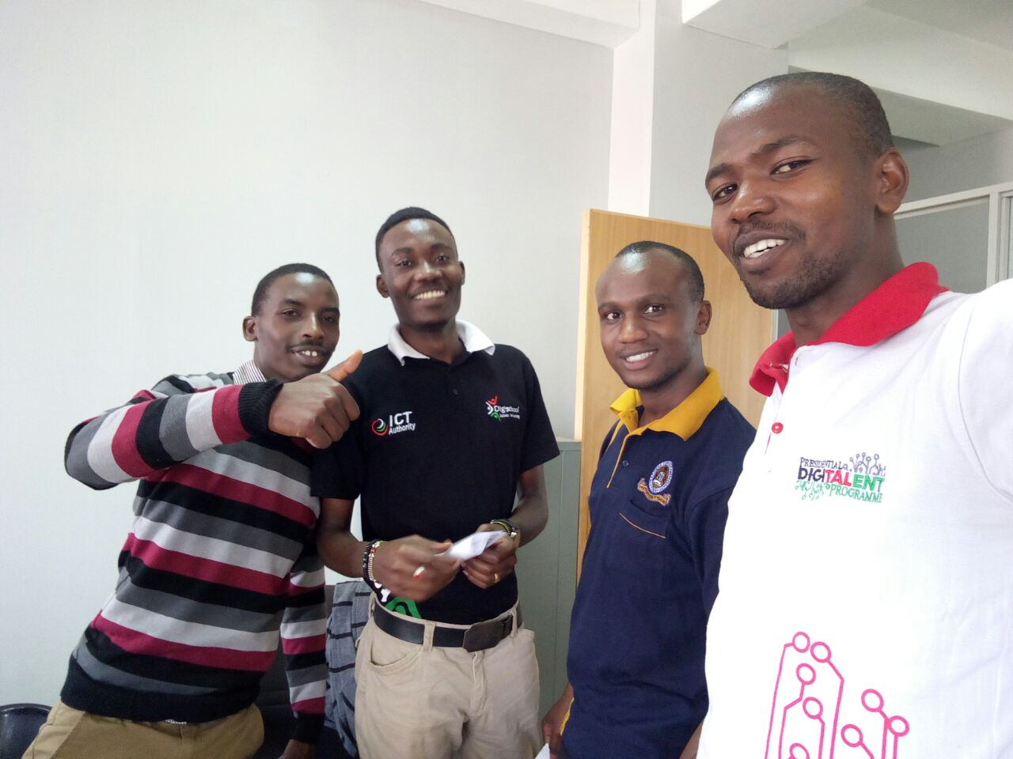
Appendix 4: Photos at the working organization or field work

