Slide 1
PDTP 2016 COHORT 2 SECOND QUARTER MEETING
PUBLIC SECTOR PLACEMENT NETWORKS EXPERIENCE REPORT JANUARY TO APRIL 2017
8TH TO 12TH 2017
PREPARED BY: EMMANUEL KOMU
ELVIS KIMEMIA

Slide 2
OBJECTIVES
ICT capacity development. This program is expected to develop ICT technical capacity in government for effective service delivery
Transforming the manner in which ICT is employed in support of effective service delivery.
Enabling the government to meet its service delivery objectives for the citizens.
Notes:
The government key objective is the effective service delivery to the citizens

Slide 3
OVERALL MINISTRY STRUCTURES AND VISIONS
The government of Kenya’s mandate is to provide effective service delivery to all Kenyan citizens irrespective of their social, cultural or religious background.
The MDA’s are currently deploying e-Government ICT infrastructure necessary for the provision of information and services to her citizens.
Consolidation and delivery of services online through multiple channels.

Slide 4
cs
PS
PS
Head of Finance
Director HRM
Head of Procurement
Head of Finance
Director HRM
Director-ICT
Head of Procurement
Director-ICT
Assistant Director
ICT Officers
Interns

Slide 5
KEY ICT PROJECTS
Ministry | Government Agency/Parastatal/State Department | Projects
Ministry of Information Communication Technology | ICT Authority | Digital Literacy Program(DLP) Presidential Digital Talent Program National Optic Fiber Interconnectivity(NOFBI)
Ministry of Treasury | Treasury | County Connectivity Project(CCP)
Judiciary | Judiciary | WIFI connectivity in all court stations

Slide 6
b) Types Of Systems In The MDA’s
a.) Treasury
Integrated Financial Management System- Used for procurement in all ministries and counties
e-Citizen Portal- Integrated system that allows government digital payments for Kenyan citizen s
b.) ICT Authority
e-Desk- This assists the AICTOs based at counties to communicate on one platform and enable them to submit their reports
Notes:
Judiciary Registry Queue and Customer Care System - The Judiciary has commenced a pilot project to set up public information centers in High Court stations and introduce queue management systems (QMS) as part of digitization with the objective of improving and achieving better and quality service delivery to citizens
Judiciary e-Diary System – It addresses challenges experienced in manual date fixing, closed diaries and publishing of the cause lists. This system enables litigants to continually take hearing dates throughout the year and automatically generates cause lists.

Slide 7
c.) Judiciary
Judiciary Automated Transcription System - facilitates the digital audio and video recording of court sessions and the preparation of transcripts.
Judicial Financial Management System - Enables all court stations facilities to manage their financial processes independent from the Treasury at both National and County level.
Judiciary e-Diary System
Judiciary Registry Queue and Customer Care System

Slide 8
Opportunities that exists for innovation for specific operational efficiency and service delivery
a.) Networking
Communications Services: Provide usable, reliable, secure email, messaging, and voice (VoIP) services.
Collaboration Services: Shared calendaring, groupware, personal encrypted backup folders, and file transfer services will be run in a Cloud.
Virtual Private Network: A Virtual Private Network (VPN) will provide an encrypted secure private network over the public internet infrastructure

Slide 9
b) Data Centers for every county
To provide disaster recovery capabilities in the event one is disabled, and secure seamless continuity of operations
Virtualization: Implement a server and resource virtualization infrastructure to fully implement the Cloud.
Security: Create a public key infrastructure to secure data in transit and at rest. Each data center to also be secured with the robust intrusion detection, intrusion prevention, anti-virus, firewall and security capabilities.

Slide 10
c.) Systems
Enterprise Resource Planning (ERP): Systems to manage core organizational functions such as finance, human resources, fixed assets and inventory/supply chain.
Customer Relationship Management (CRM): To help citizens seamlessly interact with the judiciary.
Integrated Case Management (ICM): Provide full lifecycle visibility into all cases; provide judicial officers and managers with metrics and performance statistics, and citizens with real-time access to their cases and matters before the courts.

Slide 11
Document Management and Archival Services: Provide public online access to public court archives.
d) Devices
Provide all staff with computing equipment on a Bring Your Own Device (BYOD) model.

Slide 12
SKILLS ACQUIRED IN THE PUBLIC SECTOR
a.) Technical skills
Problem solving and troubleshooting skills
Project management skills
Network installation and maintenance
ICT support skills
System development and analysis skills
Database management skills

Slide 13
b.) Organization skills
Planning
Time management skills
Prioritization of tasks
Oral communication and etiquette
Team work, delegation of roles and synergy
Task analysis and assessment
Budget creation
Reporting and presentation skills

Slide 14
What are the Challenges/issues / observation in terms of:
a.)Technology (Information Security issues (high-level),a network perspective , systems , etc.)
Some of the server rooms are not as per the IT standards requirement.
Other server room lacks proper air conditioning facility, electric fans to regulate the temperatures.
There are no maintenance tools and equipment thus a need to rely on head-quarters facilities to conduct periodic maintenance
Outdated hardware e.g computers with 512 MB RAM.
Obsolete software are still in use e.g Windows XP.
Lack of staffed ICT equipment inventory to provide servicing for existing systems

Slide 15
b.) People Issues
Majority of the staff at the registry lack ICT skills and knowledge
Urgent need for in house ICT staff at the different office locations.
Accountability of staff on the proper usage and maintenance of ICT equipment.
Need for training in the security of information both in hard and soft copy.

Slide 16
c.) Process issues
The MDA’s to automate their systems, there is too much bureacracy in acquiring ICT equipment when required/needed. This leaves the staff members lacking and frustrated as it affects their work.

Slide 17
Supervisors
Our supervisors are very experienced and really aggressive; for example, they suggest weekly meetings where we set targets for each new week. Challenges are addressed at this meetings and weekly work plans and deliverables are formulated to track progress.

Slide 18
Learned Experiences
Managerial skills
Leadership skills
Conflict resolution skills
Project management skills
Administrative skills

Slide 19
Recommendations
a.) Technology
The MDA’s should also incorporate best security technologies in the industry in order to safe guard their data to ensure there is authorized access to information, data confidentiality and accountability.
The respective MDA’s should strive to ensure that the systems at their headquarters are deployed to there respective MDA’s as this will help to streamline the flow of process and activities
We also propose that tough security measures such as biometric access systems should be employed in safe guarding the critical data which ranges from sensitive documents I each MDA.

Slide 20
b.) People
We recommend that staff should be taken through several trainings and workshops on ICT in order to handle tasks under the systems to be deployed. ICT authority should liaise with the MDA’s and have the trainings conducted frequently by the presidential digi-talent trainees
Make our mentors understand that we need their hearty and selfless support in stream-lining and developing our careers.

Slide 21
c.) Process
Tendering process to be done via an online system for transparency, accountability and easy tracking of the procurement processes(An e-procurement system)
For recruitment purposes we propose an online and automated method for recruitment i.e. an internal job application online portal instead of old fashioned hard copy.
At ICTA we should design a portal that can enable our supervisors to login and create their accounts and report via the accounts to avoid much of the paperwork that we encountered at the start of cohort II attachment.
Supervisors at various places of attachment to be enlightened about PDTP and its objectives before interns are deployed.

Slide 22
Appendix 1
List of teams:
EMMANUEL KOMU
ELVIS WANJAGI
KEVIN GESORA
KIPTOO KIPTAI

Slide 23
Appendix 2
Public sector organizations:
Government Digital payments(e-Citizen)
Konza Technopolis Development Authority
Office of the AG
Huduma centre
Postal Corporation
All the Ministries of Kenya

Slide 24
Appendix 3
Site visits and workshops attended at the public sector
Connect summit
Nairobi innovation week

Slide 25
Appendix 4
Photos at working organization or fieldwork

Slide 26
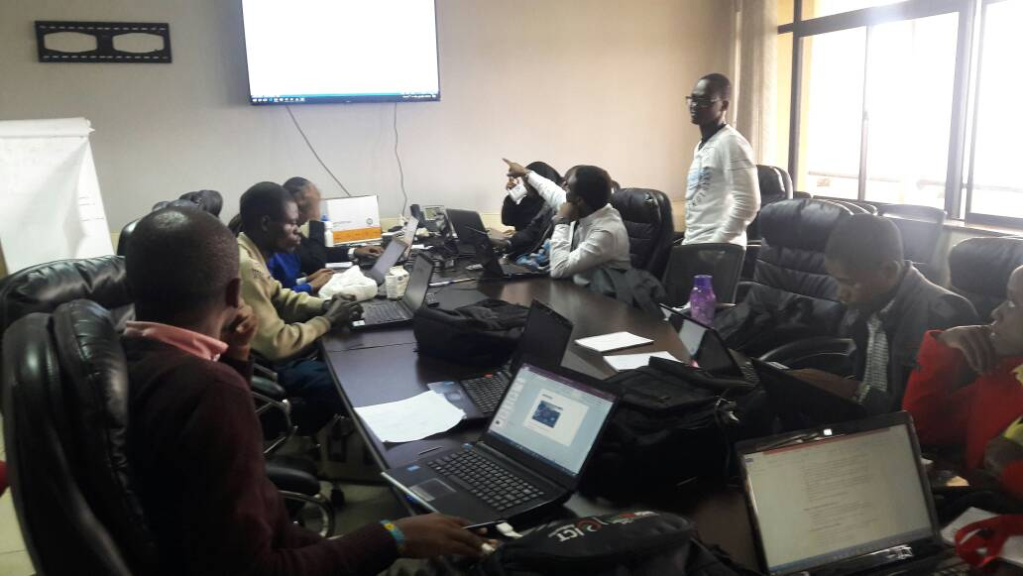

Slide 27
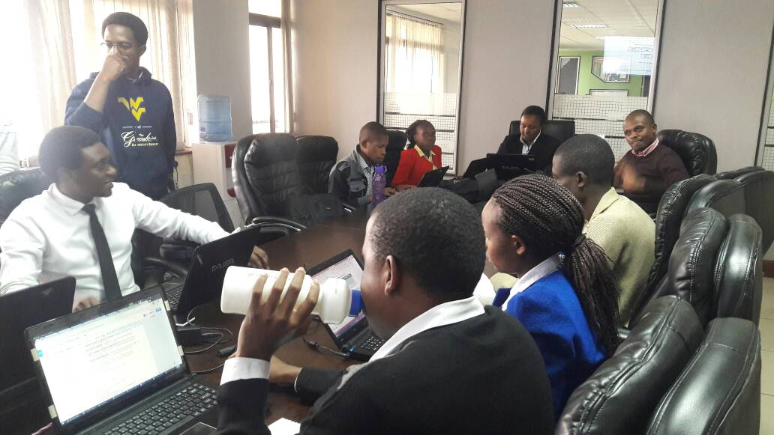

Slide 28
