Slide 1
PDTP 2016 COHORT 2 INNOVATIONS PRESENTATION
PUBLIC SECTOR PLACEMENT
E-CITIZEN CUSTOMER SUPPORT SYSTEM
2nd NOVEMBER 2017
PREPARED BY: ELVIS KIMEMIA
GLADYS MAILU
BEN MUTURI

Slide 2
INTRODUCTION
E-Citizen is the first-stop portal for Government information and services, organized with your needs in mind by incorporating MCDAs.
It is run by Government Digital Payments (GDP) taskforce whose mandate is to ensure that individuals and business are enabled to make payments for government services electronically e.g through m-pesa, eazzy pay, etc

Slide 3
PROBLEM STATEMENT
There is need for an online customer help desk to address concerns and challenges faced by users online since E-citizen does not provide an online platform for the same. The proposed E-CITIZEN online customer support system seeks to serve this need.

Slide 4
How it works
The proposed ECITIZEN customer support system shall enable clients to forward issues and concerns encountered while using the ECITIZEN portal according to level of urgency. The admin shall then forward the issues to relevant MCDA’S in the form of tickets. At the MCDA level, the tickets are assigned to specific persons to handle them and get back to clients.
The admin shall be able to know the issues resolved, issues pending and whether or not issues were resolved in time. Clients shall be notified via mail the status of their issue raised.
All this happens without one requiring to visit any office (online).

Slide 5
Client
Admin receives query
Feedback
mcda
Level of urgency
Creates a query

Slide 6
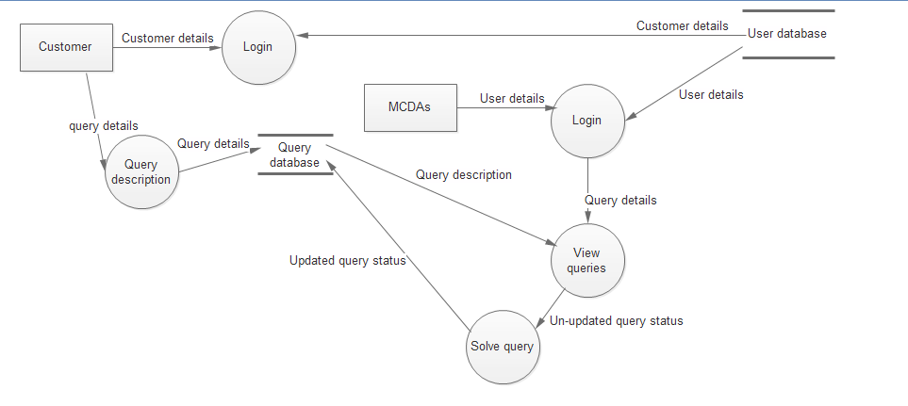
DFD Process Flow

Slide 7
Feasibility
The eCitizen support system is a viable innovation. As almost or all government services have moved online it is important that customers are satisfied and have feedback after an inquiry. The system will allow remote communication to the customer support system which will be created for customer convenience. Through the system we will be able to track trouble tickets, whether recurring problems are solved right away. The resources required are a computer, switch, technical and software

Slide 8
Relevance
The proposed E-citizen customer support system resonates with the ICT masterplan goal of an effective and efficient public service delivery using ICT. It also resonates with the eCitizen objective of improving service delivery on the eCitizen support.

Slide 9
Conclusion
It can be commercialized using three major steps: market research to identify target market, market testing, modification and then marketing of the final product.
The system can be purchased by any organization or business to address customer queries.
-Addressing customer queries becomes easier and faster
-Customers can easily follow the status of their queries
-Escalation and follow up on customer queries is made easier
-Frequent customer queries can easily be identified and addressed.

Slide 10
THANK YOU

