Slide 1
.
PDTP COHORT 2 SECOND QUARTER MEETING 8TH - 12TH MAY
PRIVATE SECTOR PLACEMENT NETWORKS EXPERIENCE REPORT JANUARY TO APRIL 2017
Prepared by: Kiptai Kiptoo
Kevin Gesora

Slide 2


PRIVATE SECTOR OBJECTIVES
-Infrastructure practices and trends -LAN Network trends and Technologies -Network upgrade and migration Strategies - Network Performance Management - ICT service management -Diagnosis, maintenance and support of LANS -Pro-active versus Reactive Network Administration -Infrastructure Practices and Trends
LARGE SCALE | MEDIUM SCALE | SMALL SCALE
22 | 20 | 21

Slide 3
KEY GOVERNMENT ICT PROJECTS
1. COUNTY CONNECTIVITY PROJECT (CCP) –soulco
2. NOFBI- Huawei
3. SAFE CITY - Huawei
4. KONZA SMART CITY
5. GUMS – Government Unified Messaging System

Slide 4
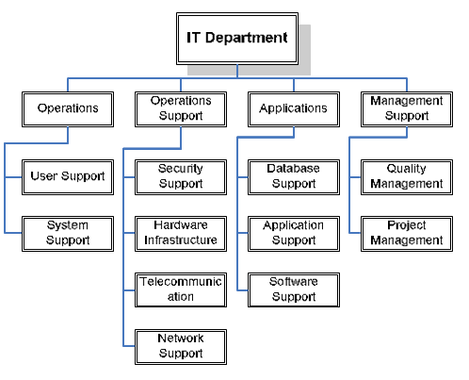
ICT DEPARMENT STRUCTURE

Slide 5




TECHNICAL SKILLS
Cabling (Copper& Fiber) | Network Configurations | Network Monitoring | Networks Support
-Network support and maintenance -Network designing and deployment and documentation | -Routers and switches -Wireless devices -VOIP and Teleconferencing | -Network Management Systems (Solarwinds&Radwin) -Monitoring the supported network technologies -Grading of faults -Creation of Trouble Tickets | -Preventive maintenance of Networks equipment -User Support

Slide 6



ORGANISATIONAL SKILLS
TIME MANAGEMENT SKILLS | MENTAL SKILLS | PHYSICAL SKILLS
-Creating and keeping deadlines -Goal setting and meeting goals -Coordinating events & Multitasking -Decision making | -Listening skills -Communication -Creative thinking -Conflict resolution | -Resource management -Responsibility (office materials and equipment)

Slide 7




LESSONS TO GOVERNMENT
……………………………………………………………………………………………………………………………………………………………………………………………………………………………………………………………………………………………………………………
TECHNOLOGY | PEOPLE | PROCESS
-Network Upgrade -Network management system -Staff management sys | -Create dedicated ICT Departments -Skilled personnel -Level skilled personnel -Work Tools -Trainings & Workshops | -System deployment -Document projects -Bureaucracy

Slide 8
PROJECT SUPERVISORS &MENTORSHIP
PROJECT SUPERVISORS | MENTORSHIP
-Resourceful -Flexible -Mentor -Promoted Teamwork -Critisized constuctively -Positive attitude

Slide 9
CHALLENGES & RECOMMENDATION
-Poor Communication.
-Insufficient Time
-Limited Access to the Premises or Equipments
-Proper Work Attire for Fields Work
-Company Orientation

Slide 10
.
The end

