Slide 1
DATA UNDERSTANDING WITH AUTOMOBILE PRICE DATA
PAVAN KALYAN B

Slide 2
PROBLEM STATEMENT
The given data is regarding the car insurance for various brands and their price based on their features.
Based on the many features like length, drive-wheels, body-style, engine-type, fuel-type , the cars vary internally and externally.
we are able to notice '?' in these column names :-
normalized-losses - (‘?’- 41),
num-of-doors - (‘?’- 2),
bore - (‘?’- 4),
stroke - (‘?’- 4),
horsepower - (‘?’- 2),
peak-rpm - (‘?’- 2),
price - (‘?’- 4).

Slide 3
PROBLEM STATEMENT CONTD.,
Data-cleaning is required for the above statement.
In data-understanding phase neglect those above columns as of now.
Some of the cars are made based on the fuel-type:-
'gas' fuel-type because it uses spark-plug to ignite the engine.
‘diesel’ fuel-type uses compression to start the engine.
Gasoline engines are quieter and nippier than diesel engines.
Pollution - Diesel cars emit roughly 13% more CO2 gas per gallon of fuel compared to gasoline cars.
We know that higher the compression-ratio lower will be the consumption of fuel
Gas – (8:1 – 12:1)
Diesel - (14:1 – 23:1)

Slide 4
FEATURE NAMES AND IT’S EXTRACTION
Symbolling - (-3,-2,-1,0,1,2,3) A value of +3 indicates that the auto is risky, -3 indicates that it is probably safe.
Normalized-losses - The second attribute, which is the relative average loss payment per insured vehicle year.
Make - Different types of car brands.
Fuel-type - indicates the fuel-type of car like ‘gas’ or ‘diesel’.
Aspiration - (std, turbo) is an internal combustion engine in which oxygen intake depends solely on atmospheric pressure and does not rely on forced induction through a turbocharger or a supercharger.
Num-of-doors - (two, four) how many doors to be set.
Body-style – (hardtop, wagon, sedan, hatchback, convertible )This represents the style of the car.

Slide 5
Drive-wheels - (4WD, FWD , RWD) wheel driving types:-
4WD - four wheel drive,
FWD - front wheel drive,
RWD - rear wheel drive.
Engine-location - Indicates the location of the engine (front, rear)
Wheel base - Distance between its front and rear wheels (continuous from 86.6 120.9)
Length - Indicates the length of the car (continuous from 141.1 to 208.1)
Width - Indicates the width of the car (continuous from 60.3 to 72.3)
Height - Indicates the height of the car (continuous from 47.8 to 59.8)
Curb-weight - overall weight of the car (continuous from 1488 to 4066)
Num-of-cylinders - Number of cylinders inside the engine (eight, five, four, six, three, twelve, two)
Engine-type – types of engine used (dohc, dohcv, l, ohc, ohcf, ohcv, rotor)

Slide 6
Engine-size – size of the engine (continuous from 61 to 326)
Fuel-system – Types of fuel system( 1bbl, 2bbl, 4bbl, idi, mfi, mpfi, spdi, spfi )
Bore - Diameter of each cylinder (continuous from 2.54 to 3.94)
Stroke - A phase of engines cycle during which pistons travel from top to bottom or vice versa (continuous from 2.07 to 4.17)
Compression-ratio - ratio of the volume of the cylinder and the combustion chamber when the piston is at the bottom and vice versa (continuous from 7 to 23)
Horse-power - unit of power used to measure the forcefulness of a vehicle's engine (continuous from 48 to 288)
Peak-rpm - Car engine rpm increases as you press the accelerator (continuous from 4150 to 6600)
City-mpg - Mileage in the city (continuous from 13 to 49)
Highway-mpg - mileage in the highway (continuous from 16 to 54)
Price – Price of car insurance (continuous from 5118 to 45400)

Slide 7
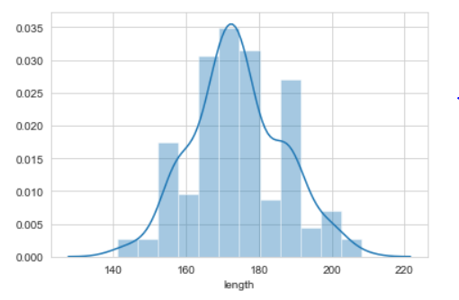
HISTOGRAM
We can observe the positive kurtosis here due to its high peakness in the plot
Max length of making a car is 208
Majority of length of cars made in range between 163-180
Min length of making a car is 141

Slide 8
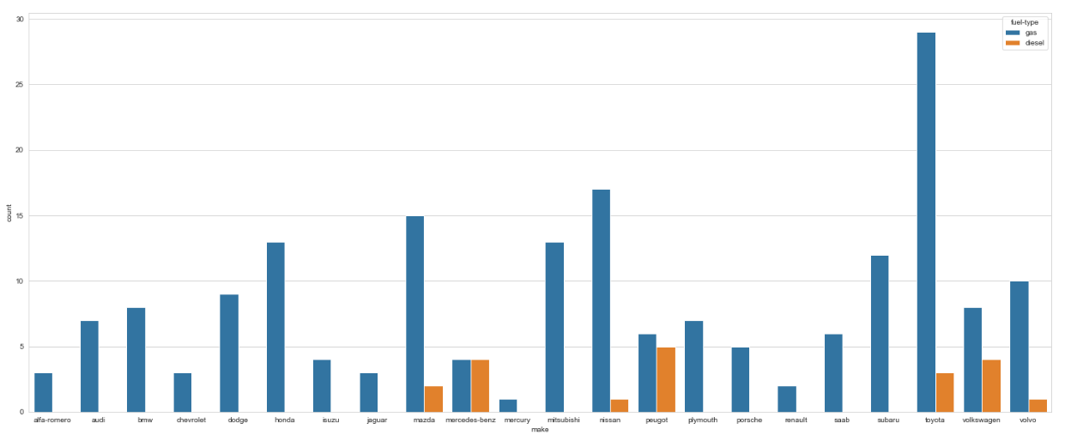
COUNT PLOT
We can observe here majority of cars have been insured in ‘Toyota’ brand with 'gas' fuel-type.

Slide 9
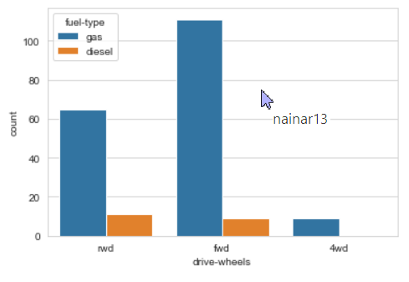
COUNT PLOT
Comparison based on the drive-wheels with fuel-type
We can see many companies prefer the ‘FWD’ and ‘RWD’ drive wheels with gas engine
Companies drive-wheels with ‘FWD' and ‘RWD’ uses very less count of diesel engines.
Companies drive-wheels with ‘4WD' has only gas engine and there is no diesel engine used.

Slide 10
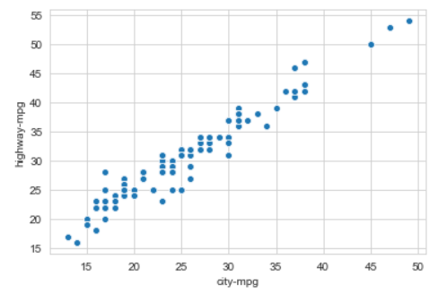
SCATTER PLOT
Here we can observe the moderate positive correlation between 'city-mpg’ and 'highway-mpg'

Slide 11
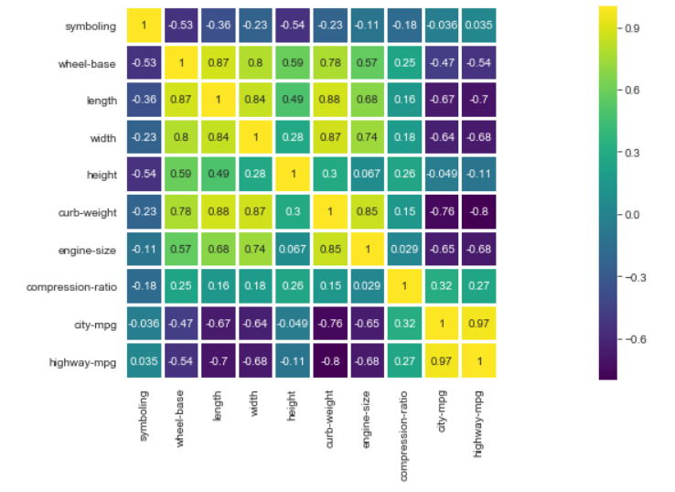
HEATMAP
This gives the correlation of the insurance data and the intensity of each column that is mapped.

Slide 12
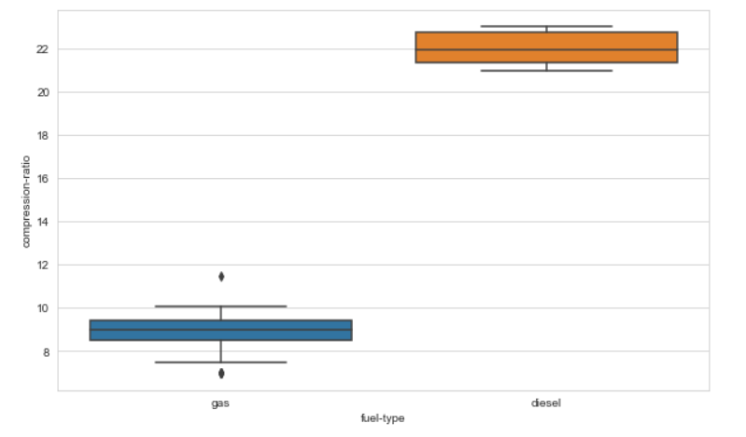
BOX PLOT
We can notice two outliers in the x-axis (gas)
We can observe here the compression ratio is higher in the diesel engine than the gas engine
Higher the compression-ratio lower will be the consumption of fuel

Slide 13
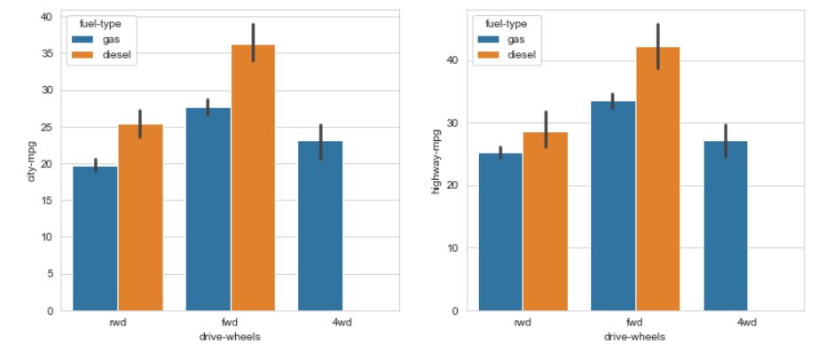
BAR PLOT
Comparison based on drive-wheels
Cars with ‘FWD' using diesel type engines gives high mpg in both city and highway
Cars with ‘RWD' using gas type engines gives very low mpg in both city and highway
Majority of the cars use the ‘FWD' - forward wheel drive for long drives

Slide 14
THANK YOU

