Slide 1

Individual Project 1 : German Credit Risk
Pallavi Kamal

Slide 2
Question to Solve:
I am using German Credit Risk dataset .The dataset will be used to predict if Loan sanctioned to an individual will be a good risk or bad risk.
Can I use this dataset to build Statistics models to predict the loan Risk and compare the accuracy of the models to check which model has the highest accuracy.
If Yes, then how can I reduce the model and check if prediction accuracy improved or not?

Slide 3
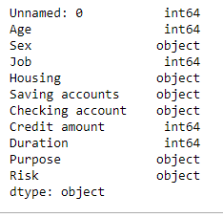
About Dataset:
The German Credit Risk dataset is a classic dataset of Good and Bad Loans.
It has total 11 columns and 1000 rows .
Out of 11 Columns we have 5 numeric features and 6 Categorical features

Slide 4
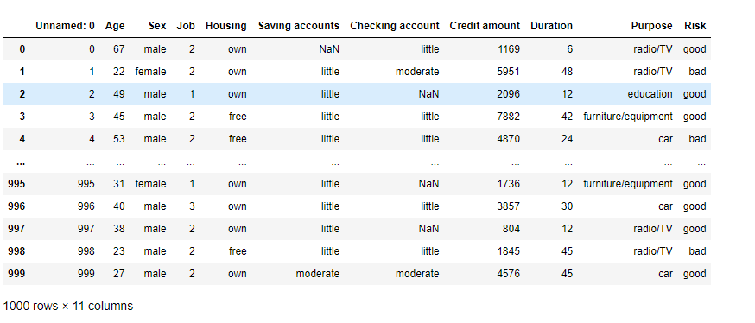
Data:

Slide 5
Columns –
Out of the 11 Columns , I will be selecting 09 columns .
Columns are : - Age, Job, Housing, Saving accounts, Checking account, Credit amount, Duration, Purpose, Risk
Not Selecting: - I am not Selecting columns “Unnamed:0” and “Gender”.
Reason:
‘Unnamed:0’ is a row number column.
I think to get the Risk of loan, ‘Gender’ shouldn’t be a deciding feature.

Slide 6
Data Cleaning & Feature Selection
For Data Cleaning , I removed all the null values.
Checking data balanced or not
Also checked what feature effect directly the risk of the loan using correlation.

Slide 7
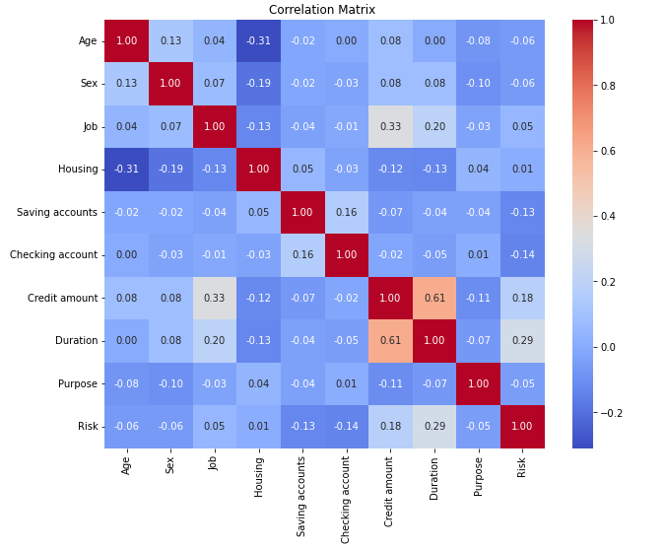
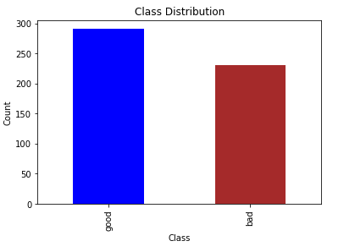
Data Cleaning & Feature Selection

Slide 8
Methodology
I have used 3 Statistical Models:
Logistic Regression- Logistic Regression models the probability that a given instance belongs to a particular class. The output of the logistic regression model is a probability score between 0 and 1.
Decision Tree - Decision Trees are inherently interpretable. The rules and decision paths used for classification can be easily understood and visualized, making them useful for explaining model predictions
Random Forest - Random Forests often yield high predictive accuracy. By combining multiple decision trees and aggregating their predictions, Random Forests can capture complex relationships in the data, leading to improved generalization performance

Slide 9
Language & Libraries
I have used Python and Python Libraries for all the Statistical Models.
from sklearn.linear_model import LogisticRegression – For Logistic Regression
from sklearn.tree import DecisionTreeClassifier – For Decision Tree
from sklearn.ensemble import RandomForestClassifier – For Random Forest
from sklearn.model_selection import train_test_split – For Train Test Split
from sklearn.metrics import precision_score, roc_auc_score, roc_curve, auc – For Precision, Area Under Curve
from sklearn.metrics import accuracy_score, confusion_matrix - For Confusion Matrix, Accuracy of the Model
Pandas, Matplotlib,Numpy – For Dataframe , Plotting and Arrays

Slide 10
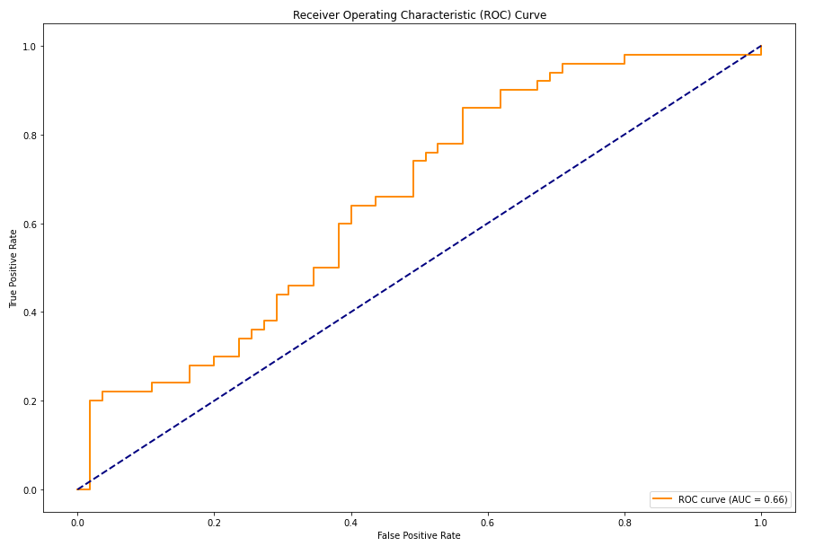
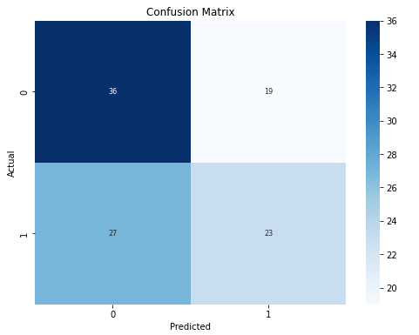
Logistic Regression
Logistic Regression Accuracy: 0.5619047619047619
Logistic Regression Precision: 0.5476190476190477
Logistic Regression Confusion Matrix:
[[36 19]
[27 23]]

Slide 11
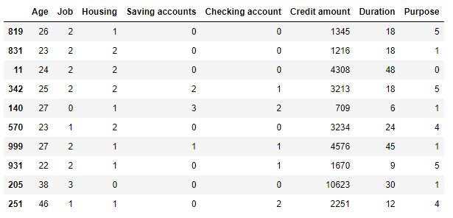
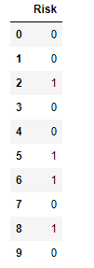
Test data Prediction Test Data Input Prediction by Model (Good:0, Bad:1)

Slide 12
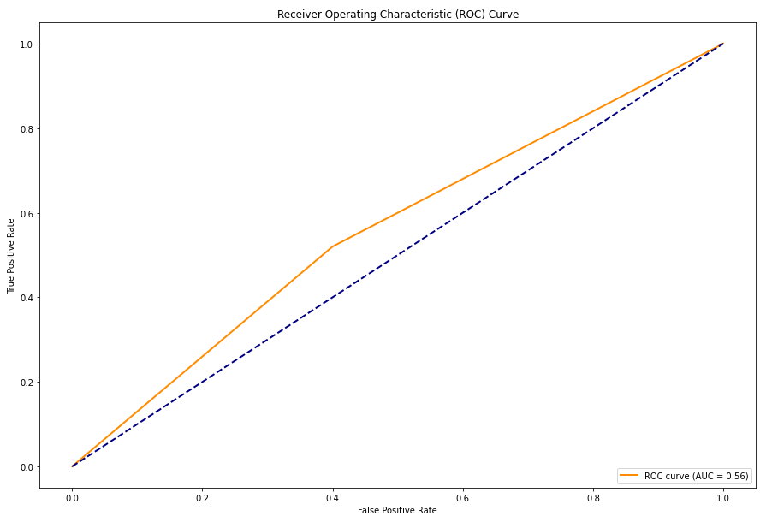
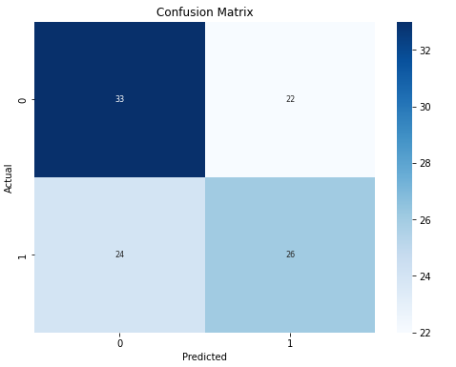
Decision Tree
Decision Tree Accuracy: 0.5619047619047619
Decision Tree Precision: 0.5416666666666666
Decision Tree Confusion Matrix:
[[33 22]
[24 26]]

Slide 13
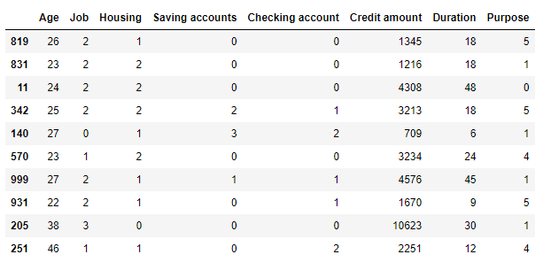

Test data Prediction Test Data Input Prediction by Model (Good:0, Bad:1)

Slide 14
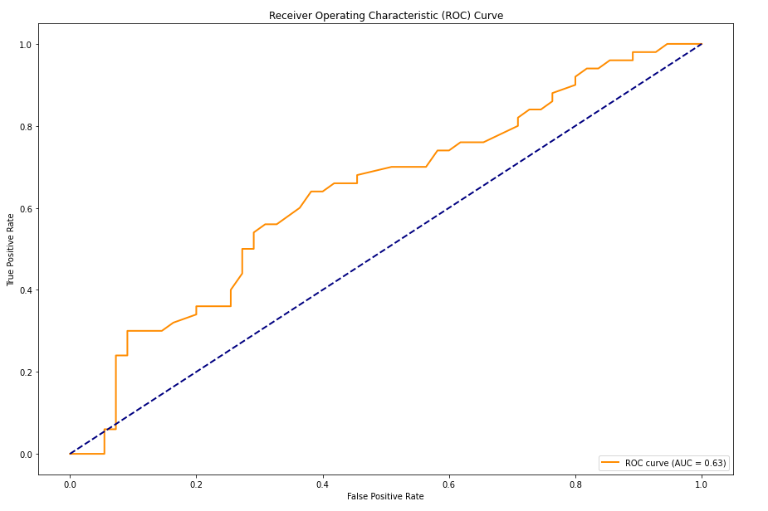
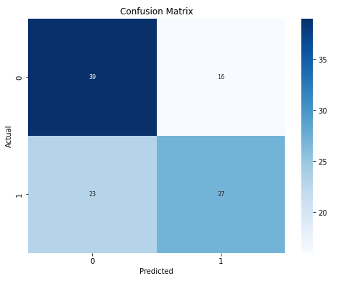
Random Forest
Random Forest Accuracy: 0.6285714285714286
Random Forest Precision: 0.627906976744186
Random Forest Confusion Matrix:
[[39 16]
[23 27]]

Slide 15
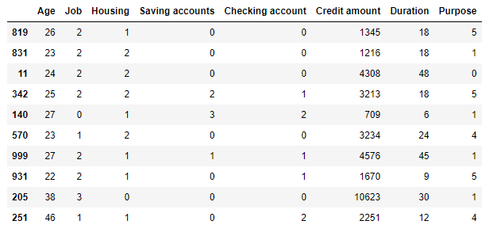

Test data Prediction Test Data Input Prediction by Model (Good:0, Bad:1)

Slide 16
Reduction Of Models
I have used Principal Component Analysis (PCA) for dimensionality reduction on my dataset.
The main reason for using PCA is that it reduces the number of features (or dimensions) in my dataset while retaining as much of the original information as possible.

Slide 17
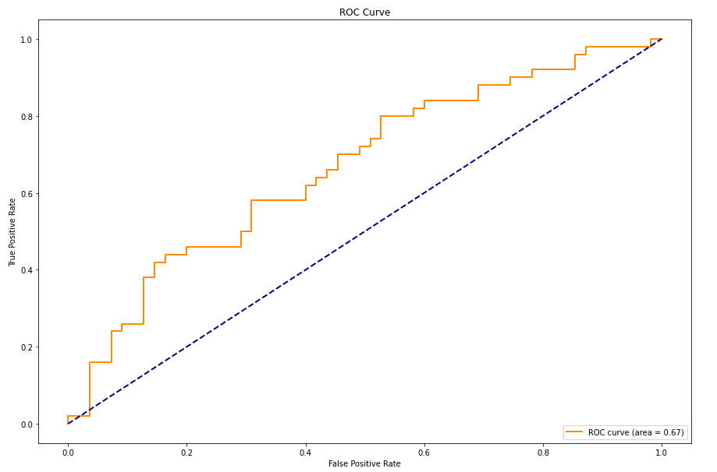
Logistic Regression after PCA
Logistic Regression Accuracy after PCA: 0.59
Logistic Regression Precision after PCA: 0.5897
ROC AUC: 0.666
Note - After PCA, we can see that the Accuracy , Precision and ROC-AUC increased .

Slide 18
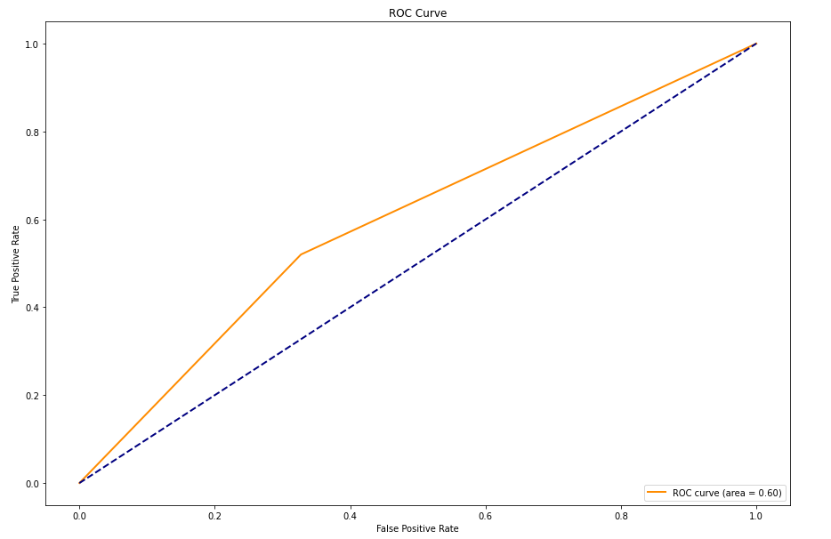
Decision Tree after PCA
Decision Tree Accuracy after PCA: 0.6
Decision Tree Precision after PCA: 0.59
ROC AUC: 0.5963
Note - After PCA, we can see that the Accuracy , Precision and ROC-AUC increased .

Slide 19
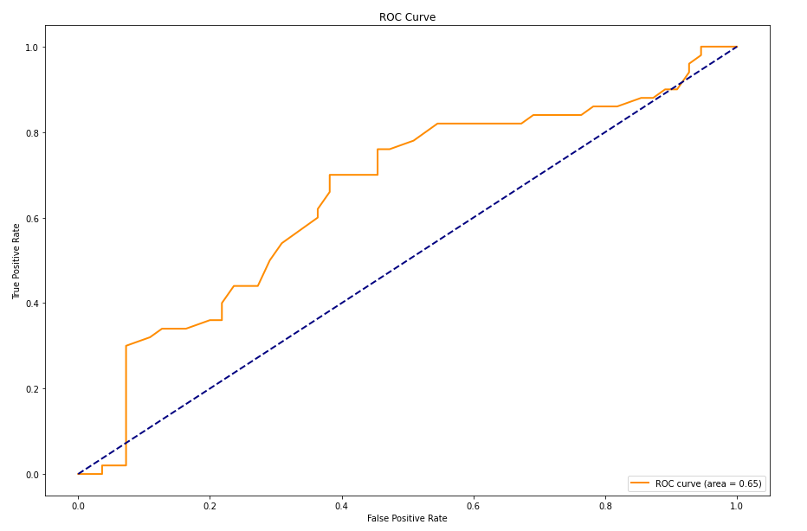
Random Forest after PCA
Random Forest Accuracy after PCA: 0.60
Random Forest Precision after PCA: 0.611
ROC AUC: 0.65
Note - After PCA, we can see that the Accuracy & Precision decreased rather than improve.
In this situation for Random Forest, It’s good option to choose ‘No Reduction’
Random Forests can handle datasets with a moderate number of features, and they may perform well without the need for dimensionality reduction

Slide 20
Discussions/Conclusions
The investigations/Models , that I have used will be able to predict the Target Variable reliably.
Although the Accuracy is not so good , but I can say that as the number of data points will increase the Accuracy will also increase and the predictions will be more and more reliable. (Please note – In the dataset, that I have used, it has only 1000 rows).
Another findings is that - As we can see that using the Statistical models , will be able to predict the Target Variable reliably but if we do reduction of the model then surely it will increase the accuracy.
Last but not the least, in case of Random Forest, It’s wise not to do the dimensionality reduction because, for this dataset, the accuracy decreased rather than going up.

Slide 21
THANK YOU

