Slide 1
Connect 4 AI: Using Minimax with Alpha-Beta Pruning
Team Matrix
Kiranmai Modugu
Greeshma Chanduri
Pravalika Kamineni

Slide 2
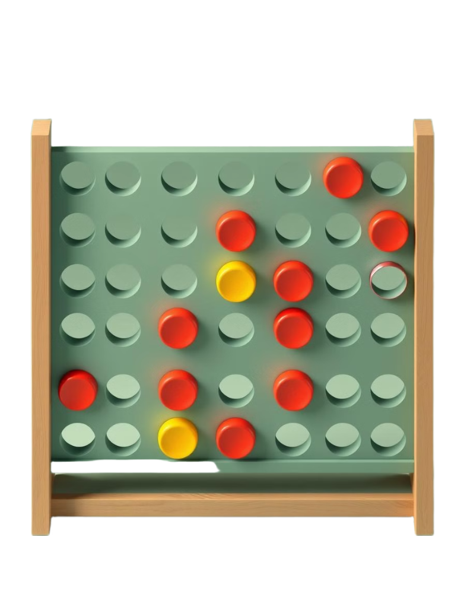
Project Overview
Reinforcement of AI in Connect 4 using the Minimax algorithm with alpha-beta pruning. AI agent to efficiently determine optimal moves. Aims to outperform a random move strategy.
Research Question
I hypothesize that a Minimax algorithm with alpha-beta pruning will enable an AI agent to efficiently determine optimal moves in Connect 4, outperforming a random move strategy in terms of win rate and decision-making speed.

Slide 3
Project Objectives
Primary Objective
To design and implement an AI agent for Connect 4 using the Minimax algorithm with alpha-beta pruning.
Specific Goals
Achieve a high win rate against human player.
Optimize decision-making through alpha-beta pruning.
Develop interactive GUI using Pygame.

Slide 4
Approach and Methodology
Methodology
Implement Minimax with alpha-beta pruning.
Use a depth-limited search.
Represent board as a 6x7 NumPy matrix.
Tools and Techniques
Language: Python Libraries: NumPy, Pygame Algorithm: Minimax with alpha-beta pruning for move optimization.

Slide 5
Project Deliverables
Source code (GitHub repository).
Project report detailing implementation and evaluation.
Demo video showcasing gameplay.
Relevance
Code demonstrates Minimax implementation and GUI. Report evaluates performance. Video provides visual proof.

Slide 6
Evaluation Methodology
Metrics
Win Rate: >70% against human.
Decision Time: <1 second per move.
Score Improvement: Compared against random-move baseline.
Evaluation Process
Conduct test games with team members.
Measure computation time.
Analyze pruning efficiency.

