Slide 1

STUDENT PERFORMANCE PREDICTION (HYBRID ENSEMBLE)
Geeshma
Aarthi
Sakshi
Pravalika
A hybrid ensemble model combining Random Forest, XGBoost, and Neural Networks. Aims to improve prediction accuracy on student performance using real dataset and dynamic weighting.

Slide 2
Project Overview
Ensemble
Theory
Combines multiple models to boost overall prediction accuracy.
Proposed Hybrid Ensemble
Weights: 40% RF, 30% XGB, 30% Neural Network for diversity.
Dataset & Results
UCI Student Performance data; achieved 85% accuracy via Streamlit app.
Context & Challenge
Objectives
Early student performance prediction aids timely interventions.
Manual methods are slow; automation improves efficiency.
Create a flexible hybrid ensemble model.
Benchmark against standard approaches.

Slide 3
Dataset and Preprocessing
Dataset: 395 students, 32 features (e.g., sex, G1, G2, absences).
Demographic: Sex (male/female), age (15–22).
Socio-economic: Mother’s education (Medu), father’s education (Fedu), mother’s job (Mjob).
Behavioral: Study time, absences, alcohol consumption (Dalc, Walc).
Academic: First period grade (G1), second period grade (G2), final grade (G3).
Target: G3 (final grade) binned as Low (0-9), Medium (10-14), High (15-20).
Preprocessing:
Encoding: Converts text (e.g., “F”/”M”) to numbers for computation.
Normalization: Scales features (e.g., absences 0-93) to a standard range.
Split: 80% train (316 samples), 20% test (79 samples), seed = 42.

Slide 4
Weighted Hybrid Ensemble Details
A Hybrid ensemble is a machine learning approach that combines multiple models to make better predictions than any single model could on its own. In this project , the hybrid ensemble includes three models :Random Forest ,XG Boost, and Neural Network.
The three models collaborate by with each making their own prediction about a student's final grades (Low ,Medium and High )
Weighted Prediction Formula
Model Roles
P(class) = w_RF * P_RF + w_XGB * P_XGB + w_NN * P_NN
XGBoost: captures sequential trends.
Random Forest: ensures stability,
interpretability.
Neural Network: models complex
nonlinear patterns.
P(class):The final probability that a student belongs to a particular class (e.g., Medium).
w_RF, w_XGB, w_NN:The weights assigned to each model’s prediction. (Examples: w_RF = 0.4, w_XGB = 0.3, w_NN = 0.3, or w_RF = 0.25, w_XGB = 0.25, w_NN = 0.5).
P_RF, P_XGB, P_NN: The probability that each individual model (Random Forest, XGBoost, Neural Network) predicts for the class.

Slide 5
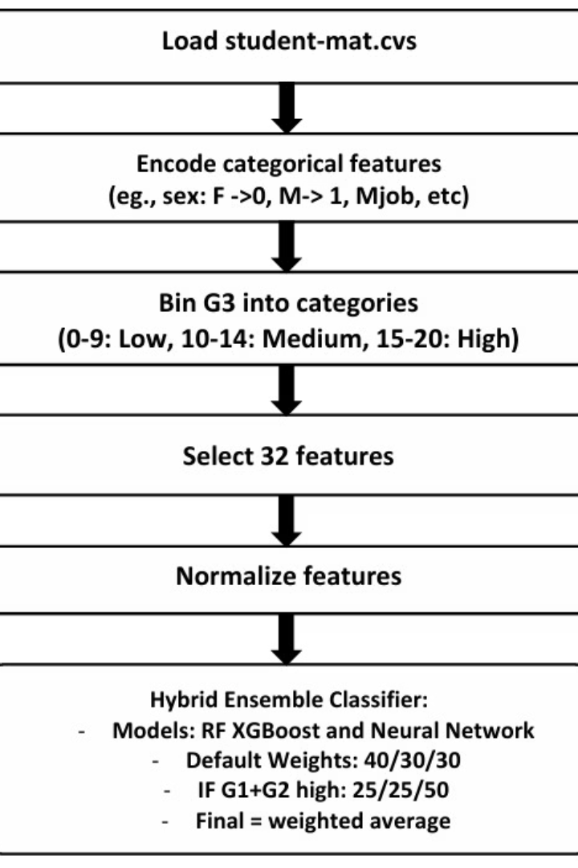
Model Development
Load student-mat.csv: Loads the dataset with 395 student records and 32 features (e.g., age, prior grades G1/G2, absences).
Encode categorical features: Converts text features (e.g., sex: "F" → 0, "M" → 1; Mjob: "teacher" → 0) into numbers using LabelEncoder for model compatibility.
Bin G3 into categories: Transforms the final grade (G3, 0–20) into three categories: Low (0–9), Medium (10–14), High (15–20), making it a classification task.
Select 32 features: 32 relevant features (e.g., G1, G2, absences) to focus on meaningful predictors.
Normalize features: This step makes sure all number-based information (like absences or G1 grades) is adjusted to be on the same level.
Hybrid Ensemble Classifier:
Models: Combines Random Forest (RF), XGBoost, and a Neural Network (MLP) to make predictions.
Dynamic Weights: Initially, RF: 40%, XGBoost: 30%, Neural Network: 30%.
Final Prediction: Combines model predictions using a weighted average

Slide 6
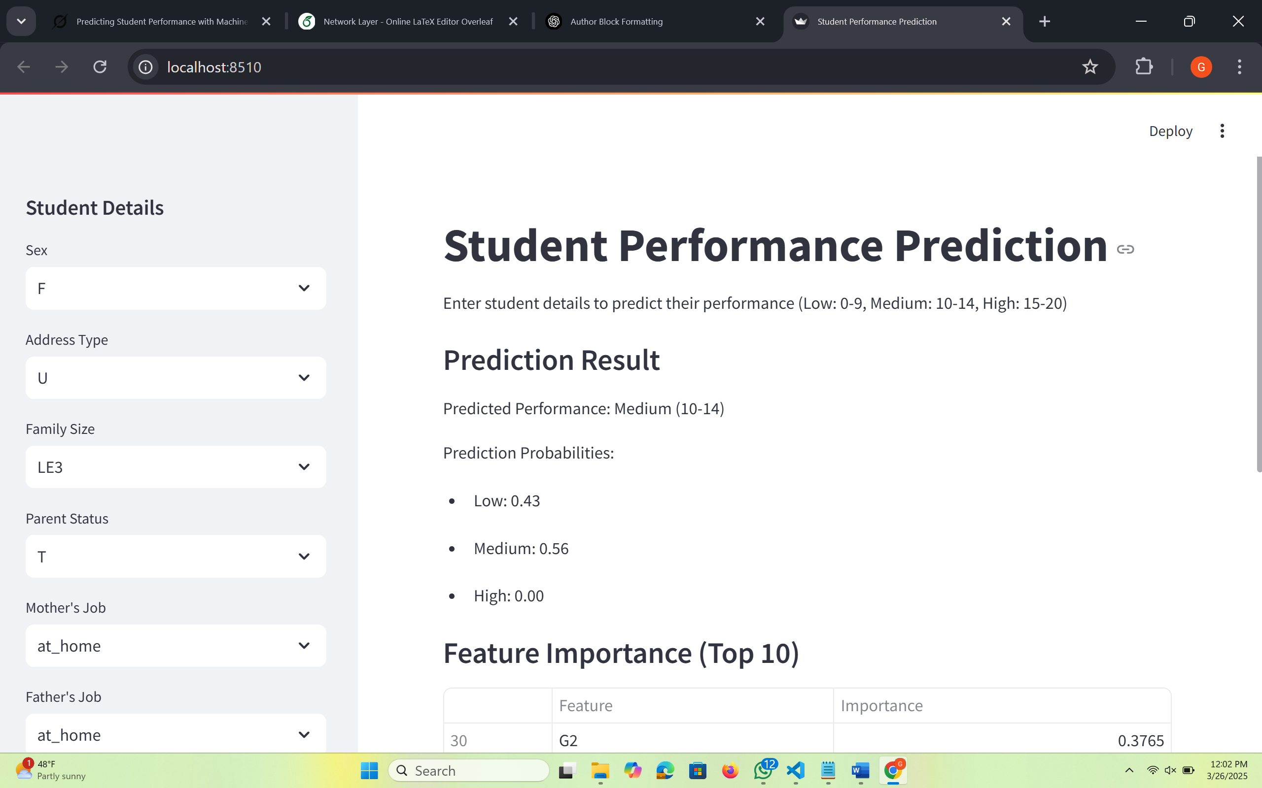
Project Visuals

Slide 7
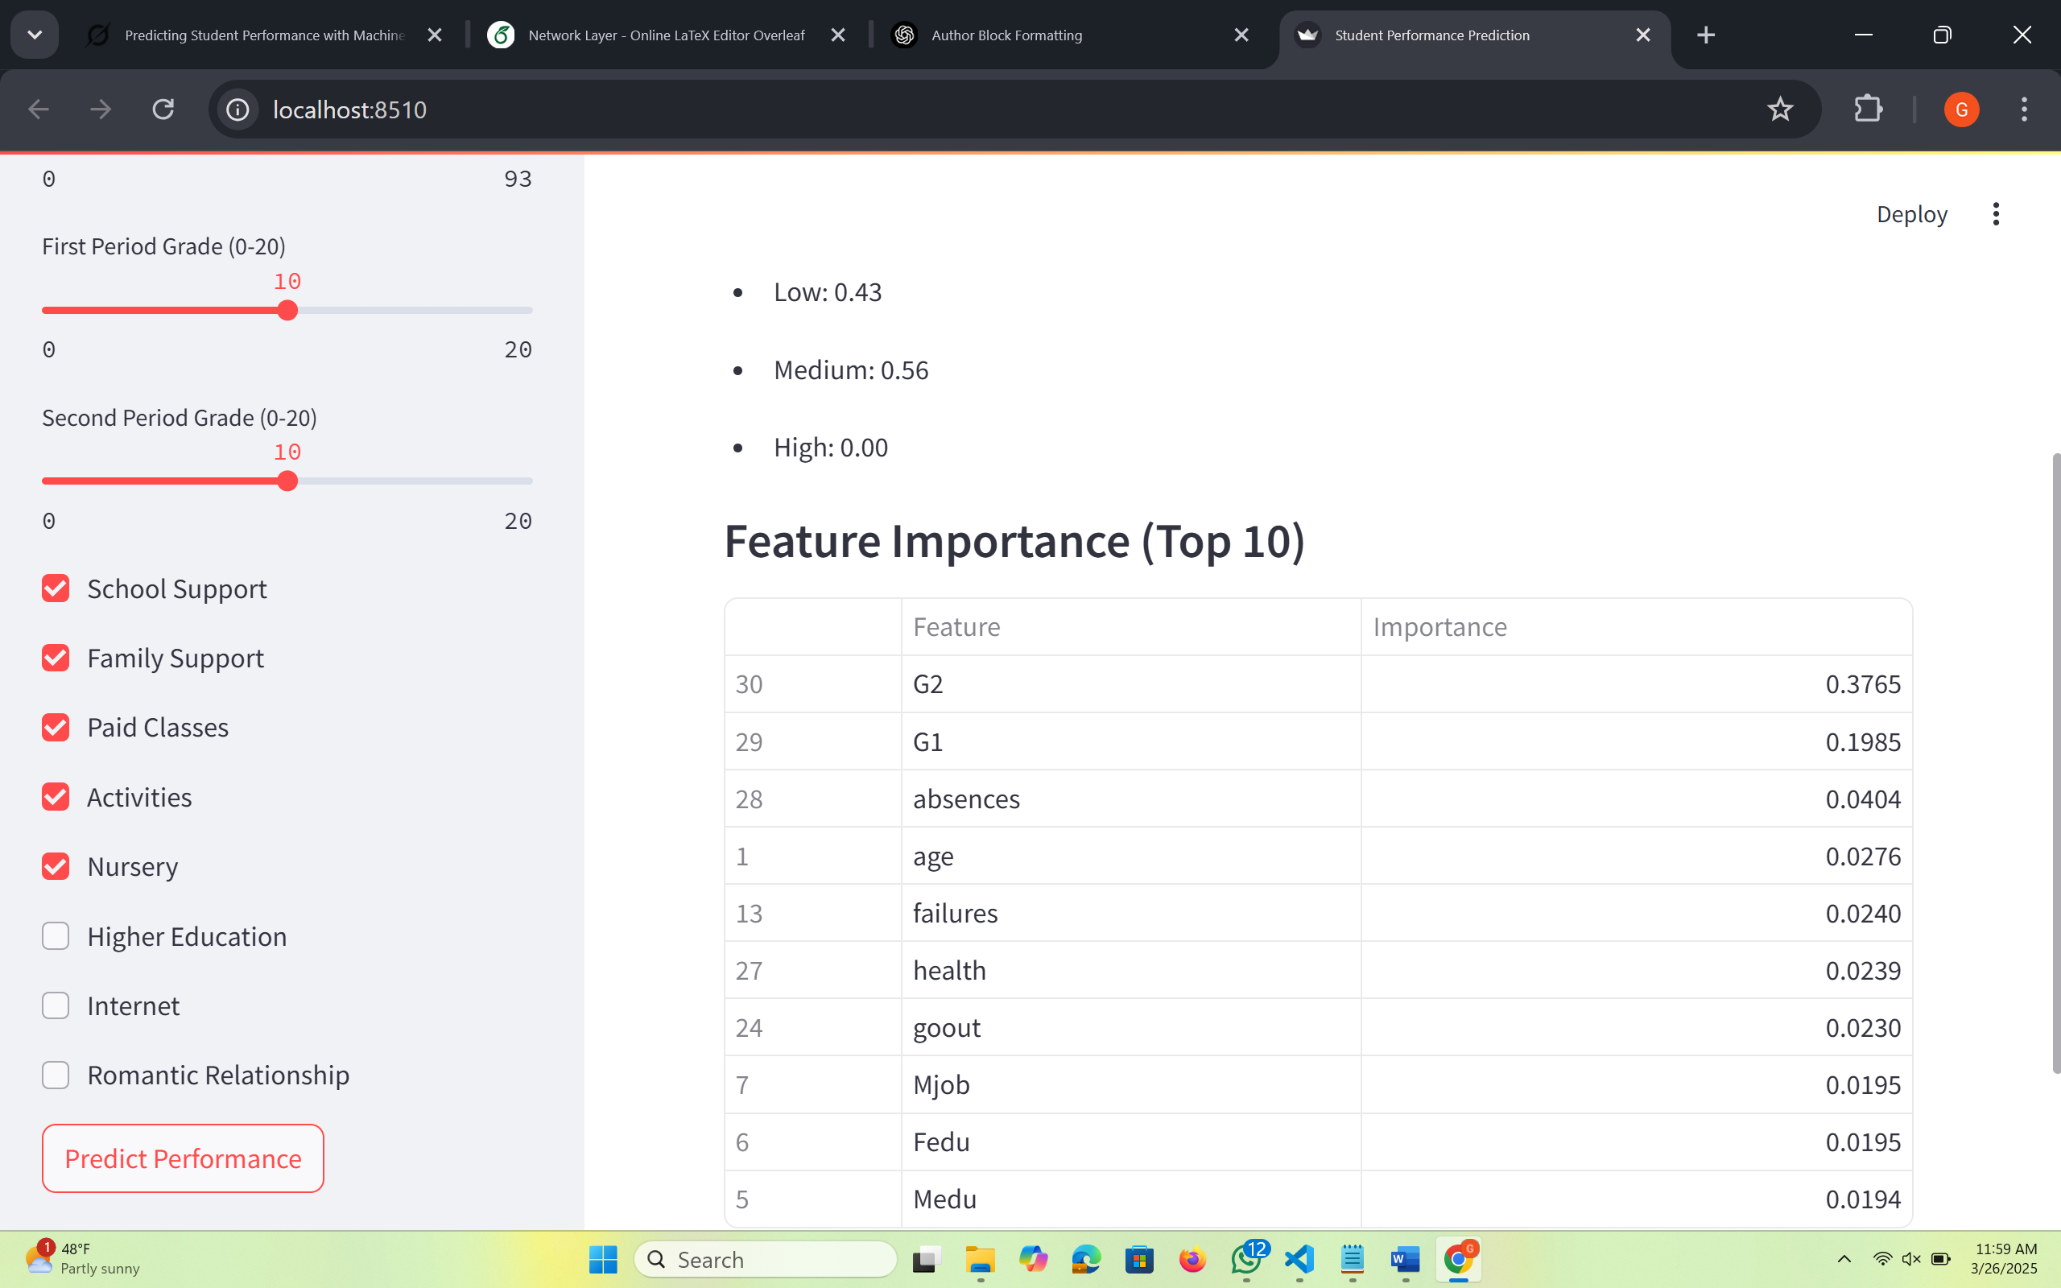

Slide 8
Conclusion and Future Work
Built a predictive model to estimate student academic performance by Including real-time feedback and behavioral data and applied enhanced deep learning for enhanced accuracy and got the Model accuracy at 85%; balancing precision, adaptability, and usability.
Provides interpretable, flexible predictions to assist educators.
Enables personalized academic support and data-driven interventions by educators.
Next Steps
Validate on additional diverse datasets.
Refine dynamic weighting strategies.
Expand interface functionality.

Slide 9
THANK YOU

