Slide 1

Lead Score Case Study
Submitted by
Pasupulat Kamlesh kumar

Slide 2
Problem Statement:
X Education sells online courses to Industry professionals.
The company markets its courses on several websites and search engines like Google. Once these people land on the website, they might browse the courses or fill up a form for the course or watch some videos. When these people fill up a form providing their email address or phone number, they are classified to be a lead
The company requires you to build a model wherein you need to assign a lead score to each of the leads such that the customers with higher lead score have a higher conversion chance and the customers with lower lead score have a lower conversion chance.
Business Goal:
The company requires you to build a model wherein you need to assign a lead score to each of the leads such that the customers with higher lead score have a higher conversion chance and the customers with lower lead score have a lower conversion chance.

Slide 3
Strategy:
Source the data for analysis
Clean and prepare the data
Exploratory Data Analysis
Splitting the data into Test and Train dataset
Building a logistic Regression model and calculate Lead Score
Evaluating the model by using different metrics – Specificity and Sensitivity or Precision and Recall
Applying the best model in Test data based on the Sensitivity and Specificity Metrics.

Slide 4
Steps followed to solve
Data Sourcing
Data Cleaning
Featuring Scaling
Model Building
Feature Selection using RFE
Prediction on Test set
Dropping columns that are having high percentage of mission values
Checking the number of unique categories in each categorical column
Data Preparation
Creating dummies for all categorical columns
Performing train-test split
Performing Scaling
Building a logistic regression model
Finding Optimal cut off point

Slide 5
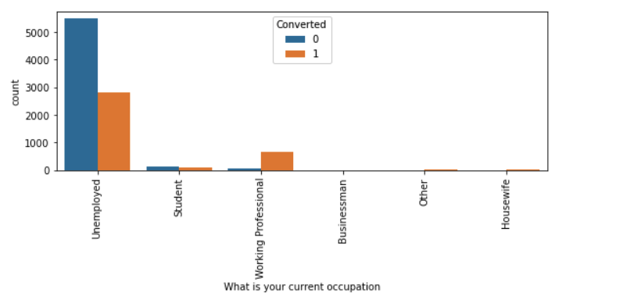
Exploratory Data Analysis
Unemployed and working professional are tends to take courses. Working professionals has better rate conversion

Slide 6
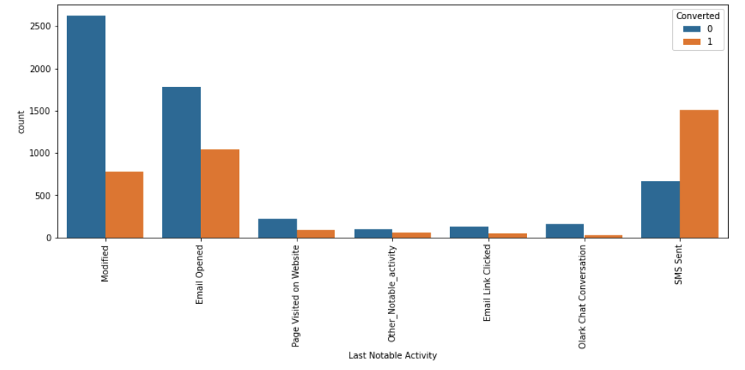
Exploratory Data Analysis

Slide 7
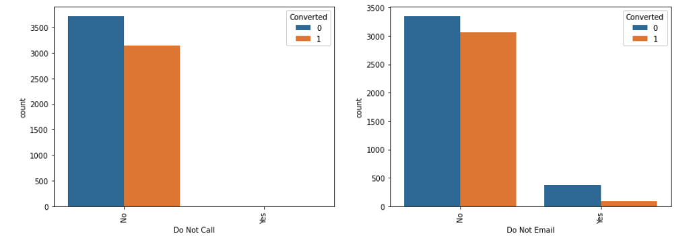
Exploratory Data Analysis

Slide 8
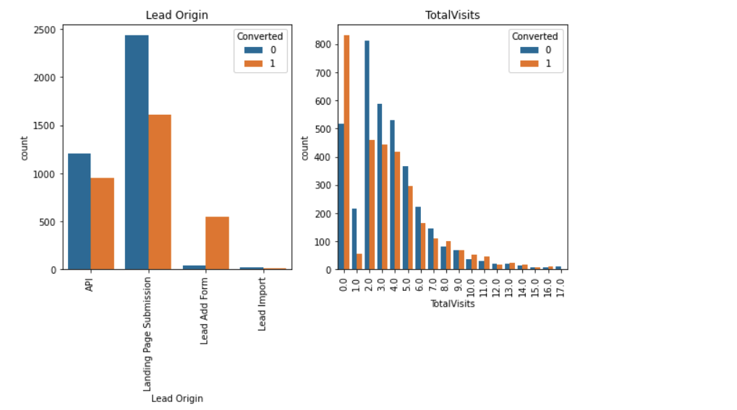
Exploratory Data Analysis

Slide 9
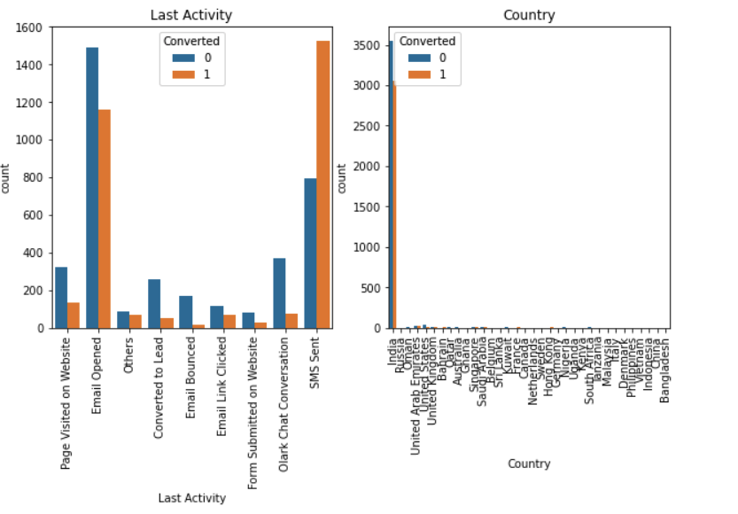
Exploratory Data Analysis
SMS and Email are more effective in conversion lead. Most of the enquiries are from India

Slide 10
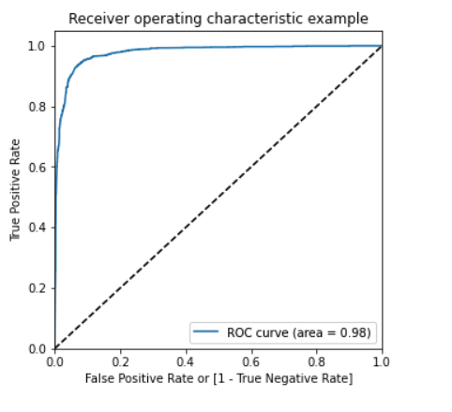
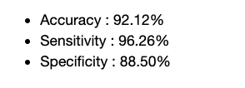
Model Evaluation
The ROC curve has a value of 0.98

Slide 11
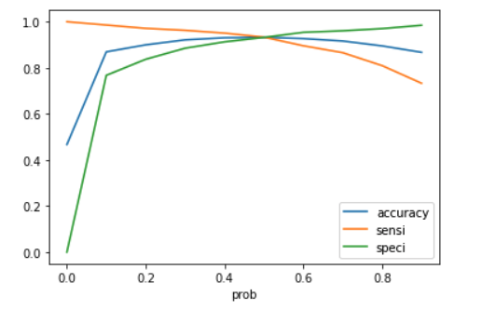
Model Evaluation

Slide 12
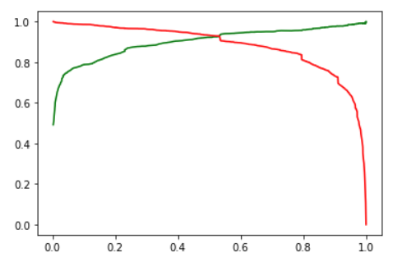
Model Evaluation
The graph depicts an optimal cut off of 0.56 bases on Precision and Recall

Slide 13
Model Evaluation
The top 3 variables that contribute for lead getting converted in the model are
Tags
Lead Origin
Total Time Spend on Website
With the Accuracy, Sensitivity and Specificity values of test set are around 91%, 95% and 88% respectively, and values of train set are around 92%, 96% and 88% respectively model seems to perform good

