Slide 1
Face recognition using Principle component Analysis (PCA)
Using matlab tool

Slide 2
Pca overview
An Unsupervised Learning method
Dimensionality Reduction involved for Feature Extraction
Used as a Pattern Recognition Classifier
Reduces computational complexity
Use Case:
Build a face recognition system using PCA
Data Set Used:
AT&T’s “Database of Faces” consisting of 400 images of 40 subjects

Slide 3
Data allocation of MOde
Mode 1
Mode 2
Training data set – first 5 images belonging to each of the 40 subjects
Test data set – remaining 5 images belonging to each of the 40 subjects
Training data set – all the 10 images belonging to first 25 subjects
Test data set – all the 10 images belonging to remaining 15 subjects

Slide 4
STEPs involved
Load the images into MATLAB and read each of them into a variable (image_data) – feature vector created using concatenation & resize
Divide the images data set into specific training (train_data_mode#) and testing (test_data_mode#) data sets – based on mode # 1 or 2
Compute mean of training data set
Subtract training mean from training data set and compute covariance using the resulting training data matrix
Compute eigen vectors and eigen values of the covariance matrix
Sort eigen vectors using eigen values resulting in a new subspace: feature vector with reduced dimensions

Slide 5
STEPs involved
Project the training and test data sets into the new subspace
Data sets to be projected have training data mean deducted
Compute the distance between the two matrices using Euclidean distance
Normalize the distance matrix derived (optional)
Assign score labels to the distance matrix as genuine (0) or imposter (1)
Derive ROC, EER, FAR and FRR using ‘ezroc 3’ function
Accuracy of Classifier is anlaysed at varying thresholds

Slide 6
Data projected into new subspace
Mode 1
Mode 2
Originally identified training and test data sets are used to project data into the new subspace: feature vector of reduced dimension
Original test data set is used to project data into the new subspace: feature vector of reduced dimension as
Training – first 5 images belonging to each of the 15 original test subjects
Test – remaining 5 images belonging to each of the 15 original test subjects

Slide 7
Far & frr Findings
FAR | FRR
 | MODE 1 | MODE 2
@ 0% | 0.933259 | 0.8994118
@ 5% | 0.297256 | 0.443428571
@ 10% | 0.176615 | 0.30847619

Slide 8
Accuracy of classifier
Accuracy of Classifier = (1 – ((FAR + FRR)/2)) * 100
ACCURACY OF CLASSIFIER | MODE 1 | MODE 2
@ 0% Threshold | 54% | 78%
@ 5% Threshold | 83% | 76%
@ 10% Threshold | 87% | 80%

Slide 9
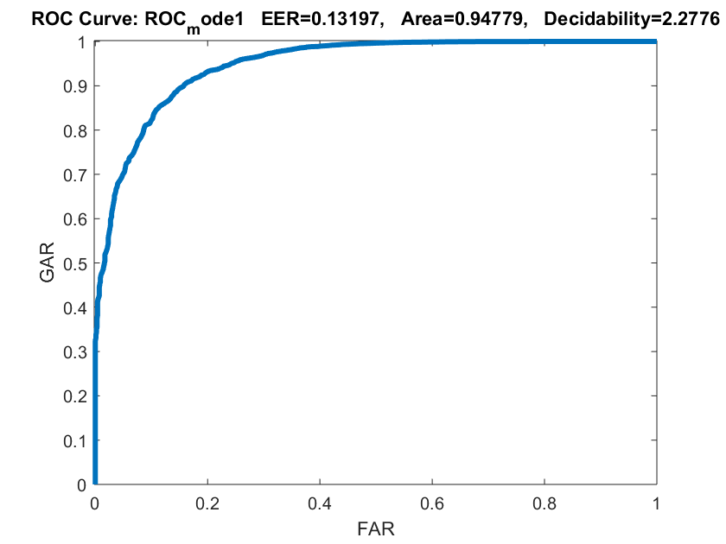
Mode 1 ROC
PCA_Mode1_PoonamK.m
At Equal Error Rate of 0.13197, FAR & FRR are equal
Area under ROC curve is 0.94779 resulting in the model fit having ~ 95% accuracy
Decidability rate is 2.2776

Slide 10
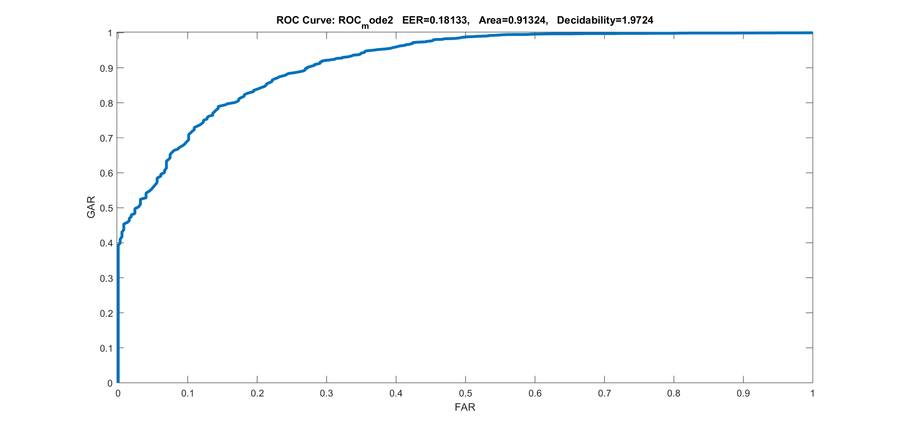
Mode 2 ROC
PCA_Mode2_PoonamK.m
At Equal Error Rate of 0.18133, FAR & FRR are equal
Area under ROC curve is 0.91324 resulting in the model fit having ~ 91% accuracy
Decidability rate is 1.9724

Slide 11
Learnings
Performance of the Classifier/Model is better in mode 1 when compared with mode 2
Reason of better performance of mode 1 is the inclusion of a portion of data belonging to all the subjects in the training data set (same subjects appear in both training and testing phases leading to overlapping)
Model obtained using mode 1 is more robust and accurate as it results in better feature representation when compared to mode 2
Mode 2 has scope of improvement to further fine-tuning the feature vector and its dimension to yield more robust and accurate results

Slide 12
References
Google search
MATLAB help files
Material made available by the instructor

