Slide 1



Technical Coaching 101
Essential Tips for Aspiring Professionals

Slide 2

What is technical coaching?
THE ART OF “CAPTAIN CHEDDAR “ AKA “CAP “

Slide 3
TECHNICAL COACHING IS PROCESS that helps you: SMELl, taste, feel, act and react better, whenever your “cheese is on the move“.

Slide 4
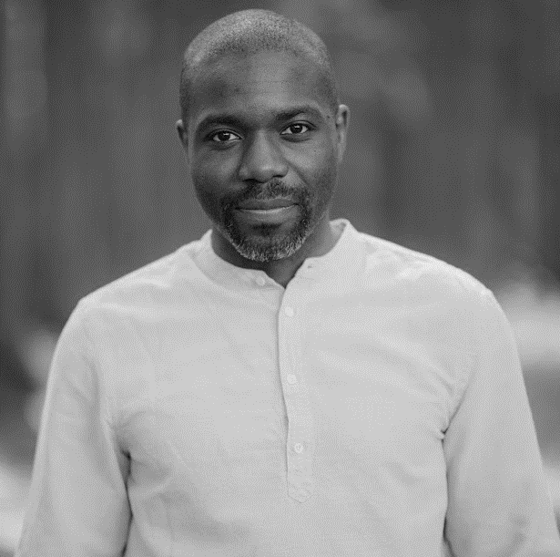
Your cap
DR. PAULIN KANTUE
16+ YEARS IN AEROSPACE INDUSTRY (AFRICA, EUROPE)
PHD IN AEROSPACE
ENJOY WORKING ALONE AND LEADING TEAMS
8 YEARS OF COACHING YOUNG TECHIES (UAV4AFRICA).
FOUNDER OF MOLOMOLO TECH STUDIOS (700+ subscribers in 6 months).

Slide 5

"Change Happens: They Keep Moving the Cheese"
– You and the world around you, will ALWAYS change. CAP will helps to open your eyes, mind and feet.

Slide 6
"Anticipate Change: Get Ready for the Cheese to Move"
– Learn to become proactive and develop foresight. Your CAP has seen ´´this movie´´ before.

Slide 7
"Adapt to Change Quickly: The Quicker You Let Go of Old Cheese, The Sooner You Can Enjoy New Cheese.”
– No one can adapt for the BETTER without CAP on their side.

Slide 8
"Monitor Change: Smell the Cheese Often So You Know When It Is Getting Old"
– Brainless routine is a killer of self-awareness. Let your CAP teach you how to STAY awake.

Slide 9
"Enjoy Change! Savor the Adventure and Enjoy the Taste of New Cheese!"
– Learn from CAP on how to embrace change and seek new opportunities.

Slide 10
So What‘s next?
LET‘S LOOK FOR YOUR NEW CHEESE (ARE YOU READY?)

