Slide 1
Movie Recommendation System
A Comprehensive Analysis of Our Movie Recommendation Approach

Slide 2
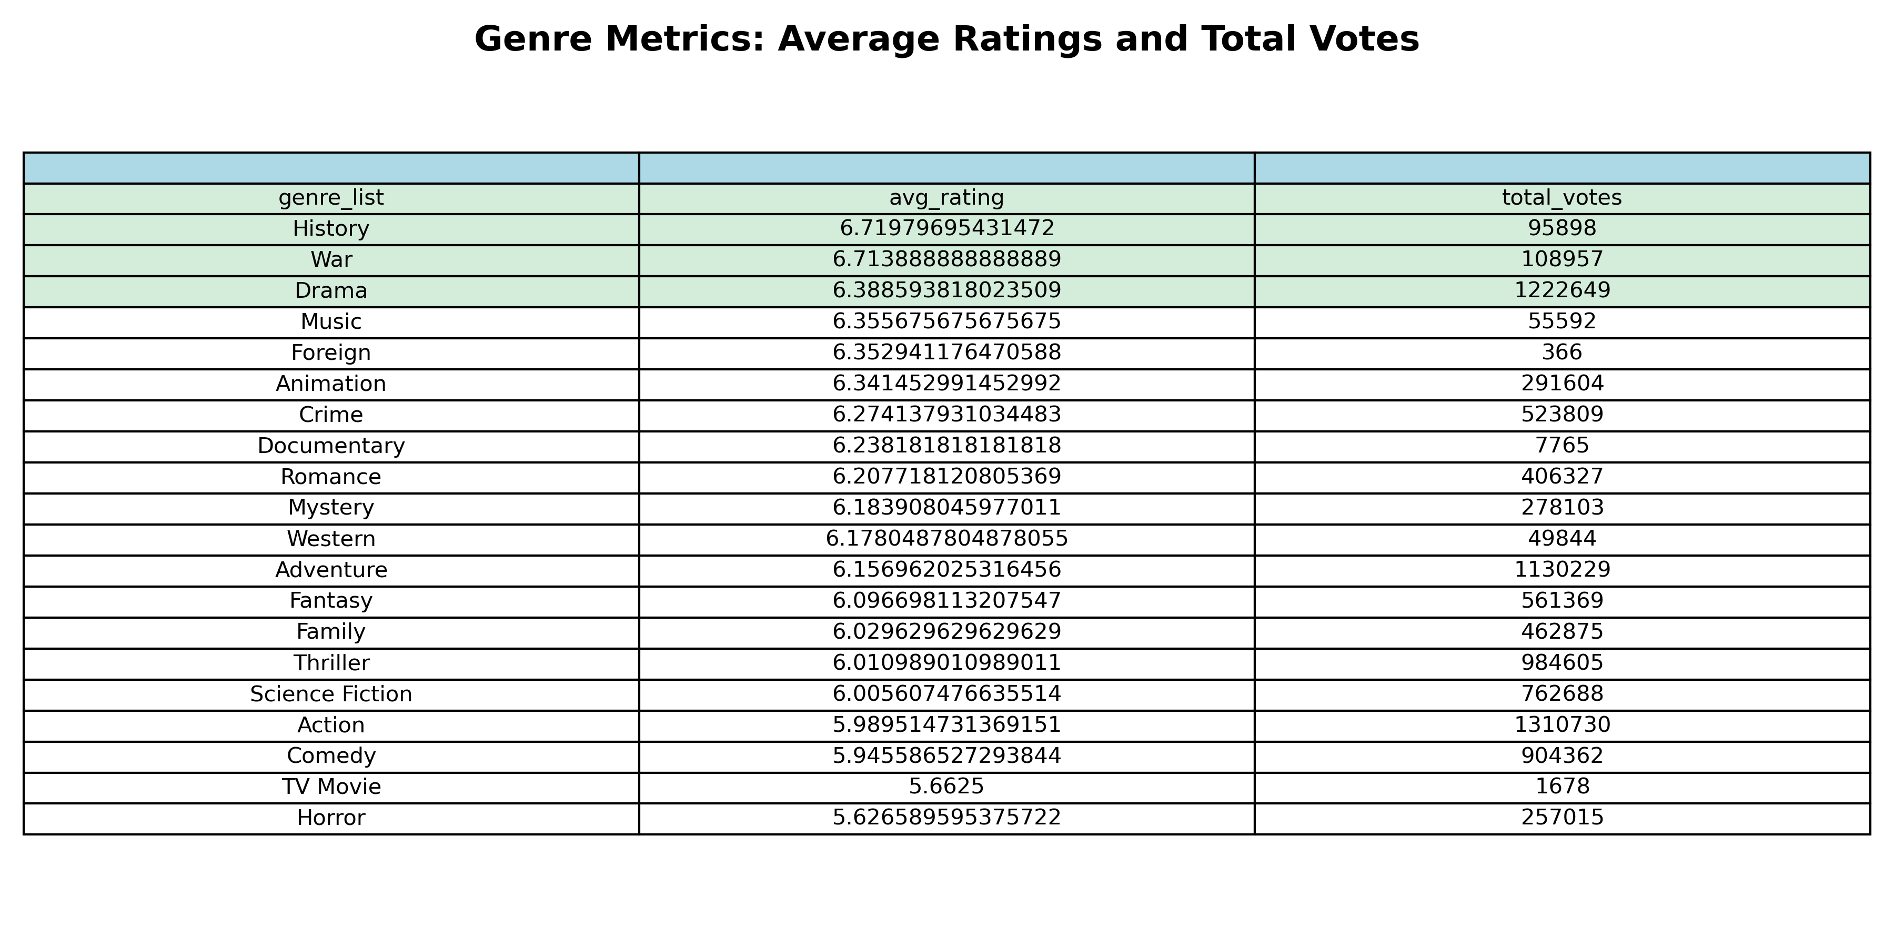
Genre Metrics: Average Ratings and Total Votes
This table shows the average ratings and total number of votes for each genre in the TMDB dataset.

Slide 3
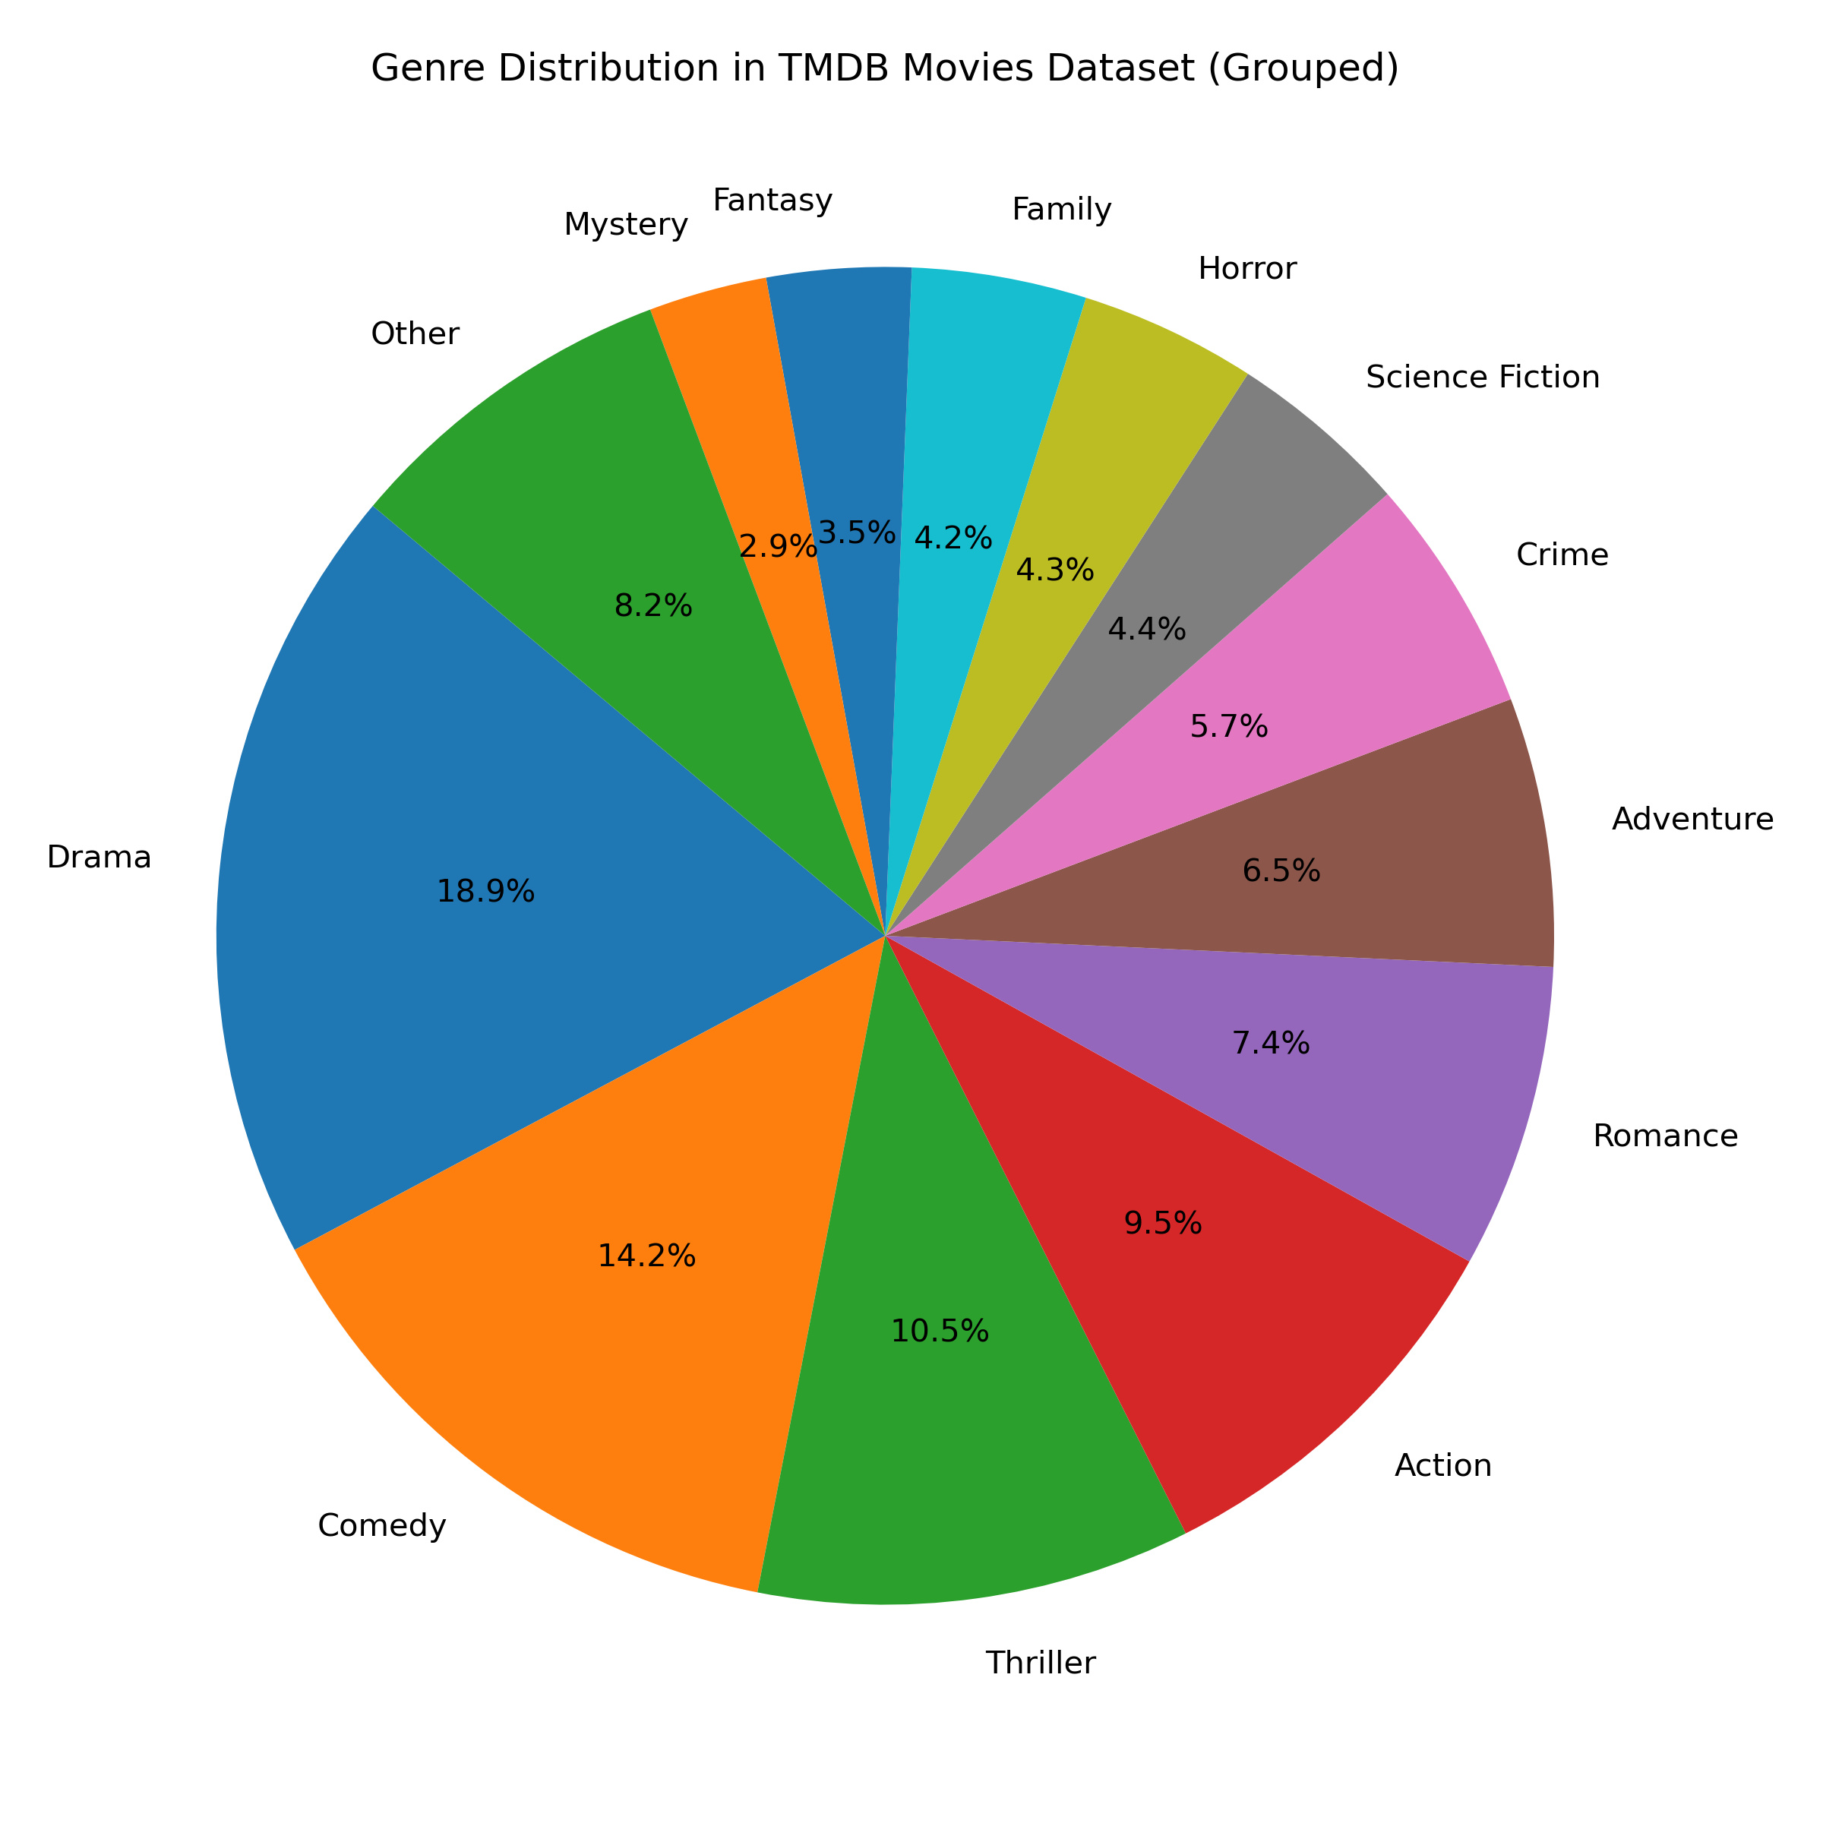
Genre Distribution in TMDB Movies Dataset
This pie chart visualizes the distribution of movie genres in the TMDB dataset. The largest genres include Drama, Comedy, and Romance.

Slide 4

Top Movie Recommendations
These are the top movie recommendations based on user preferences and similar movies.

Slide 5
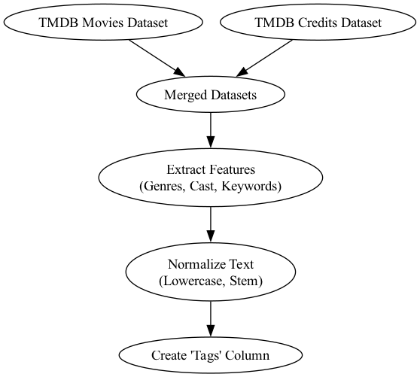
Data Preprocessing Workflow
This flowchart illustrates the preprocessing steps: merging datasets, extracting features (genres, cast), and normalizing the text.

Slide 6
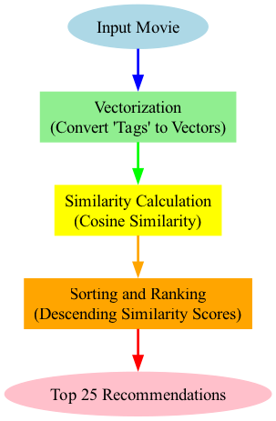
AI Model Development Workflow
This flowchart visualizes the process of model development: inputting a movie, vectorization, similarity calculation, and ranking recommendations.

Slide 7
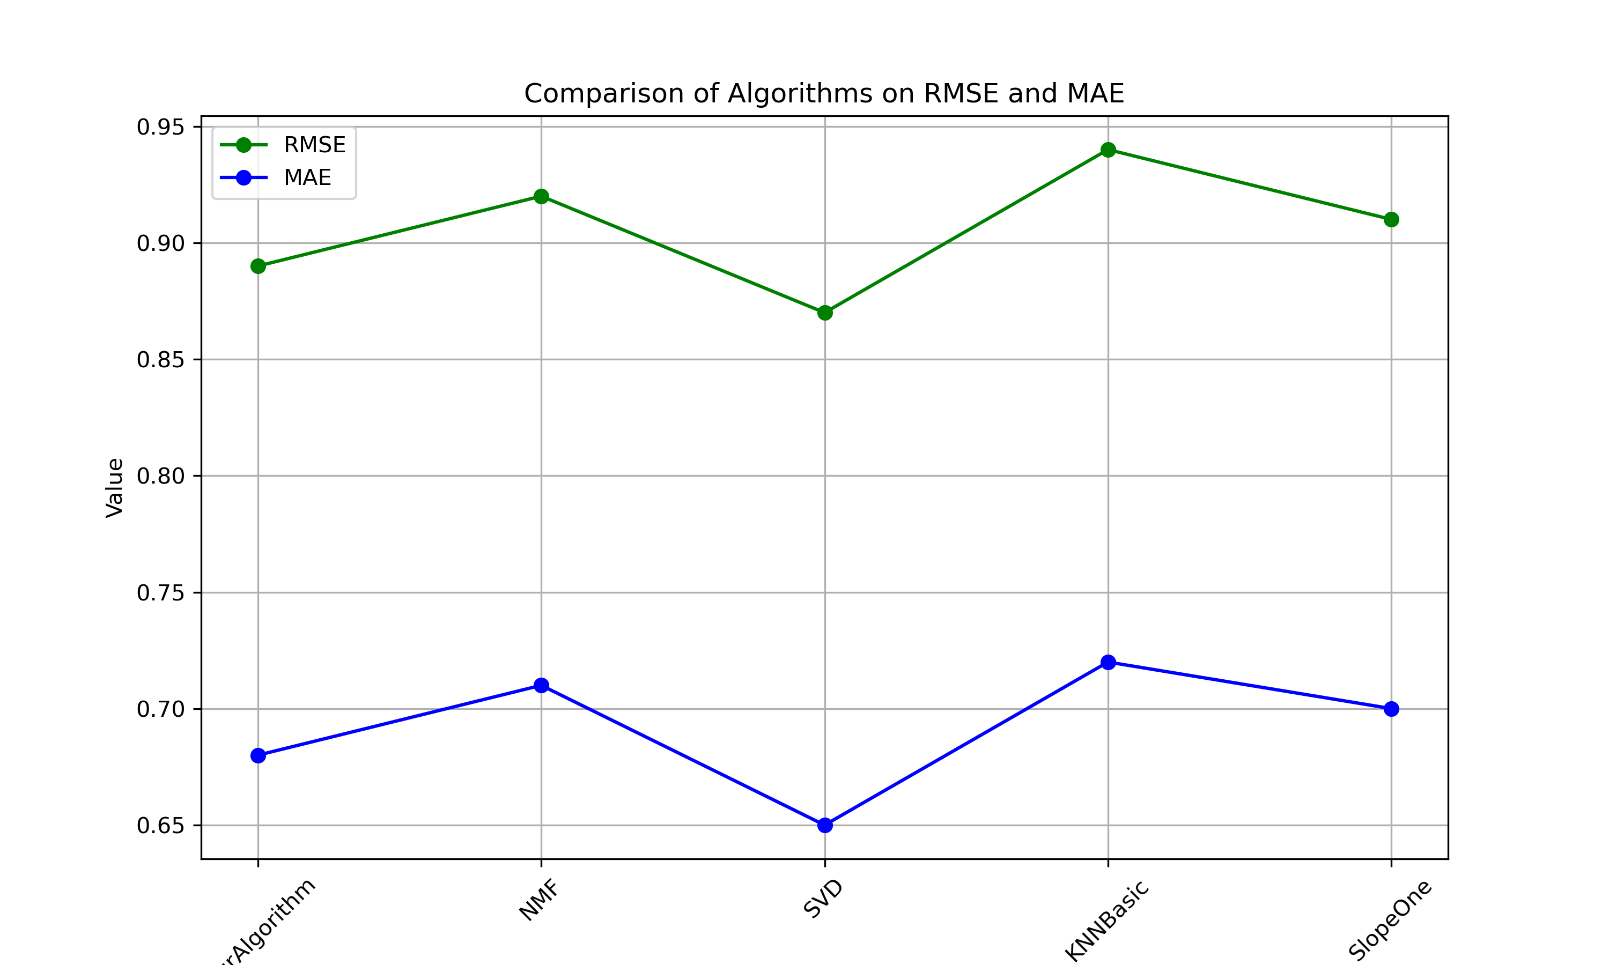
Algorithm Comparison on RMSE and MAE
This chart compares the performance of different algorithms based on RMSE and MAE, showing the accuracy and error metrics for each.

