Slide 1


Text Segmentation with feature similarity for Exam Assessment using Machine Learning
Project Stage II SPPU Examination
Aditya Singh 71719384F
Pranav Kapse 71719591M
Rahul Nagpal 71719767M
Shivam Kumar 71719835K
Name of the guide :- Ms P. V. Ambekar
Department of Computer Engineering,
Sinhgad Institute of Technology and Science, Pune
2019-20

Slide 2
Agenda
Introduction of Group Members
Introduction of Project Topic
Motivation
Literature Survey
Problem Statement
Objectives
Activities per Objective
Schedule
System Architecture
SRS
UML/DFD
Summary
References
Text segmentation with feature similarity for Exam Assessment

Slide 3

Introduction of Group Member 1
Bio – Data : Personal Information
Roll No | 71719784F
Name of Student | Aditya Singh
Date of Birth | 7 July 1997
Address House No Bldg No | A-12 203
Lane, Appt,Society | Mangal Bhairav Nanded City
City District | Pune
Tal Dist State Pin | 411041
Email id | adisingh071997@gmail.com
Mobile No. | 9522470100
Text segmentation with feature similarity for Exam Assessment

Slide 4
Introduction of Group Member 1
Academic Track Record
Class | Sem | Year of Adm | % Marks | Remark
F. E. | I | 2016-2017 | 7.16 | -
 | II |  | 7.28 | -
S. E. | I | 2017-2018 | 7.96 | -
 | II |  | 7.76 | -
T. E. | I | 2018-2019 | 7.00 | -
 | II |  | 7.42 | -
B. E. | I | 2019-2020 | 8.06 | -
Text segmentation with feature similarity for Exam Assessment

Slide 5

Introduction of Group Member 2
Bio – Data : Personal Information
Roll No | 71719591M
Name of Student | Pranav Kapse
Date of Birth | 10 Sep 1998
Address House No Bldg No | Flat no.602/B-9
Lane, Appt,Society | Nirmal Township, Suncity road
City District | Pune
Tal Dist State Pin | 411041
Email id | pkapse173@gmail.com
Mobile No. | 9765418414
Text segmentation with feature similarity for Exam Assessment

Slide 6
Introduction of Group Member 2
Academic Track Record
Class | Sem | Year of Adm | % Marks | Remark
F. E. | I | 2016-2017 | 7.68 | -
 | II |  | 8.72 | -
S. E. | I | 2017-2018 | 8.56 | -
 | II |  | 8.04 | -
T. E. | I | 2018-2019 | 8.09 | -
 | II |  | 7.91 | -
B. E. | I | 2019-2020 | 8.00 | -
Text segmentation with feature similarity for Exam Assessment

Slide 7

Introduction of Group Member 3
Bio – Data : Personal Information
Roll No | 71719767M
Name of Student | Rahul Nagpal
Date of Birth | 10 Oct 1997
Address House No Bldg No | D-808
Lane, Appt,Society | Lalit Nanded City
City District | Pune
Tal Dist State Pin | 411041
Email id | rahul11310@gmail.com
Mobile No. | 7028807459
Text segmentation with feature similarity for Exam Assessment

Slide 8
Introduction of Group Member 3
Academic Track Record
Class | Sem | Year of Adm | % Marks | Remark
F. E. | I | 2016-2017 | 8.6 | -
 | II |  | 8.44 | -
S. E. | I | 2017-2018 | 8.04 | -
 | II |  | 7.96 | -
T. E. | I | 2018-2019 | 7.48 | -
 | II |  | 7.48 | -
B. E. | I | 2019-2020 | 8.59 | -
Text segmentation with feature similarity for Exam Assessment

Slide 9

Introduction of Group Member 4
Bio – Data : Personal Information
Roll No | 71719835K
Name of Student | Shivam Kumar
Date of Birth | 14 Feb 1999
Address House No Bldg No | A -303
Lane, Appt,Society | Savitri Villa Narhe
City District | Pune
Tal Dist State Pin | 411041
Email id | shiva7558581869@gmail.com
Mobile No. | 7558581869
Text segmentation with feature similarity for Exam Assessment

Slide 10
Introduction of Group Member 4
Academic Track Record
Class | Sem | Year of Adm | % Marks | Remark
F. E. | I | 2016-2017 | 8.36 | -
 | II |  | 8.48 | -
S. E. | I | 2017-2018 | 7.96 | -
 | II |  | 6.80 | -
T. E. | I | 2018-2019 | 6.00 | -
 | II |  | 6.22 | -
B. E. | I | 2019-2020 | 8.55 | -
Text segmentation with feature similarity for Exam Assessment

Slide 11
Introduction
We apply a “matching aggregation” model to measure
the similarity between a question and a candidate answer.
We propose to use question specific contextual relations connected to candidate answers to help candidate assessment, which can also significantly improve Knowledge Base Question Answering performance.
The user answer is matched with the specimen answer using Machine Learning Algorithm.
Text segmentation with feature similarity for Exam Assessment

Slide 12
Motivation
Nowadays the usage of paper is increasing exponentially which in turns affects the environment.
To reduce the use of paper and to save the environment we are developing an online system which evaluates the theoretical answers online .
To reduce the human efforts and for faster generation of results Machine Learning Algorithm is used.
Text segmentation with feature similarity for Exam Assessment

Slide 13
Literature Survey
Paper title | Concept | Advantages | Limitation
Knowledge Base Question Answering With a Matching-Aggregation Model and Question-Specific Contextual Relations. | Explore the use of a “matching aggregation” framework to match candidate answers with questions. | a “matching aggregation” model to measure the similarity between a question and a candidate answer. | Complex questions are still challenges in Knowledge base Question Answering which may involve logic and reasoning.
Text segmentation with feature similarity for Exam Assessment

Slide 14
Literature Survey
Paper title | Concept | Advantages | Limitation
Identifying students’ weaknesses and strengths based on online discussion using topic modelling. | This paper proposes a topic model-based approach to extract students weaknesses and strength based on Latent Dirichlet Allocation (LDA). | This paper uses classiﬁcation algorithm to categorize the forum messages as questions, answers or neutral comments. | This approach is not suitable for all the datasets. In this paper, approach not discussed about relationship among the topics extracted.
Text segmentation with feature similarity for Exam Assessment

Slide 15
Literature Survey
Paper title | Concept | Advantages | Limitation
A Systematic Mapping Study of Language Features Identification from Large Text Collection. | The NLP resources are quite useful when it comes to building a machine capable of translating between linguistic pairs (a solution that strives to resolve the language barrier problems). | This paper achieved semantic role labeling , spatial expression recognition ,opinion summarization ,topic linking and visualization plugins. | The greatest challenge is creating a vocabulary for any language. How increase in text collection affect the improvement of accuracy.
Text segmentation with feature similarity for Exam Assessment

Slide 16
Literature Survey
Paper title | Concept | Advantages | Limitation
A Novel Part of Speech Tagging Framework for NLP based Business Process Management | Author proposed a novel POS tagging framework to tackle the problems. And also proposed methods mainly use NLP pipelines to make syntactic analysis of the textual BPD resources. | NLP pipelines uses POS tagging for great performance effect on downstream tasks such as dependency parsing. | The accuracy of current POS tagging approaches is limited on business process description (BPD) texts, which makes the results of NLP based BPM incorrect or incomplete.
Text segmentation with feature similarity for Exam Assessment

Slide 17
Literature Survey
Paper title | Concept | Advantages | Limitation
Can Duplicate Questions on Stack Overflow Benefit the Software Development Community? | Analyzing the duplicate questions from two perspective and benefits of this to developer community. | Help in analyzing the similarity between text which help the developer community for like alternative phrasing and solutions. | As all duplicate are not created equal so study of usefulness of duplicate cannot be done which give meaningful quantative measure.
Text segmentation with feature similarity for Exam Assessment

Slide 18
Literature Survey
Paper title | Concept | Advantages | Limitation
Challenges and Opportunities of Applying Natural Language Processing in Business Process Management | In this paper, we show how NLP has potential in raising the beneﬁts of BPM practices at different levels and how they are modelled , updated and optimised. | NLP has an advantage over following applications such as Education , Healthcare etc. | It has a large investment cost.
Text segmentation with feature similarity for Exam Assessment

Slide 19
Gap Analysis
There is no such system available which evaluate the theoretical answer for online examination. Now a days we only have the online MCQ examination so similarly we are developing a system which can evaluate the theoretical answer which will reduce the effort.
Text segmentation with feature similarity for Exam Assessment

Slide 20
Problem Statement
To develop an online examination system to assess theoretical answers by using NLP.
Text segmentation with feature similarity for Exam Assessment

Slide 21
Objectives
To calculate the similarity percentage between user answer and specimen answer.
To tokenize the data for analysis and matching.
To identify the similarity between user and specimen answer according to their semantic properties.
Text segmentation with feature similarity for Exam Assessment

Slide 22
Activities per Objective
Objective 1:
Data Acquisition
Data Preprocessing
Text segmentation with feature similarity for Exam Assessment

Slide 23
Activities per Objective
Objective 2:
Data Processing
Semantic Analysis
Text segmentation with feature similarity for Exam Assessment

Slide 24
Activities per Objective
Objective 3:
Similarity Checking
Text segmentation with feature similarity for Exam Assessment

Slide 25
Feasibility Study
Problem statement feasibility assessment using, satisfiability analysis and NP Hard, NP-Complete or P type using modern algebra and relevant mathematical models. This project is in the domain of Machine Learning. The problems in the Machine Learning domain depend on various factors such as data size, hyper parameters, etc. The hyper parameters are more deciding than the data size in consideration. So, given proper tuning of the hyper parameters, the Deep Learning problems are approachable in polynomial time and hence are known to be NP problems. The majority of the time is spent in pre-processing of the dataset, followed by training of the models. The training time can be reduced by using GPU-enabled ML libraries. Hence, it can be concluded that the project model falls in P type.
Text segmentation with feature similarity for Exam Assessment

Slide 26
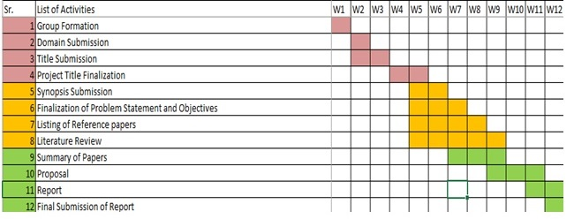
Schedule
Text segmentation with feature similarity for Exam Assessment

Slide 27
System Architecture
Start
Raw Acquisition
Preprocessing
Error free
Reliability check
Erroneous data
Data Storage decision
Offline data
Filtration
Unnecessary data
Discard
Offline Data Storage
Perform Analysis
Load balancing
Processing servers
Results Storage
Aggregation,compilation,results storage
Analysis and decision
Percentage of Similarity
Text segmentation with feature similarity for Exam Assessment

Slide 28
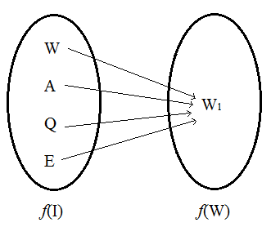
Mathematical Model
Mapping Diagram
f( r ) be the rule which predicates work type provided that set of Input function.
f( r ) : f ( I ) → f ( W ) {many to one mapping}
Functional Dependency
Relational dependency is: Output function is dependent on Input attributes.
Goal Function → Input attributes
i.ef( W ) → f ( I )
Text segmentation with feature similarity for Exam Assessment

Slide 29
SRS
SRS.docx
Text segmentation with feature similarity for Exam Assessment

Slide 30
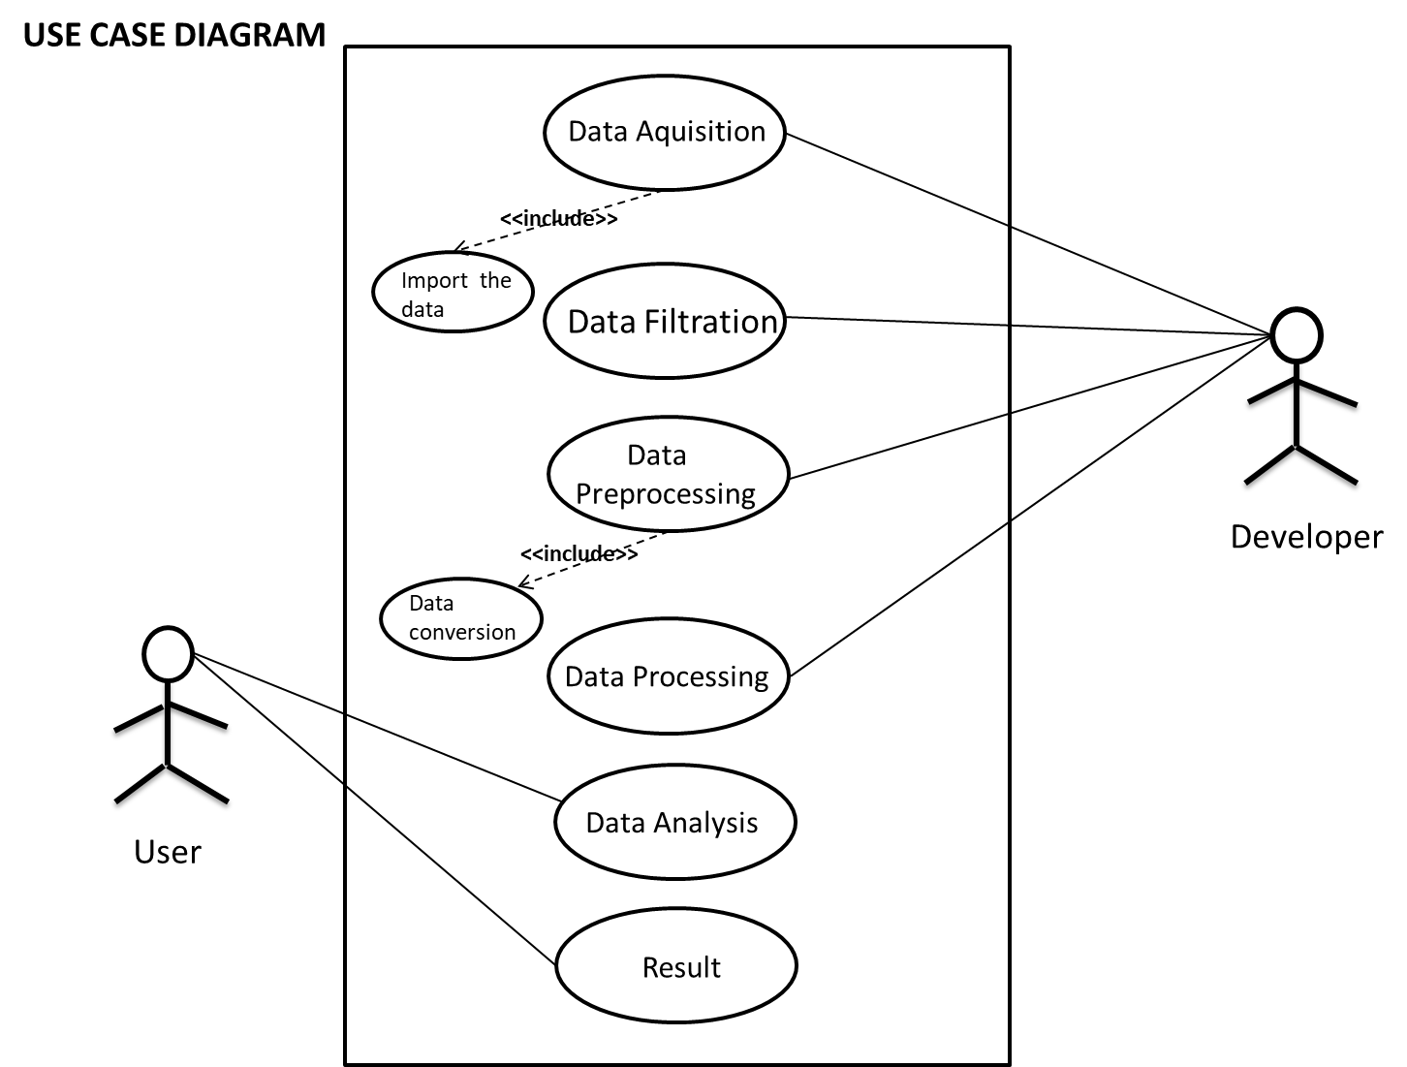
Use Case Diagram
Text segmentation with feature similarity for Exam Assessment

Slide 31
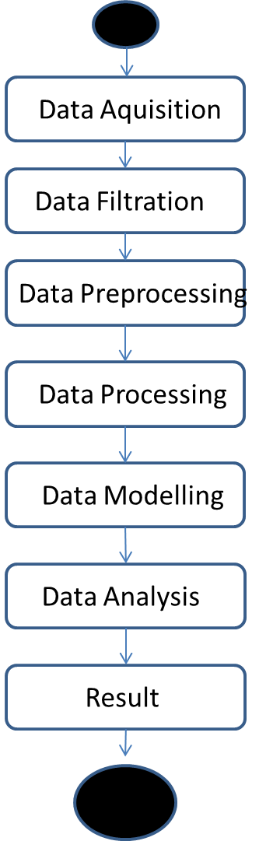
Activity Diagram
Text segmentation with feature similarity for Exam Assessment

Slide 32
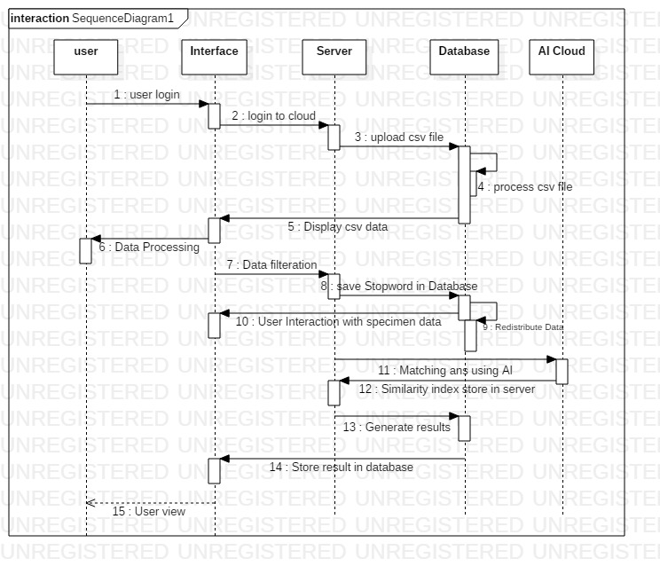
Sequence Diagram
Text segmentation with feature similarity for Exam Assessment

Slide 33
Project Implementation :Algorithm
Measuring similarity
2. Vectorization:
TFIDF method
Frequency Count method
Word embedding method
3. Distance Computation
Cosine Similarity
Text segmentation with feature similarity for Exam Assessment

Slide 34
Project Implementation :Testing
Test Case ID | Test Case | Objectives | Steps | Expected Result | Actual Result | Test Status
1. | Data Acquisition | To connect the data Feed link and acquire the live data | API Class Object | Object Created | Object Created | Pass
 |  |  | API Function Call | Function Calling | Function Called | Pass
 |  |  | API Response | Response Received | Response received from the object | Pass
 |  |  | Data feed collection | All data is collected in runtime object | Data collected | Pass
Text segmentation with feature similarity for Exam Assessment

Slide 35
Test Case ID | Test Case | Objectives | Steps | Expected Result | Actual Result | Test Status
2. | Analysis | Check that all the functions are working properly according to plan | Parameters | The output should be according to only selected parameters | The output is according to selected parameters | Pass
 |  |  | Invalid Selection | If invalid parameter that are not available an error should come | Display of error message | Pass
 |  |  | Erroneous data | Discard Erroneous data | Erroneous data Discarded | Fail
 |  |  | Historical data | Collect all the Historical Data | Data Collected | Pass
Text segmentation with feature similarity for Exam Assessment

Slide 36
Test Case ID | Test Case | Objectives | Steps | Expected Result | Actual Result | Test Status
3. | System | Check that the systems performance does not degrade | Performance | System performance should not degrade | System performance does not degrade | Pass
4. | Application | Check that the application works properly with all system configuration and response time must not degrade | Generation of Alerts | Alerts generation should be done within minimum expected time. | The output is in time limit. | Pass
 |  |  | Adding new data | Data Alert should not take more than expected time to upload. | Data is uploaded in the expected time range | Pass
 |  |  | Values displayed on screen | The values displayed after analysis should be correct. | The values are correctly displayed | Pass
Text segmentation with feature similarity for Exam Assessment

Slide 37
Test Case ID | Test Case | Objectives | Steps | Expected Result | Actual Result | Test Status
5. | Database | Proper database queries are fired on the database according to the Live and historical data | Retrieval of Traffic information | Should provide proper authentication | Authentication is provided | Pass
 |  |  | Update | Whenever new accounts are created or data is added, it should be reflected in the database. | Updates are reflected in database. | Pass
Text segmentation with feature similarity for Exam Assessment

Slide 38
Summary
In this we have studied the use of Knowledge Base Question Answering analysis method which is using NLP resources and technique and determining Duplication of the statement from different perspective(using NLP and TF-IDF).
Passing the raw statement and matching with the specimen copy and determining the similarity.
Text segmentation with feature similarity for Exam Assessment

Slide 39
Future Scope
With the help of this system we can check theoretical papers with faster speed and also we will be able to generate accurate result. And this leads in contribution to Green Computing. We are just developing this examination system for theoretical question and answers only , so in future we will researching for Numerical questions and various types of different questions. This will help in different educational fields.
Text segmentation with feature similarity for Exam Assessment

Slide 40
References
1. Knowledge Base Question Answering With a Matching-Aggregation Model and Question-Specific Contextual Relations.
https://ieeexplore.ieee.org/document/8752379
2. Identifying students’ weaknesses and strengths based on online discussion using topic modeling.
https://ieeexplore.ieee.org/document/8820865
3. A Novel Part of Speech Tagging Framework for NLP based Business Process Management.
https://ieeexplore.ieee.org/document/8818299
4. A Systematic Mapping Study of Language Features Identification from Large Text Collection.
https://ieeexplore.ieee.org/document/8760042
5. Can Duplicate Questions on Stack Overﬂow Beneﬁt the Software Development Community?
https://rebels.ece.mcgill.ca/papers/msr2019_abric.pdf
6. Challenges and Opportunities of Applying Natural Language Processing in Business Process Management.
https://www.aclweb.org/anthology/C18-1236
Text segmentation with feature similarity for Exam Assessment

Slide 41
Thank You!!!

