Slide 1
Can a Neural Network Decode Quantum Errors Better Than Bayes' Theorem?
Adaptive Machine Learning for Real-Time Quantum Error Correction
Pranav Reddy · Clark Enge
UC Santa Barbara · Data Science Club

Slide 2
Quantum Computers Are Incredibly Fragile
• Qubits lose information in microseconds
• Error rates: ~0.1–1% per operation (vs ~10⁻¹⁵ for classical bits)
• Without error correction, quantum advantage is impossible
• Every major quantum roadmap depends on solving this
• Google, IBM, Microsoft all agree:
Error correction is THE bottleneck for useful quantum computing
Notes:
Hook: quantum computers are powerful but incredibly fragile. Error correction is the single biggest unsolved engineering challenge. If we can't fix errors faster than they happen, quantum computing stays in the lab.

Slide 3
The 3-Qubit Repetition Code
• Encode 1 logical qubit across 3 physical qubits
|0⟩ → |000⟩ |1⟩ → |111⟩
• Measure stabilizers to detect errors without
destroying the quantum state
• Each error produces a unique syndrome signature
Syndrome Table
Error | S₁ | S₂
No error | +1 | +1
Flip qubit 1 | −1 | +1
Flip qubit 2 | −1 | −1
Flip qubit 3 | +1 | −1
Notes:
Think of it like a checksum. We don't read the data directly — we read parity checks that tell us if something flipped.

Slide 4
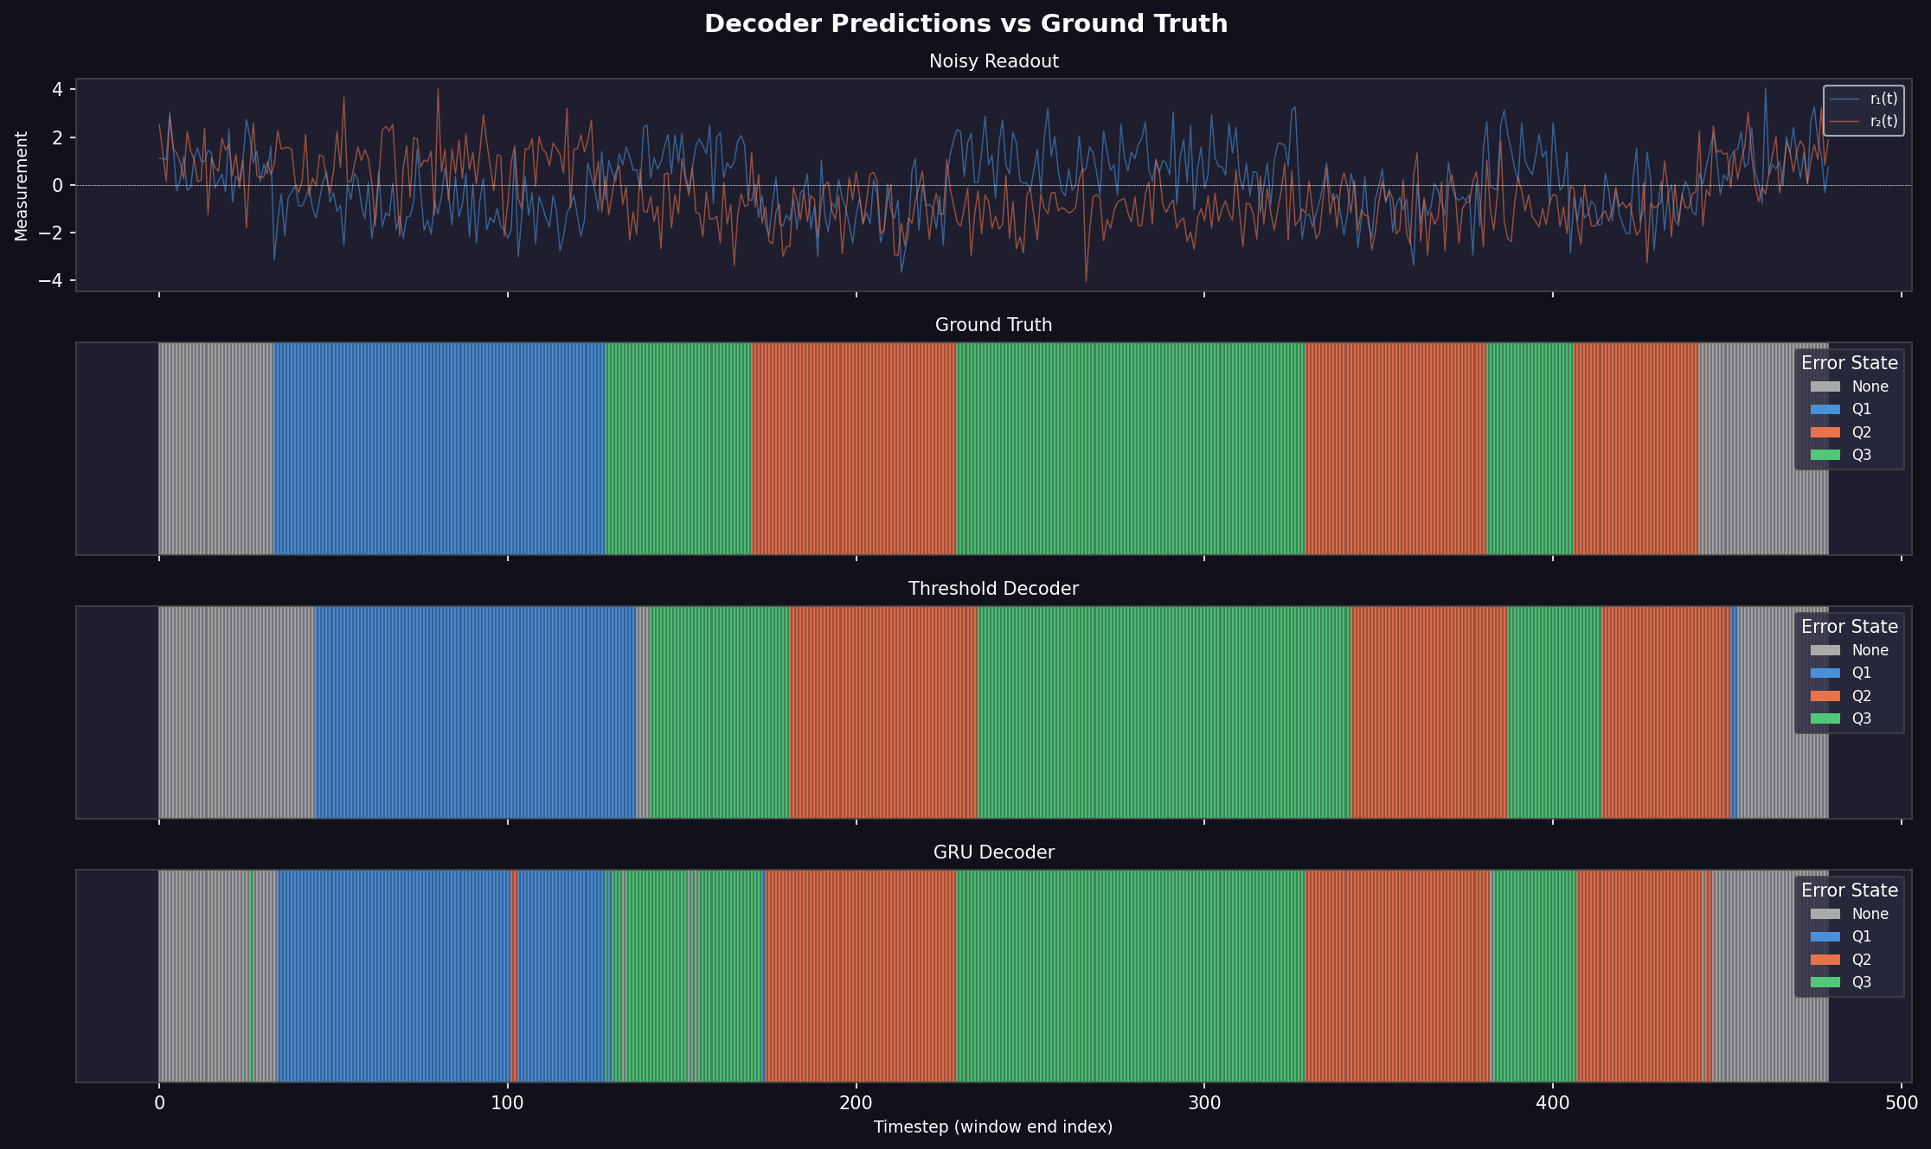
Real Measurements Are Noisy Analog Signals
• Real hardware gives continuous readout:
r(t) = signal + noise
• The decoder must infer the error state
from a noisy time series
• This is a classification problem:
4 error classes from 2 noisy signals
• This is where ML comes in — we're doing
signal processing under uncertainty
Notes:
We're not doing textbook QEC with discrete syndrome bits. We're working with continuous analog readout buried in noise. The decoder has to figure out what happened from messy real-valued signals.

Slide 5
Three Decoders, Head to Head
Threshold
Bayesian Filter
GRU Neural Net
Average signal, check the sign
Optimal probabilistic filter (Wonham/HMM)
Recurrent network that learns from data
No model needed Fast, simple, fragile
Requires known noise model Optimal when assumptions hold
Learns the model from examples Robust to model mismatch
The Bayesian filter is mathematically optimal IF you know the exact noise model. The GRU doesn't need that assumption — it learns directly from data.
Notes:
The Bayesian filter is the gold standard — optimal under known noise model. The GRU learns the dynamics from data. The question is: which wins when the model is wrong?

Slide 6
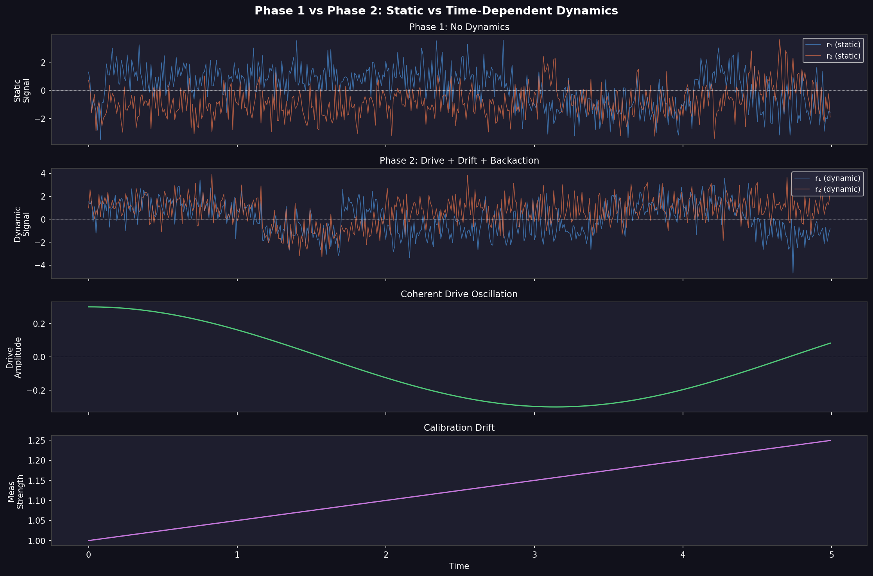
Phase 1 & 2: GRU Wins Under Dynamics
Phase 1 — Static (ideal)
Phase 2 — Hamiltonian dynamics
Decoder | Accuracy
Threshold | ~86%
GRU | ~96%
Decoder | Accuracy
Threshold | ~85%
Bayesian Filter | ~94%
GRU | ~96%
When we add coherent drive, calibration drift, and measurement backaction, the Bayesian filter's assumptions break. The GRU maintains performance by learning dynamics directly from data.
Notes:
Phase 1 is the easy case. Phase 2 adds real physics. The Bayesian filter degrades because its model is wrong. The GRU just learns the dynamics.

Slide 7
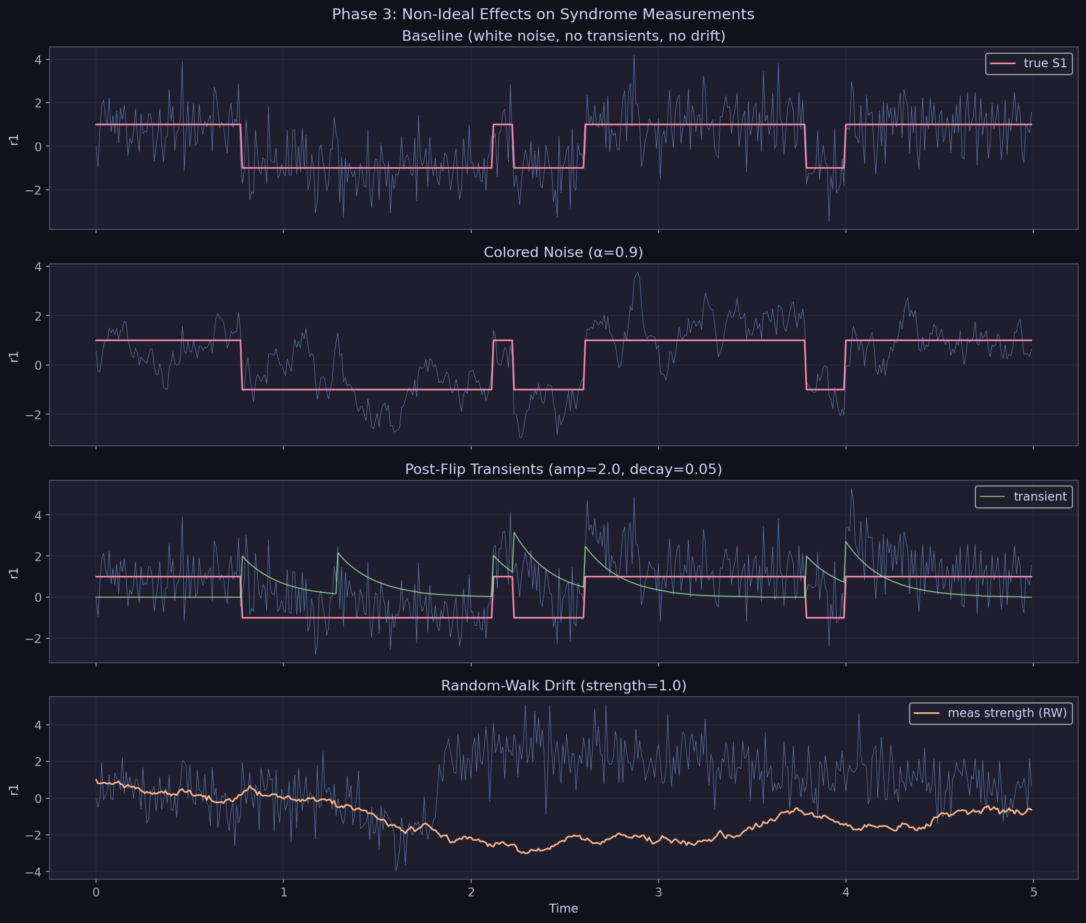
Phase 3: Real Hardware Is Worse Than You Think
Three non-idealities that break
model-based decoders:
1. Colored noise
Temporally correlated (AR(1)),
not white Gaussian
2. Post-flip transients
Exponential ring-down after
each error event
3. Random-walk drift
Measurement calibration wanders
via Brownian motion
Notes:
These effects appear in real superconducting qubit hardware. The Bayesian filter assumes white noise and static parameters — both assumptions are now violated.

Slide 8
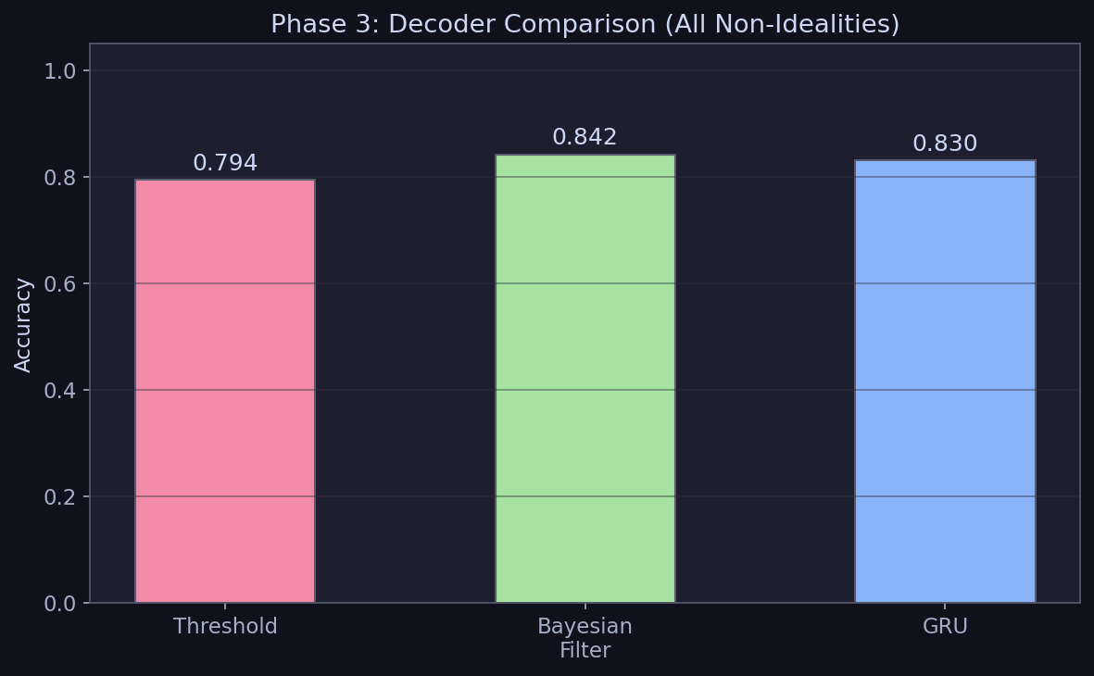
Phase 3 Results: Everyone Degrades
Decoder | Accuracy | Notes
Threshold | 79.4% | Simple averaging fails with colored noise
Bayesian Filter | 84.2% | White noise assumption violated
GRU | 83.1% | Learns from data, but overfits
Key insight: The Bayesian filter's advantage disappears when its assumptions are wrong. The GRU is competitive but needs more data. This motivates our key question...
Notes:
Bayesian and GRU are neck-and-neck. The model-based approach loses its edge when the model is wrong. What happens when things get even worse?

Slide 9
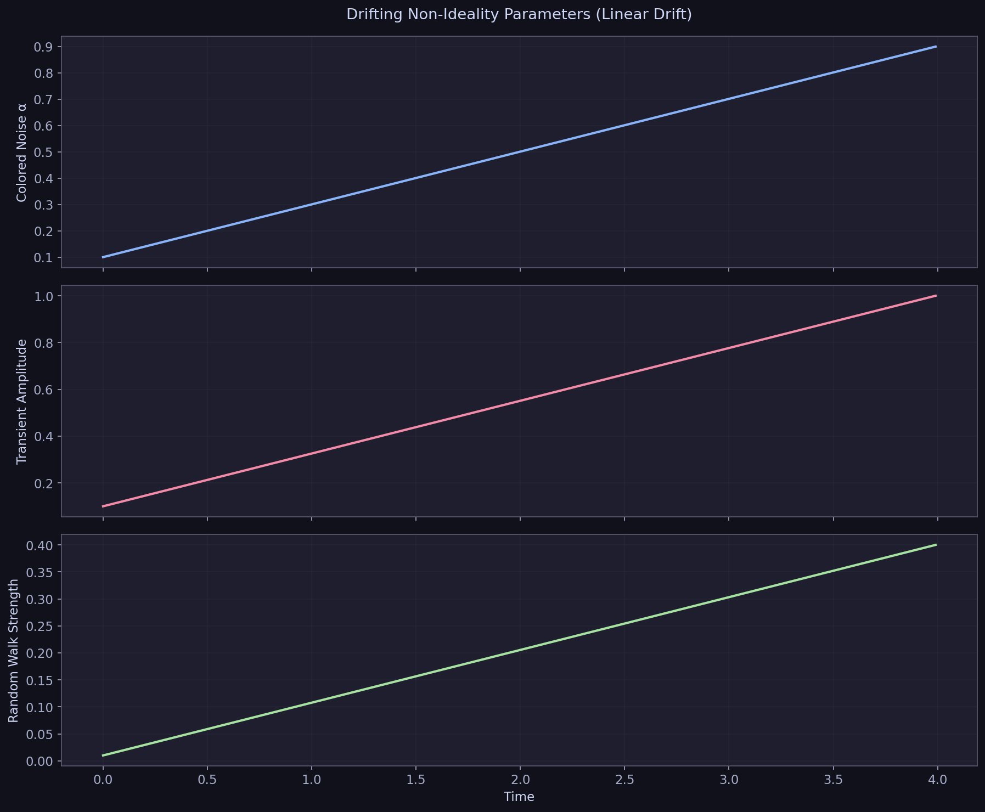
Phase 4: Hardware Drifts During Operation
• Real quantum hardware drifts continuously:
temperature, aging, environment
• Parameters aren't just non-ideal —
they're non-stationary
• A decoder trained on yesterday's noise
fails on today's hardware
• Current solution: stop computation,
recalibrate, restart (expensive!)
Notes:
This is the problem nobody has solved with ML decoders. You train your network, deploy it, and within hours the hardware has drifted. The industry solution is constant recalibration.

Slide 10
Our Solution: A Decoder That Keeps Learning
Same GRU architecture, but weights update during inference
EMA-smoothed gradient updates — stable, low-overhead
Three adaptation strategies tested:
Static GRU
Trained once, frozen (baseline)
Pseudo-label
Self-training with confident predictions → fails under drift
Hybrid
Periodic true labels + pseudo-labels → prevents pseudo-label collapse
Notes:
Key insight: pure self-training fails because when the model is confidently wrong, it reinforces its own mistakes. But periodic recalibration anchors the model.

Slide 11
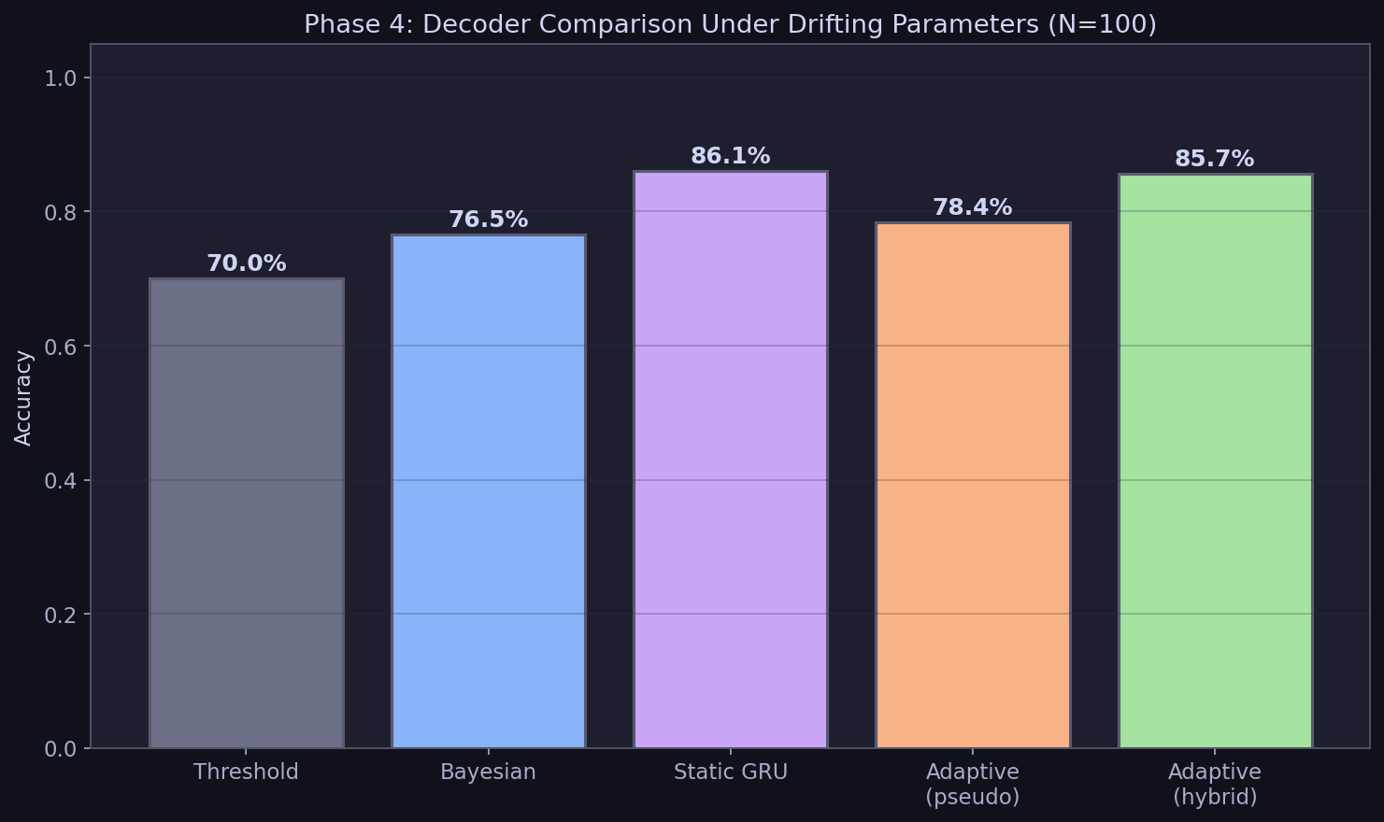
Phase 4 Results: Five-Way Decoder Comparison
Overall accuracy under drifting non-idealities (N=100, T=400)
Decoder | Accuracy
Threshold | 70.0%
Bayesian Filter | 76.5%
Static GRU | 86.1%
Adaptive (pseudo-labels) | 78.4%
Adaptive (hybrid, every 20) | 85.7%
Notes:
The headline number matters less than the temporal breakdown on the next slide.

Slide 12
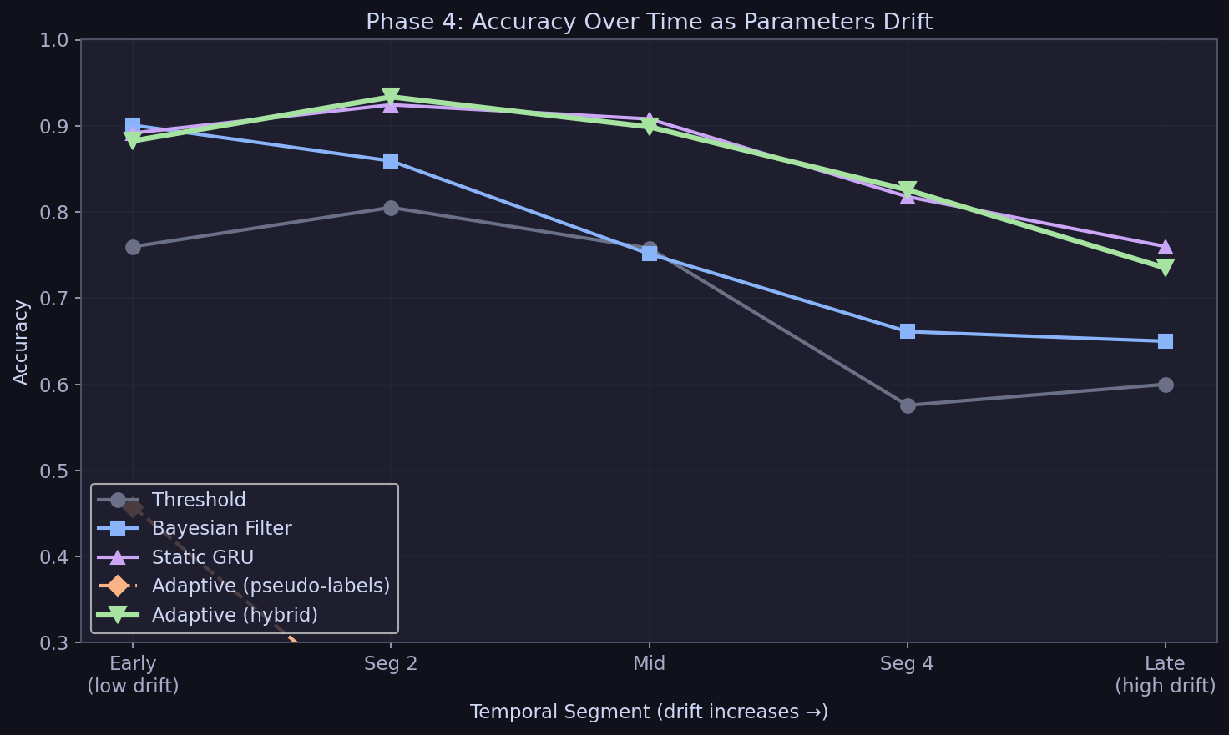
⭐ As Hardware Drifts, Static Decoders Fail — Adaptive Survives
Static drop 13.2pp · Hybrid drop 14.7pp · Pseudo-label collapses to 12–46% across all segments
Segment | Threshold | Bayesian | Static GRU | Pseudo-label | Hybrid
1 (early) | 76.0% | 90.1% | 89.2% | 45.8% | 88.2%
2 | 80.5% | 85.9% | 92.4% | 20.9% | 93.4%
3 (mid) | 75.8% | 75.1% | 90.8% | 12.2% | 89.9%
4 | 57.6% | 66.1% | 81.8% | 19.7% | 82.6%
5 (late) | 60.0% | 65.0% | 76.0% | 26.4% | 73.5%
Notes:
THIS IS THE KEY SLIDE. Point to the lines diverging. Early on, everyone does fine. As parameters drift, static decoders fall off. Pseudo-label barely helps — confident wrong predictions poison self-training. Hybrid maintains accuracy. This is the path to self-calibrating QEC.

Slide 13
Why Pure Self-Training Fails: The Pseudo-Label Trap
• Model stays ~99.9% confident on average
• But accuracy collapses to 26.4% at segment 5
• High confidence + wrong answer = poisoned labels
• The model reinforces its own mistakes
• Accuracy stays below 50% across every segment
Correct + High Conf
✅ Good
Wrong + High Conf
❌ Poison!
Correct + Low Conf
⚠️ Skip
Wrong + Low Conf
⚠️ Skip
The confidence threshold can't save you when the distribution shifts. You need ground truth to anchor the model.
Notes:
This is a well-known failure mode in semi-supervised learning. When the data distribution shifts, confident predictions become unreliable.

Slide 14
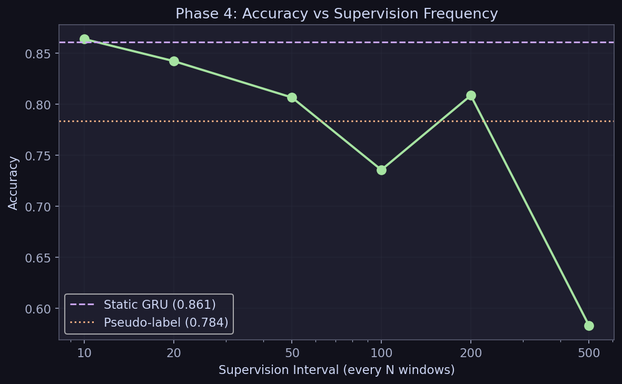
How Often Do You Need True Labels?
Even 1–2% true-label rate holds accuracy within ~6pp of static
Supervision Rate | % Supervised | Accuracy
Every 10 | 10% | 86.4%
Every 20 | 5% | 84.2%
Every 50 | 2% | 80.7%
Every 100 | 1% | 73.6%
Every 200 | 0.5% | 80.9%
Every 500 | 0.2% | 58.3%
Static (none) | 0% | 86.1%
Notes:
Even 1-2% true labels gives most of the benefit. That's one recalibration every 50-100 windows — realistic for real hardware.

Slide 15
The Journey: Four Phases of Increasing Realism
Phase 1
Phase 2
Phase 3
Phase 4
Static Syndromes
Hamiltonian Dynamics
Non-Ideal Effects
Drifting Parameters
→
→
→
GRU: ~96%
GRU: ~96% Bayes: ~94%
GRU: ~83% Bayes: ~84%
Hybrid: 85.7% Static: 86.1%
Ideal world
Add physics
Add hardware imperfections
Hardware changes during operation
Notes:
Each phase adds realism. Phase 1-2: GRU dominates. Phase 3: non-idealities level the field. Phase 4: only adaptive decoders survive drift.

Slide 16
What's Novel Here
1
First adaptive ML decoder for QEC
Online learning during inference — nobody has done this
2
Time-varying non-ideality simulator
Parameters drift within trajectories, not just between them
3
Hybrid supervision strategy
Periodic recalibration prevents pseudo-label collapse while static decoders cannot adapt at all
4
Comprehensive benchmark
5 decoders × 4 phases of realism, 248 unit tests
Notes:
Phase 4 is entirely novel. Nobody has done adaptive online learning for QEC. The simulator and hybrid supervision approach are new contributions.

Slide 17
Future Work & Path to Impact
→ Larger codes
Scale from 3-qubit to surface codes (the industry standard)
→ Real hardware
Validate on IBM / Google superconducting qubits
→ Smarter adaptation
Meta-learning to adapt faster, ensemble methods
→ Multi-task learning
Simultaneously decode errors AND estimate drifting parameters
→ Publication
Quantum ML workshops (NeurIPS, ICML) or journals (PRX Quantum)
Notes:
The 3-qubit code is a proof of concept. The real test is surface codes. But the principle — adaptive online learning for QEC — transfers directly.

Slide 18
Quantum Computers Break. We Taught a Neural Network to Keep Up.
1. Model-based decoders fail when hardware doesn't match the model
2. Static ML decoders fail when hardware drifts over time
3. Adaptive decoders with periodic recalibration maintain accuracy
Self-calibrating quantum error correction is possible. This is the first step.
Notes:
Three clean takeaways. End strong.

Slide 19
Backup: GRU Architecture Detail
Input: (window_size, 2) — measurement windows of r₁(t), r₂(t)
GRU: 64 hidden units, 1 layer, batch_first=True
Classifier: Linear(64→32) → ReLU → Dropout(0.1) → Linear(32→4)
Training: Adam optimizer, lr=0.001, 50 epochs, batch_size=256
Adaptive additions:
• EMA gradient buffers (decay=0.7)
• Online weight updates (adapt_lr=0.001)
• Confidence threshold for pseudo-labels (0.8)
• supervised_every parameter for hybrid mode

Slide 20
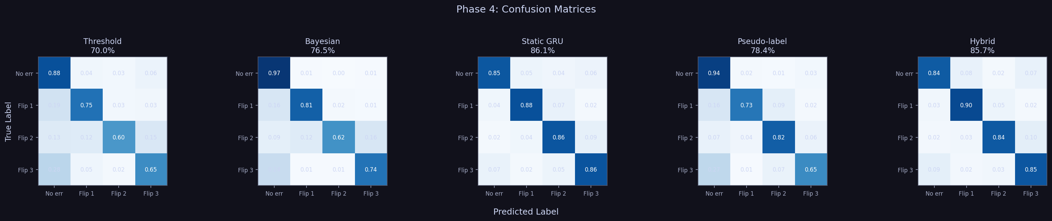
Backup: Confusion Matrices

Slide 21
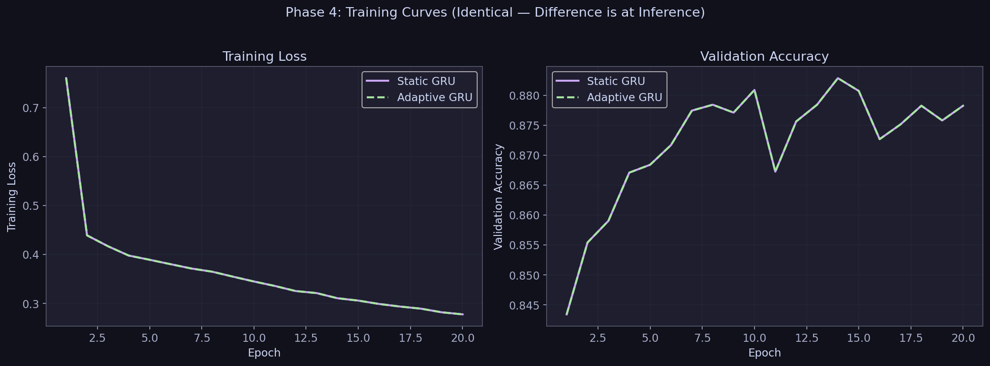
Backup: Training Curves
Static and adaptive GRU have identical training curves — difference is at inference only

Slide 22
Backup: Test Suite & Reproducibility
248 unit tests across all phases:
• 44 tests — quantum operator math
• 58 tests — Phase 2 Hamiltonian simulator
• 22 tests — Bayesian filter
• 99 tests — Phase 3 non-ideal effects
• 25 tests — Phase 4 adaptive decoder (incl. hybrid supervision)
Backward compatibility verified:
Phase 4 (no drift) == Phase 3 == Phase 2 == Phase 1
Full reproducibility via seeded RNG (seed=42 throughout)
Repository: github.com/pkarakala/cqec-ml-decoder

