Slide 1
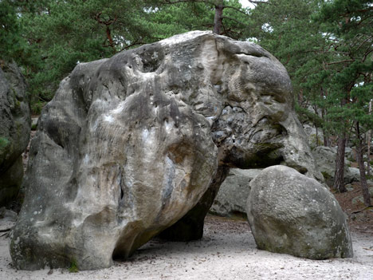
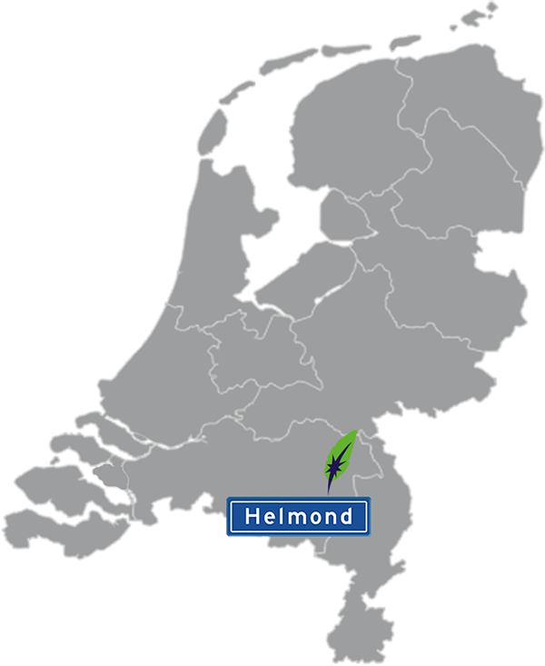

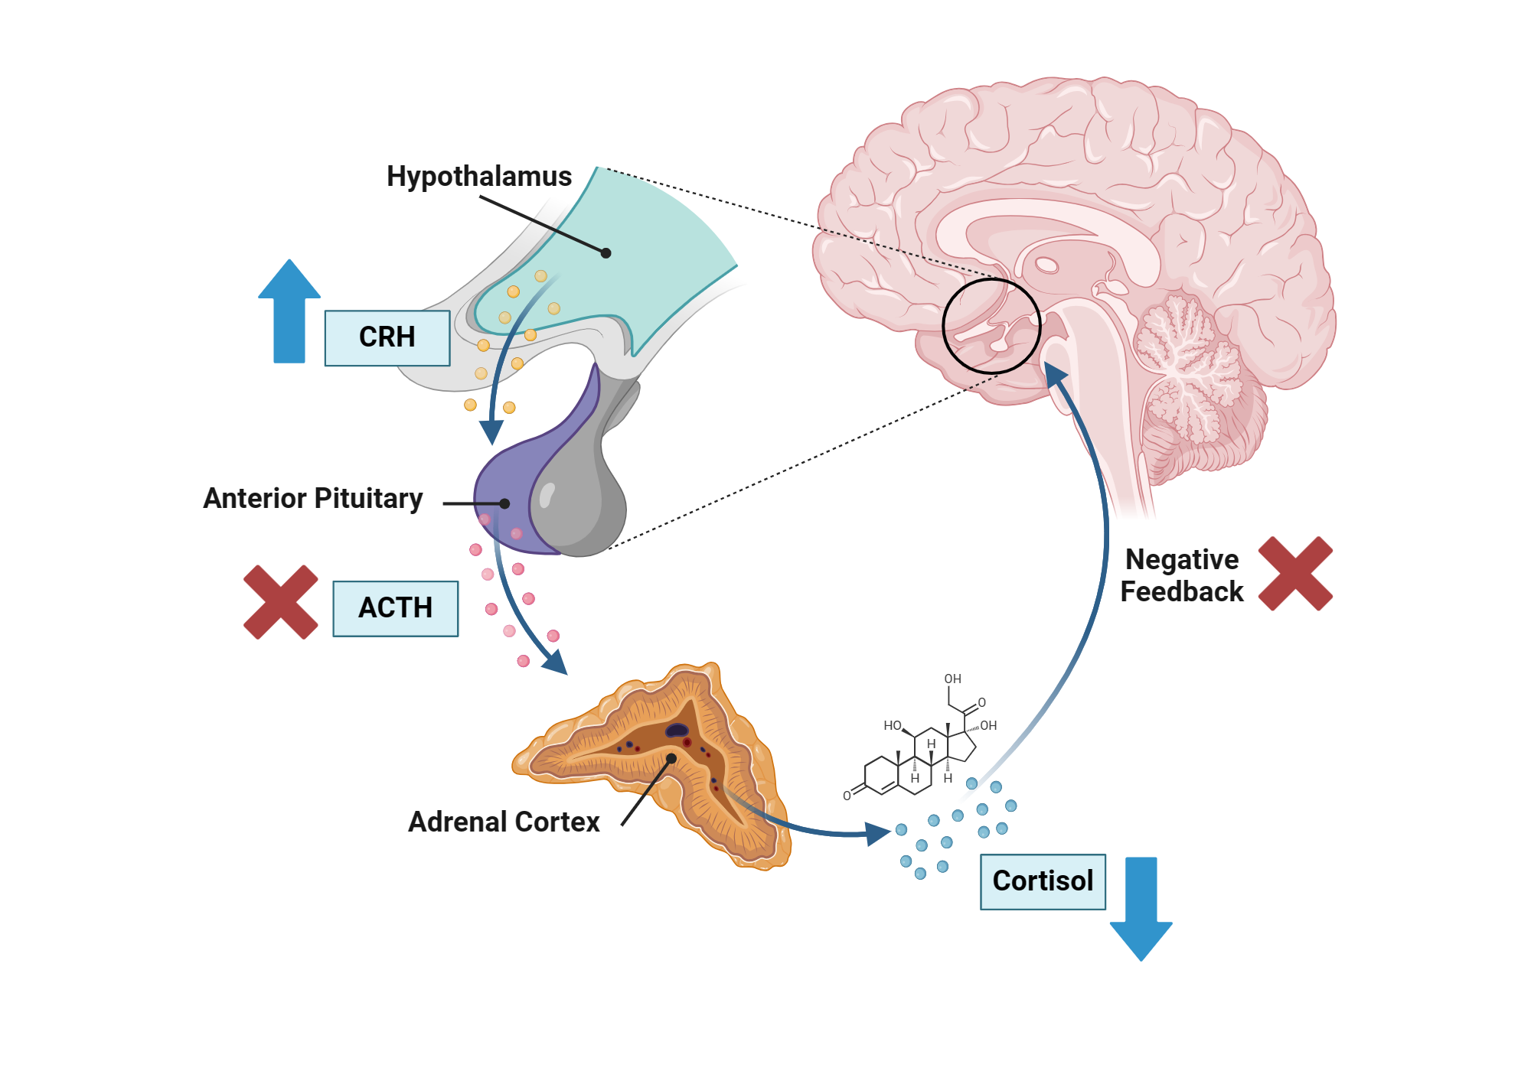



Ice Breaker (Marc)

Slide 2
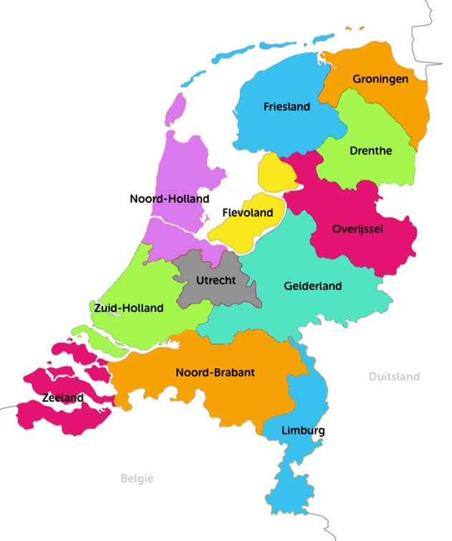
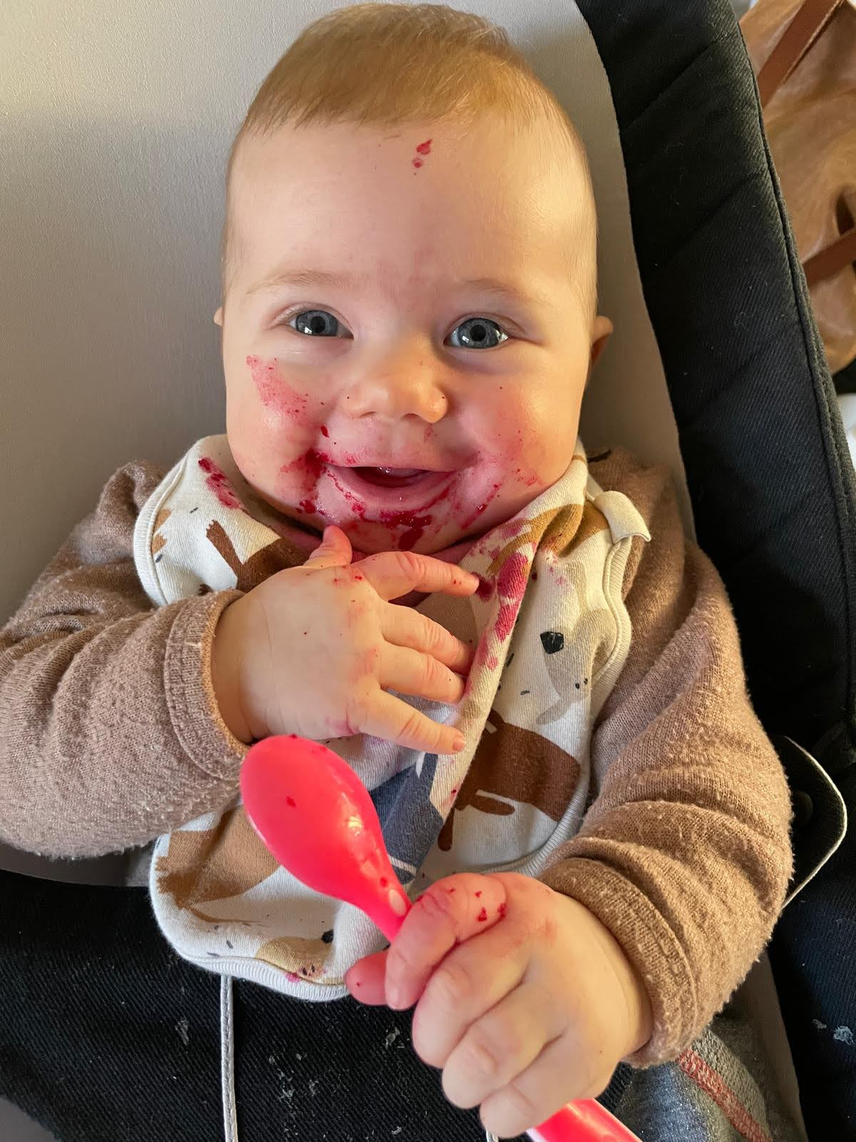
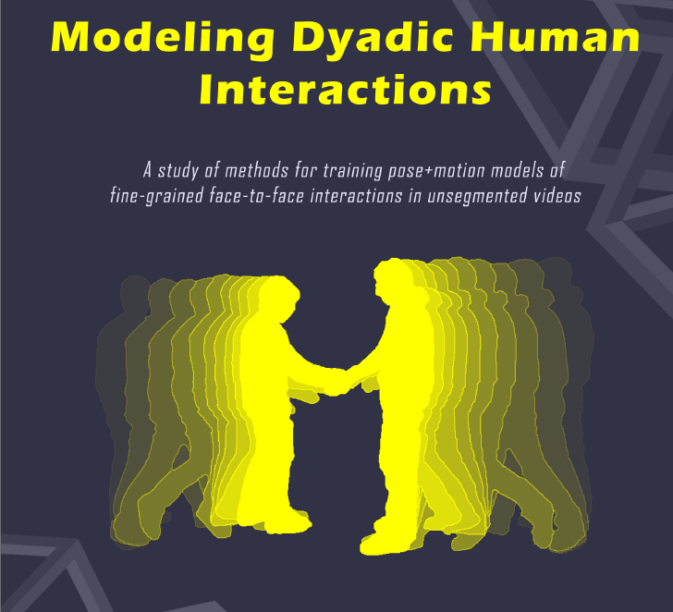

Ice Breaker (Coert)
Research scientist into technical aspects and challenges of bringing AI and Computer Vision to industry and/or society
Hannah
Hilversum
Rotterdam
Alpha.one lead R&D computer vision for visual saliency prediction in marketing tool Junbi.ai

Slide 3
Ice Breaker (Michael)

Slide 4
Ice Breaker (Panos)

Slide 5

Ice breaker crowd

Slide 6
Course contents - overview
Day 1; Introduction to AI, Classical Machine Learning, Hands-on modelling and back ground theory
Day 2; Foundation Models, more advanced AI, Hands-on optimizing models
Materials: <Github url>, <Google Docs>

Slide 7
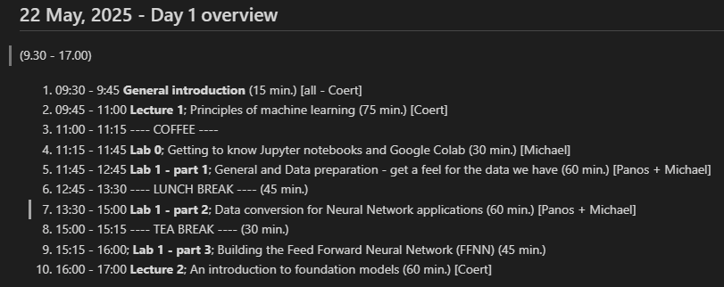
Day 1
https://github.com/pkaramertzanis/modelling_hazard_assessment/blob/master/agenda/001_echa_course_contents.md

Slide 8
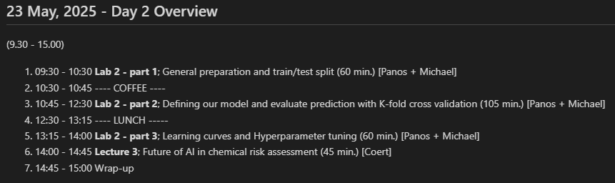
Day 2
https://github.com/pkaramertzanis/modelling_hazard_assessment/blob/master/agenda/001_echa_course_contents.md

