Slide 1

MUSIC INFLUENCES EMOTION
GW Data Analytics Bootcamp | Project 1 | 2024.2.January
Patrick Karey
Derick Ngeyen
Jessica Snowden

Slide 2
Impact of Music
Music offers a resource for emotion regulation. People use music to achieve various goals, such as to energize, maintain focus on a task, and reduce boredom. For instance, sad music enables the listener to disengage from the distressing situations (breakup, death, etc.), and focus instead on the beauty of the music (Huron & Margulis, 2011).
Authors Huron , Margulis E. H. provides research on how the frequency of specific genres of music does influence emotion and mental functioning just as music positive emotion it can also promotive a negative emotion.
Our Data reflects popular genres within a specific age group and how music impacts emotions within a given age and how listening to a specific genre can cause a positive experience based on the given age group.
Notes:
DISPLAY DATA on the Next Slides

Slide 3
MUSIC DATA
INCLUDES a SURVEY of over 700+ Participants
DATA COLUMNS
DATE, TIME, AGE, FREQUENCY, GENRE, MENTAL FUNCTION, EXPERIENCE (RESULT after listening)
MUSIC DATA

Slide 4
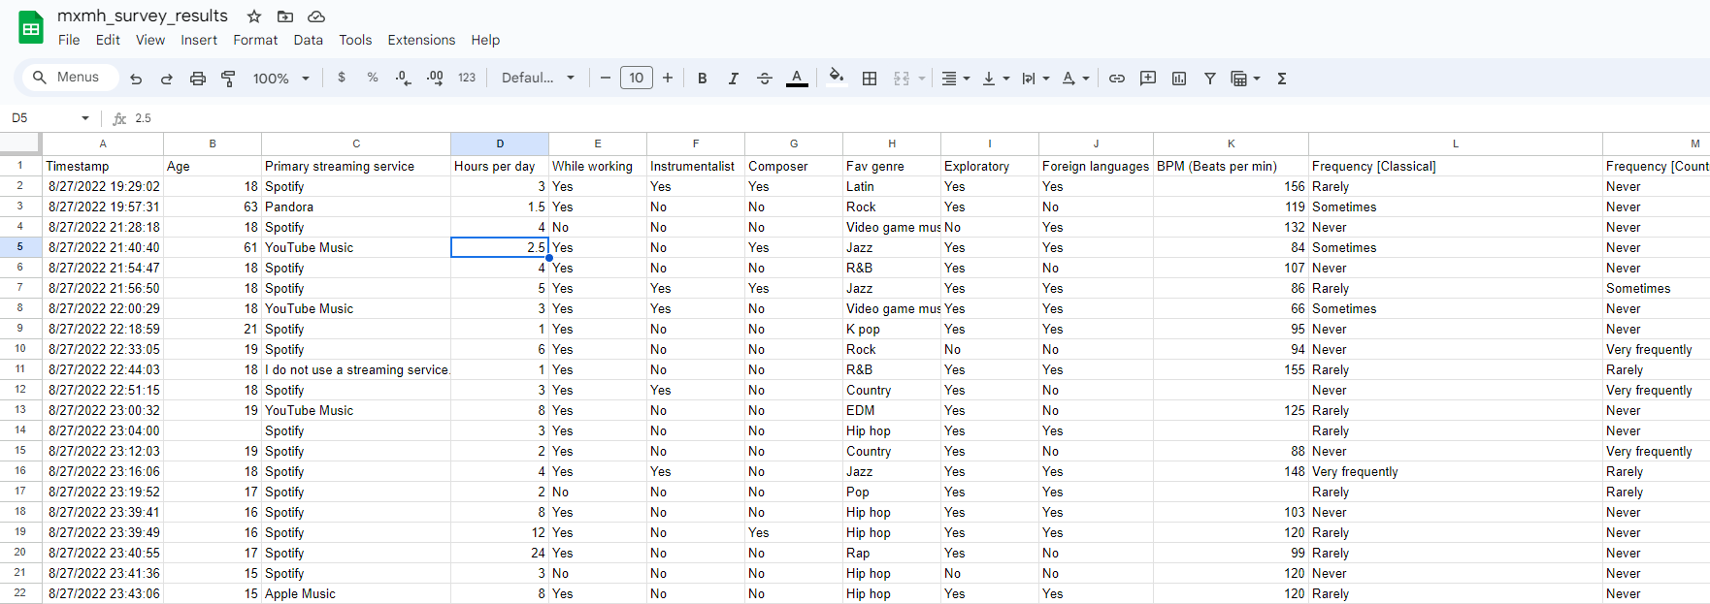
DATA Continued

Slide 5
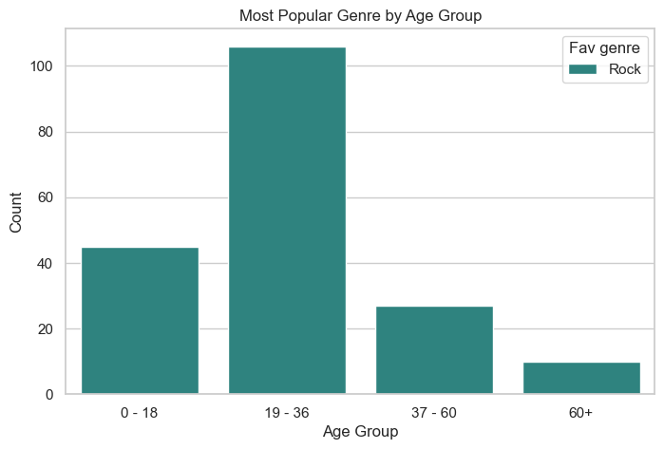
Popular Genre Across AGE
Categorizing AGE GROUP
Notes:
### Data Preparation
Step 1 - Add age group to make it categorical
Step 2 - Make features numerical to make it easy for analysis
Step 3 - Replace nulls will appropriate values

Slide 6
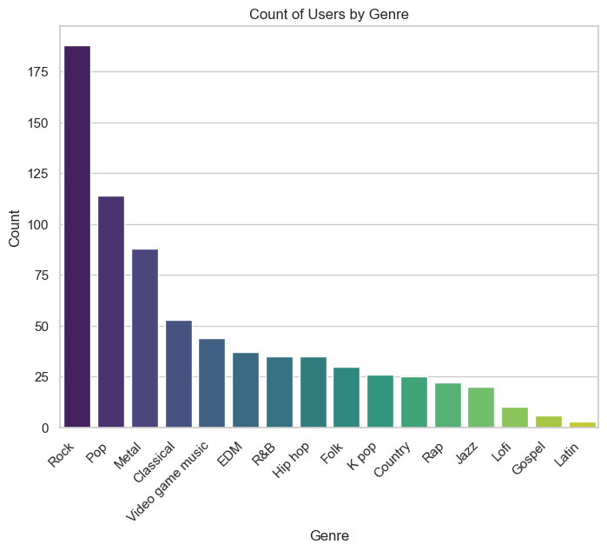
Distribution of Genres of different ages
(by genre_counts to show how data is being calculated)
Gender Trend and what people like the most

Slide 7
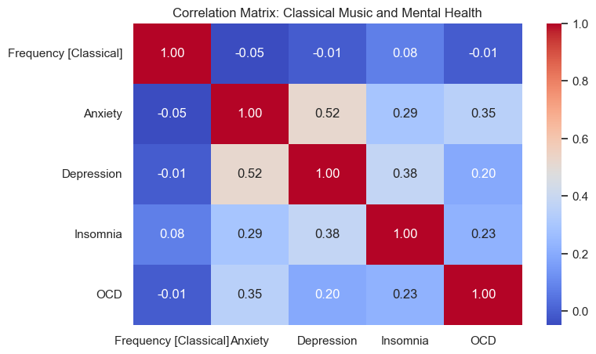
Correlation between Classical Music & Medical Condition
Depression and Classical music have a high correlation compared to Insomnia and OCD
Notes:
People Listening to LOFI have a better outcome (positive experience) with anxiety, depression, insomnia (decrease symptoms relating to condition)

Slide 8
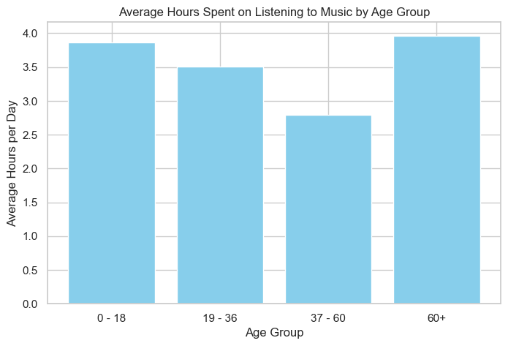

Slide 9
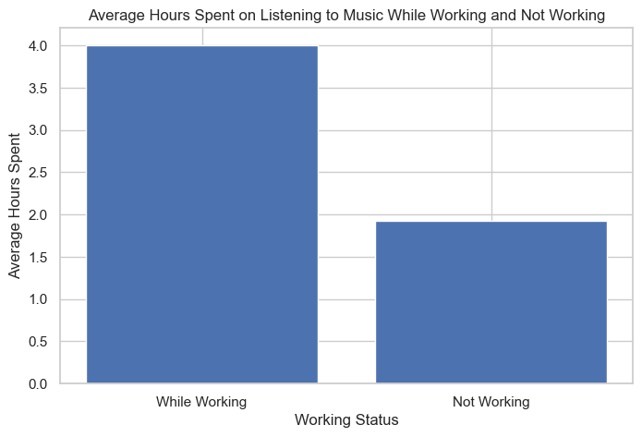
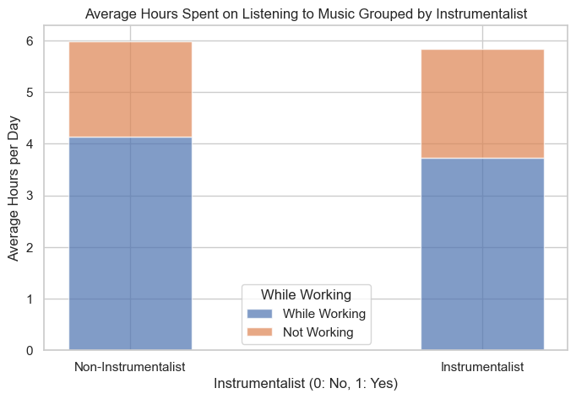

Slide 10
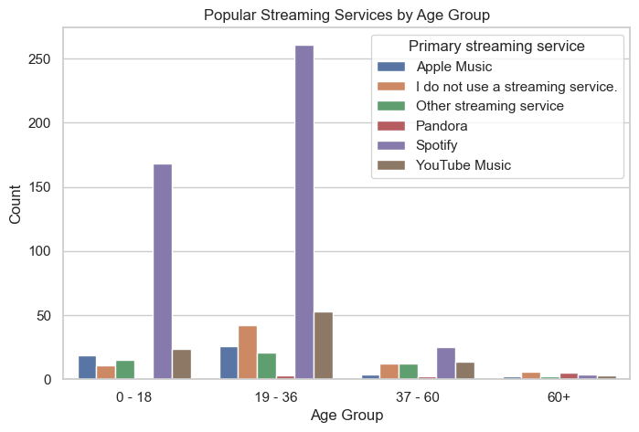
Popular Streaming Service by Age Group

Slide 11
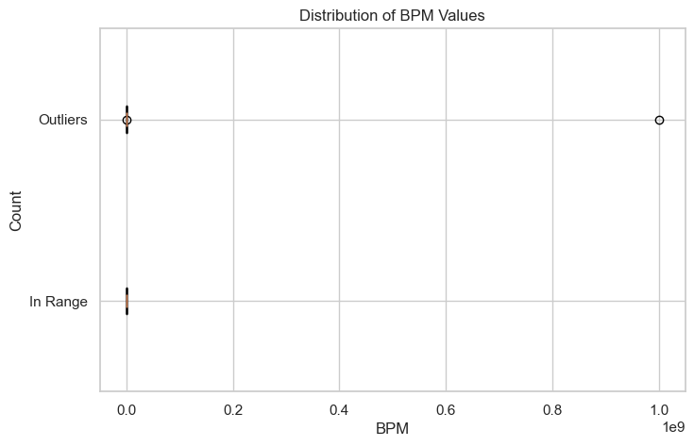
DATA DISCPRENCIES

Slide 12
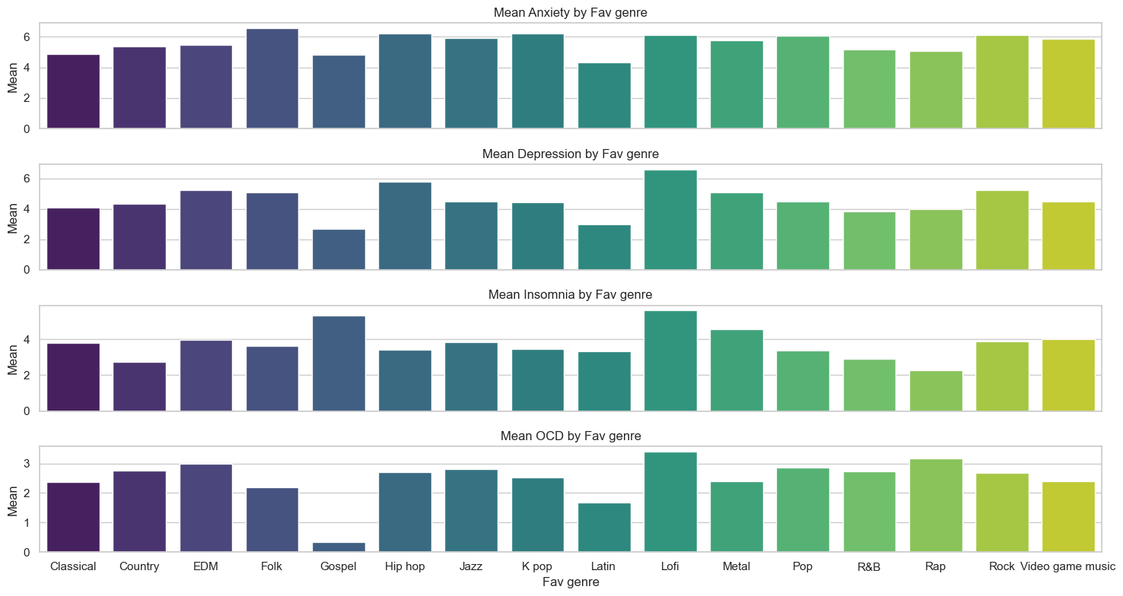
CONCLUSION

Slide 13
References
Davies, J.B. (1978). The psychology of music. London: Hutchinson.
Huron D., Margulis E. H. (2011). “Music expectancy and thrills,” in, Handbook of Music and Emotion: Theory, Research, Applications, eds Juslin P. N., Sloboda J. A., editors. (New York: Oxford University Press; ), 575–604
Juslin PN (2019), Musical Emotions Explained, Oxford University Press.

