Slide 1


FoodPacker
An application which allows users to form shop list from home and then get already packed shopping bags in the shops.
NN ©️

Slide 2
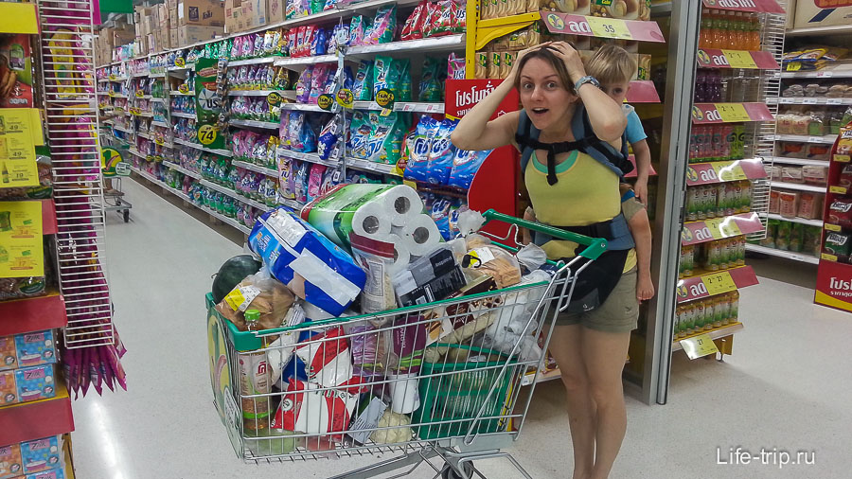
SO MANY THINGS TO DO!
DO YOU WANT TO BE LIKE THIS WOMAN…

Slide 3

OR LIKE THIS WOMAN?

Slide 4
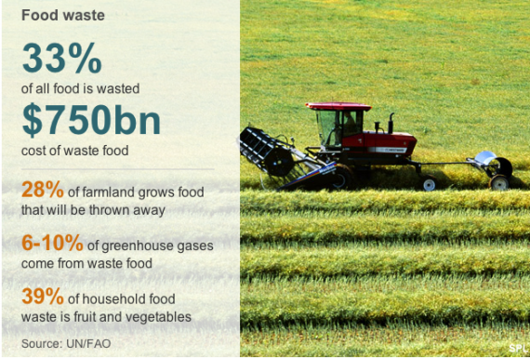

Slide 5
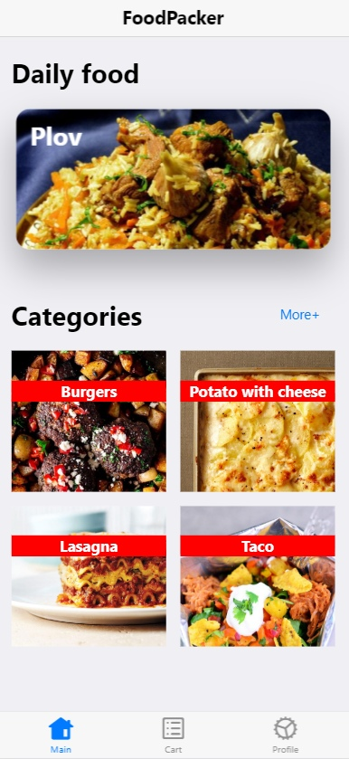
ANDROID PROJECT
Place your screenshot here
YOU CAN CHECK IT THERE

Slide 6






USER’S PROCESS IS EASY
Choosing recipe
Choosing market(s)
Packing shopping cart in the app.
Packing in real life.
Getting prepared bag in a market

Slide 7






ADVATAGES
PEOPLE
MARKETS
Economy of time
Increasing of sales
Less thieves
Comfort
Controlling your purchases
Less spoiled food

Slide 8






TARGET MARKET IS YAKUTSK CITY’S
Markets
Wholesale stores
Really huge shops
Storages of products
Regular People
18-21 years old students
22-65 years old workers or parental leavers
60-75 years old people
Notes:
14-21 years old students, 22-65 years old workers, 60-75 years old

Slide 9
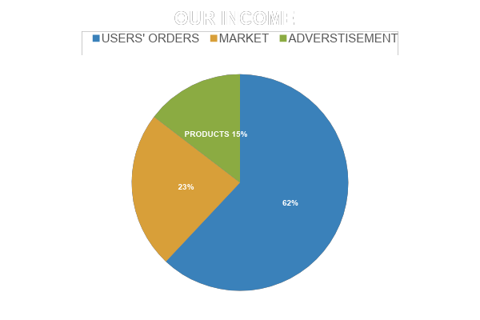
MONETIZING

Slide 10
FUTURE UPDATES
Delivery by our app
Adaptive recipes based on individual preferences
Adding users’ own recipes
Ignoring some products at all
Full information about ingredients
Teleportation
We are ready for any suggestions from you.

Slide 11
5
Hey! We going to increase this number!

Slide 12

MAPS
our office

Slide 13
PROCESS OF WORKING IN HACKATHON
19/04
Fed2019/04
/12wdw
20/04
Concept
Hard working
THE PROJECT
1919/04
/04
21/04
Finish

Slide 14
THANKS!
Any questions?
You can find us at
valerii777999@gmail.com – developer, team leader
petrkathrine@mail.ru - manager
ziqunion95@gmail.com - developer
nyrgun01@gmail.com - designer

