Slide 1
E2B
E2E
etc
E2B
B2B
C2B
C2C
The Machine
E = Employee, B = Business, C = Customer

Slide 2
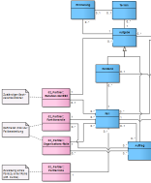
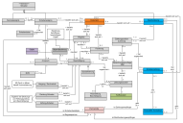
E2B
E2E
etc
E2B
B2B
C2B
C2C
The Machine
Occasion
Business Objects
E = Employee, B = Business, C = Customer

Slide 3
E2B
E2E
etc
E2B
B2B
C2B
C2C
The Machine
Input
Output
Processing
E = Employee, B = Business, C = Customer

