Slide 1
Replica
SM Travels
Kaustubh Pandey
Model Logics
Arrivals as per schedule & types given
Trunk lines and reserve lines
Methods for expected wait time estimation
Three pools of Operators
Callers queueing priority
Callers and Operators matching as per logic given
After call work after releasing trunk line
Operator shift patterns
Animation
2D animation
3D animation
Graphs for required performance measures
Assumptions
Single parameter optimization
No customer calling back after hanging up once
No major optimization done
Simulation Execution
Simulation time units = mins
Simulation Run Length = 540
Number of replications = 500
Number of alternative designed compared = 1
Warm up period, if any =
Simulation Optimisation used? Yes

Slide 2
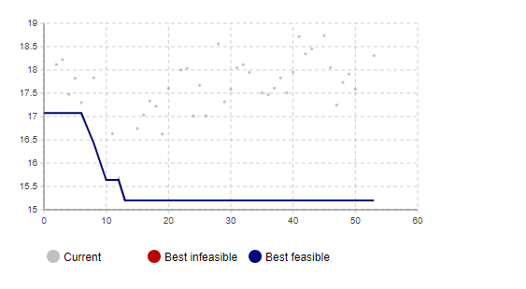
Replica
SM Travels
Output measures | Base Case | Alternate 1 | Alternate 2
1. Fraction of Gold customers with wait/ queue time of <= 90 secs
2. Fraction of Silver customers with wait/ queue time of <= 3 mins
3. Fraction of regular customers with wait/ queue time of <= 15 mins
4. Fraction cardholders receiving busy signal
5. Fraction regulars receiving busy signal
Operating Cost per day | 18559 | 17619
SETTINGS (write the value for each below) | regop=14, slvop=19, gldop=35 | regop=16, slvop=30, gldop=21
Trunk lines | 68 | 67
Number of cardholder reserve lines | 54 | 51
Operators by type and shift
mean_wait_time | 19.981 | 17.899
Difficulties and Learnings
Hard to optimize a multi-parameter based system
Most crucial task: output analysis
Could not account for efficiency

Slide 3
Replica
SM Travels
Wait time estimation logic:
x -> entity to calculate for
def wait_time():
a = []
for i in queue.before_x():
a += i.wait_time() + j.delay_time()) (j is caller being served at the moment)
return a

Slide 4
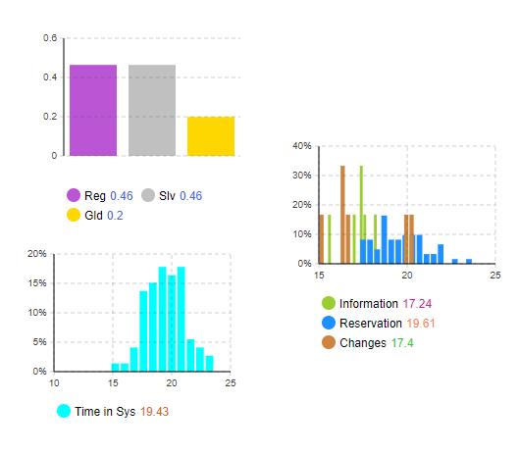
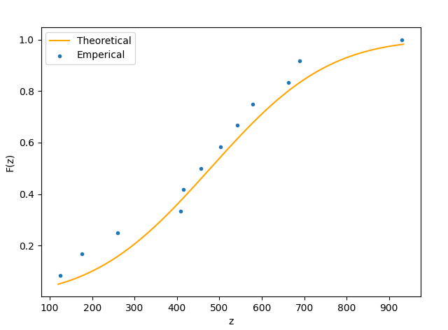
Replica
SM Travels
Recommendation: Keeping operator distributions a somewhat triangular(reg, slv, gld)

