Slide 1


When Choosing Plausible Alternatives, Clever Hans can be Clever
Pride Kavumba Naoya Inoue Benjamin Heinzerling
Keshav Singh Paul Reisert Kentaro Inui
https://balanced-copa.github.io
Notes:
Add logos remove affiliations. add logs
remove github logo and text

Slide 2
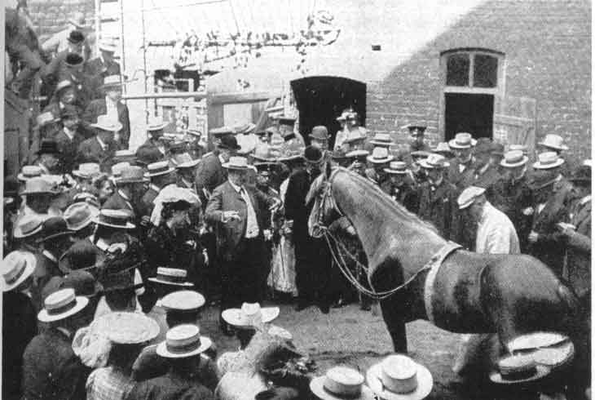
Clever Hans performed arithmetic by
exploiting cues from handlers
Notes:
Simple math (add)
Picked up nodes (mimic)

Slide 3
Clever Hans Effect in NLP
NLI: models perform well with incomplete input [Gururangan+18; Poliak+18; Dasgupta+18]
Machine Reading Comprehension: superficial cues make questions easier [Sugawara+18]
Argument Reasoning Comprehension: BERT exploits superficial cues (e.g. not). Nearly random performance without cues [Niven+19]

Slide 4

COPA: Choice Of Plausible Alternatives [Roemmele+11]
Benchmark for causal reasoning
Part of SuperGLUE [Wang+19]
Example:
Premise: The woman hummed to herself.
Question: What was the cause for this?
Alternative1: She was in a good mood.
Alternative2: She was nervous.
Notes:
Read the entire example
Explain the reasoning
Reduce overlap

Slide 5
Rise of the Muppets on COPA
Is this the Clever Hans effect?

Slide 6
Research Questions
Does COPA have superficial cues?
If so, do pre-trained language models exploit these cues?
If they do, how do LMs perform without cues?

Slide 7
Superficial Cues in COPA
Superficial cues:
Uneven token distributions across classes
Allow models to use simple heuristics to solve
We found cues in COPA:
Some tokens appear more often in one alternative
Most informative cues: in, was, to, the, a
These cues are predictive of the correct choice

Slide 8

Research Questions
Does COPA have superficial cues?
Yes!
Do pre-trained language models exploit these cues?
Notes:
To answer this question we first train RoBERTa on alternatives

Slide 9
RoBERTa [Liu+19] exploits superficial cues
Experiment: provide only incomplete input
Makes the task impossible
Question: What was the cause of this?
A1: She was in a good mood.
A2: She was nervous
RoBERTa performs better (59.6%) than random chance
Problematic: COPA is designed as a choice between alternatives given the premise

Slide 10
Splitting COPA into Easy and Hard Subsets
Easy subset: instances correctly solved by RoBERTa when shown alternatives only
Hard subset:
Remaining instances

Slide 11
BERT on COPA
BERT strongly exploits superficial cues
BERT improves mainly on the Easy subset

Slide 12
RoBERTa on COPA
RoBERTa also exploits superficial cues
But: RoBERTa seems to rely less on superficial cues than BERT

Slide 13
Research Questions
Does COPA have superficial cues?
Yes!
Do pre-trained language models exploit these cues?
Yes!
How do LMs perform without cues?

Slide 14
Let’s fix COPA!

Slide 15
Balanced COPA
Balanced token distribution across alternatives
This neutralizes superficial cues
Original COPA instance
Mirrored COPA instance
P: The woman hummed to herself.
Q: CAUSE?
She was in a good mood.
❌ She was nervous.
P: The woman trembled.
Q: CAUSE?
❌ She was in a good mood.
She was nervous.
Notes:
Idea between making these tokens balanced and challenging part. If you the idea you can generate much more effective large model

Slide 16
Balanced COPA
Available at
https://balanced-copa.github.io
Makes superficial cues ineffective
Human Evaluation shows it is of similar quality as the original COPA
Notes:
See paper

Slide 17
Training without Superficial Cues
Train BERT and RoBERTa on Balanced COPA
Test on original COPA

Slide 18
Balanced COPA: BERT
Performance on Easy subset drops significantly
BERT strongly relied on superficial cues
Surprising improvements on Hard subset
BERT learns the task to some degree
Notes:
The sort of bias is

Slide 19
Balanced COPA: RoBERTa
Smaller drop on Easy subset
RoBERTa relies less on cues
Larger improvement on Hard subset
RoBERTa learns the task to a greater degree
Notes:
You have two stages one is comparison BERT results first then RoBERTa. Lessons learnt of BERT slide. Change the colors of the graph for different setting. Emphasize it more that performance on the easy and hard its the same

Slide 20

Research Questions
Does COPA have superficial cues?
Yes!
Do pre-trained language models exploit these cues?
Yes!
How do LMs perform without cues?
They do well!

Slide 21
Conclusions
COPA contains superficial cues
BERT exploits these cues
RoBERTa relies less on cues
Balanced COPA does not contain superficial cues (hopefully) https://balanced-copa.github.io
Trained on Balanced COPA, BERT and RoBERTa perform well
Notes:
COPA contains superficial cues
Balanced COPA does not contain superficial cues (Hopefully)

Slide 23
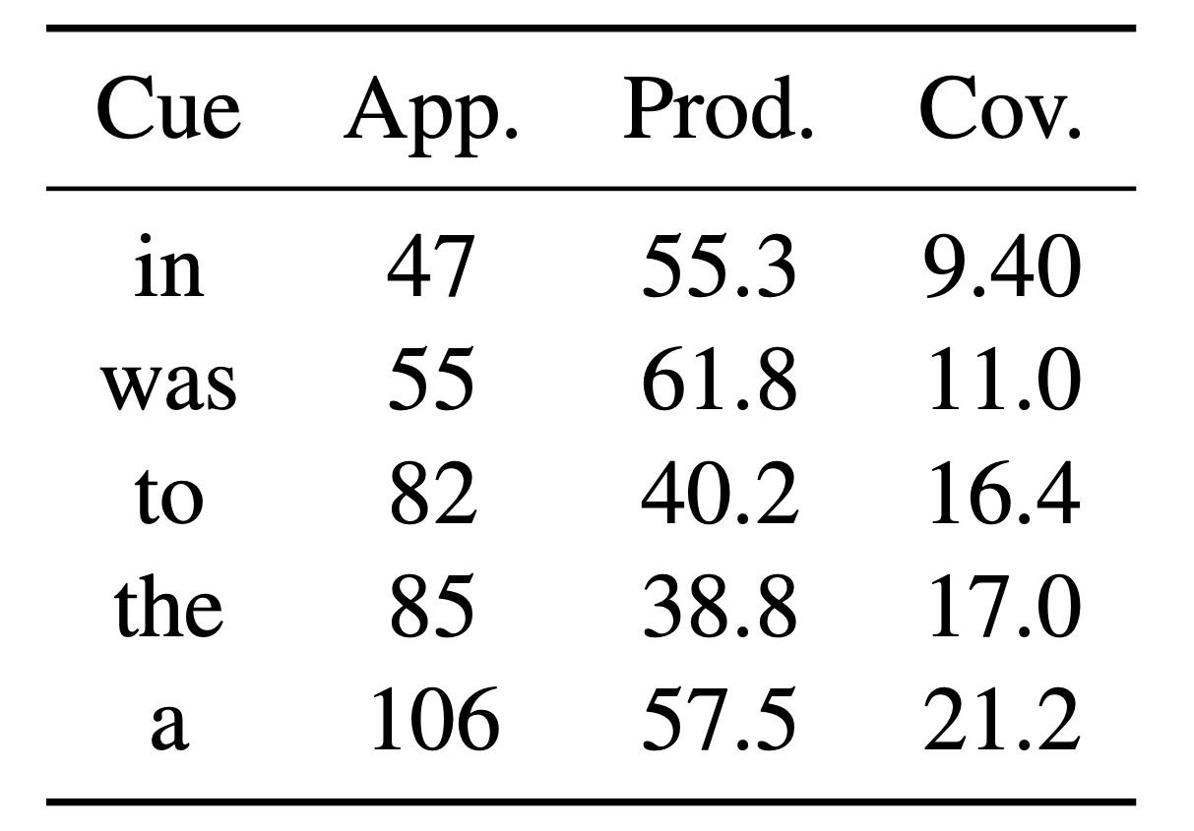
Superficial cues

Slide 24
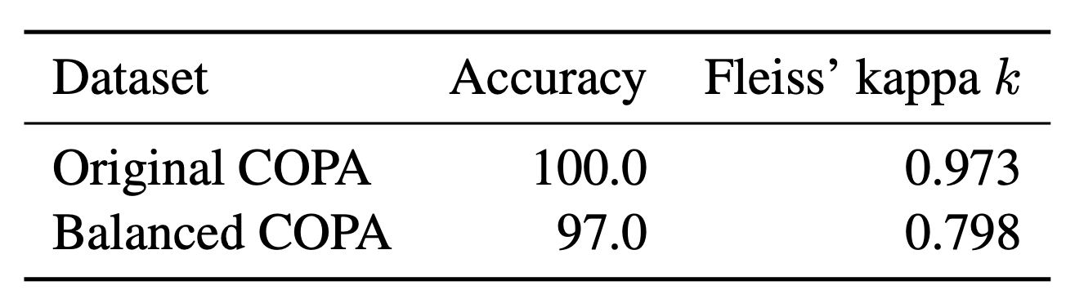
AMT: Human Evaluation

Slide 25
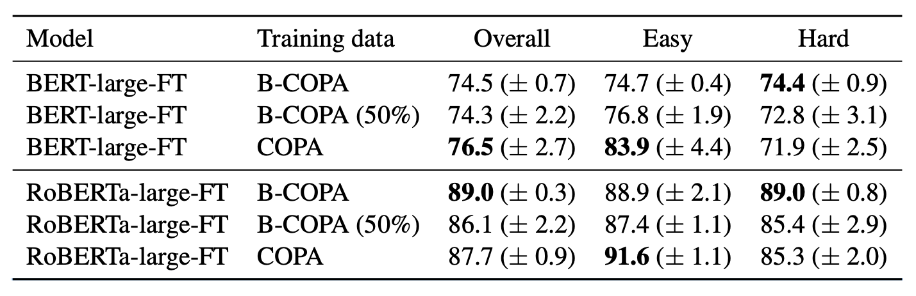
Evaluation on Balanced COPA

Slide 26
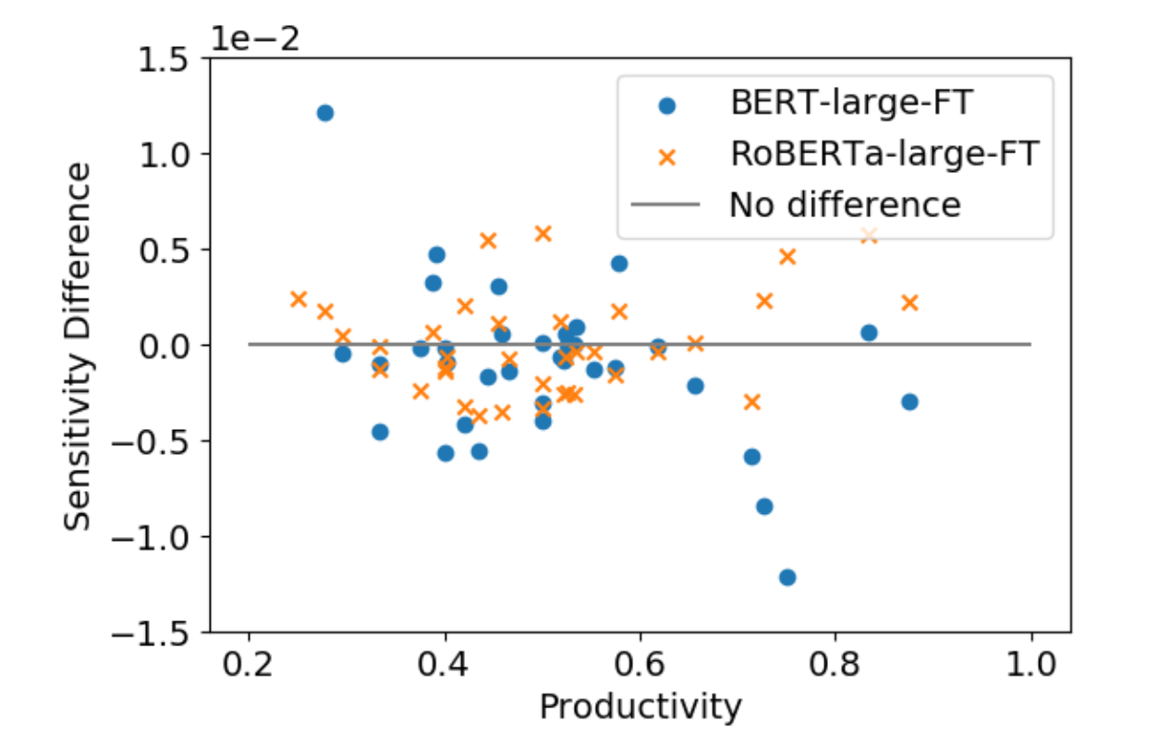
Gradient Sensitivity
BERT’s sensitivity to productive cues reduces
RoBERTa sensitivity change not so clear

Slide 27
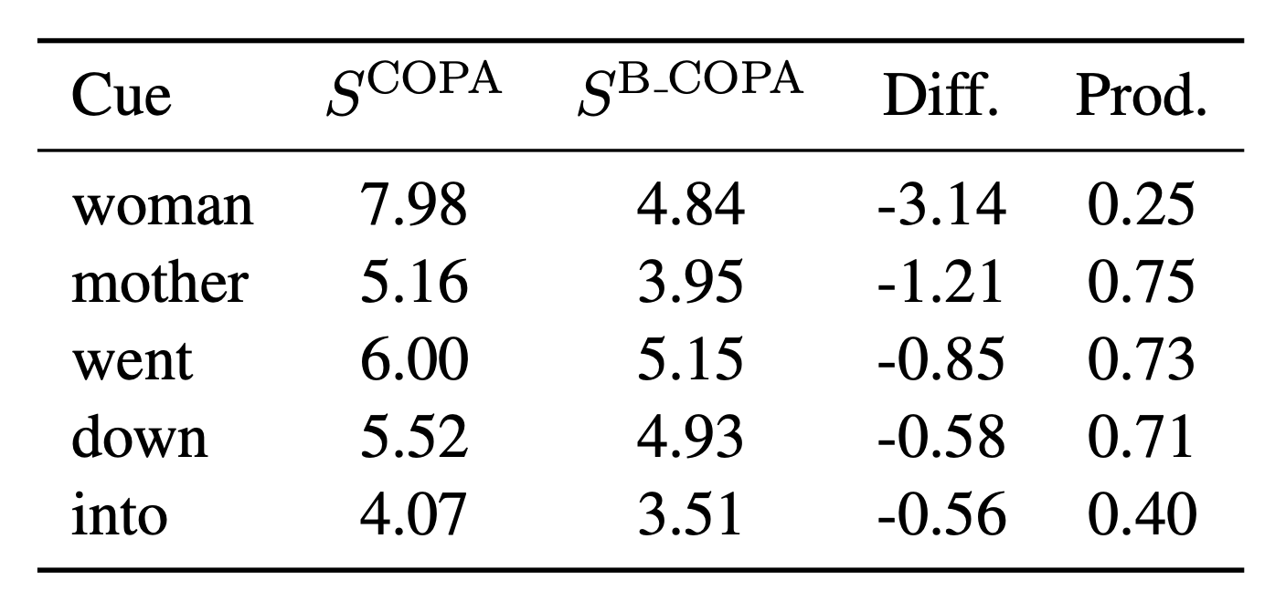
BERT Sensitivity to superficial cues
BERT’s sensitivity to productive superficial cues reduces

