Slide 1

Ask Red Bull
Botcamp project
Naturally speaking personal assistant for Red Bull content exploration

Slide 2



What for?
To explore Red Bull media content on the TV screen using naturally speaking voice interface

Slide 3
Dialogue examples
Show me next Red Bull events please.
Next Red Bull events.
What about bike events in USA?
Bike Red Bull Events in USA.

Slide 4
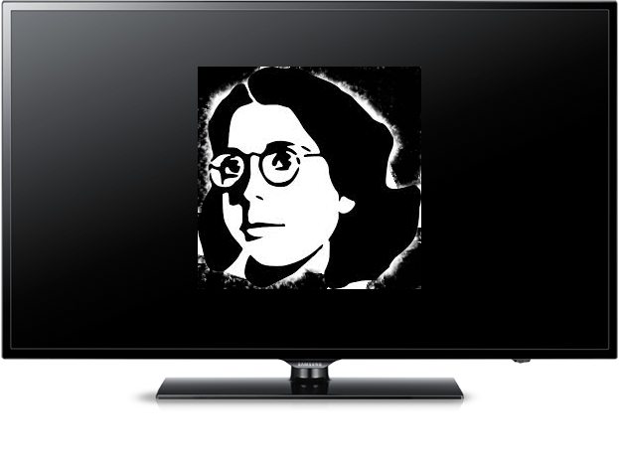


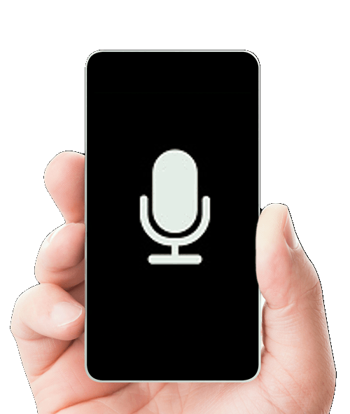

How? Architecture description.

Slide 5

How? Interaction
NATURAL
LANGUAGE
ANALYSIS
KNOWLEDGE
BASE
REQUEST (Red Bull API)
SYNTHSIS: TTS AND
MEDIA VIEW (HTML OR VIDEO)

Slide 6
Third party software and services
Google ASR
Google TTS

Slide 7
Thank you for your attention.

