Slide 1
Windows 8 Metro / HTML5 JS “First Blood”
Peter Kellner
http://peterkellner.net
Microsoft MVP, ASP.NET
ASPInsider
Primary Organizer
Silicon Valley Code Camp October 6th and 7th 2012

Slide 2
The Plan
Intro To Windows 8 And Interface
JavaScript Patterns In Windows 8
WinRT Basics
Silicon Valley Code Camp Speaker Viewer
Notes:
Not js expert

Slide 3
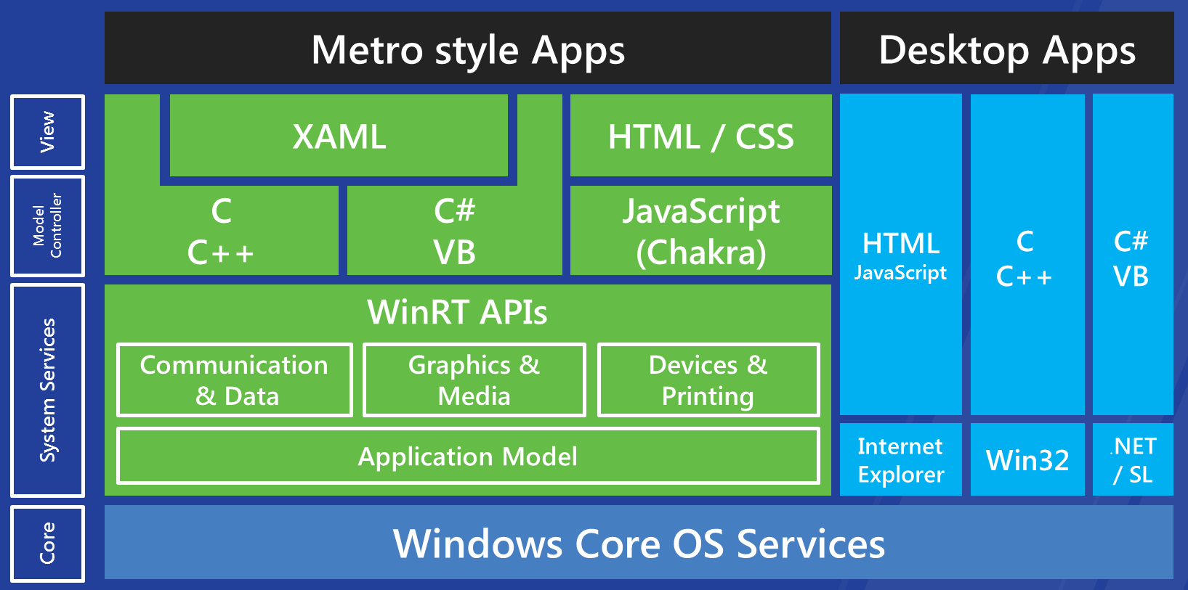
Windows 8 WinRT
Notes:
Basic slide to make sure everyone watching knows we'll be focusing on HTML/JavaScript Metro apps.

Slide 4
IE10 Discusson
Cut The Rope (runs Metro and Broswer)
IE10 Browser
IE10 Metro
Strict mode required for Metro

Slide 5
The New UI
The Lost Start Button (Win Logo Key)
Charms (Search and Settings) (from left)
The app bar (from top or bottom)
Keyboard shortcuts
Mouse Shortcuts
Tablet Not Necessary

Slide 6
JavaScript Patterns For Windows 8
Fundamentals of JavaScript
Libraries
Tools
Best Practices

Slide 7
Variable Scope
JavaScript has:
Global scope (if forget var keyword)
Function scope
Defaults to global (Greedy)
Metro style apps use single script context for the app
Doesn’t do page navigation – scopes don’t reset
Each “page” will need different scripts
Global scope can get really busy

Slide 8
Module Patten
Defines annoymous function, execute immediately. Variables pulled into function scope. Still access global scope (WinJS.Navigation…)
(function() {
var x = 100;
function attachListenersToStuffForExample() {
zz = 10;
}
WinJS.Navigation.navigate(“/html/myapp1.html”);
})();

Slide 9
Using Objects as Namespaces
Helper in base.js
WinJS.Namespace.define
Example Usage:
WinJS.Namespace.define(“MyNameSpace”,{
myUsefulFunction: function() { alert(‘hi’); }
});
MyNameSpace.myUsefulFunction();

Slide 10
Defining Objects with WinJS
Always put objects on Prototype (use WinJS helper methods, big perf increase)
Example:
var myObj = WinJS.Class.define(
function() { },
{
method1: function() {alert(‘hi’);}
});

Slide 11
JavaScript Libraries
Microsoft says: “JQuery Just works!”
You can use other libraries! (test it yourself though)
Exceptions: XHR differences, Host Enforcements, etc. (IE10 does not support cores, single domain not enforced, cores request fails)

Slide 12
Security Issues
Host Enforcements
Prevents “bad” HTML from getting inserted
(script blocks,iframes,event handler,etc.)
Reason is because JavaScript has full WinRT
Parses innerHTML; outerHTML;
setAdjacentHTML (data- are not on whitelist)

Slide 13
Contexts (you choose)
Local Context (My Appointments)
Full access to WinRT (all your code)
Web Context (bing app with map)
Full access to Web
Pull Scripts
No Calls to WinRT
(window.PostMessage To Send Data Between (need to marshal data because string))

Slide 14
WinJS Basics
Helpers for NS/Constructor Definitions
Promises
Nav/App Model
Page Fragments
Data Binding
Controls
Animations
And More

Slide 15
App Model
Page Loads
Scripts Loads
Script Executes
Hookup to Events
Page Shows

Slide 16
Promises / Async Processing
Object that says: “I want you to do something and tell me later” Hence “Then” with 3 callback functions. (success,failure,error)
Very similar to other frameworks
WinJS.xhr({url: “http://…}).then(success(),failure(),error()…

Slide 17

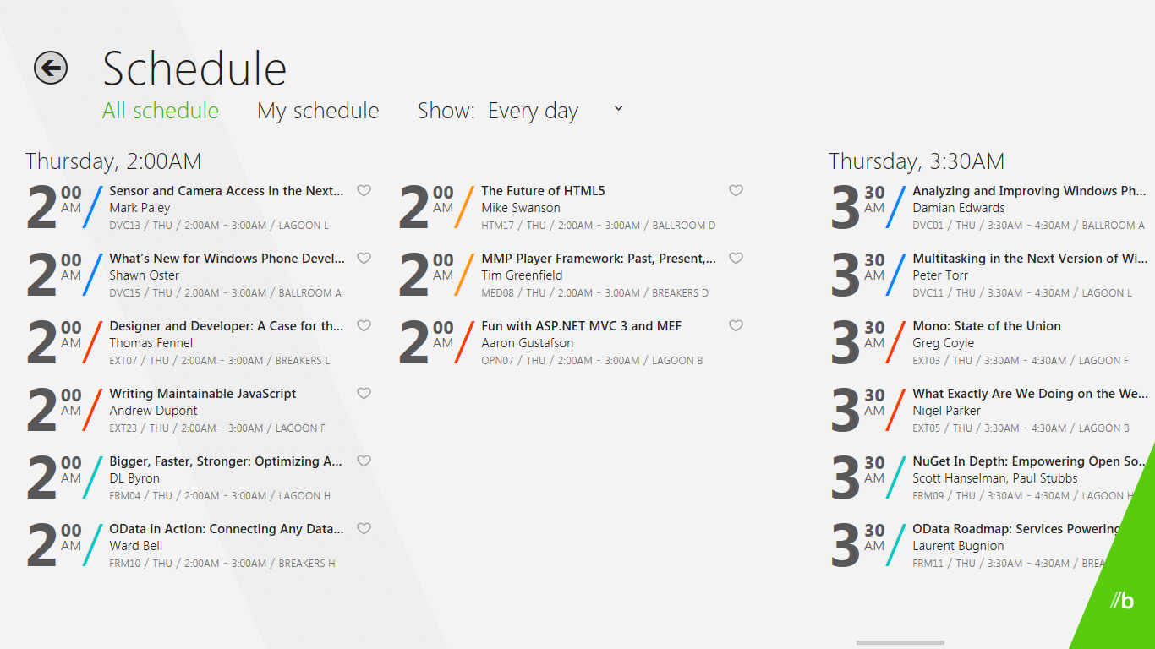




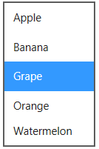



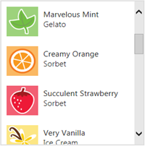
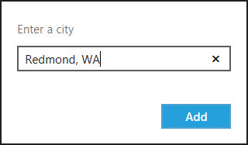


In-box controls for Metro style apps
Button
Grid View
Password
Reveal Button
Checkbox
Combo Box
Progress Ring
Progress Bar
Context Menu
List Box
Rating
Radio Button
Flip View
List View
Slider
Flyout
Text Box
Spell Checking!
Clear Button
Toggle Switch
Hyperlink
Scroll Bar
Tooltip
Panning Indicator
App Bar
Notes:
Play nicely with Touch (work with mouse)
Programmatically / declarative

Slide 18
DataBinding Engine
Oneway only (Data to UI)
Async (coalescing, just one change)

Slide 19
The SV Code Camp App
Off to the Demo…

Slide 20
References
BUILD Videos
Windows Libraries for JavaScript (WinJS)
Building Metro Style Apps With JavaScript

Slide 21
Questions
Peter Kellner
Mobile Web Developer / Server Side & Client Side Consultant/Architect (looking for clients!)
2007-2012 MVP, ASP.NET
Development including publishing 4 MSDN Articles on ASP.NET 2.0
Organized 2006-2012 Silicon Valley Code Camps
Complete Custom Insurance Co. Management s/w to run $200M business.
1986 – 2001 President Tufden Inc. Built and Delivered: 500 doctor office turnkey computer systems; University Clinic Scheduling System;
. Cornell University BS,MS Engineering
peter@peterkellner.net http://peterkellner.net

