Slide 1

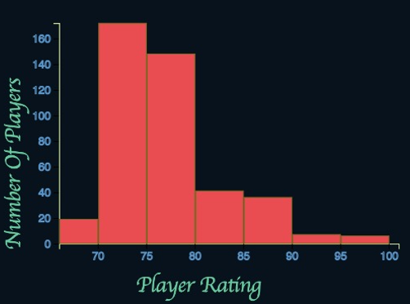

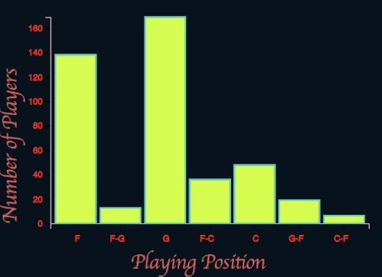
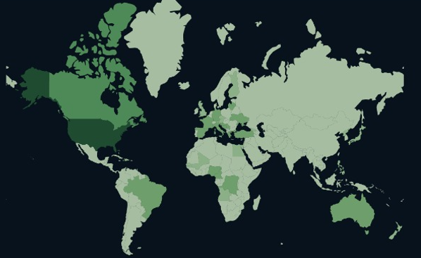
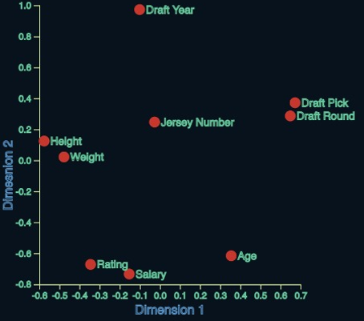
NBA Players Statistic Dashboard CSE564 Project by Kenil Patel and Rajadorai DS
Introduction
This dashboard aims at analyzing the NBA players dataset (Kaggle) and applying enhanced visualization techniques to find out interesting trends, aligning with the motto of visualization, ‘Detect the expected, Discover the Unexpected’
Visualization methodologies
The histogram on the right organizes the data-points into bins and shows the frequency distribution of each bin. Filters can be applied to this chart by selecting a specific bar in the bar chart or by selecting a specific country on the choropleth.
The word cloud below highlights the dominating categorical variable based on its occurrence in the dataset.
Key Inferences
There’s a rise of the “guard-dominated play” and downfall of popularity of the Centers
The salary of guards/forwards who are usually 6’3-6’9 tall is much higher than the salary of Centers. This is a trend that started in the early 2010s.
The globalization of the NBA is represented by how spread out the choropleth map is. This is a surprising reveal considering how American focused the NBA used to be.
This chart helps to visualize the categorical data in the dataset. Clicking on individual bar updates the histogram by highlighting only the data corresponding to the selected bar.
This plot shows the relationship between the different numerical attributes in the dataset. The more closer the attributes on the plane, more closely are they related to each other.
The choropleth above shows what is the proportion of players coming from each country. Darker shade indicates a larger number of players coming from that country and vice versa.

