Slide 1
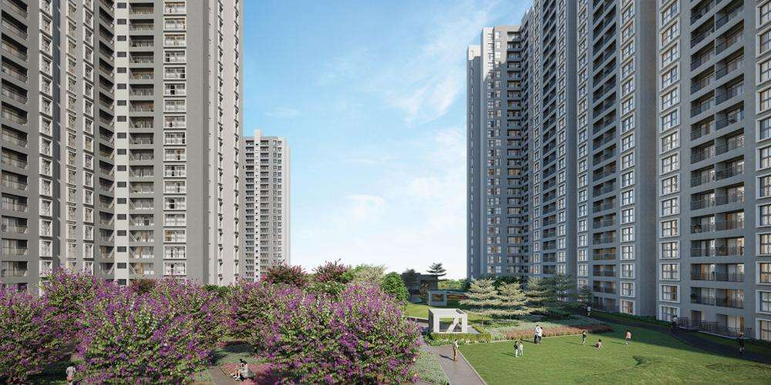
GODREJ PARK RETREAT
• A Green Community •
First General Body Meeting (GBM)
Saturday, 21st March 2026 | 10:30 AM – 12:30 PM
Sarjapur Road, Bengaluru
Residents Welfare Association

Slide 2
AGENDA
1
RWA Member Introductions
5
Future Plans – Welfare
Key job descriptions & work division
2
Tie-ups with Key Vendors
6
Future Plans – Financial
Key contributors
Budget, approvals & optimization
3
Financial Statement
7
Closing Remarks
From handover month (July 2025) onwards – Treasurer
4
Welfare Achievements
8
Open Forum
Housekeeping, beautification, lift & structure maintenance
Residents ask questions & interact with RWA
Godrej Park Retreat | First GBM | 21st March 2026

Slide 3
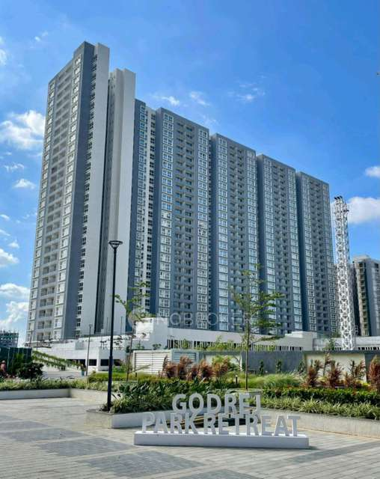
1
RWA MEMBER INTRODUCTIONS
Key Job Descriptions & Work Division

Slide 4
RWA MEMBER INTRODUCTIONS
Office Bearers – Key Job Descriptions
SECTION 1: RWA INTRODUCTIONS
PRESIDENT
VICE PRESIDENT
SECRETARY
TREASURER
Mr. Prasad
Mr. Harsha
Mr. Sambit Banerjee
Mr. Subhrajit Paul
✓ Overall governance & leadership
✓ Supports President in governance
✓ Meeting coordination & minutes
✓ Financial management & audits
✓ Final decision authority
✓ MOU initiation & vendor approvals
✓ Official communications (SPOC)
✓ Contract & agreement reviews
✓ External relations & escalations
✓ Oversees day-to-day operations
✓ GBM planning & execution
✓ Banking, budgets & reporting
Godrej Park Retreat | First GBM | 21st March 2026

Slide 5
TOWER REPRESENTATIVES & SUPPORT TEAM
Work Division & Key Team Members
A
Tower A
B
Tower B
C
Tower C
D
Tower D
Mr. Rajendra
Ms. Sayantoni Dutta
Mr. Prasenjit Saha
Mr. Priyadarshi
E
Tower E
F
Tower F
G
Tower G
H
Tower H
Mr. Anuj Pandey
Mr. Ketan Patel
Mr. Santosh Singh
Mr. Ompal Singh
FACILITIES & SUPPORT TEAM
Project Team
Security Managers
Operations & Facilities Management
Pawan & Vamsi (Godrej Project)
2 Security Managers on-site
Jayaprakash & Team (Godrej Living)
Godrej Park Retreat | First GBM | 21st March 2026

Slide 6
2
TIE-UPS WITH KEY VENDORS
Key Contributors & Strategic Partnerships

Slide 7

TIE-UPS WITH KEY VENDORS – OVERVIEW
Key Contributors & Partnerships
Sparsh Hospital
Brother Chemist
Apollo Clinic
MOU Signed
Approved & MOU
Inquiry Initiated
My Gate Park+ ANPR
Airtel Network Boster
Tilt.bike
Onboarding Started
Under Evaluation
15% Revenue Share
AdOnMo
HDFC Bank
Laundry Vendors
Approved & MOU
Account Approved
Under Evaluation
Vegetable Vendors
Airtel
Under Evaluation
In Progress
Godrej Park Retreat | First GBM | 21st March 2026

Slide 8


RWA COORDINATORS
• Prasenjit Saha (Led negotiation & sign-off)
SPARSH HOSPITAL
EXTERNAL PARTNER
• Sparsh Hospital, Bengaluru
SPARSH HOSPITAL
PARTNERSHIP
PARTNER
★ KEY HIGHLIGHT
MOU Signed – 2 Medical Kits + 1 Wheelchair provided to the society
✓ All benefits documented in signed MOU
✓ Healthcare access for all GPR families
✓ MOU shared with all board members
Godrej Park Retreat | First GBM | 21st March 2026

Slide 9
RWA COORDINATORS
• Subhrajit Paul – Treasurer (Contract review)
• Harsha – VP (MOU initiation)
BROTHER CHEMIST
BROTHER CHEMIST
EXTERNAL PARTNER
PARTNERSHIP
• Brother Chemist
PARTNER
★ KEY HIGHLIGHT
Approved & MOU Signed – 38K Rent & Min 10% discount on branded medicines for all residents
✓ 10% discount on branded/generics Medicine
✓ No minimum transaction – discounts on bills
✓ Vendor to get Pharmacy & Drug License
Godrej Park Retreat | First GBM | 21st March 2026

Slide 10
RWA COORDINATORS
APOLLO CLINIC
• Ketan Patel – (Initiated inquiry)
APOLLO CLINIC
EXTERNAL PARTNER
• Apollo Clinic Team, Bengaluru
APOLLO CLINIC
PARTNERSHIP
PARTNER
★ KEY HIGHLIGHT
Inquiry initiated for setting up an in-premise clinic inside GPR
✓ Primary healthcare, check-ups & diagnostics
✓ Emergency medical assistance + pharmacy
✓ Exploring gated community clinic model
Godrej Park Retreat | First GBM | 21st March 2026

Slide 11

RWA COORDINATORS
• Sambit Banerjee – Secretary (SPOC & lead)
• Anuj Pandey & Raj (Initiated inquiry)
MyGate
EXTERNAL PARTNER
• MyGate Team
MyGate
PARTNERSHIP
PARTNER
★ KEY HIGHLIGHT
Onboarding initiated
✓ Society management: visitors, deliveries, communication
✓ All communications via official email
✓ Sign-off after GPL legal clearance
Godrej Park Retreat | First GBM | 21st March 2026

Slide 12
RWA COORDINATORS
• Raj– (Implementation)
PARK+ ANPR
PARK+ ANPR
EXTERNAL PARTNER
• Park+ Team
PARTNERSHIP
PARTNER
★ KEY HIGHLIGHT
Automatic Number Plate Recognition boom barrier installed at main gate
✓ Auto boom barrier for registered vehicles
✓ Register vehicles in MyGate app
✓ Enhanced security with vehicle tracking
Godrej Park Retreat | First GBM | 21st March 2026

Slide 13

RWA COORDINATORS
• Ketan Patel & Sayantoni – (SPOC & lead with Negotiation)
• NT Prasad– President (Contract review & Signed)
TILT.BIKE
EXTERNAL PARTNER
• Tilt.bike Team
TILT.BIKE
PARTNERSHIP
PARTNER
★ KEY HIGHLIGHT
15% revenue share
✓ Zero cost/liability to society
✓ Brand sponsorships routed to RWA
✓ Cycling events with sponsor kiosks
Godrej Park Retreat | First GBM | 21st March 2026

Slide 14

RWA COORDINATORS
• Ketan Patel – (SPOC & lead)
• Subhrajit Paul – Treasurer (Contract review)
AdOnMo
EXTERNAL PARTNER
• Murali Manohar Routhu – AdOnMo, Bengaluru
AdOnMo
PARTNERSHIP
PARTNER
★ KEY HIGHLIGHT
Intelligent Digital Notice Board System – 5-year agreement under final review
✓ Fixed consideration 3 years, mutual increment after
✓ BESCOM changes covered by AdOnMo
Godrej Park Retreat | First GBM | 21st March 2026

Slide 15

RWA COORDINATORS
• Subhrajit Paul – Treasurer (Led proposal)
• RWA Team—Review & Approve
HDFC BANK
EXTERNAL PARTNER
• HDFC Bank – Banking Partner
HDFC BANK
PARTNERSHIP
PARTNER
★ KEY HIGHLIGHT
RWA Bank Account approved – Tally plugin, payment gateway & auto reconciliation
✓ Tally plug-in with auto reconciliation
✓ Online fund transfer, FD, utility payments
✓ EazyPay for online & offline collections
Godrej Park Retreat | First GBM | 21st March 2026

Slide 16


LAUNDRY VENDOR
★ Complete financial & operational analysis done
✓ Rent proposal: ₹4,000 → ₹12,000 analyzed
✓ Family-wise usage & margin analysis
✓ Multiple vendor meetings conducted
Coordinated by: Subhrajit Paul – Treasurer
LAUNDRY & VEGETABLE VENDORS
LAUNDRY VENDOR
VEGETABLE VENDOR
EVALUATION
★ Organic Mandya & Retro Cart and SLV evaluated
✓ ₹10K/month + ₹15K one-time sponsorship
✓ Organic & regular vegetables offered
✓ Decision based on quality & resident satisfaction
Coordinated by: Prasenjit Saha, Ketan Patel
External: Organic Mandya , Retro Cart, SLV.
VEGETABLE VENDOR
Godrej Park Retreat | First GBM | 21st March 2026

Slide 17
RWA COORDINATORS
• Ketan Patel & Sayantoni – (Coordination)
• Harsha– (Intercom)
AIRTEL
TATA
ACT
Telecom
EXTERNAL PARTNER
• Siddanagouda B – Airtel
• Sathish J – Tata Play Fiber
PARTNERSHIP
PARTNER
★ KEY HIGHLIGHT
Signage finalized + Booster Tower survey done + Intercom in lifts planned
✓ Booster tower survey completed
✓ Cones, mirrors, barricades tracked
✓ Free Wi-Fi point at podium requested
Godrej Park Retreat | First GBM | 21st March 2026

Slide 18
3
FINANCIAL STATEMENT
From Handover Month (July 2025) Onwards – Treasurer

Slide 19

FINANCIAL STATEMENT
CAM Reconciliation – Presented by Treasurer
FINANCIALS
Presented by: Subhrajit Paul
Description | Total | Registered | Balance
No. of Units | 976 | 882 | 94
Area (Sqft) | 9,73,372 | 8,83,937 | 89,435
Sinking Fund (excl. GST) | ₹ 3,50,41,392 | ₹ 3,18,21,732 | ₹ 32,19,660
Maintenance (excl. GST) | ₹ 3,50,41,392 | ₹ 3,18,21,732 | ₹ 32,19,660
Total CAM Collected | ₹ 7,00,82,784 | ₹ 6,36,43,464 | ₹ 64,39,320
Less: Expenses till Jan 2026 |  | ₹ 1,02,87,819
NET TRANSFERABLE |  | ₹ 5,33,55,645
External: Vamsi Krishna P & Pavan Kumar MS (Godrej Properties) | Water tankers: 293 loads (Dec 2025), 130 paid, 163 pending
Godrej Park Retreat | First GBM | 21st March 2026

Slide 20
FINANCIAL MANAGEMENT – PENDING ITEMS
Agenda Point 3 (continued)
✓ BESCOM NOC Delay: Impacting electricity charges – follow-up in progress
✓ Finance & Sponsorship Guidelines with clear approval thresholds being formalized
✓ Expense Breakdown requested from Godrej Living
✓ Detailed audit completed for Sankranti & Saraswati Puja expenses
✓ Sub-committee guidelines approved – all sponsorship via official RWA sub-account
✓ No individual collection in personal accounts – strict transparency policy
Godrej Park Retreat | First GBM | 21st March 2026

Slide 21
4
WELFARE ACHIEVEMENTS
Housekeeping, Beautification, Maintenance & Resident Welfare

Slide 22
WELFARE: HOUSEKEEPING & BEAUTIFICATION
Agenda Point 4: Processes & Key Contributors
SECTION 4: WELFARE ACHIEVEMENTS
✓ OWC (Organic Waste Converter) machine installed & ready
Proposal: 2 trained operators for door-to-door wet waste collection & composting
✓ Summer Gardening Green Plan: Daily watering, pest control, heat-resistant plants
✓ Cleanliness & Penalty Policy: Items in corner parking removed after 1st March
✓ Deep cleaning of tower floors – cable shortage being resolved by GPL
✓ BBMP compliance for in-house wet-waste processing
✓ Compost production for society landscaping
Key Contributors: Ketan Patel, Jayaprakash AP (Godrej Living)
Godrej Park Retreat | First GBM | 21st March 2026

Slide 23
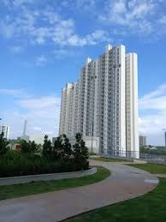
WELFARE: LIFT, STRUCTURE & INFRASTRUCTURE
Agenda Point 4: Maintenance Achievements
✓ Tower A: Lift issues – immediate action taken
✓ Tower F: Gate rainwater seepage – permanent fix demanded
✓ Main Doors: Alignment & color uniformity across all towers
✓ Balcony Glass: 4-month pending replacement – escalated
✓ Speed Breakers: GPL agreed near Tower E ramp (kids’ safety)
✓ AQI Monitoring: Proposal for Podium/Clubhouse
✓ Intercom in Lifts: Airtel vendor to provide
✓ Faulty Lights: Under warranty replacement
✓ Ladders: Cost verification in progress
Key Contributors: Ketan Patel, Rajendra (A Tower), Jayaprakash AP
Godrej Park Retreat | First GBM | 21st March 2026

Slide 24
WELFARE: RESIDENT INITIATIVES & EVENTS
Agenda Point 4: Security, Water, Festivals, Sports & Community
SECURITY & ACCESS
✓ Cost review: ₹24-25K vs ₹16K nearby
✓ Potential saving: ₹19.2L/year
✓ Park+ ANPR boom barrier
✓ Vehicle registration via MyGate
✓ Community fine system
WATER MANAGEMENT
✓ Water Quality Task Force formed
✓ Borewells: 1 (Ph1) + 2 (Ph2)
✓ Tanker data cross-verified
✓ Summer preparedness planning
FESTIVALS & EVENTS
✓ Lohri, Sankranti, Republic Day – done
✓ Vasant Panchami sponsorship explored
✓ Holi 2026 – volunteers, raindance, DJ
✓ Festival SOP + official sub-account
COMMUNITY INITIATIVES
✓ Sports Committee – SOP being drafted
✓ Bicycle parking for kids’ safety
✓ Women’s health services
✓ Telegram channel for communication
✓ Airtel SIM + phone for Telegram
Godrej Park Retreat | First GBM | 21st March 2026

Slide 25
PROJECT HANDOVER STATUS
Handover from Godrej Properties
✓ Detailed handover update & pending items shared
✓ Proposal: Third-party expert for verification
✓ Documents: Fire NOC, Lift certificates, Water quality
✓ Systems: BMS, CCTV, ELV, STP/WTP, DG sets
✓ CAM reconciliation received (Oct 2025 – Jan 2026)
✓ Fitout charges coordination in progress
✓ Strengthened handover process proposed
✓ BESCOM NOC delay – impacting electricity charges
KEY CONTACTS
• Ketan Patel – F Tower
• Vamsi Krishna P – GPL
• Pavan Kumar MS – GPL
Godrej Park Retreat | First GBM | 21st March 2026

Slide 26
5-6
FUTURE PLANS
Welfare & Financial Management

Slide 27
FUTURE PLANS – WELFARE
Agenda Point 5
SECTION 5: FUTURE WELFARE
CLUBHOUSE
SUSTAINABILITY
TECHNOLOGY
Track 6-month plan Pharmacy, Clinic, Salon, Grocery, Sports
Launch OWC operations Water management Summer gardening
MyGate onboarding Park+ ANPR, Telegram AQI monitors
COMMUNITY
INFRASTRUCTURE
HANDOVER
Sports committee Cycling (Tilt.bike) Women’s health
Tower repairs, Lifts Seepage fixes Deep cleaning
3rd-party verification Documentation Pending items
Godrej Park Retreat | First GBM | 21st March 2026

Slide 28
FUTURE PLANS – FINANCIAL MANAGEMENT
Agenda Point 6
SECTION 6: FUTURE FINANCIAL
APPROVAL THRESHOLDS
REGULAR AUDITS
VENDOR OPTIMIZATION
Clear financial limits for all expense categories
Quarterly audits Post-event financial reports
Security vendor review ₹19.2L potential savings
REVENUE STREAMS
BANKING
BUDGET PLANNING
Tilt.bike ~₹1.44L/yr AdOnMo, Veg vendor ₹10K/mo
HDFC Tally integration EazyPay collections
Annual budget framework Reserve fund management
Godrej Park Retreat | First GBM | 21st March 2026

Slide 29

CLOSING REMARKS
We serve the community – Transparency, Accountability & Resident Welfare are our core values

Slide 30

OPEN FORUM
Questions & Interaction with RWA Members
Thank You for Your Participation!

