Slide 1
Measuring shirking in MLB
Patrick Ghazarian

Slide 2
What is shirking?
Players have incentive to outperform expectations nearing the end of their contract year
After signing a long-term contract, players sometimes underperform. This is called shirking
Shirking happens if a player’s actual performance falls below expected performance in the year following a newly signed contract

Slide 3
Why is this important?
It would be beneficial for sports teams to know if the length of the contracts they are offering players will affect that player’s actual performance on the field.
Theory would suggest that contracts would eventually evolve to discourage opportunistic behavior

Slide 4
Our approach
We began by running a standard test of shirking based on comparing a player’s expected to actual performance.
SHIRK= (expected performance - actual performance)
Previous literature
Krautmann ( Shirking in Major League Baseball)

Slide 5
Regression Equation
SHIRK=β₀+β₁Length+β₂Age+ε

Slide 6
Results
54% of players had a negative value in 2017
Implies NOT shirking
72% of players had a negative value in 2016
Implies many players were outperforming expectations BEFORE new contract
Our results found that the length of a contracts has no significant effect on the shirking behavior of players

Slide 7
Results
----------------------------------------------------------------------------
SHIRK2017 | Coef. Std. Err. t P>|t|
-----------------------------------------------------------------------------
Length | -.0023877 .0131769 -0.18 0.857
Age | .0173757* .0066381 2.62 0.013
_cons | -.5726929 .2252716 -2.54 0.015

Slide 8
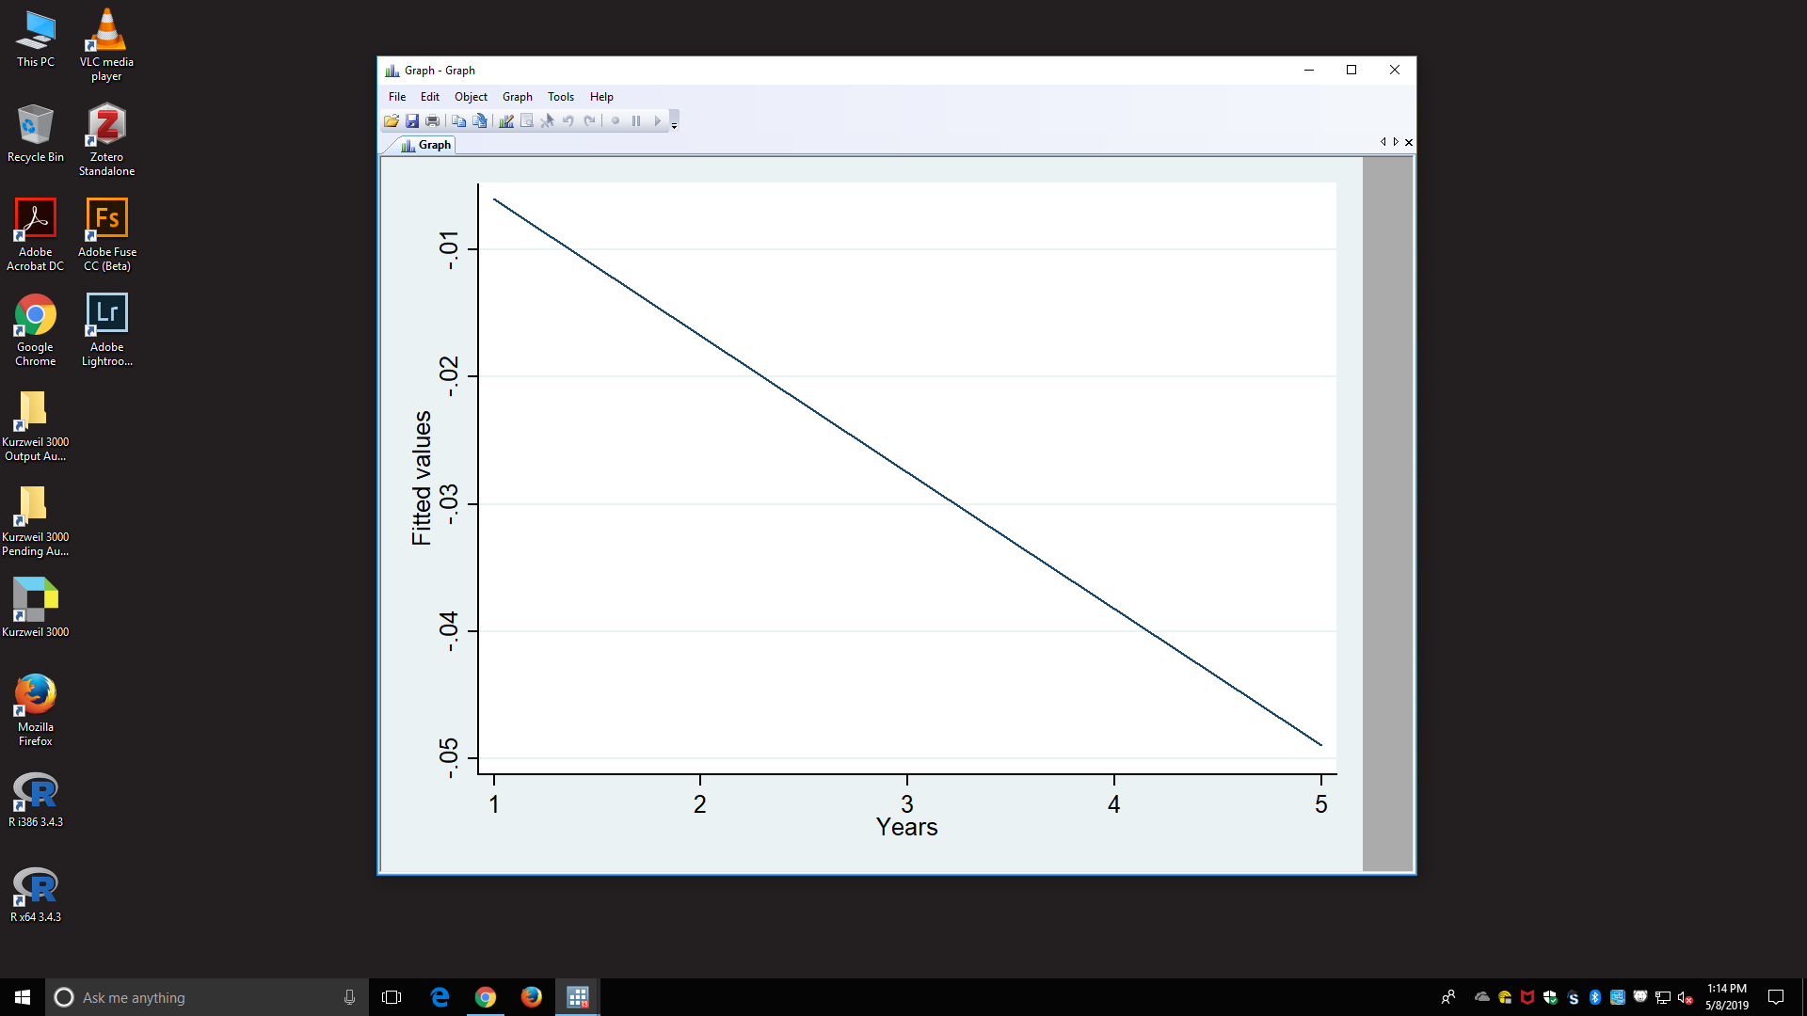
Graph of shirking and length of contract

Slide 9
Conclusion
In theory longer contracts would encourage this behavior
Difficulty in testing (disagreements on proper standards)
Other studies found length of contract to be significant when shirk is measured by different methods
Other factors ( Marginal Revenue Productivity, Player injuries)

Slide 10
Work Cited
Krautmann, A. C., & Donley, T. D. (2009). Shirking in Major League Baseball Revisited. Journal of Sports Economics, 10(3), 292–304. https://doi.org/10.1177/1527002508325817

