Slide 1
Huffman Coding

Slide 2
Huffman Coding
Huffman codes can be used to compress information
  Like WinZip – although WinZip doesn’t use the Huffman algorithm
  JPEGs do use Huffman as part of their compression process
The basic idea is that instead of storing each character in a file as an 8-bit ASCII value, we will instead store the more frequently occurring characters using fewer bits and less frequently occurring characters using more bits
  On average this should decrease the filesize (usually ½)

Slide 3
Huffman Coding
As an example, lets take the string:
  “duke blue devils”
We first to a frequency count of the characters:
    e:3, d:2, u:2, l:2, space:2, k:1, b:1, v:1, i:1, s:1
Next we use a Greedy algorithm to build up a Huffman Tree
  We start with nodes for each character
e,3
d,2
u,2
l,2
sp,2
k,1
b,1
v,1
i,1
s,1

Slide 4
Huffman Coding
We then pick the nodes with the smallest frequency and combine them together to form a new node
  The selection of these nodes is the Greedy part
The two selected nodes are removed from the set, but replace by the combined node
This continues until we have only 1 node left in the set

Slide 5
Huffman Coding
e,3
d,2
u,2
l,2
sp,2
k,1
b,1
v,1
i,1
s,1

Slide 6
Huffman Coding
e,3
d,2
u,2
l,2
sp,2
k,1
b,1
v,1
2
i,1
s,1

Slide 7
Huffman Coding
e,3
d,2
u,2
l,2
sp,2
k,1
2
2
b,1
v,1
i,1
s,1

Slide 8
Huffman Coding
e,3
d,2
u,2
l,2
sp,2
3
2
k,1
2
i,1
s,1
b,1
v,1

Slide 9
Huffman Coding
e,3
d,2
u,2
4
3
2
l,2
sp,2
k,1
2
i,1
s,1
b,1
v,1

Slide 10
Huffman Coding
e,3
4
4
3
2
d,2
u,2
l,2
sp,2
k,1
2
i,1
s,1
b,1
v,1

Slide 11
Huffman Coding
e,3
4
4
5
d,2
u,2
l,2
sp,2
2
3
i,1
s,1
k,1
2
b,1
v,1

Slide 12
Huffman Coding
7
4
5
e,3
4
l,2
sp,2
2
3
d,2
u,2
i,1
s,1
k,1
2
b,1
v,1

Slide 13
Huffman Coding
7
9
e,3
4
4
5
d,2
u,2
l,2
sp,2
2
3
i,1
s,1
k,1
2
b,1
v,1

Slide 14
Huffman Coding
16
7
9
e,3
4
4
5
d,2
u,2
l,2
sp,2
2
3
i,1
s,1
k,1
2
b,1
v,1
Notes:
0 means go left
1 means go right

Slide 15
Huffman Coding
Now we assign codes to the tree by placing a 0 on every left branch and a 1 on every right branch
A traversal of the tree from root to leaf give the Huffman code for that particular leaf character
Note that no code is the prefix of another code
Notes:
ISSUES:
1. 1011xxxx

Slide 16
Huffman Coding
e | 00
d | 010
u | 011
l | 100
sp | 101
i | 1100
s | 1101
k | 1110
b | 11110
v | 11111
16
0
1
7
9
0
1
0
1
e,3
4
4
5
0
1
0
1
0
1
d,2
u,2
l,2
sp,2
2
3
0
1
0
1
i,1
s,1
k,1
2
0
1
b,1
v,1

Slide 17
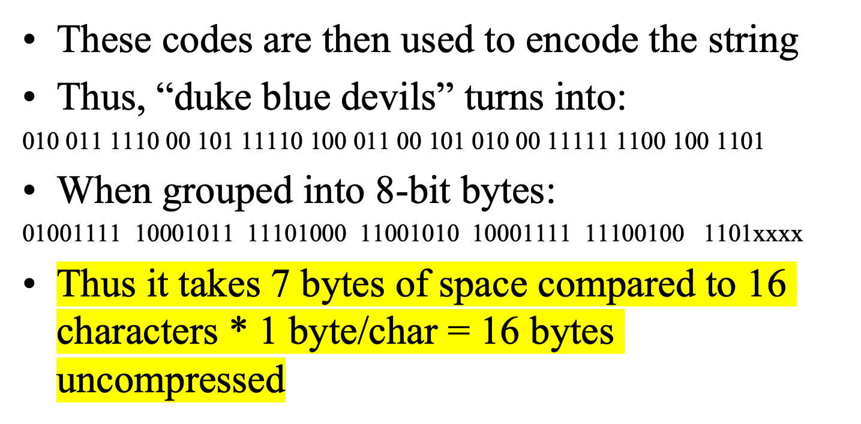
Huffman Coding
Notes:
ISSUES WITH THIS:
1. last byte has only 4 bits in it – need to pad it in some way – 1011xxxx
Can’t pad with 0’s – would write out three additional e’s because e is coded as 00 – might need a cancellation character
2. need to save Huffman table info as a header in the compressed file (need the key to be able to read the bits)
Need some original info about the file saved, otherwise can’t decompress it (save a whole tree of info, plus the 7 bytes which we’ve compressed with key)

Slide 18
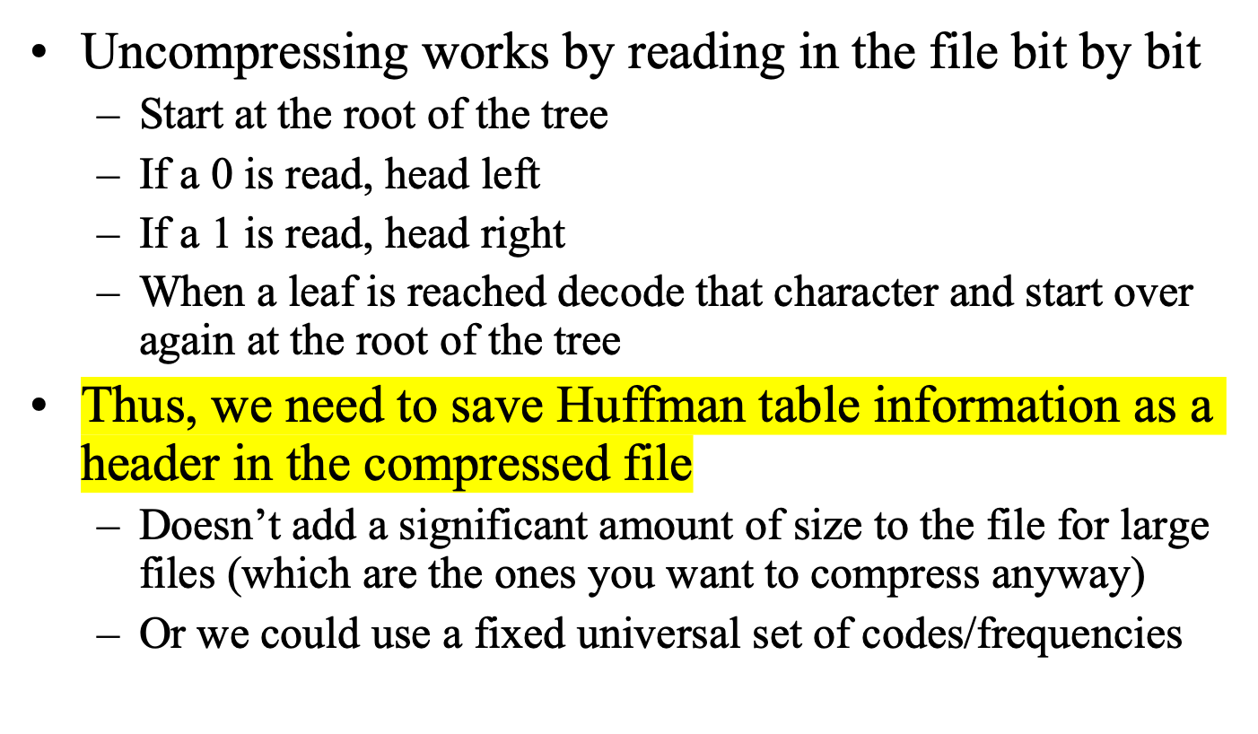
Huffman Coding
Notes:
If the frequency table doesn’t seem to match the key that’s being used to compress or decompress, then it’s a problem
Ex. Declaration of independence vs. code file (lots of e’s vs. ; ‘s often)
TEST WITH SMALL FILES:
abbccc
Build tree by hand to see what it should be – write out bits and break into bytes

