Slide 1






Pivotal Cloud Foundry
Cloud Native App
Spring Boot
Pivotal Cloud Cache
Greenplum MPP
SFDC
Spring Cloud Stream

Slide 2
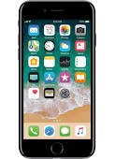
Pivotal Cloud Foundry
Cloud Native App
Beacon
request
customer
Spring Boot
favorites
promotions
favorites
Pivotal Cloud Cache
Favorites, promotions
Beacon
request
Greenplum MPP
SFDC
Spring Cloud Stream
favorites
promotions

